Slide 1
Introduction to Python
Unit 1

Slide 2
Python
Python is a simple, general purpose, high level, and object-oriented programming language.
Python is an interpreted scripting language.
It was created by Guido van Rossum, and released in 1991.
It is used for:
web development (server-side),
software development,
mathematics,
system scripting.

Slide 3
Python can be used on a server to create web applications.
Python can connect to database systems.
Python can be used to handle big data and perform complex mathematics.
Python works on different platforms (Windows, Mac, Linux, Raspberry Pi, etc).
Python has a simple syntax similar to the English language.
Python can be treated in a procedural way, an object-oriented way.
It can be used as a scripting language or can be compiled to byte-code for building large applications.
It provides very high-level dynamic data types and supports dynamic type checking.
It supports automatic garbage collection.
It can be easily integrated with C, C++,Java etc.

Slide 4
Applications
Python is also versatile and widely used in every technical field, such as Machine Learning, Artificial Intelligence, Web Development, Mobile Application, Desktop Application, Scientific Calculation
Data Analysis and Processing
Artificial Intelligence
Games
Hardware/Sensor/Robots
Desktop Applications

Slide 5
Features:
Easy-to-learn − Python has few keywords, simple structure, and a clearly defined syntax.
Easy-to-read
Easy-to-maintain
A broad standard library − Python's bulk of the library is very portable and cross-platform compatible on UNIX, Windows, and Macintosh.
Interactive Mode − Python has support for an interactive mode which allows interactive testing and debugging of snippets of code.
Portable − Python can run on a wide variety of hardware platforms and has the same interface on all platforms.

Slide 6
Interactive mode Programming
Script Mode Programming

Slide 7
Comments
Comments can be used to improve readability of the program.
They are ignored by the interpreter.
Comments starts with a #
Eg:
# First comment
print ("Hello, Python!")

Slide 8
Identifiers
A Python identifier is a name used to identify a variable, function, class, module or other object.
An identifier starts with a letter A to Z or a to z or an underscore (_) followed by zero or more letters, underscores and digits (0 to 9).
Python does not allow punctuation characters such as @, $, and % within identifiers.
Python is a case sensitive programming language.
A, a1 , _a, _1a,
%1, #1 #a

Slide 9
Identifier conventions A__a->B a
Class names start with an uppercase letter. All other identifiers start with a lowercase letter.
Starting an identifier with a single leading underscore indicates that the identifier is private. _a a_b
Starting an identifier with two leading underscores indicates a strong private identifier. __a
If the identifier also ends with two trailing underscores, the identifier is a language-defined special name.
abc__ __builtin__

Slide 10
Keywords
These are reserved words
cannot use them as constants or variables or any other identifier names.
All the Python keywords contain lowercase letters only.
and exec not
as finally or
assert for pass
break from print
class global raise
Continue if return
def import try
del in while
elif is with
else lambda yield
except

Slide 11
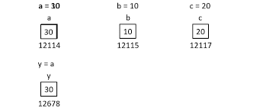
Variables a=“abcd”
Variables are reserved memory locations to store values.
Based on the data type of a variable, the interpreter allocates memory and decides what can be stored in the reserved memory.
Therefore, by assigning different data types to the variables, you can store integers, decimals or characters in these variables.
x = 5 y = "John" print(x) print(y)

Slide 12
Global variables
Variables that are created outside of a function are known as global variables.
Global variables can be used by everyone, both inside of functions and outside.

Slide 13
Data Types

Slide 14
Type function
Return the data type of a variable
X=10
Type(X)

Slide 15
Number
Number data types store numeric values. Number objects are created when you assign a value to them.
var1 = 1
var2 = 10.1
Remove the variable using del command
del var1
del var_a, var_b

Slide 16
Python supports four different numerical types −
int (signed integers)
long (long integers, they can also be represented in octal and hexadecimal)
float (floating point real values)
complex (complex numbers)

Slide 17
boolean
Integers contain Boolean Type, which is a unique data type, consisting of two constants, True & False.
A Boolean True value is Non-Zero, Non-Null and Non-empty
flag = True
Print(type(flag))
<type 'bool'>

Slide 18
None
This is special data type with single value.
It is used to signify the absence of value/false in a situation.
Itis represented by “None”.

Slide 19
Assigning Values to Variables
Python variables do not need explicit declaration to reserve memory space.
The declaration happens automatically when you assign a value to a variable.
The equal sign (=) is used to assign values to variables.
The operand to the left of the = operator is the name of the variable and the operand to the right of the = operator is the value stored in the variable.
counter = 100 # An integer assignment
miles = 1000.0 # A floating point
name = "John" # A string

Slide 20
Multiple Assignment
a = b = c = 1
a, b, c = 1, 2, "john“ chaining

Slide 21
Operators
Operators are used to perform operations on variables and values.
Python divides the operators in the following groups:
Arithmetic operators
Comparison operators
Logical operators
Bitwise operators
Assignment operators
Identity operators
Membership operators

Slide 22
Arithmetic operators
used with numeric values to perform common mathematical operations
Operator Name Example
+ Addition x + y
- Subtraction x - y
* Multiplication x * y
/ Division x / y
% Modulus x % y
Note: in python2 : 5/2 returns 2 where as in python3 5/2 returns 2.5

Slide 23
Comparison Operator
These operators compare the values on either side of them and decide the relation among them. They are also called Relational operators.
Returns a true or false value
== Equal x == y
!= Not equal x != y
> Greater than x > y
< Less than x < y
>= Greater than or equal to x >= y
<= Less than or equal to x <= y

Slide 24
Logical operators
Logical operators are used to combine conditional statements
and Returns True if both statements are true x < 5 and x < 10
or Returns True if one of the statements is true x < 5 or x < 4
not Reverse the result, returns False if the result is true not(x < 5 and x < 10)

Slide 25
Bitwise operator
Bitwise operator works on bits and performs bit-by-bit operation.
& Operator copies a bit, to the result, if it exists in both operands
| It copies a bit, if it exists in either operand.
^ It copies the bit, if it is set in one operand but not both.
~ It is unary and has the effect of 'flipping' bits.
a<< n Binary Left Shift The left operand's value is moved left by the number of bits specified by the right operand.
a>>2 Binary Right Shift The left operand's value is moved right by the number of bits specified by the right operand.

Slide 26
Assignment Operators y=y+z+3 y+=(z+3)
= | x = 5 | x = 5 | Try it »
+= | x += 3 | x = x + 3 | Ty=z+3ry it »
-= | x -= 3 | x = x - 3 | Try it »
*= | x *= 3 | x = x * 3 | Try it »
/= | x /= 3 | x = x / 3 | Try it »
%= | x %= 3 | x = x % 3 | Try it »
//= | x //= 3 | x = x // 3

Slide 27
Python Membership Operators
Python’s membership operators test for membership in a sequence, such as strings, lists, or tuples.
in | Evaluates to true if it finds a variable in the specified sequence and false otherwise.
not in | Evaluates to true if it does not finds a variable in the specified sequence and false otherwise.

Slide 28
Example:
x = ["apple", "banana"]
print("banana" in x)
print("mango" in x)

Slide 29
Identity operators
Identity operators compare the memory locations of two objects.
is | Evaluates to true if the variables on either side of the operator point to the same object and false otherwise. | x is y, here is results in True if id(x) equals id(y).
is not | Evaluates to false if the variables on either side of the operator point to the same object and true otherwise. | x is not y, here is not results in True if id(x) is not equal to id(y).

Slide 30
Example
x = ["apple", "banana"]
y = ["apple", "banana"]
u = ["apple", "banana"]
z = x
print(x is z)
print(x is y)
print(x == u)
print(x is u)

Slide 31
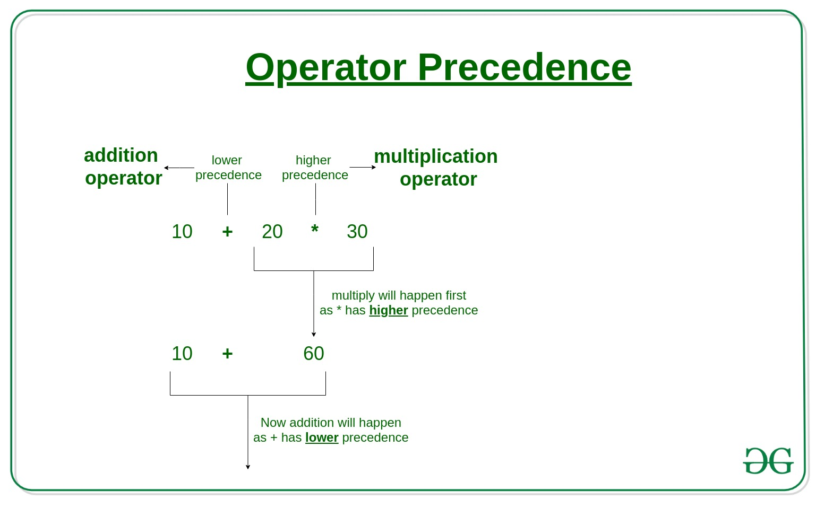
Operator Precedence
used to determine which operation to perform first in an expression with more than one operator with different precedence

Slide 32
Operator Precedence in python
1 | ** Exponentiation (raise to the power)
2 | ~ + - Complement, unary plus and minus (method names for the last two are +@ and -@)
3 | * / % // Multiply, divide, modulo and floor division
4 | + - Addition and subtraction
5 | >> << Right and left bitwise shift

Slide 33
6 | & Bitwise 'AND'
7 | ^ | Bitwise exclusive `OR' and regular `OR'
8 | <= < > >= Comparison operators
9 | <> == != Equality operators
10 | = %= /= //= -= += *= **= Assignment operators

Slide 34
11 | is is not Identity operators
12 | in not in Membership operators
13 | not or and Logical operators

Slide 35
Print()
The print() function writes the given object to the standard output device (screen) or to the text stream file.
Print a message onto the screen:
print("Hello World")
Print a more than one message onto the screen
print("Hello", "how are you?")

Slide 36
In python2 ; print is a used as a statement as
Example
Print ‘hello’
a=10
print a

Slide 37
Displaying values of variables
a = 5
# Two objects are passed
print("a =", a)
b = a
# Three objects are passed
print('a =', a, '= b')

Slide 38
input ( prompt )
This function first takes the input from the user
If the input provided is not correct then either syntax error or exception is raised by python.
val = input("Enter your value: ")
print(val)

Slide 39
The eval()
The eval() method parses the expression passed to this method and runs python expression (code) within the program.
The eval() function evaluates the specified expression, if the expression is a legal Python statement, it will be executed.
eval(expression, globals, locals)
expression A String, that will be evaluated as Python code
globals Optional. A dictionary containing global parameters
locals Optional. A dictionary containing local parameters

Slide 40
example
x = 1
print(eval('x + 1'))

