Slide 1
MediLink
A relational database connecting patients, doctors, hospitals, pharmacies,
pharmaceutical companies, and research centers
NAME
Mirza Naeem Beg
GITHUB
mirzanaeembeg
EDX
mn_beg
LOCATION
Dhaka, Bangladesh
RECORDED
August 20, 2026
CS50 SQL Final Project Video Overview | https://mirzanaeembeg.github.io/

Slide 2
Scope
A network that makes medical advice easier to access, and helps prescribers and suppliers coordinate.
Patients & Doctors
Facilities
Network
Identifying info, specialties, chamber details, hospital affiliation
Hospitals, pharmacies, pharma companies, research centers
Polymorphic follows between any two user types
Care
Prescriptions
Supply Chain
Threaded patient-doctor messages and doctor posts
Multi-medicine prescriptions tied to a consultation
Free samples to doctors, bulk supply to pharmacies, patient collection

Slide 3
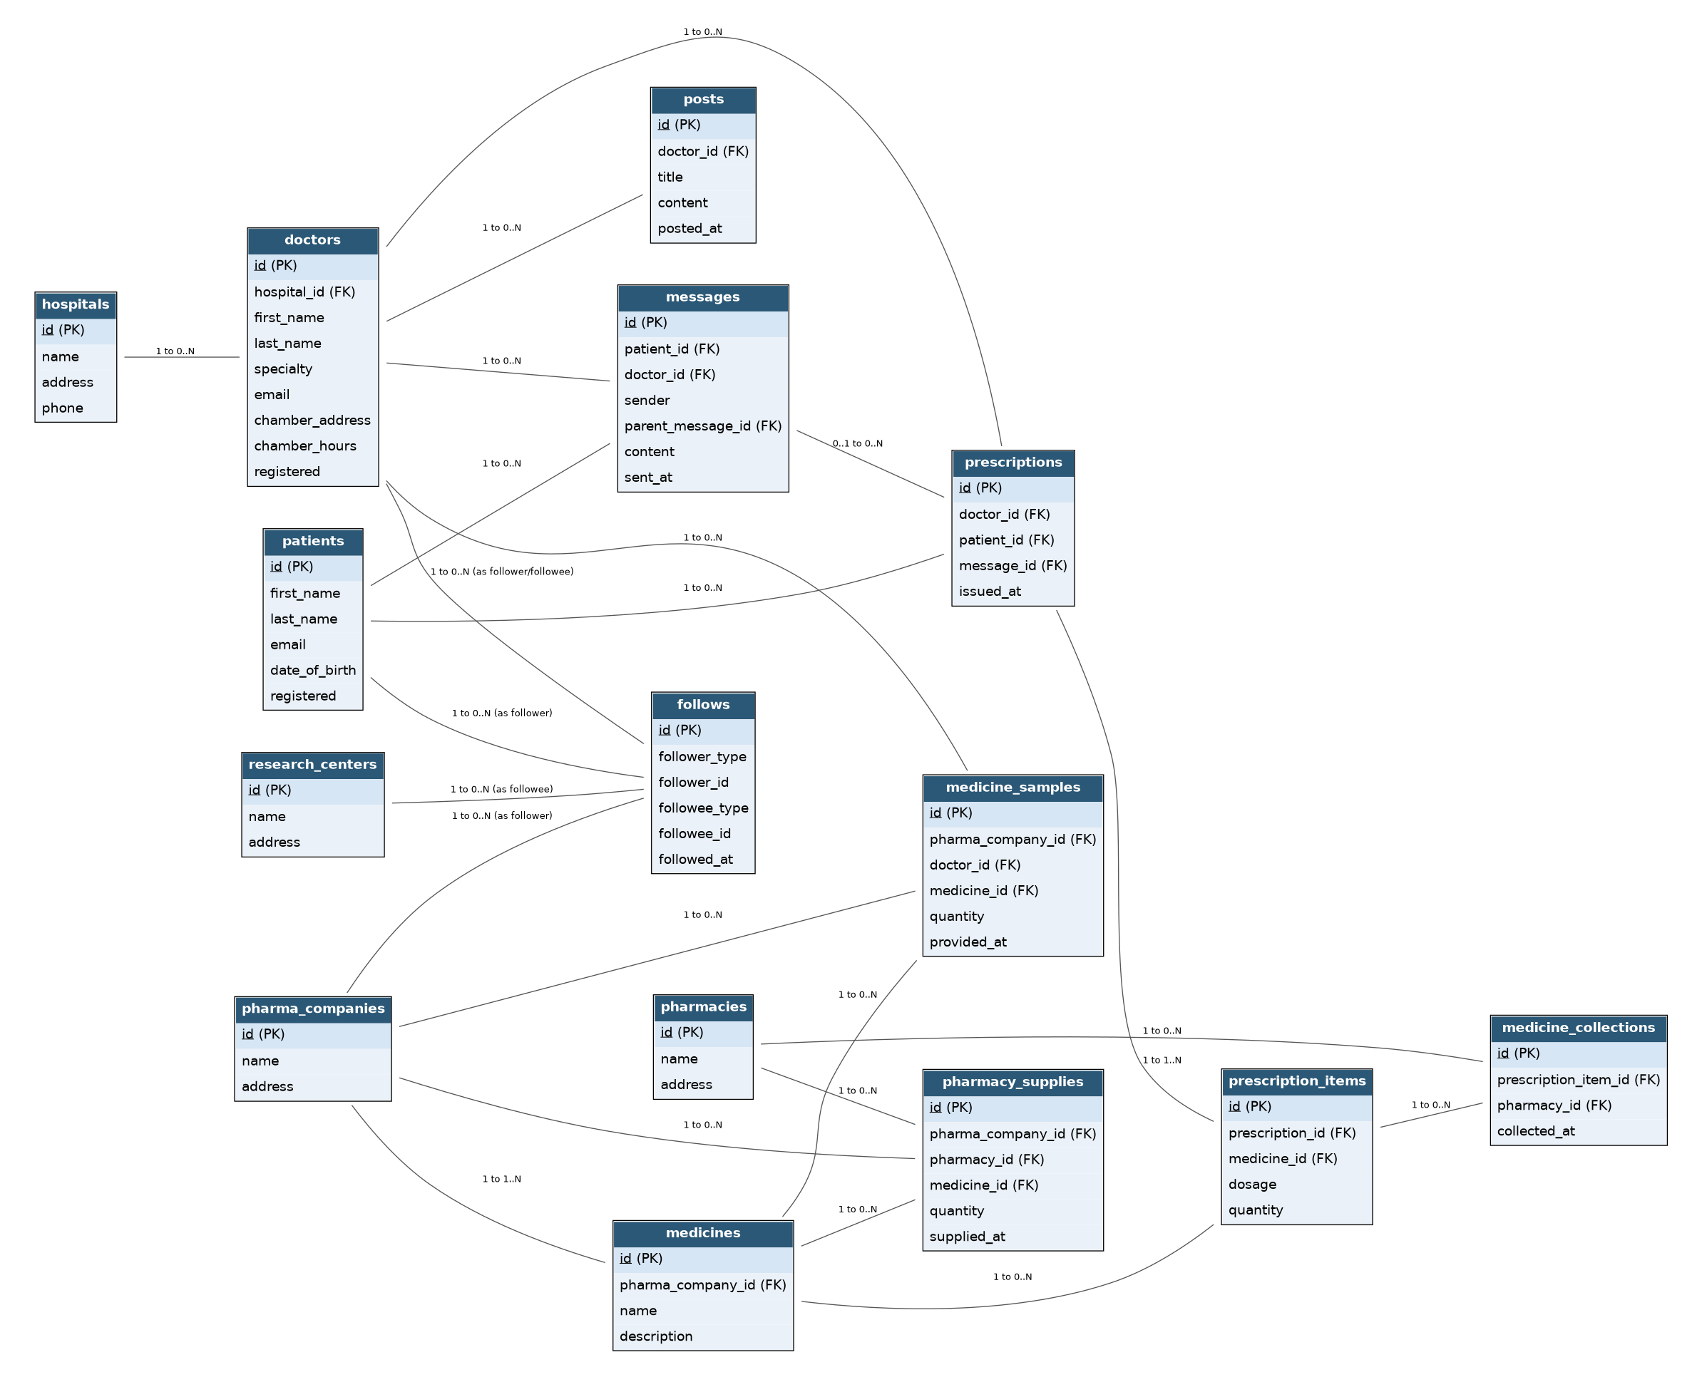
Entities & Relationships

Slide 4
Schema Highlights
1
The polymorphic follows table
One table lets any of the six user types follow any other as patient→doctor, doctor→research center, pharma→doctor via follower_type / followee_type CHECK constraints.
2
Threaded messages & traceable prescriptions
messages self-references via parent_message_id for reply threads; prescriptions optionally links back to the consultation message that prompted it.
3
Full supply-chain trail
medicine_samples and pharmacy_supplies both point back to medicines, so a batch can be traced from manufacturer to doctor sample or pharmacy shelf, and medicine_collections closes the loop to the patient.
4
Indexes matched to real queries
Name/specialty search on doctors and patients, both directions of follows, and patient+doctor message threads are all indexed against queries.sql's actual lookups.

Slide 5
Optimizations & Limitations
OPTIMIZATIONS
LIMITATIONS
Name/specialty indexes on doctors & patients for the app's most common lookups
Medicine name index since it's searched across prescriptions, samples, and supply
Bidirectional follows indexes for "who I follow" and "who follows me"
Thread & history indexes on messages and prescriptions for fast conversation and history retrieval
No dynamic FK on follows. SQLite can't validate follower_id/followee_id against a table chosen by a *_type column; enforced at the app layer
No partial fulfillment tracking. medicine_collections logs that a collection happened, not how much of the quantity it covered
No inventory balance check. a pharmacy could be recorded as supplying more than it received
Out of scope: billing, insurance, scheduling, video/voice, moderation

