Slide 1
RailVision Analytics — Current Strategy Overview

Slide 2
RailVision Analytics — Current Strategy Overview
● Internal Executive Strategy Review
● Focus: shortline market, EcoRail + LTOC platform, GTM model, and 12-month priorities
● Audience: Executive team / Board-prep
● Date: [Insert date]
💡 RailVision is building the operating-intelligence layer for underserved shortline railroads, using EcoRail and LTOC as the Trojan horse to a broader autonomy platform.
1 / 8

Slide 3
We exist to give shortlines Class I–grade intelligence at shortline economics
● Who we are: RailVision Analytics — rail operations + data science focused on North American shortlines
● Vision: Become the operating-intelligence layer for every shortline railroad in North America
● Trojan horse approach: Start with EcoRail fuel optimization and LTOC visibility, expand into full operating platform
● Why now: Aging fleets, tight margins, and no purpose-built software have created a structural technology gap
● Confidential — for internal executive use only
2 / 8

Slide 4
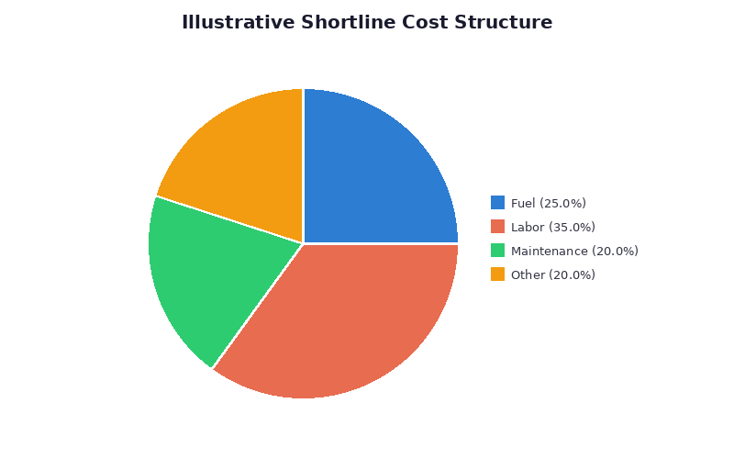
Shortlines move critical freight but operate with thin margins and limited tools
● ~600+ shortline railroads in North America handle a large share of first/last-mile freight
● Fuel often represents 20–30% of operating cost, yet most lack real-time optimization tools
● Locomotive fleets are decades old, driving high unplanned maintenance and downtime
● Operational decisions are often made with spreadsheets, radios, and experience, not data
💡 Shortlines feel Class I performance pressure without Class I tools — this is the gap RailVision is built to fill.
3 / 8

Slide 5
The Opportunity in Numbers
RailVision is positioned to capture an underserved, fragmented market where a few holding companies control a large share of the shortline footprint. > The combination of **fragmentation at the railroad level** and **consolidation at the holding-company level** makes a land-and-expand strategy both necessary and achievable.

Slide 6
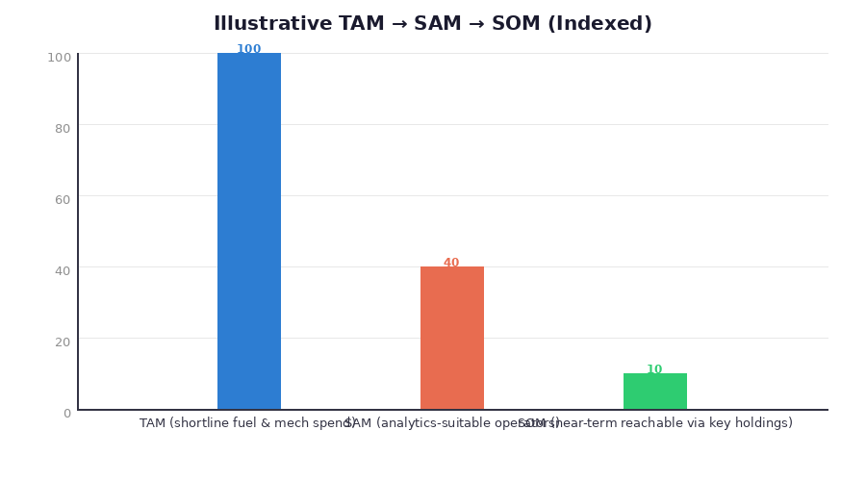
Shortline market is fragmented at the road level but consolidating at the owner level
● ~600+ shortlines across North America; highly fragmented local operators
● Dozens of holding companies (e.g., GWRR, OmniTrax, Watco) control large multi-road portfolios
● Shortlines collectively represent a multi-hundred-million-dollar fuel and maintenance spend
● Serviceable opportunity for RailVision: value-added analytics on fuel and locomotive cost, sold via holding companies
💡 Winning 2–3 large holding companies can unlock access to dozens of individual shortlines and meaningful recurring ARR.
4 / 8

Slide 7
EcoRail turns raw train and fuel data into actionable savings
● EcoRail ingests consist, GPS, territory, and fuel data to recommend optimal throttle, speed, and handling
● Delivered initially in advisory mode ("Google Maps" for engineers) with no PTC integration requirement
● Zero-upfront, value-share model: railroads only pay when verified fuel savings are achieved
● Typical goal: demonstrate high single-digit fuel savings on eligible trips in 60–90 day pilots
● Tablet-based deployment enables fast rollout on almost any locomotive in the fleet
💡 EcoRail is the entry point — it proves financial value fast, earns trust, and opens the door for deeper integration.
5 / 8

Slide 8
LTOC: Live Train Location & Operating Context as a management-control tool
● LTOC = Live Train Location & Operating Context — real-time geo-location plus current limits, slow orders, ETAs, and pacing
● Visible both in-cab and in-office, standardizing the view between crews and managers
● Reduces uncertainty around train status, improves compliance, and supports safer, smoother operations
● When combined with EcoRail data, LTOC becomes a foundation for locomotive total operating cost insights
💡 LTOC is both a demo hook and a control layer — it makes value visible and operationally sticky.
Dimension | Today (Typical Shortline) | With LTOC
Train visibility | Radio calls, spreadsheets | **Live map + operating context**
Compliance | Manual checks | Exception alerts & playback
Crew support | Experience-driven | Advisory guidance in-cab
Management view | Lagging reports | Near real-time dashboards
6 / 8

Slide 9
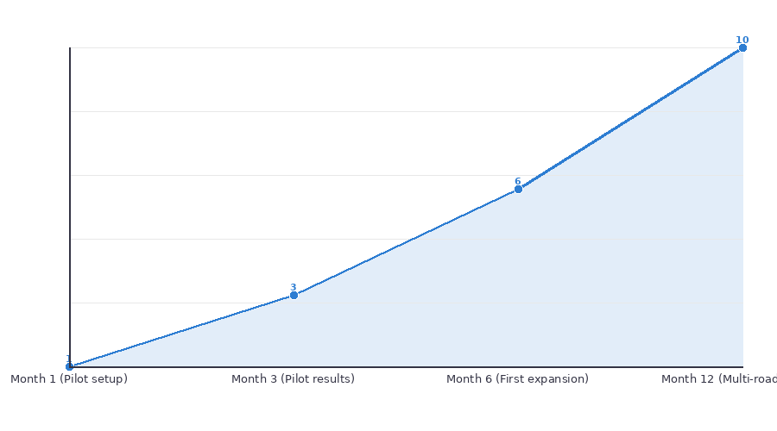
GTM: value-share pilots with GWRR & OmniTrax as flagship proof points
● Lead offer: Shortline-Proof ROI — zero upfront, runs on any locomotive, pay only when you save
● Proof motion: 60–90 day corridor pilots targeting high single-digit fuel savings and improved advisory compliance
● GWRR: Active multi-corridor pilot; potential access to 100+ properties if successful
● OmniTrax: Pilot underway; validates repeatability of the sales and deployment motion
● Commercial model: 30% value-share on verified savings or flat subscription, with value-share as primary wedge
💡 The immediate strategic objective is clear: convert GWRR and OmniTrax from pilots into scalable, multi-road rollouts.
7 / 8

Slide 10
Key risks and what we must prove in the next 12 months
● Pilot performance risk: Fuel savings and compliance must be independently verified and defensible
● Adoption risk: Conservative buyers may stall beyond pilots without strong internal champions and case studies
● Concentration risk: Near-term ARR targets depend heavily on successful GWRR and OmniTrax expansion
● Messaging risk: Overstating savings or market size can damage credibility with partners and investors
1. Prove EcoRail and LTOC value with hard data from GWRR and OmniTrax pilots
2. Convert at least one pilot to a multi-road rollout with a clear land-and-expand playbook
3. Standardize external messaging on savings, TAM, and product claims for investor- and partner-readiness
4. Prepare LTOC and EcoRail for scale (support, onboarding, and product robustness) to handle additional holding companies
💡 The next 12 months are about **proof and scalability** — validating the model with GWRR and OmniTrax and getting the company ready to repeat that success.
8 / 8

