Slide 1
RailVision Analytics — Strategic Overview 2025

Slide 2
RailVision Is Building the Autonomy Platform for Rail — Starting with a Revenue-Generating AI Solution
● "Google Maps for Rail" — EcoRail uses AI and self-driving algorithms to deliver real-time fuel optimization
● 650+ shortlines completely unserved by any deployed fuel optimization technology today
● +7% average fuel savings live with crews today; up to +15% max demonstrated in human-operated environments
● 30% gainshare model eliminates customer risk — railroads pay only on verified savings
● Raising $3M to scale from pilot traction to $2.5M ARR in 12 months
● Staged "Trojan Horse" strategy: fuel savings today → full autonomous rail operations tomorrow
💡 The shortline fuel optimization market is a $30M+ ARR opportunity — and RailVision is the only company with a deployed, validated product.
1 / 13

Slide 3
The Opportunity
A $30M+ market with zero deployed solutions — and a path to $113M+ in Class I

Slide 4
Fuel Is the #1 Controllable Cost for Every Railroad — and Shortlines Have No Solution
● Fuel is the second-largest expense for railroads after labor — and the #1 controllable cost
● Class I railroads spend $9.4–$11.8 billion annually on fuel across 7 major carriers
● Wabtec's Trip Optimizer serves Class I with hardware-heavy installs on 6,000+ locomotives
● 650+ shortline railroads are completely unserved — Trip Optimizer is too expensive and complex to deploy
● The unserved shortline + EMS-unequipped market represents $30M+ ARR in North America alone
● No competitor has a deployed, validated software product in this segment
💡 RailVision is the only company with documented fuel savings results in the shortline market.
2 / 13

Slide 5
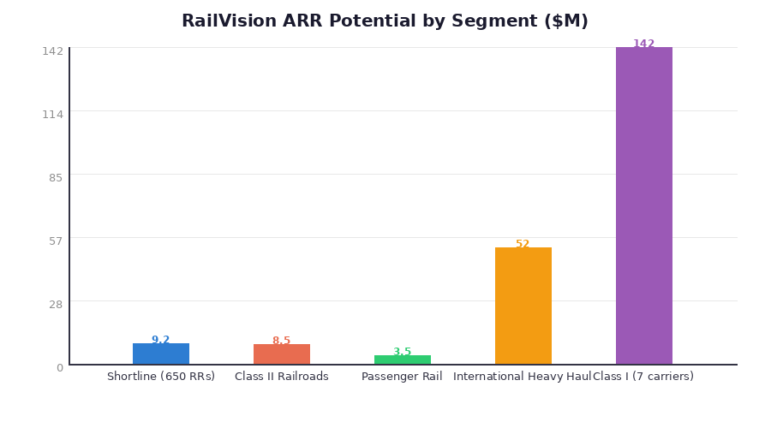
Total Addressable Market Spans $9.2M in Shortline to $142M in Class I
💡 Near-term focus: Shortline & Class II ($17.7M ARR). Long-term: Class I and international represent a $194M+ platform opportunity.
3 / 13

Slide 6
EcoRail — The Solution
A 'Google Maps' for rail — AI-powered, tablet-deployed, locomotive-agnostic

Slide 7
EcoRail Delivers End-to-End Trip Intelligence Through Three Core Modules
● Deployment: A bracket and a tablet — onboarding takes weeks, not months
● Locomotive-agnostic: Works on any engine, any railroad, any terrain
● Revenue model: 30% gainshare on verified 8% fuel savings — zero upfront customer cost
● EcoRail is the Trojan Horse — every deployment builds the data foundation for autonomous rail
💡 "RailVision is taking a staged, revenue-generating approach to build the foundational platform of autonomy."
Module | What It Does | Key Value
**Trip Setup** | Drivers receive & review operational info via AI integrations | Eliminates manual pre-trip planning
**Live Recommendations** | Real-time driving guidance adapted to terrain, speed, conditions | **Delivers 7–15% fuel savings live**
**Trip Review** | Post-trip performance analysis for continuous improvement | Builds operational data flywheel
4 / 13

Slide 8
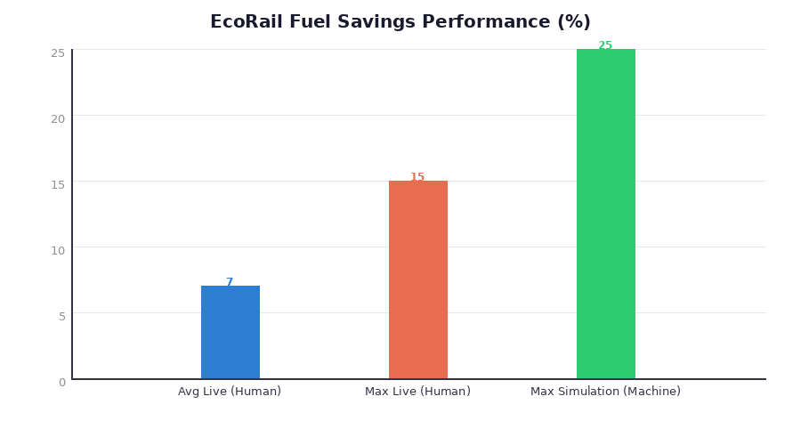
EcoRail Has Demonstrated Up to 25% Fuel Savings Across Operating Modes
● +7% average fuel savings — demonstrated live with train crews operating EcoRail today
● +15% maximum fuel savings — demonstrated in live human-operated environments
● +25% maximum fuel savings — demonstrated in machine-operated simulation (future autonomous state)
● As algorithms continue to improve, the value to customers increases without hardware changes
💡 Every percentage point of fuel savings translates to millions in annual cost reduction for railroads.
5 / 13

Slide 9
RailVision Outperforms Wabtec on Every Dimension That Matters to Shortlines
💡 RailVision's three moats: more advanced algorithms, minimal hardware, and a user experience that crews actually adopt.
Dimension | **RailVision EcoRail** | Wabtec Trip Optimizer
**Fuel Savings** | **7–25%** | 5–17%
**Hardware Required** | **Bracket + tablet** | Heavy onboard install
**Deployment Time** | **Weeks** | Months to years
**Locomotive-Agnostic** | **Yes** | No — system-specific
**Installed Base** | Pilots underway (GWRR, OmniTrax) | 6,000+ locomotives
**Market Focus** | **Shortline → Class I** | Class I only
**Pricing Model** | **Gainshare (no upfront cost)** | CapEx + license fees
**Onboarding Complexity** | **Simple — crews love it** | Extensive retraining
6 / 13

Slide 10
Growth & Commercialization
From pilot traction to $2.5M ARR in 12 months

Slide 11
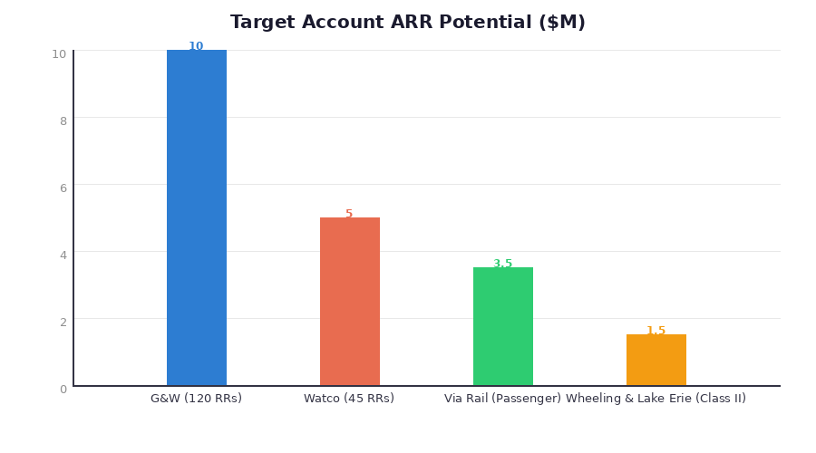
GWRR and OmniTrax Pilots Are Live — $20M+ Pipeline Behind Them
● GWRR pilot underway — 112 properties, $2.7M near-term ARR, 90-day validation timeline
● OmniTrax pilot underway — documenting fuel savings results for commercial rollout
● G&W full potential: $10M ARR across 120 railroads — largest shortline operator in North America
● Watco: $5M ARR across 45 railroads — second priority after G&W validation
● Via Rail: $3.5M ARR — largest passenger railroad in Canada, sustainability-driven buyer
💡 When GWRR pilots close with documented results, the competitive dynamics — and the valuation — change permanently.
7 / 13

Slide 12
Five Strategic Partners Create Distribution, Credibility, and Defensibility
Strategic Technology Partners
● Wabtec — Fills their shortline gap; combined portfolio covers all rail segments
● Alstom — Entry into North American freight + global autonomous rail ambitions
● Potential for joint platform development toward next-gen autonomous operations
Channel & Distribution Partners
● Loram — Predictive maintenance ecosystem; presence in 32 countries
● Holland — 100+ year railway company; shortline relationships across NA
● Railhead — 800+ shortline customers, 60+ locations; PE-backed (Madison Dearborn)
💡 A combined Holland-Loram investment structure provides shared risk, combined railroad networks, and cross-border alignment.
8 / 13

Slide 13
Leadership Team Combines Deep Rail Expertise with AI/ML Technical Capability
Dev Jain — CEO & Founder
● McGill University graduate; Centech Top Entrepreneur
● 7+ years of rail industry experience building AI systems
● Active Canadian Military Reservist
● Architect of EcoRail's self-driving algorithms
● Contact: dev.jain@railvision.ca
Jamie O'Rourke — VP Sales & Strategy
● 20-year railroad sales veteran with deep industry relationships
● Direct connections to Class I, Class II, and shortline decision-makers
● Led go-to-market strategy and strategic partner development
● Driving GWRR, OmniTrax, and Wabtec commercial conversations
💡 Planned hires with $3M raise: 2–3 strategic engineering hires + field deployment team to support scaling to 15+ properties.
9 / 13

Slide 14
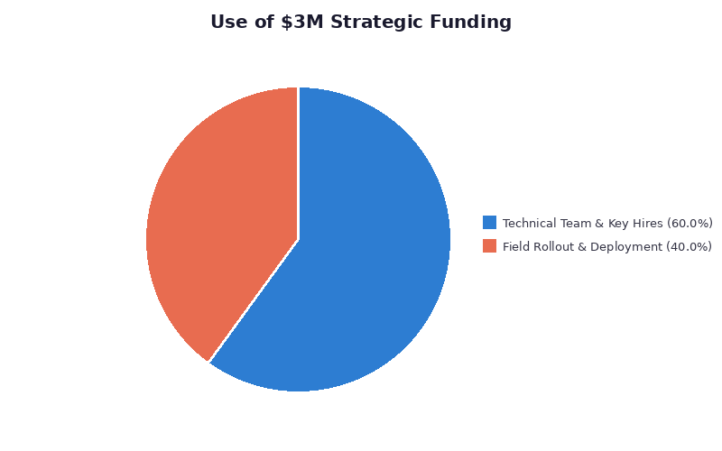
Raising $3M to Scale from Pilot to $2.5M ARR — Targeting $50–100M Exit
● $1.8M — Technical Team & Key Hires: Product development, API integrations (Wabtec/Alstom), 2–3 engineering hires
● $1.2M — Field Rollout: GWRR pilot deployment (3 properties), validation support, scaling to 15+ properties by Q4 2026
● 12-Month ARR Target: $2.5M — driven by GWRR expansion + Watco + new shortline deployments
● Exit Valuation: $50M–$100M — based on 20–40x ARR multiple for AI/SaaS in vertical markets
● Revenue model scales with zero marginal hardware cost — pure software economics
💡 Post-GWRR validation, the next raise will be at a fundamentally different valuation. This is the last early-stage entry point.
10 / 13

Slide 15
EcoRail Is the Trojan Horse — Every Deployment Builds the Foundation for Full Autonomy
● Stage 1 generates revenue today while building the operational data flywheel
● Every trip creates proprietary training data for self-driving algorithms
● Locomotive-agnostic platform means no hardware lock-in as autonomy features activate
● Comparable trajectory: autonomous trucking companies valued at $1B+ (Embark, Applied Intuition)
● Rail is a simpler autonomy problem than road — fixed tracks, controlled environments, fewer variables
💡 "We're building a fully autonomous rail industry. Starting with a revenue-generating, AI-enabled solution." — Dev Jain, CEO
Stage | Phase | Description | Status
**1** | **AI Advisory (EcoRail)** | Real-time fuel recommendations via tablet | **NOW — Live with crews**
**2** | **Enhanced Automation** | Deeper integration with locomotive controls | Next 12–24 months
**3** | **Full Autonomous Operations** | Self-driving train technology | Long-term vision
11 / 13

Slide 16
Risk & Next Steps
Mitigating risks while executing on the 90-day critical path

Slide 17
Four Key Risks — Each With a Clear Mitigation Strategy
● Key assumption to validate: Live fuel savings consistently meet or exceed 8% threshold for gainshare economics
● Regulatory environment: Favorable — FRA encouraging technology adoption for safety and efficiency
● Capital risk: $3M raise covers 12+ months of runway through ARR inflection point
💡 The single biggest de-risking event: GWRR pilot results documented within 90 days. Everything downstream accelerates from there.
Risk | Severity | Mitigation
**Adoption risk** — conservative railroads slow to adopt new tech | High | Gainshare model eliminates upfront cost; crews report positive UX
**Wabtec competitive response** — incumbents enter shortline market | Medium | Hardware-heavy approach is structural disadvantage in shortline segment
**Pilot-to-contract conversion** — GWRR/OmniTrax may not convert | High | 90-day validation with documented savings creates data-driven decision
**Concentration risk** — G&W represents outsized share of pipeline | Medium | Diversified across Watco, Via Rail, W&LE + 5 strategic partners
12 / 13

Slide 18
90-Day Priorities: Close GWRR, Secure Funding, Activate Partners
1. Close GWRR pilot with documented fuel savings — target: verified 8%+ savings across 3 properties by end of Q2
2. Secure $3M strategic round — finalize lead investor from partner ecosystem (Wabtec, Loram, or Railhead)
3. Activate Watco commercial conversation — leverage GWRR results to open second major account
4. Hire 2 engineers — accelerate API integration with Wabtec systems and algorithm improvement
5. Formalize Holland-Loram consortium — combined track partner investment structure for shared risk
6. Deliver Q2 board update — ARR trajectory, pilot data, partnership status, next-raise positioning
● 6-Month Milestone: 5+ properties live, $500K+ ARR run-rate
● 12-Month Milestone: 15+ properties live, $2.5M ARR, Series A positioning underway
💡 The window is now. GWRR results change the valuation. The current round is the last early-stage entry point before that inflection.
13 / 13

