Slide 1
Uncertain parameters
N_{c}
64
128
32
16
1
LHS
Machine learning
…
…
…
…
…
Model 1
…
Model n_{s}
ANN ROMs
Validation & prediction
Training simulations
PReLU
FC
Dropout
BatchNorm
Objective of interest

Slide 2
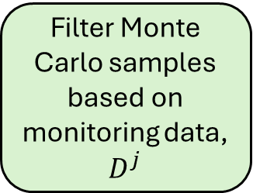
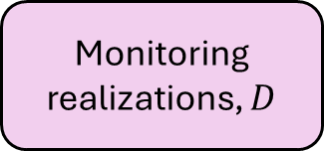
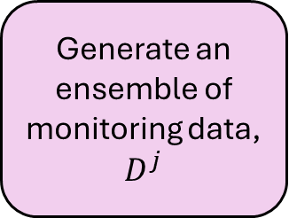
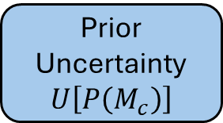
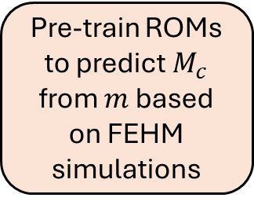
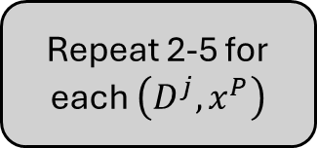
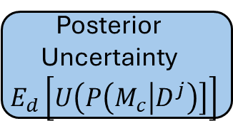

Step 1
Step 2
Step 3
Step 4
Step 5
Step 6
No monitoring design
ANN ROM
Monitoring realizations, $D$
Data Assimilation
Posterior Uncertainty
$$E_{d}\left[U\left(P\left(M_{c} | D^{j}\right)\right]\right]$$
Repeat 2-5 for each $\left(D^{j}, x^{P}\right)$
Monte Carlos realizations
1, 2, …, l_{d}
Monte Carlos realizations
1, 2, …, l_{d}
FEHM simulations
Monte Carlos realizations
1, 2, …, l_{d}
Pre-train ROMs to predict $M_{c}$ from $m$ based on FEHM simulations
Generate an ensemble of monitoring data, $D^{j}$
Filter Monte Carlo samples based on monitoring data, $D^{j}$
Uncertainty reduction, $U_{R}$
Prior Uncertainty
$$U\left[P\left(M_{c}\right)\right]$$

