Slide 1
California Fashion Foundation
Sample Scholarship Presentation
Name:
Date of Birth:
Phone:
E-mail:
College/University:
Current Major:
GPA Last semester:
Career Objective: I want to have my own design studio.
Future Plan: I always give myself a short-term and long-term plan. I vision myself working for company for couples years to learn and explore in the fashion industry. I would contribute the company as much as I can. After few years experience, I wish I can have my own design studio.
Personal PROFILE, Including Extracurricular Activities: Fashion has always been my passion since I was ten years old when I starting jugging people by what they were wearing. Fashion design is always the major I am proud of. As a fashion designer myself, after four years of study in the field, I find myself having the responsibility to spread the sustainable Fashion theory. I was an intern at Pearl by Georgina Chapman in the Li & Fung USA (LF USA), New York, over the summer.

Slide 2
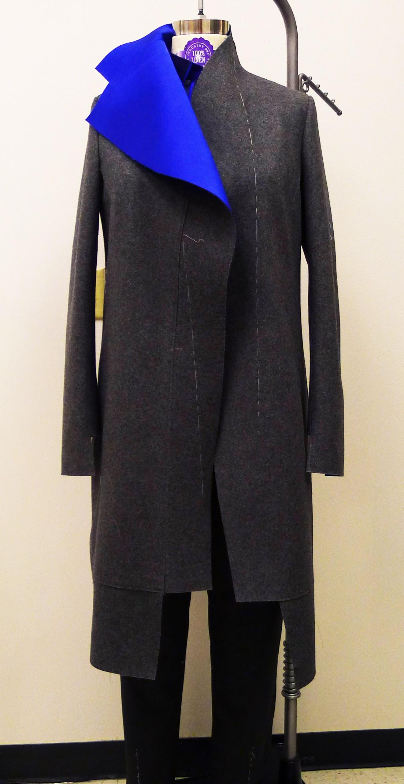
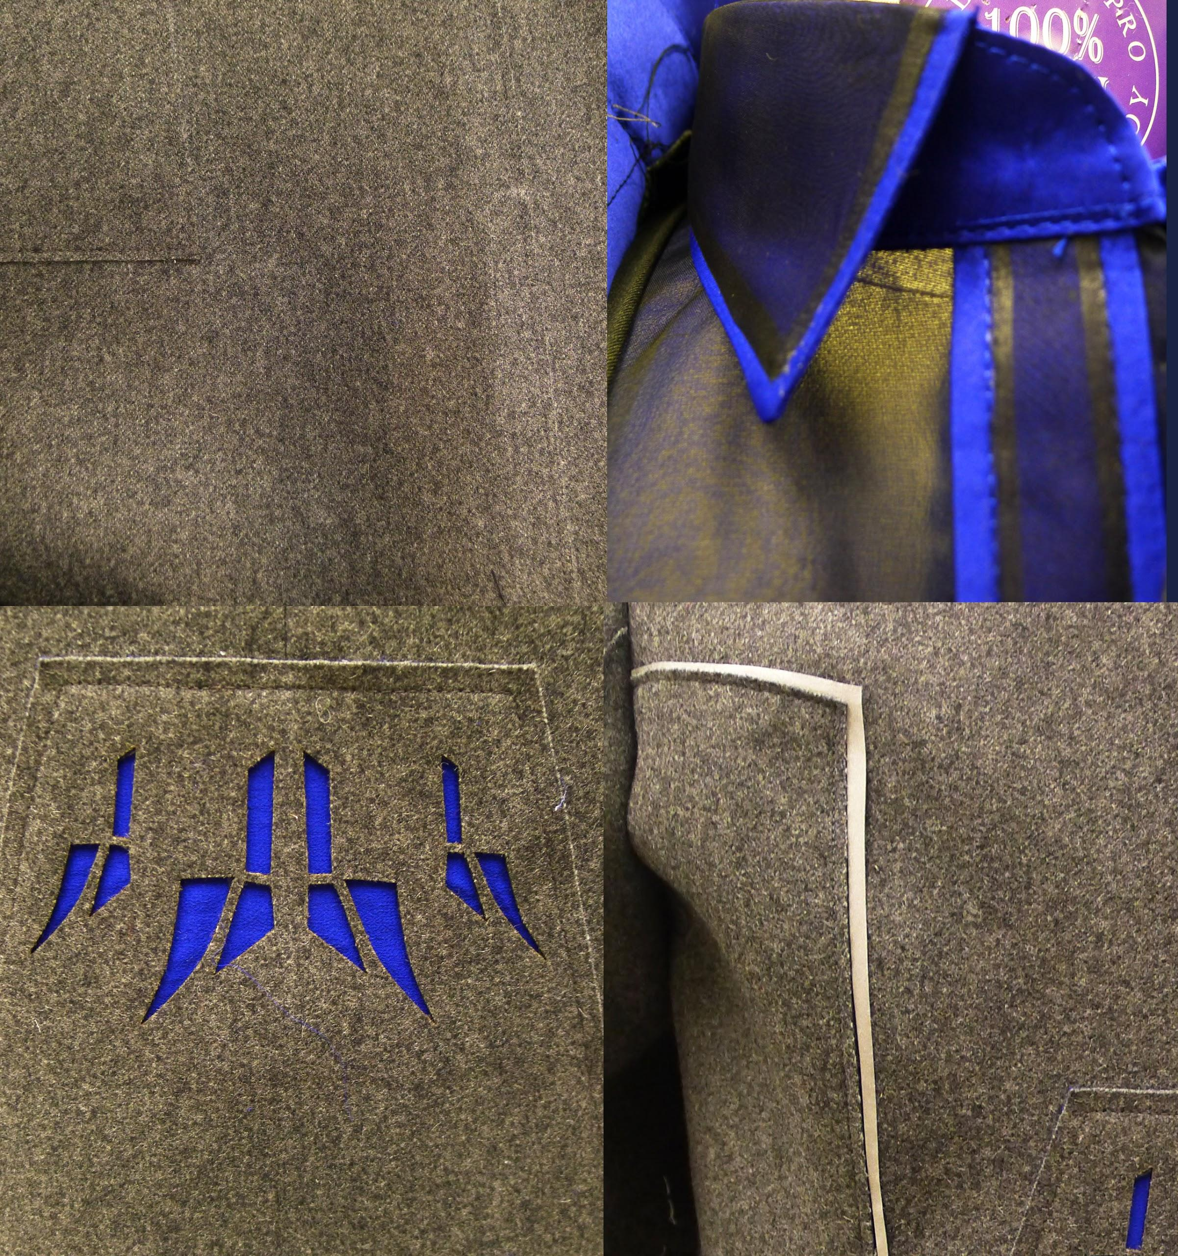
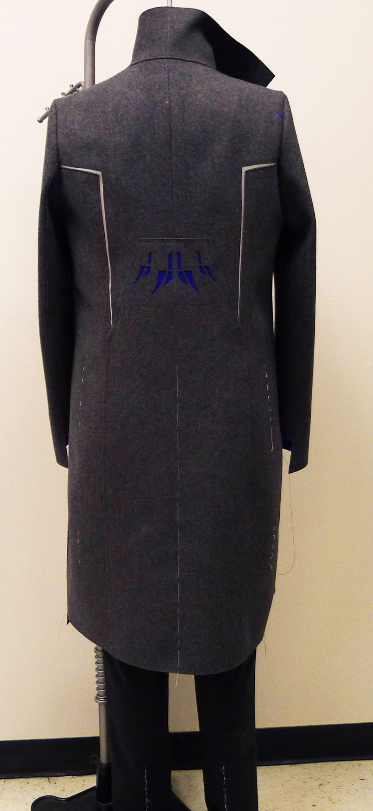
Sample Presentation
Mentor Project: Plus-size Sportswear

Slide 3
Sample Presentation
Market Category:Women’s Sportswear
Details of Design Item:
Textile: wool with neoprene, charmeuse, organza, chiffon, stretch wool suiting
Trimmings: laser cut, double face fabric,
contrast color binding, reflective Tape,overlapping seams
Findings: using the esthetic element such as adjustable fit, stretch fabric, reflective tape, bemis; using the overlapping seams instead of traditional sewing; using the clean cut edge instead of traditional finishing.
Retail Distribution Objective
Department Stores, E-tailing
Define your Customer for this Design
She is 23 to 45 years old and living in New York, the fashion capital. During the day she works hard. Afterwards, she likes to hang out with her friends. she is between a size 14-22, but it does not keep her from being confident about her figure. Being in the fashion capital, she wants to have a outfit to make her look modern and chic, as well as being comfortable.
Mentor Project: Isbel & Ruben Toledo, Plus-size Sportswear

Slide 4
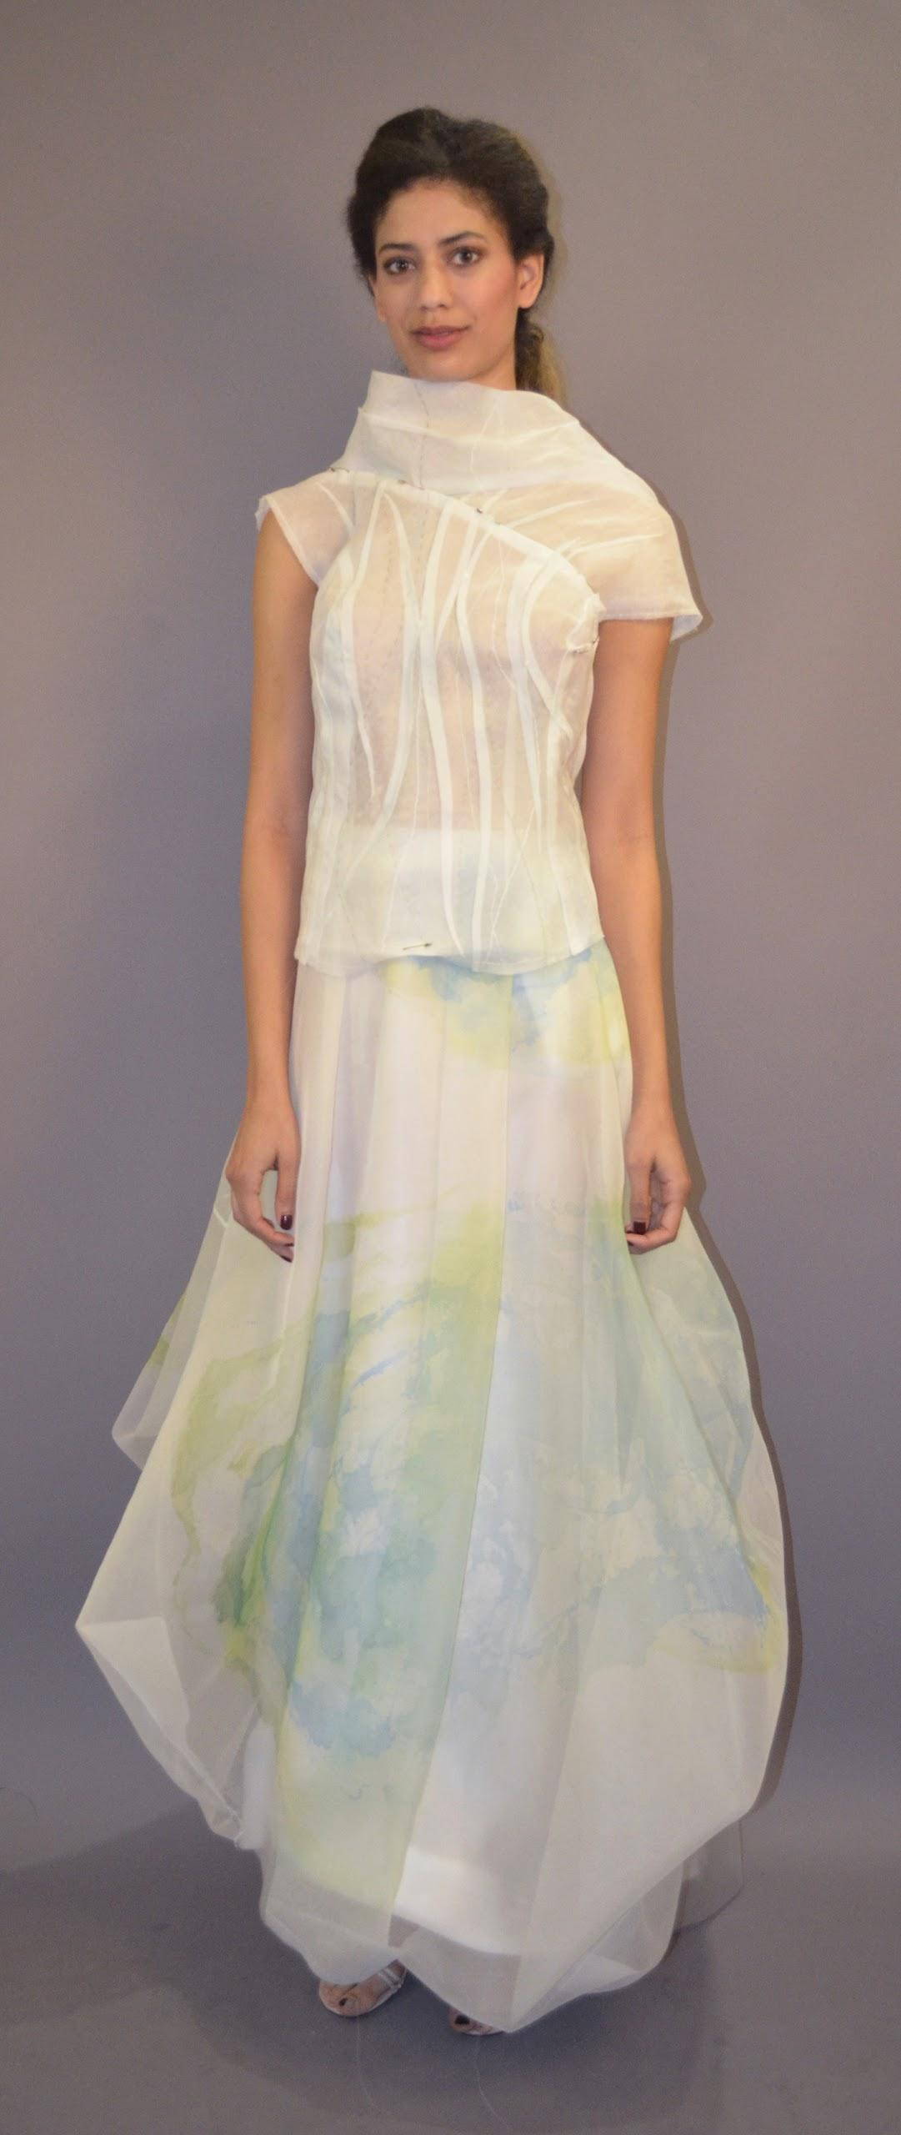
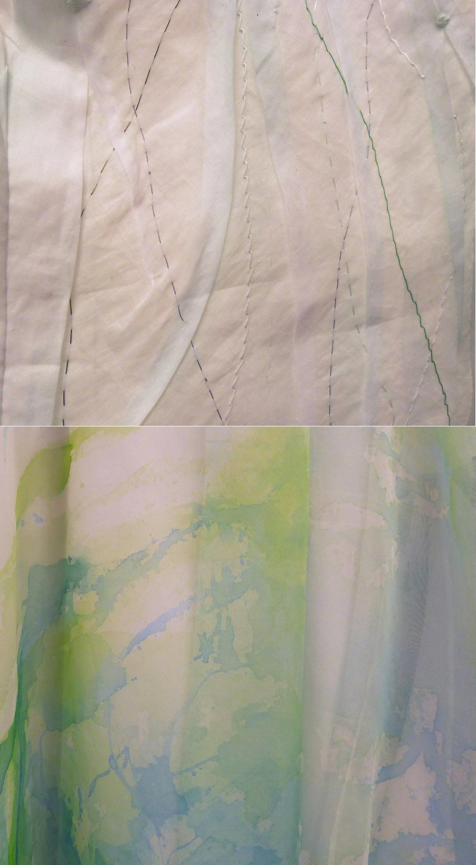
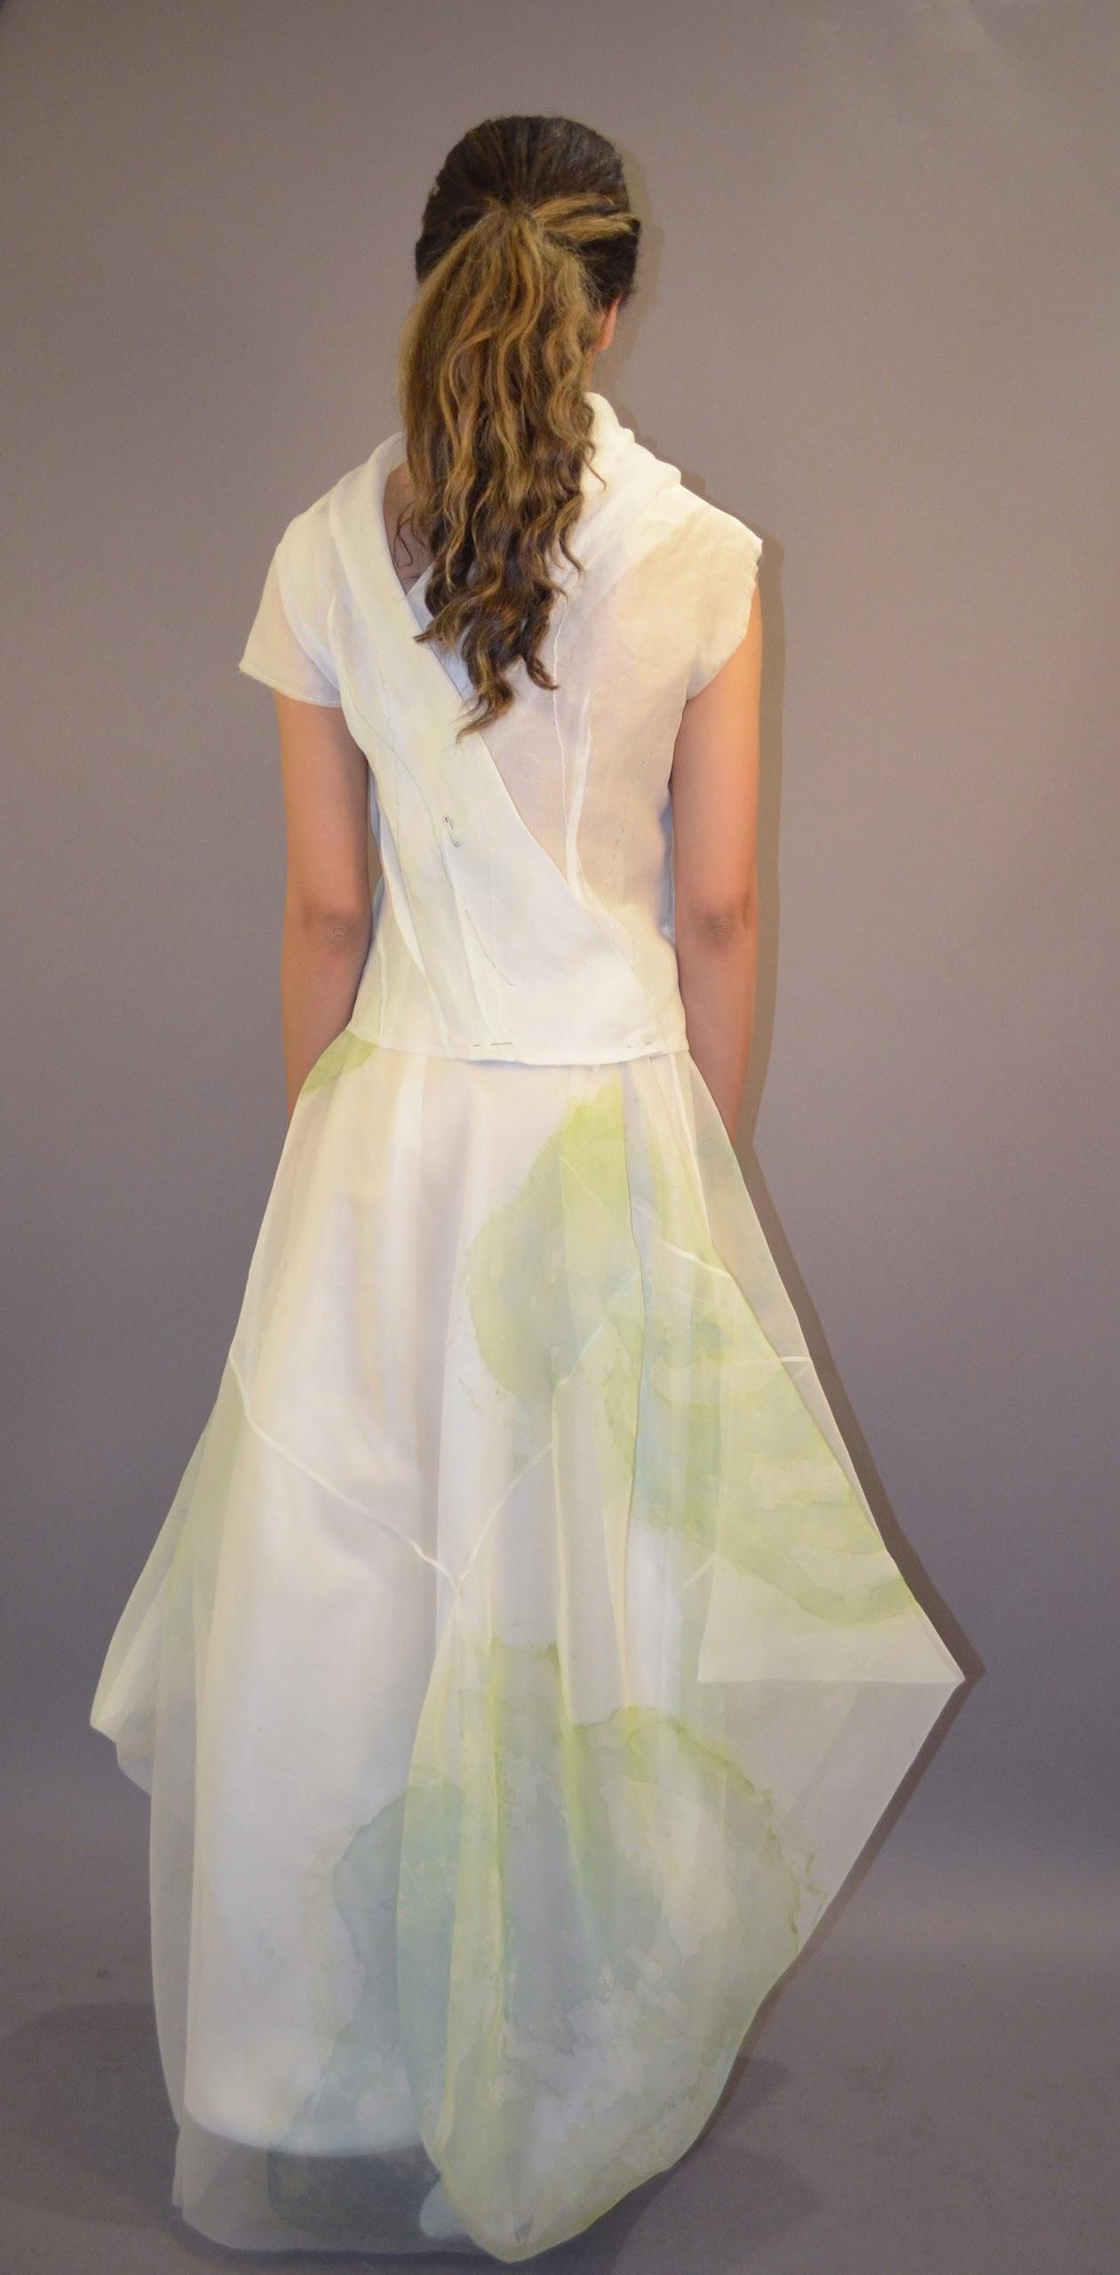
Sample Presentation
Mentor Project: Sustainable Design incorporating scraps

Slide 5
Sample Presentation
Mentor Project: Sustainable Design incorporating scraps
Market Category:Women’s Dresses
Details of Design Item:
Textile: cotton organza, silk organza, satin Organza
Trimmings:hand embroidery , watercolor textile painting,
Findings: folding with organic lines with different types of hand embroidery to create a organic nature look; watercolor painting on the sheer silk organza to give the lightness of the dress.
Retail Distribution Objective
Department store, E-tailing
Define your Customer for this Design
She is 18 to 38 years old, and cares about how the environment gets affected in the fabrication process. She loves to wear organic fabrics and appreciates handcrafted garments. She is an artist and is willing to try different style, but still wants the garment to make her look gorgeous and stand out.

