Slide 1
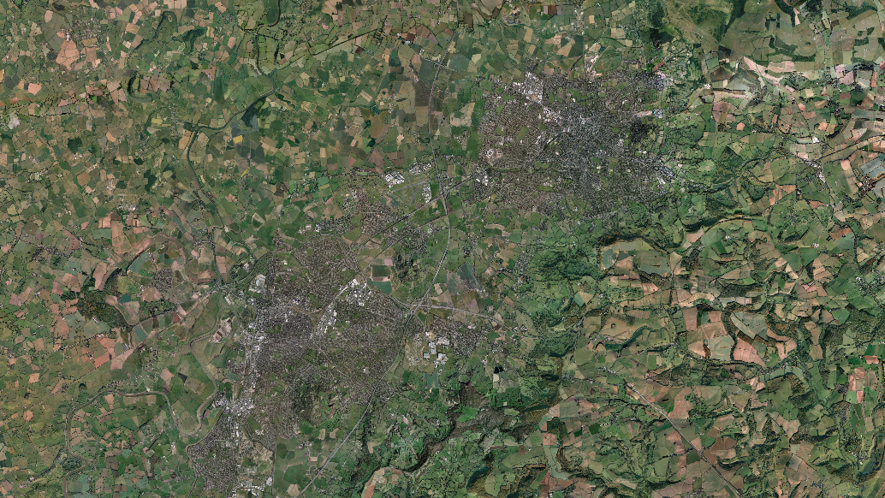
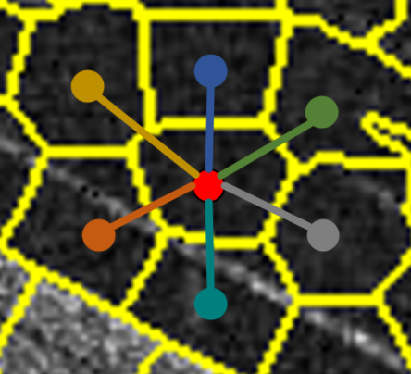
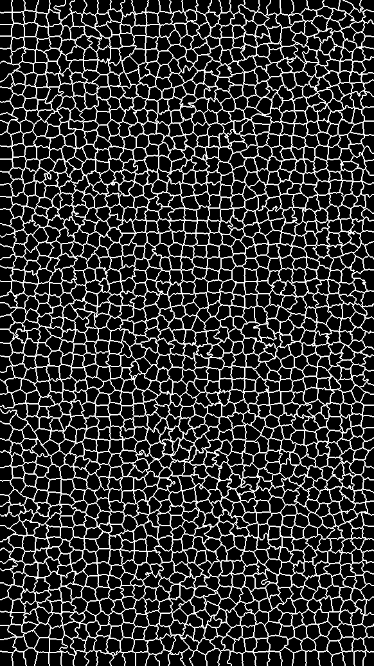
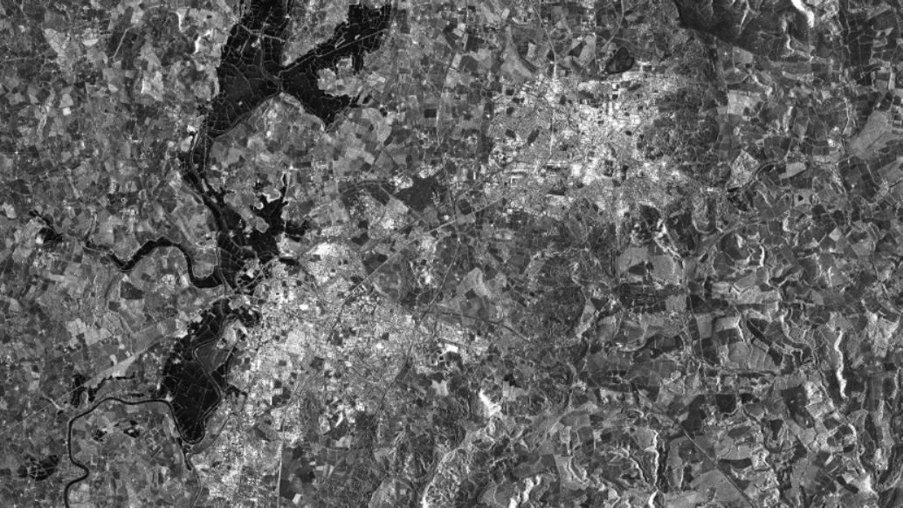
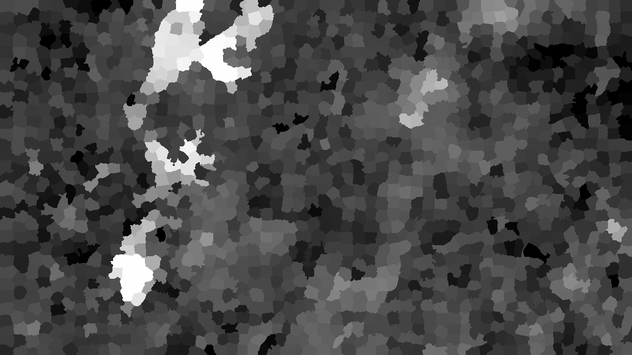
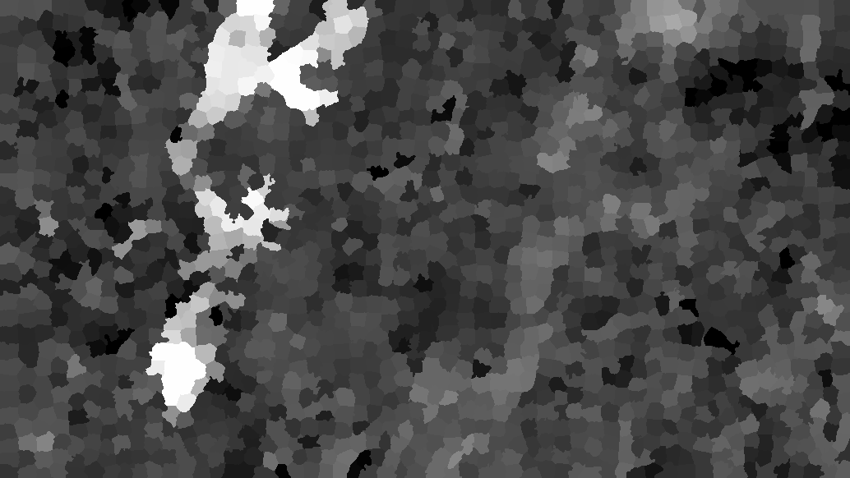
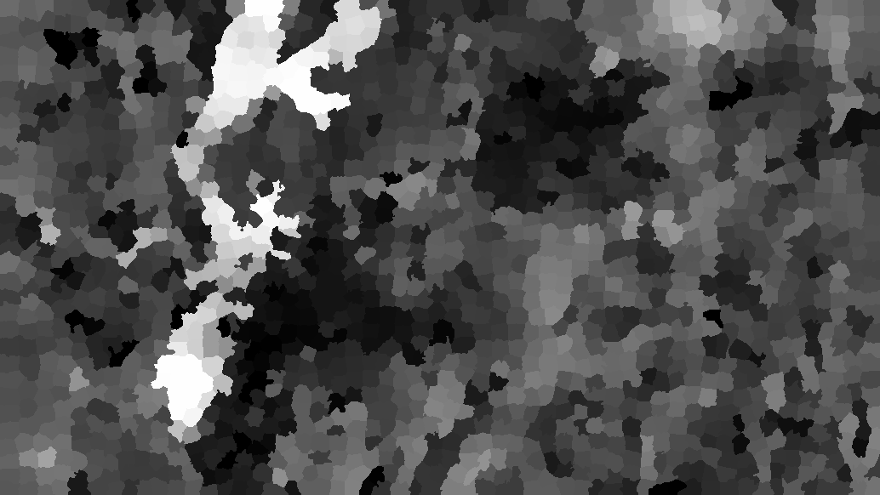
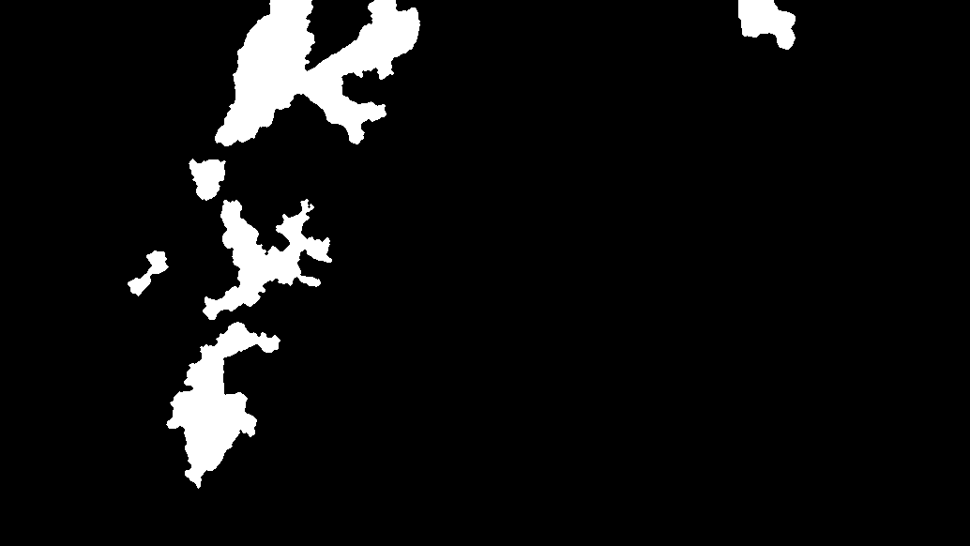































(a) Data Preprocessing
(b) CGCS-NET
Pre-event Image X
Centroid Position
$$c_{1}$$
$$ℒ_{rec}$$
$$T_{1}$$
Siamese GatedMP
Encoder
MLP Decoder
Token
Token Embedding
$$h_{1}$$
$${\hat{T}}_{1}$$
Normalizing
$$s_{1}$$
Token
Pooling
Layer
…
Layer
$$W_{1}$$
$$ℒ_{str}$$
Change Gating Head
Average
SLIC
$$ℒ_{co}$$
Pooling
Siamese GatedMP
Encoder
$$c_{2}$$
MLP Decoder
$$h_{2}$$
$${\hat{T}}_{2}$$
Normalizing
$$T_{2}$$
Token
Token
Token Embedding
Layer
Layer
$$s_{2}$$
…
Post-event Image Y
Centroid Position
$$W_{2}$$
(c) One GatedMP Layer
(d) Generating Difference Image and Binary Change Image
Weighted Aggregatio
Neighbor Features
$$c_{1}$$
Calculate
Commonality
Difference
$$a_{i}$$
$$DI_{co}$$
DI
$$W_{ }$$
$$c_{2}$$
Linear
Tanh
New $h_{i}$
$$h_{i}$$
$${\tilde{h}}_{i }$$
OTSU
Node Features
C
Node Features
$$s_{1}$$
Calculate
Structure
Difference
Linear
Sigmoid
$$DI_{str}$$
BCI
$$z_{i}$$
$${1−z}_{i}$$
$$s_{2}$$
Legend
$$ℒ_{co}$$
$$ℒ_{str}$$
$$ℒ_{str}$$
$$ℒ$$
Change Gating Head
Hadamard product
Commonality Projection Head
Structure Projection Head
commonality Loss
Structural consistency Loss
Reconstruction Loss
Adaptive Change Gating Module

