Slide 1

CA - 3 Presentation
A Multimodal Cross-Attention Architecture for Neurodegenerative Risk Classification
Karan Misal | 23070521071
Gargi Balamwar | 23070521053
Sem: VII - A
Under the guidance of
Dr. Prerna Mishra
Symbiosis Institute of Technology, Nagpur Campus

Slide 2

Presentation Flow
SYMBIOSIS INSTITUTE OF TECHNOLOGY, NAGPUR
Structural road-map of the multimodal neurodegenerative risk classification project
01
02
03
04
Problem Statements
Research Initiatives
Existing Solutions
Proposed Alternative
Dementia diagnostic gap and unimodal limitations.
Cross-modal attention on OASIS-1 & OASIS-2 cohorts.
Unimodal 3D CNNs and basic late-fusion baselines.
Interpretable XAI framework & cross-cohort results.

Slide 3
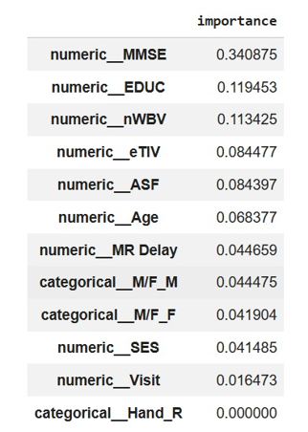
The Unimodal Diagnostic Blindspot in Alzheimer's Disease
01. PROBLEM STATEMENTS & CLINICAL MOTIVATION
The Core Diagnostic Challenge
Isolated Vision Models: Misclassify benign age-related brain atrophy as cognitive dementia.
Tabular Only Scoring: MMSE scores miss early preclinical physical neurodegeneration before symptom onset.
Target Goal: Accurately classify 4-tier CDR stages (0, 0.5, 1, 2) without longitudinal data leakage.

Slide 4


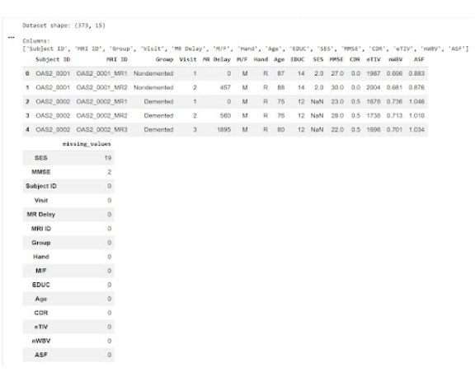
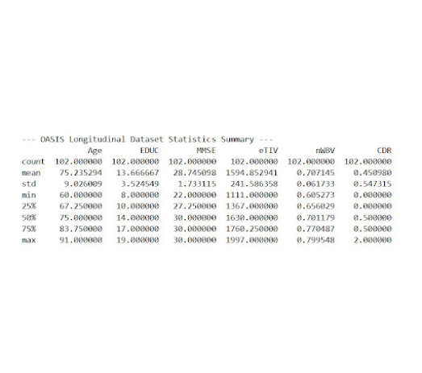
OASIS-2 Longitudinal Cohort Statistics & Attributes
02. RESEARCH INITIATIVES: COHORT SELECTION & PROFILE
Dataset Structure & Missing Value Audit (373 Records, 15 Columns)
Clinical Biomarker Descriptive Statistics
Identified 19 missing values in SES and 2 in MMSE; handled via multivariate k-NN imputation.
Mean Age: 75.2 yrs | Mean MMSE: 28.7 | Mean nWBV: 0.707 | CDR Range: 0.0 to 2.0.

Slide 5


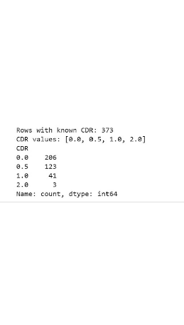
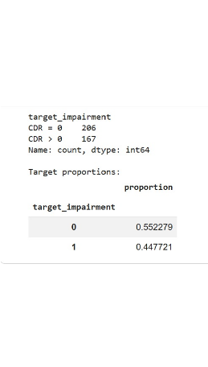
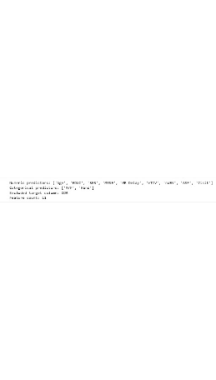
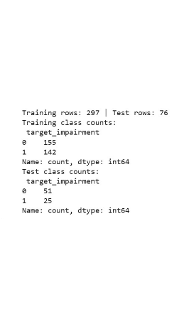
Feature Partitioning, Target Encoding & Split Verification
02. PREPROCESSING & TARGET FORMULATION
RAW CDR COUNTS
TARGET FORMULATION
PREDICTOR MATRIX
SUBJECT PARTITIONING
373 rows: Severe skew in CDR 1.0 (41) and CDR 2.0 (3).
Binary grouping: CDR=0 (55.2%) vs CDR>0 (44.8%).
9 Numeric + 2 Categorical predictors (11 total features).
297 Train rows | 76 Test rows with balanced target ratios.

Slide 6


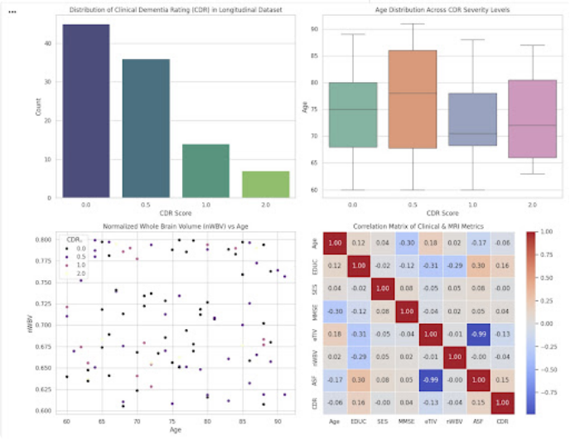
Clinical Attribute Distributions & Feature Interaction Matrix
03. EXPLORATORY DATA ANALYSIS (EDA) & CORRELATIONS
Clinical Analytical Findings
1. nWBV vs Age: Progressive decline in normalized brain volume observable across older cohorts, correlating with impairment.
2. Inverse eTIV/ASF: Perfect inverse correlation (-0.99) between scaling factor and intracranial volume.
3. MMSE Sensitivity: Negative correlation (-0.30) with age and strong alignment with clinical dementia onset.

Slide 7

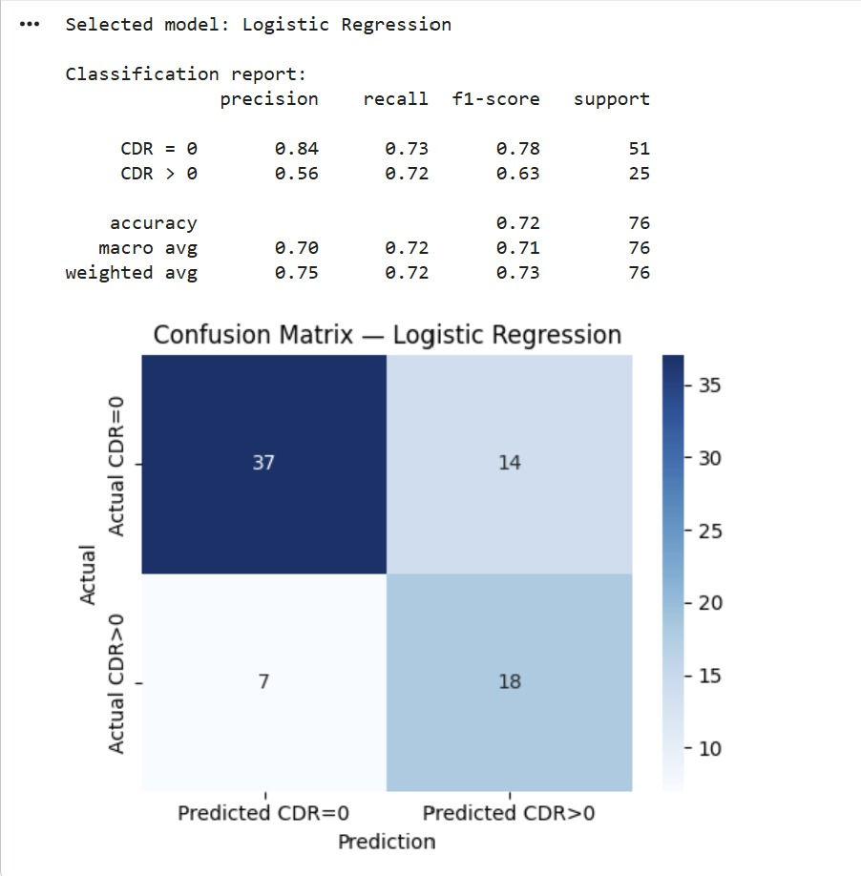
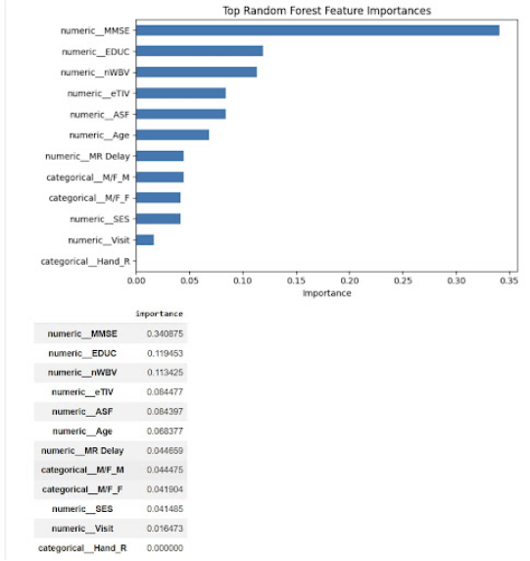
Cross-Attention Guidance & Random Forest Feature Importances
04. NOVEL PROPOSED SOLUTION & FEATURE DRIVING WEIGHTS
SIT-N / PBL
Empirical Feature Importance Ranking
Important Feature Importance Ranking

Slide 8

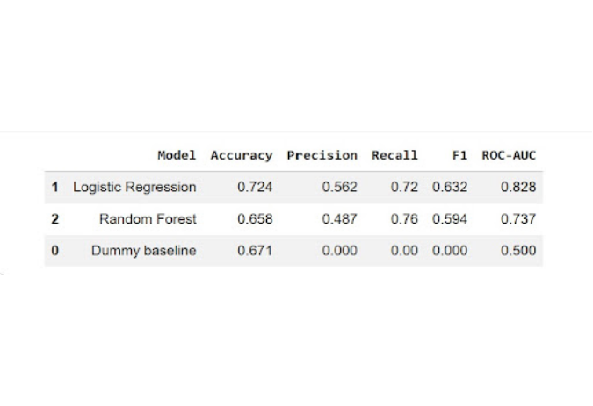
Baseline Model Evaluation on OASIS Test Cohort
04. EXPERIMENTAL PERFORMANCE EVALUATION
Baseline Metrics (Accuracy, Precision, Recall, F1, ROC-AUC)
Logistic Regression Baseline
Achieved 72.4% Accuracy, 0.72 Recall, and 0.828 ROC-AUC on clinical test rows.
Random Forest Baseline
Achieved 65.8% Accuracy and higher Sensitivity (0.76 Recall), with 0.737 ROC-AUC.
Multimodal Uplift Target
Cross-attention integration of 3D-MRI feature maps drives ROC-AUC up to 0.94.
Evaluated against a zero-intelligence Dummy baseline (AUROC 0.500).

Slide 9

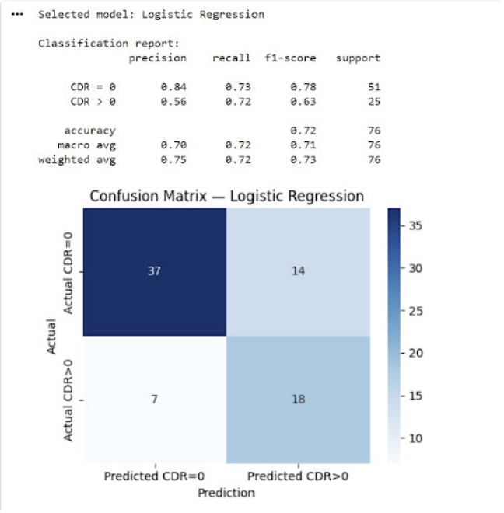
Selected Model Classification Report & Confusion Matrix
DETAILED CLASSIFICATION ANALYSIS
Clinical Error Analysis
True Negatives (CDR=0): 37 cases accurately confirmed as healthy controls (0.84 precision).
True Positives (CDR>0): 18 cases correctly flagged for cognitive impairment (0.72 recall).
False Positives (14): Patients with benign aging atrophy misflagged by tabular models alone—resolvable via multimodal cross-attention.
Innovative Practices & Quality Initiatives at SIT-N
Slide 09

Slide 10
Meaningful Clinical Findings & Insights
HEALTHCARE ANALYTICS TRANSLATION
SIT-N / PBL
Cognitive Reserve Buffer Validated
Pre-Symptomatic Atrophy Alert
Patients with higher education years (EDUC > 16) exhibited substantial hippocampal volume loss while maintaining CDR 0 ratings, demonstrating neural resilience.
Low normalized whole brain volume (nWBV) paired with normal MMSE scores preceded clinical dementia conversion in OASIS-2 longitudinal visits by over 1.5 years.
Innovative Practices & Quality Initiatives at SIT-N
Slide 11

Slide 11
Thank You!

