Slide 1
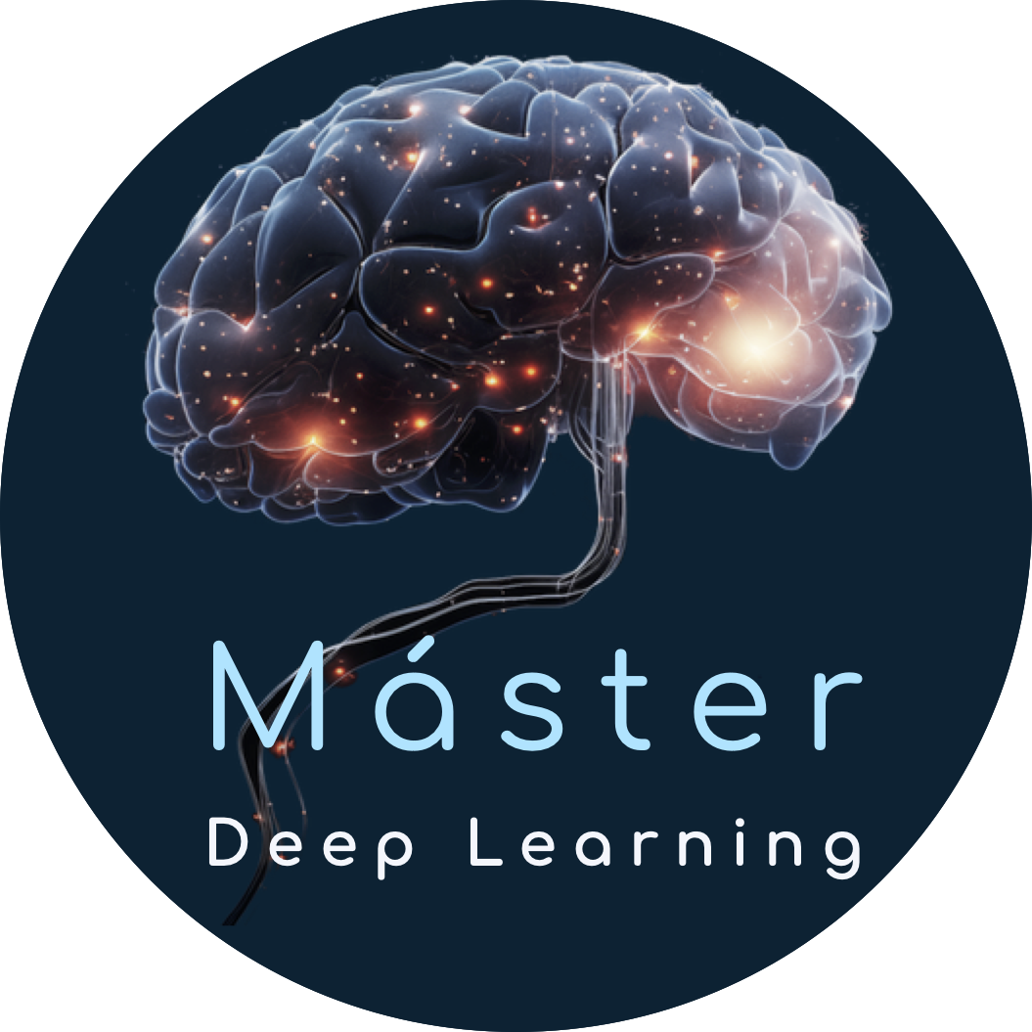


Deep Learning para series temporales
Part II
Preprocessing and Analysis

Slide 2
Proffessors
Víctor Rodríguez Fernández victor.rfernandez@upm.es
María Inmaculada Santamaría Valenzuela mi.santamaria@upm.es

Slide 3
Contents
Part I: Introduction
Why am I here?
Part II: Preprocessing and analysis
ETL + First observations
Part III: Classification
Labelling time series
Part IV: Segmentation & Clustering
Identifying long-term behaviours
Part V: Forecasting
Predicting the future
Part VI: Other Deep Learning tasks
What more can we do?

Slide 4
Prepocessing
Preprocess the data

Slide 5
ETL → EATL
Extract + Transform + Load
Extract + Analyze + Transform + Load
.csv
.txt
PandasDataset
Analyze
.tsf
Transform as needed
Load to our database

Slide 6
To be continued…
Questions? mi.santamaria@upm.es

Slide 7
Deep Learning para series temporales
Part II
Preprocessing

