Slide 1
EMPLOYEE ABSENTEESIM DATA ANALYSIS ML-2 MINI PROJECT (Clustering)
1
Presented by NICHITA PAL
Mentored by KOMILLA BHATIA

Slide 2
PROBLEM STATEMENT & OBJECTIVE
Employees are being absent during working hours and affecting the department's progress.
Identifying reasons why employees are being absent.

Slide 3
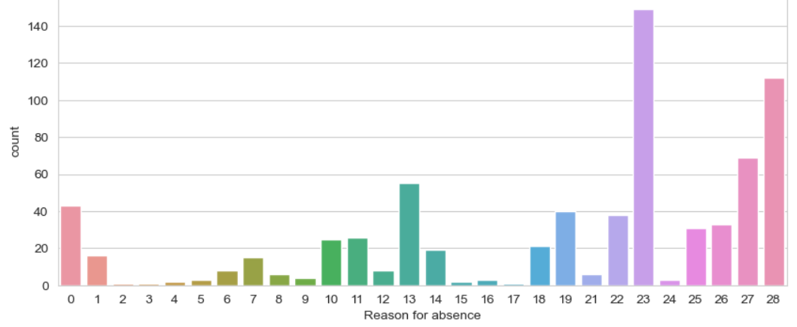
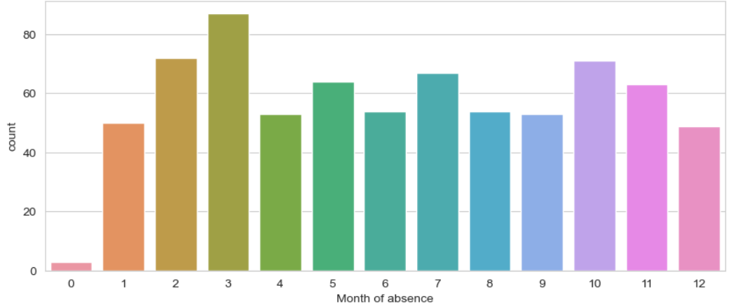
Analyzing the main reason of absence of the employees
The reason of most of the employees to be absent are non-ICD. i.e., medical consultation (23), physiotherapy (27), dental consultation (28).
Most absenteeism is reported in the season of Spring which is the month of March.

Slide 4
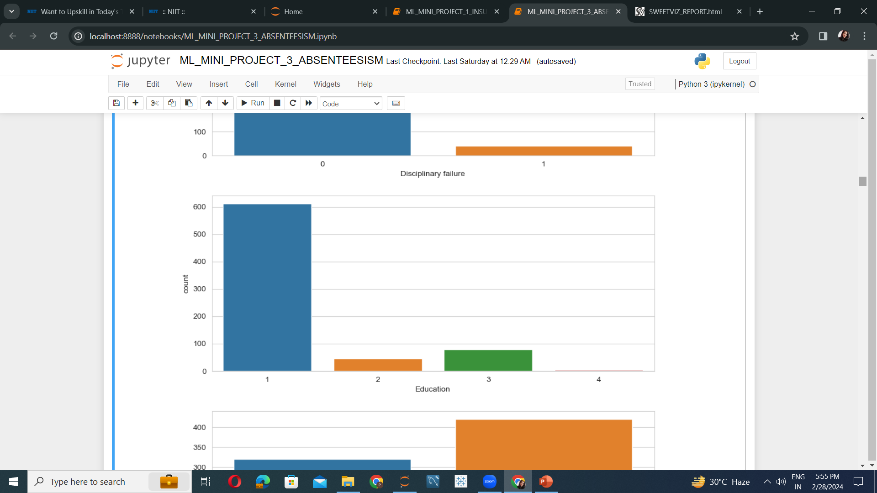
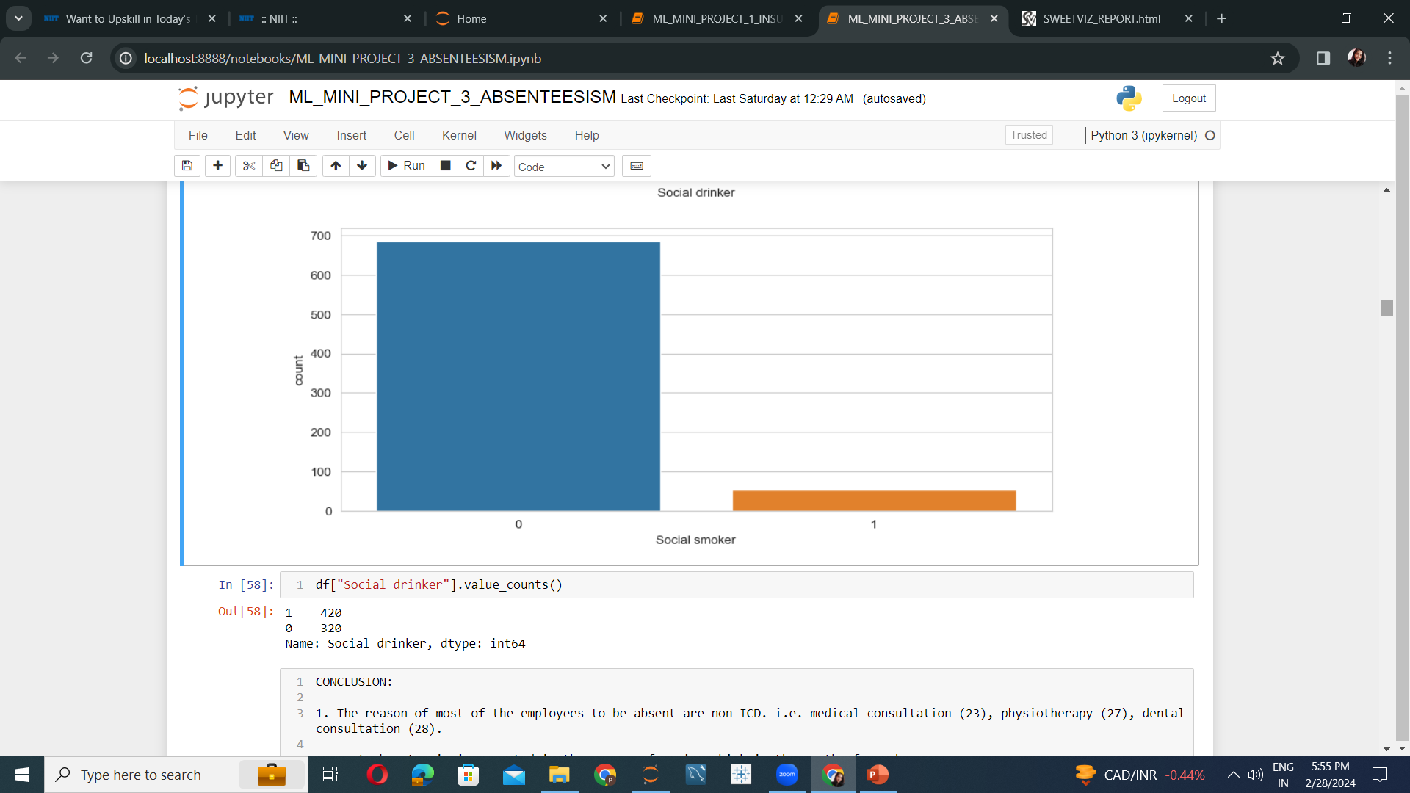
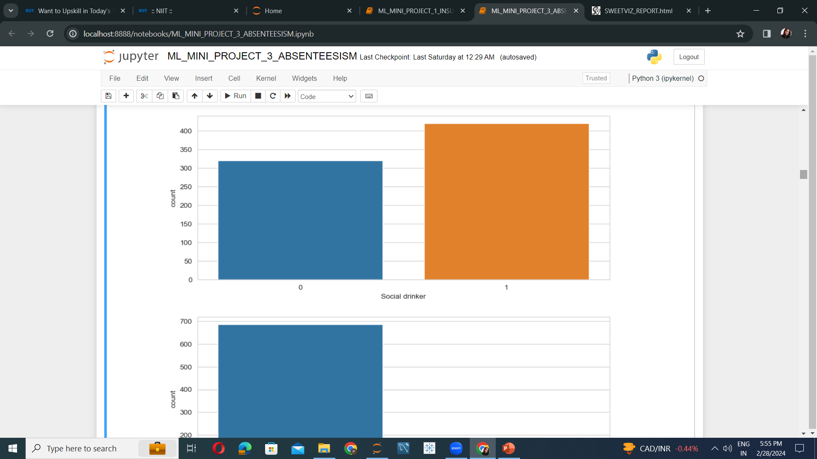
Analyzing the educational qualification as well as the smoking and drinking habits of the employees.
Most absenteeism is reported by people with high school education.
More than 50% of the absentees drink alcohol.
More than 50% of the absentees are nonsmokers.

Slide 5
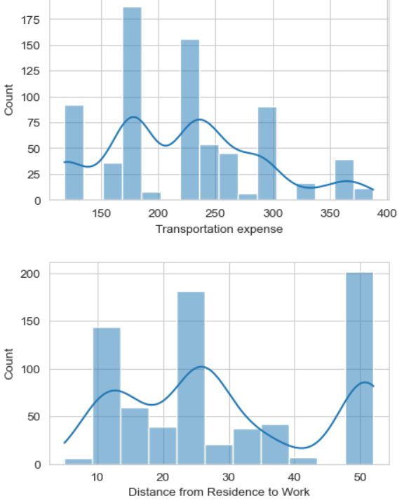
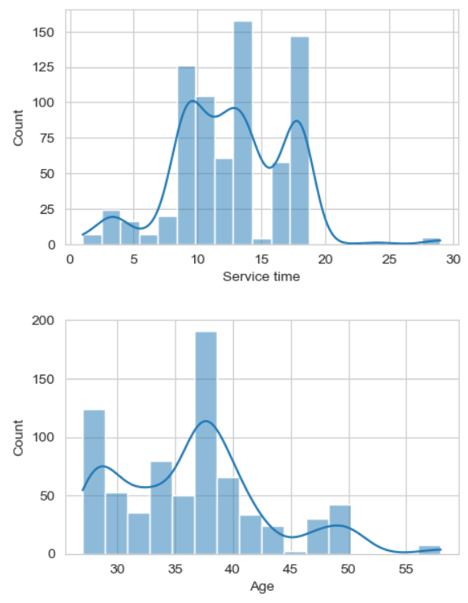
Analyzing the transportation expense, service time, Distance between residence and workplace and Age of the employees.
Transportation expense of most of the employees are between 150 & 200.
Portrait of a team member
Service time of most of the employees vary between 10 to 20 hours.
Distance between residence and workplace is mainly 10, 25 and 50.
Age of employees are mainly between 35 to 40.

Slide 6
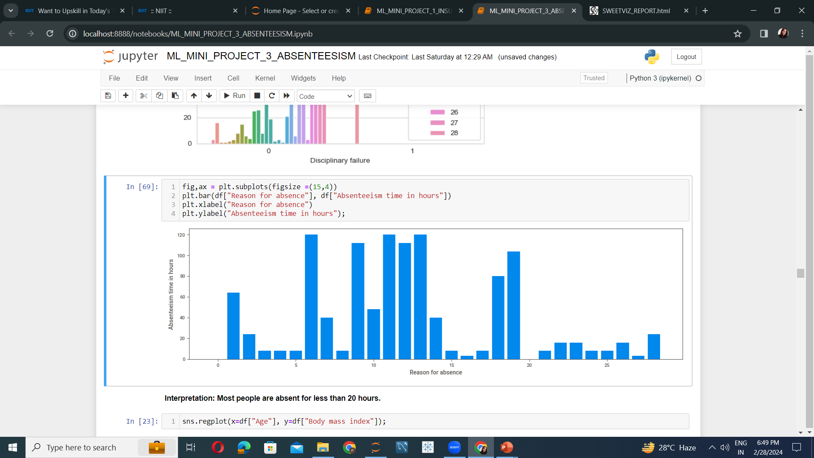
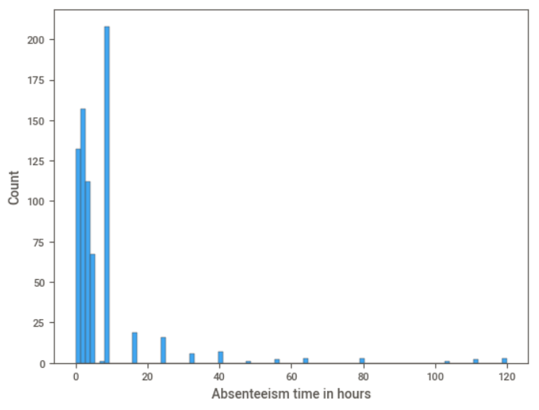
Analyzing the reason for absence with respect to the time of absenteeism along with the distribution of it.
Most people are absent for less than 20 hours.

Slide 7
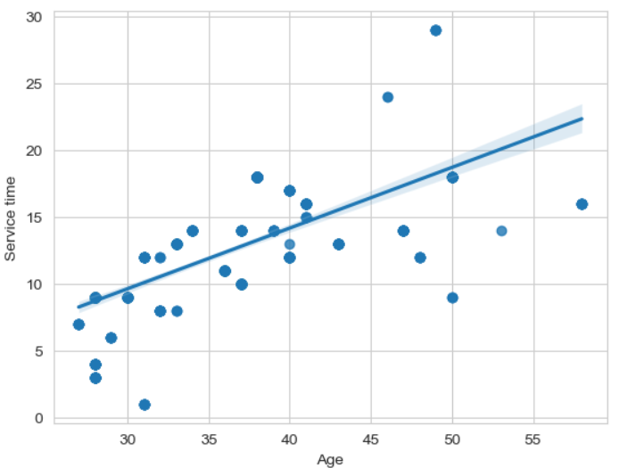
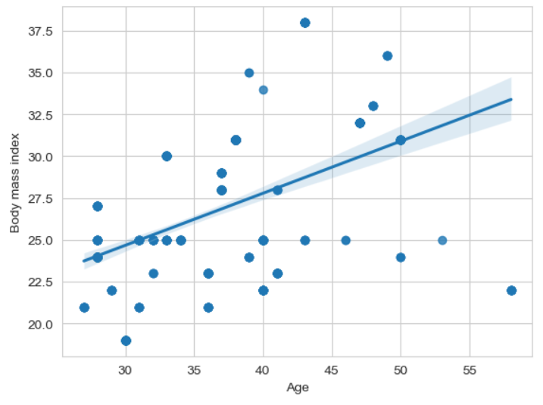
Analyzing the Age with respect to the service time and body mass index of the employees.
The service time of the customers increase with the age of customers.
The body mass index also increases with increase in age of customers.

Slide 8
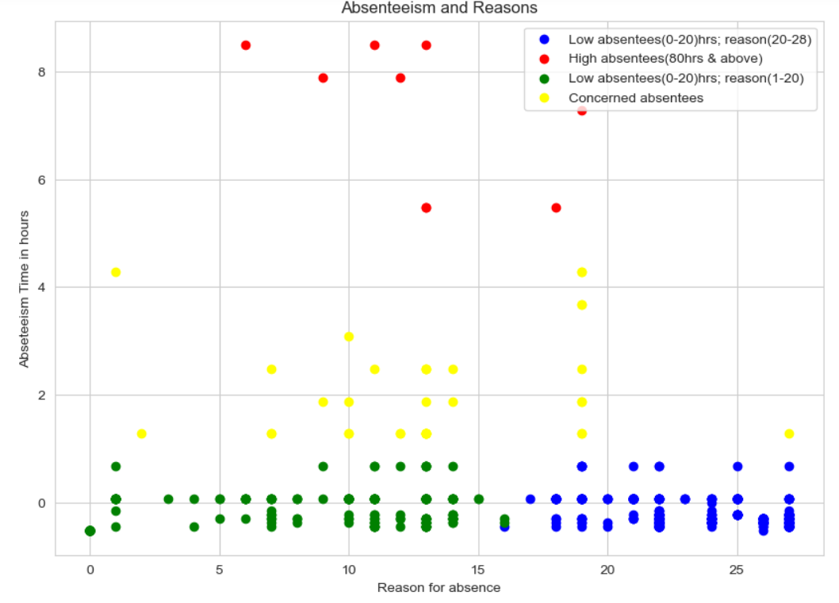
Categorizing Absentees
Red zone: Warn/Fire to reduce absenteeism.
Yellow zone: Ask for proper proof and genuine reason for absence. Get leave approved beforehand.
Green zone & Blue zone: Conduct awareness program along with reward and appreciation.

Slide 9
Algorithms & Comparisons
Algorithm | Interpretation
KMeans Clustering: Silhouette score is 40% | Properly segregated clusters. Good performance
DBSCAN: Silhouette score is 33% | Irregular and non differentiable clusters. Poor performance.

Slide 10
Conclusion
Business Decision
People with higher BMI tend to be absent for longer durations.
People are mainly targeting medical consultation, physiotherapy, dental consultation as their reasons to be absent.
Social smokers are also noticed to be absent for long durations.
Aged people are also among those who are more often away from work.
The company should restrict the timing of break in between working hours.
Ask for genuine reasons and proofs in case of emergency or medical consultation.
Conduct some fitness fun activity once a week to encourage fitness.
Provide work from home facility for those who live far away.

Slide 11
THANK YOU

