Slide 1

Movie Rental Data Analysis
SQL CAPSTONE PROJECT
Exploratory Data Analysis
Presented by Nichita Pal
Mentored by Komilla Bhatia
Notes:
To change the image on this slide, select the picture and delete it. Then click the Pictures icon in the placeholder to insert your own image.

Slide 2
Project Introduction
Dataset name: Movie On Rent ( A chain of movie rental stores operating in a certain country. It has a vast collection of movies in DVD and Blue Ray disc formats. )
Areas of analyzation:
1. What kind of movies are most often rented
2. Which genres they belong to
3. Which actors appeared in them.
Objective: To help the management stock up the inventory as per audience's preferences for improved business.

Slide 3
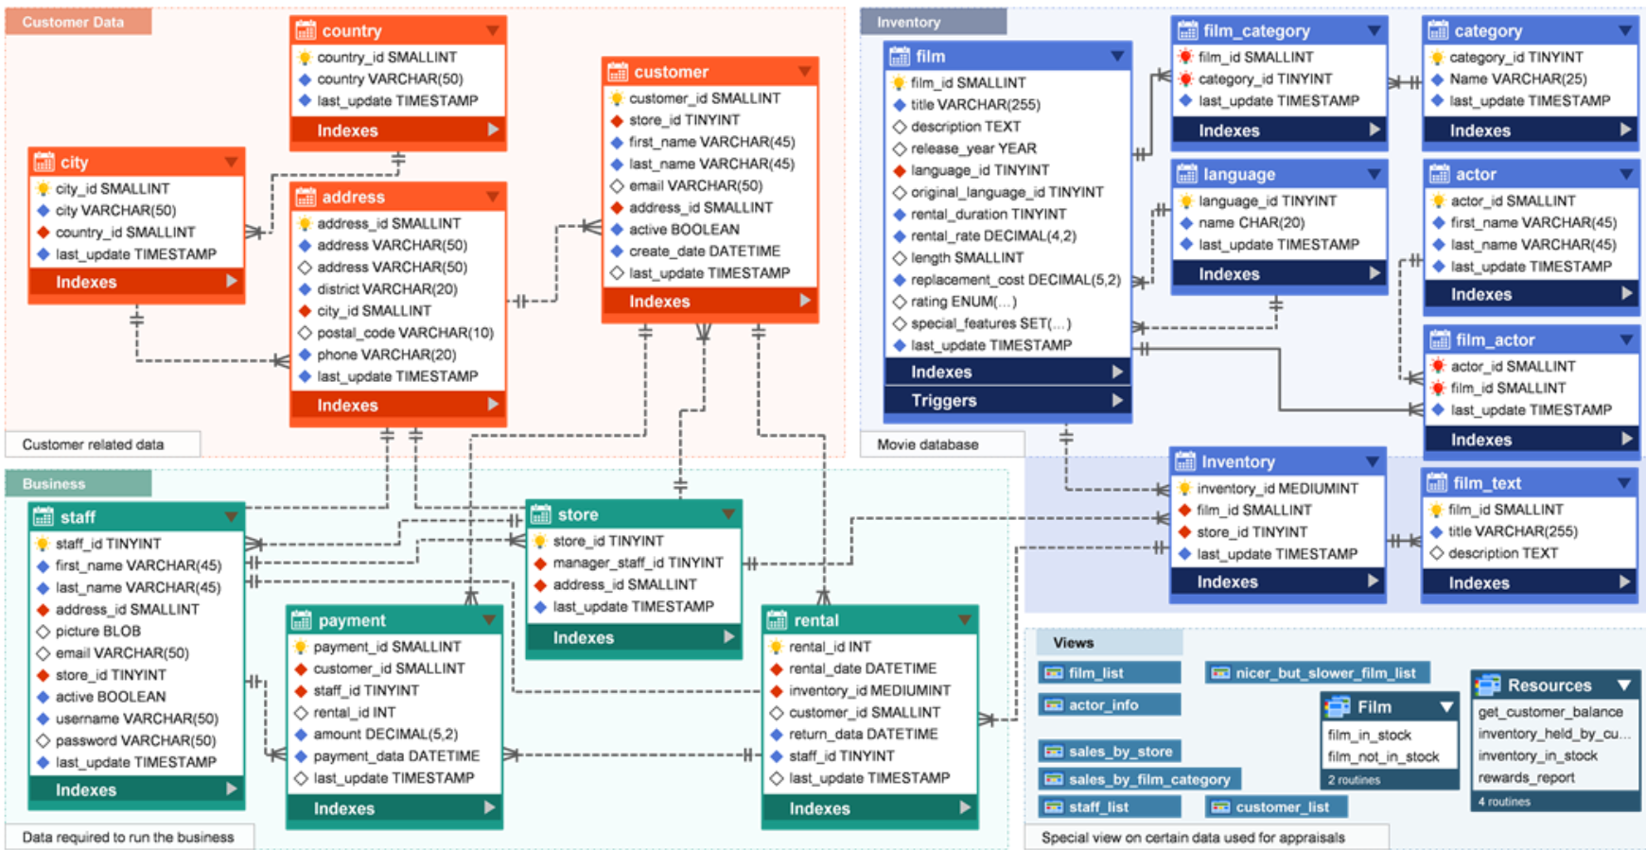
Description of Dataset
Movie On Rent is the data of a movie rental store that contains documents as Film specifications, Rental details, customer credentials etc. The above visual shows the connection between different tables.

Slide 4
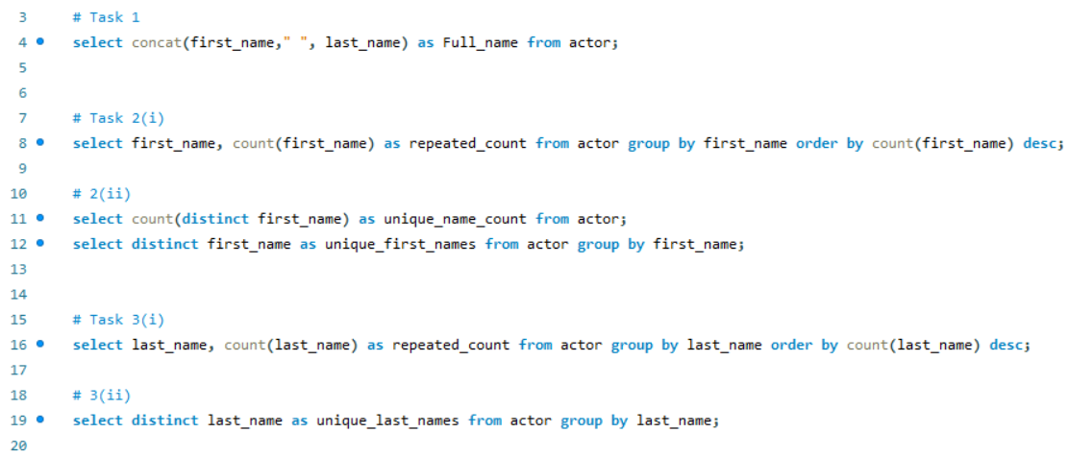
Retrieving names from the table
Function used: concat, count
Keyword used: select, from, distinct, group by, order by, desc

Slide 5
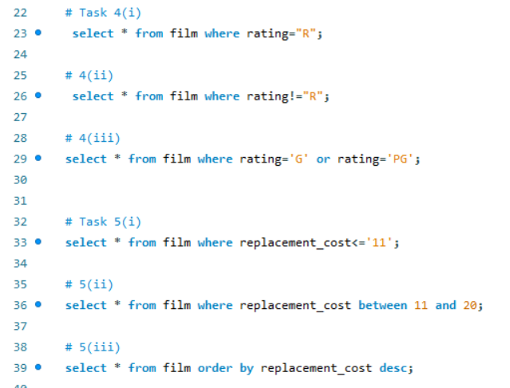
Retrieving data with specific conditions from the table
Functions used: None
Keywords used: or, and, between
Clause used: where

Slide 6
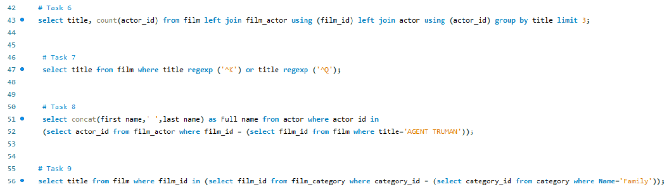
Using joins and subqueries to retrieve data from different tables
Functions used: count
Keywords used: left join, using, limit, regexp, as, in

Slide 7
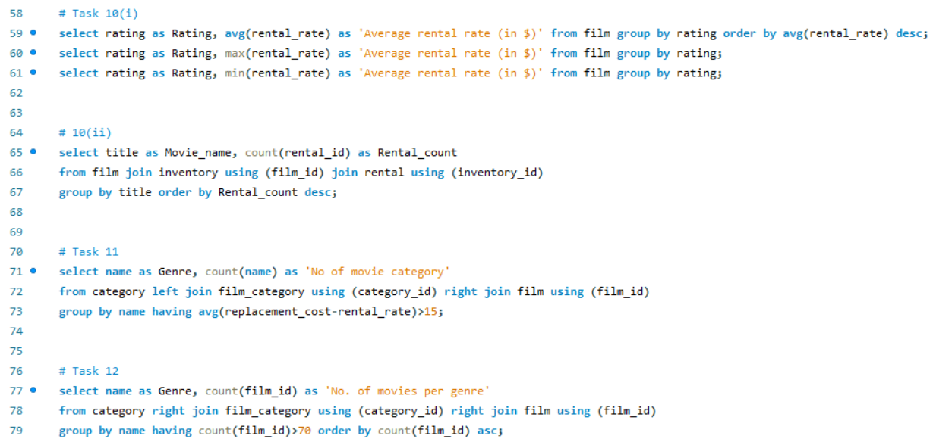
Using aggregate functions along with joins and subqueries to retrieve data from different tables
Functions used: max, min, avg, count
Keywords used: join, order by, group by, having, asc, desc,

Slide 8
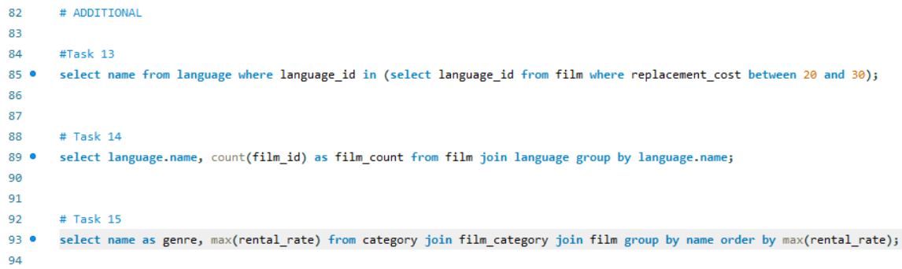
Additional points of analysis
Functions used: max, count
Keywords used: join, order by, group by, between, etc.,

Slide 9

THANK YOU

