Slide 1
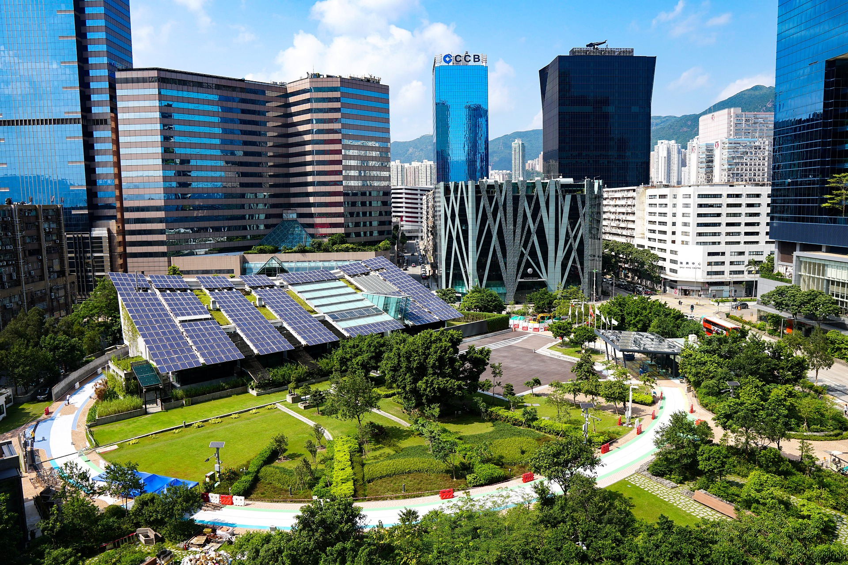
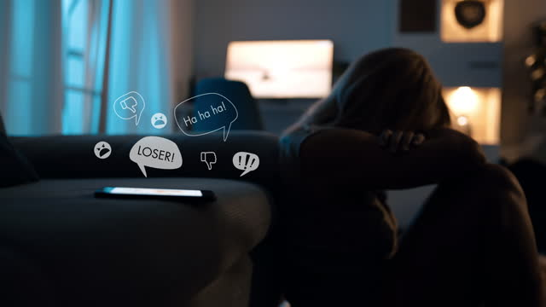

Paper Title:
"Machine & Deep Learning Algorithms for Bengali
Cyberbullying Detection"
University:
Department of Computer Science and Engineering,
Ahsanullah University of Science & Technology.
Group Members:
Misbahul Sheikh (20200204039)
Naushin Mamun (20200204010)
Nafisa Tasnim Neha (20200204020)
Date: 00/00/2024
Notes:
https://pixabay.com/en/achievement-agreement-business-3481967/

Slide 2
Outline
Introduction
03
Literature Review
04 - 05
Dataset Analysis
06
Methodology
07-08
Result Analysis
09
Conclusion And Future Works
10
References
11
Notes:
https://pixabay.com/en/books-science-shelf-library-book-408220/

Slide 3

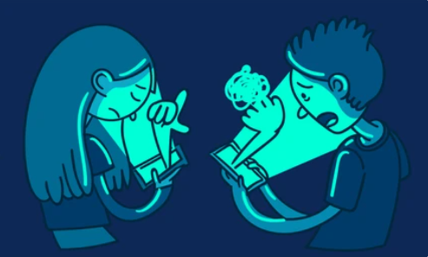
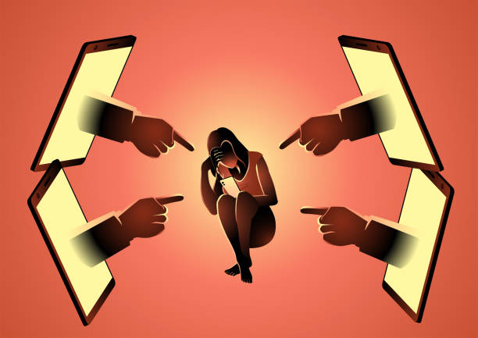
Introduction
Bullying causes immediate or long-term harm through physical, verbal, emotional, and social aggression.
Cyberbullying involves anonymous psychological harassment via technology and is hard to control.
In Bangladesh, increased internet use has led to more online harassment of women, especially on Facebook.
Machine and Deep learning models as well as Transformer based models are very effective to detect cyberbullying in multiple languages, including Bengali.

Slide 4
Literature Review
Paper 1
Reynolds et al. collected data from Formspring.me, a Q&A website.
The dataset was labeled using Amazon Mechanical Turk.
Weka tool was used for training and classifying bullying texts.
Achieved 78.5% accuracy with the C4.5 algorithm and an instance-based learner.
Paper 2
Hani et al. explored supervised ML for detecting cyberbullying patterns.
Neural Network outperformed SVM in abusive text classification.
Neural Network achieved 92.8% accuracy, while SVM achieved 90.3% accuracy.
Paper 3
Used ML and Bangla-BERT models for detecting cyberbullying on social media.
Used TF-IDF with Naive Bayes (NB), SVM, Random Forest (RF), and XGBoost.
ML models achieved similar accuracy scores between 76% and 79%.
BERT significantly improved performance, achieving 90% accuracy.
SVM was the second-best with 79% accuracy, and NB had the lowest at 76% accuracy.
Notes:
https://pixabay.com/en/thumbs-up-okay-good-well-done-2056022/

Slide 5
Literature Review
Paper 4
Dalvi et al. investigated software-based detection of abusive tweets.
Used SVM and Naive Bayes (NB) algorithms.
SVM achieved 71.25% accuracy in identifying bullied texts.
NB achieved 52.70% accuracy in identifying bullied texts.
Paper 5
Saha et al. analyzed text sentiments from Twitter using VADER and BERT.
Surveyed 5 different ML algorithms for detection accuracy.
Achieved 92% accuracy using BERT.
Paper 6
Emon et al. utilized deep learning and machine learning to identify abusive texts.
Collected Bengali comments from social media, blogs, and newspapers.
Found that Recurrent Neural Networks (RNN) outperformed other ML algorithms with an accuracy of 82.20%.
Proposed a new stemming technique for the Bengali language.
Notes:
https://pixabay.com/en/thumbs-up-okay-good-well-done-2056022/

Slide 6

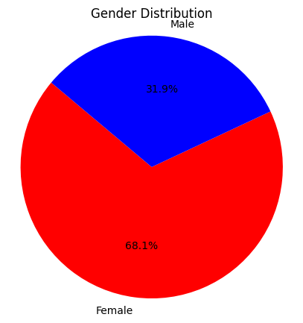
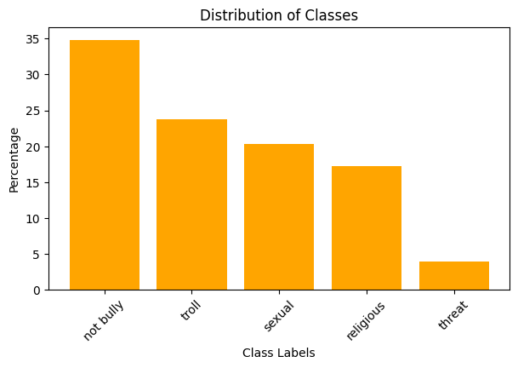
Dataset Analysis
Not bully – 34.86 %
Troll – 23.73 %
Sexual – 20.29 %
Religious – 17.22 %
Threat – 3.85 %
Img1: Gender Comment Distribution
Img2: Distribution of Classes
Notes:
https://pixabay.com/en/office-neo-urban-apple-trend-1500461/

Slide 7

Methodology
Preprocessing
Tokenization
Removing
1. Digits
2. Web links
3. Punctuation
4. Symbols
5. Non-Bengali letters
6. Stop words
Lemmatization
Feature extraction
TF-IDF
UNI-gram
BI-gram
TRI-gram
Word2Vec
GloVe
FastText
Class conversion
Dataset
ML Models
KNN
LR
RF
Performance
Accuracy
Precision
Recall
F1-score
LSTM
CNN
Bangla-Bert
Comparison
Graph
Img3: Proposed Model
Notes:
https://pixabay.com/en/office-neo-urban-apple-trend-1500461/

Slide 8

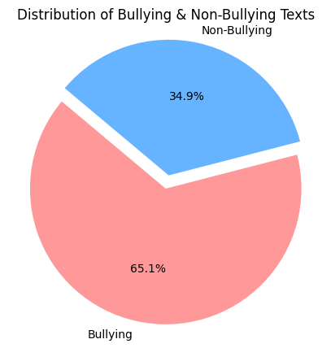
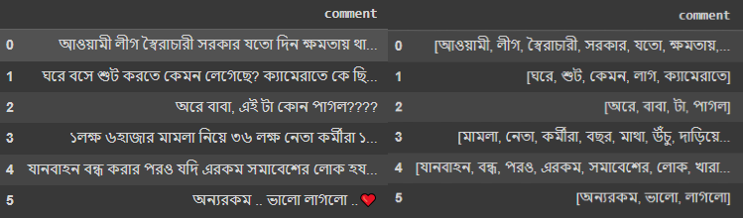
Methodology
Img4: Preprocessed Text
Img5: After Converting Binary Class to Multiclass
Notes:
https://pixabay.com/en/office-neo-urban-apple-trend-1500461/

Slide 9
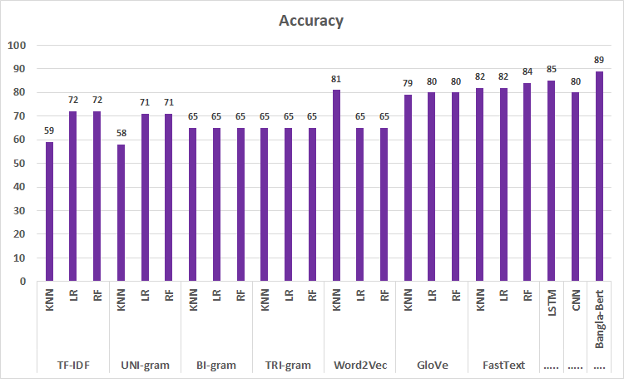
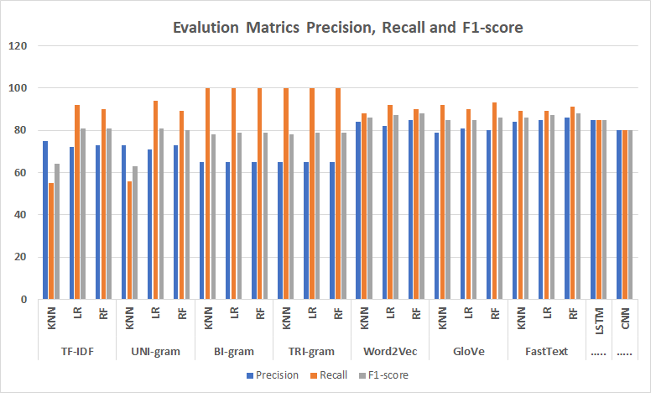
Result Analysis
Bangla-BERT worked best compared to other algorithms and achieved an accuracy of 89%.
RF with the FastText embedding technique performed better with an accuracy of 84%.
LSTM gives better results than CNN and other ML models with an accuracy of 85%.
BI-gram and TRI-gram techniques provide almost the same results.
Notes:
https://pixabay.com/en/thumbs-up-okay-good-well-done-2056022/

Slide 10
Conclusion And Future Works
Bangla-BERT model achieved 89% accuracy in Bengali cyberbullying detection.
Random Forest with FastText and LSTM models also performed well.
Future work should expand the dataset for more diversity.
Explore additional state-of-the-art transformer models.
Develop real-time detection and integrate multilingual capabilities with user feedback.
Notes:
https://pixabay.com/en/thumbs-up-okay-good-well-done-2056022/

Slide 11
References
[1] K. Reynolds, A. Kontostathis, and L. Edwards, “Using machine learning to detect cyberbullying,” in Proceedings - 10th International Conference on Machine Learning and Applications, ICMLA 2011, 2011, vol. 2, pp. 241–244, doi: 10.1109/ICMLA.2011.152.
[2] J. Hani, M. Nashaat, M. Ahmed, Z. Emad, E. Amer, and A. Mohammed, “Social media cyberbullying detection using machine learning,” Int. J. Adv. Comput. Sci. Appl., vol. 10, no. 5, pp. 703–707, 2019, doi: 10.14569/ijacsa.2019.0100587.
[3] Subrata Saha, Md. Shamimul Islam, Md. Mahbub Alam, Md. Motinur Rahman, Md. Ziaul Hasan Majumder, Md. Shah Alam and M. Khalid Hossain, “Bengali Cyberbullying Detection in Social Media Using Machine Learning Algorithms,” 2023 5th International Conference on Sustainable Technologies for Industry 5.0 (STI), 979-8-3503-9431-3/23/$31.00 ©2023 IEEE, DOI: 10.1109/STI59863.2023.10464740.
[4] R. R. Dalvi et al., “Detecting A Twitter Cyberbullying Using Machine Learning,” Proc. Int. Conf. Intell. Comput. Control Syst. ICICCS 2020, pp. 297–301, May 2020, doi: 10.1109/ICICCS48265.2020.9120893.
[5] S. Saha, M. I. H. Showrov, M. M. Rahman, and M. Z. H. Majumder, “VADER vs. BERT: A Comparative Performance Analysis for Sentiment on Coronavirus Outbreak,” 2023, pp. 371–385, doi: 10.1007/978-3-031-34619-4 30/COVER.
[6] E. A. Emon, S. Rahman, J. Banarjee, A. K. Das, and T. Mittra, “A Deep Learning Approach to Detect Abusive Bengali Text,” Jun. 2019, doi: 10.1109/ICSCC.2019.8843606.
Notes:
https://pixabay.com/en/thumbs-up-okay-good-well-done-2056022/

Slide 12

Thank you..
Notes:
https://pixabay.com/en/question-mark-labyrinth-lost-maze-2648236/

Slide 13
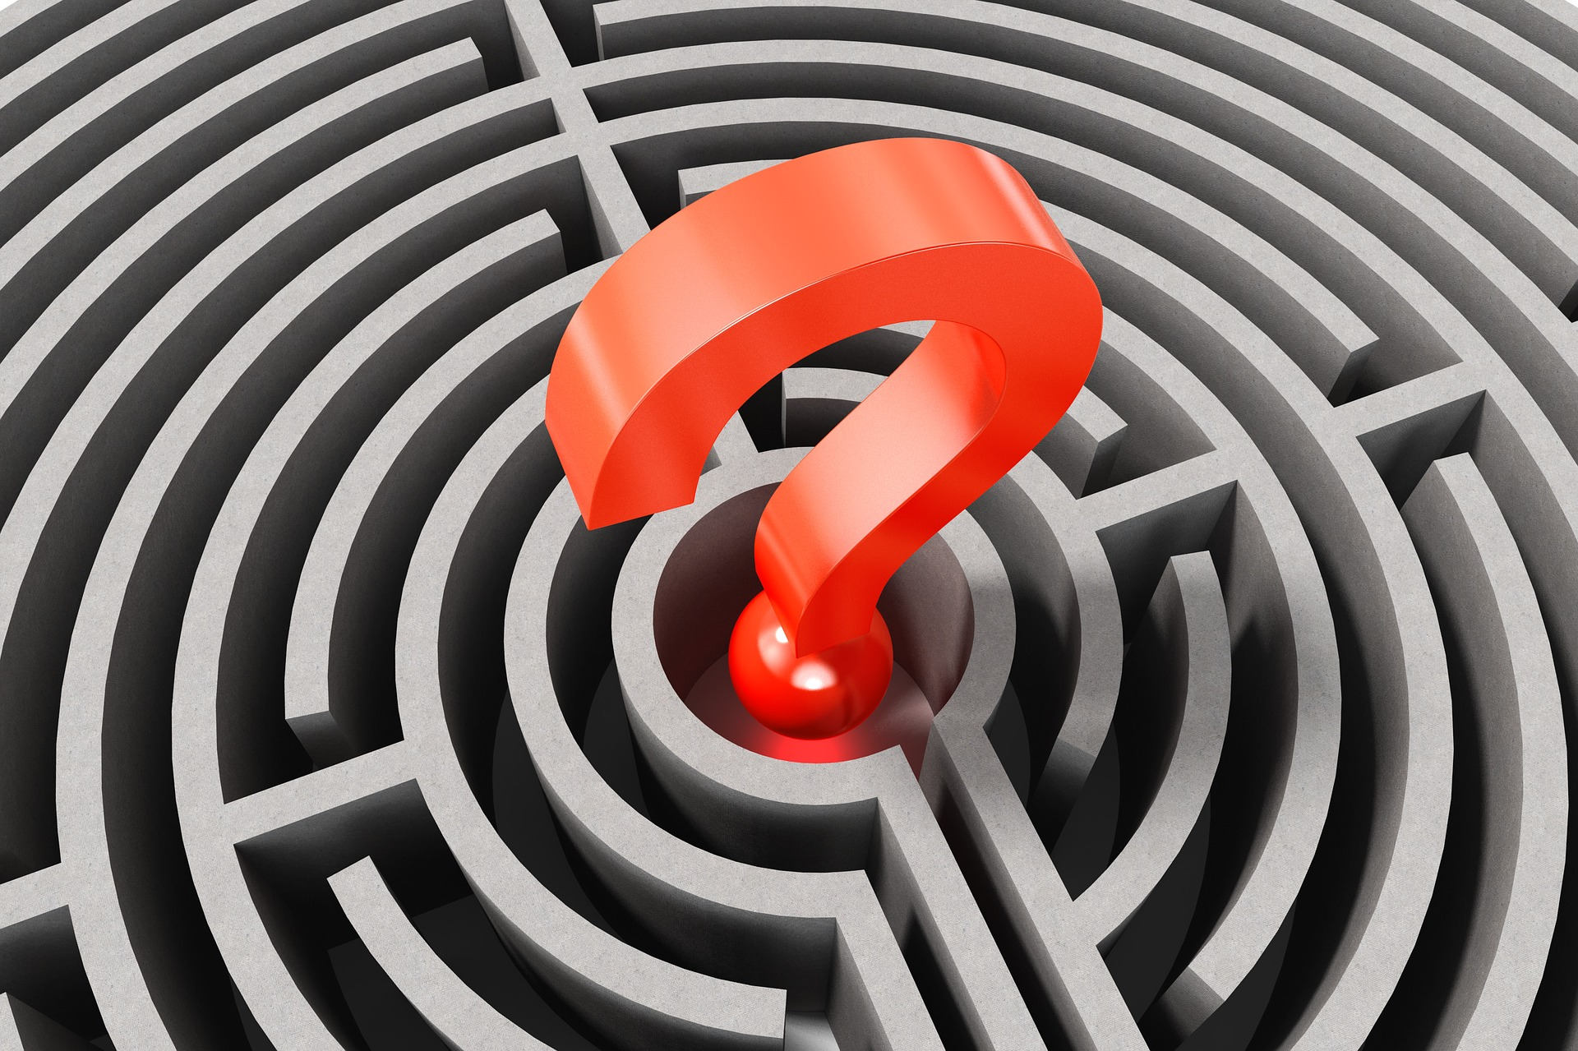

Questions
Do you have any questions?
Please ask..
Notes:
https://pixabay.com/en/question-mark-labyrinth-lost-maze-2648236/

