Slide 1
Spark Concepts: Operations and Partitions
Misbah Uddin
2021-05-08

Slide 2


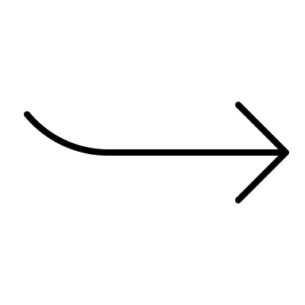
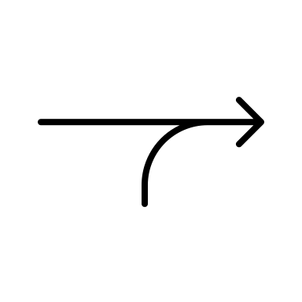
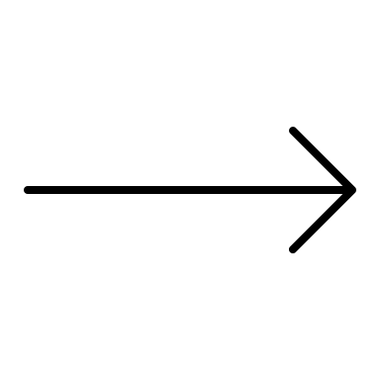
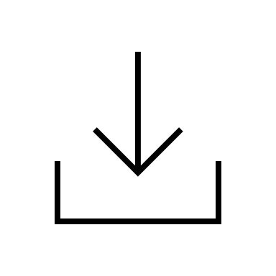
Logos
PySpark
transformation
wide transformation
narrow transformation
action

Slide 3
PySpark DataFrame
id | name | gender | age
1111 | simon jones | male | 32
2222 | joan hurt | female | 21

Slide 4
PySpark Transformation
id | name | gender | age
1111 | simon jones | male | 32
2222 | joan hurt | female | 21
id | name | gender | age | group
1111 | simon jones | male | 32 | 3
2222 | joan hurt | female | 21 | 2

Slide 5
Spark Action
id | name | gender | age
1111 | simon jones | male | 32
2222 | joan hurt | female | 21
2

Slide 6
Lazy vs Narrow Transformations
partition₁
partition₁
partition₁
partition₁
partition₂
partition₂
partition₂
partition₂
partition_{n}
partition_{n}
partition_{n}
partition_{n}
parent
RDD
child
RDD
parent
RDD
child
RDD

