Slide 1
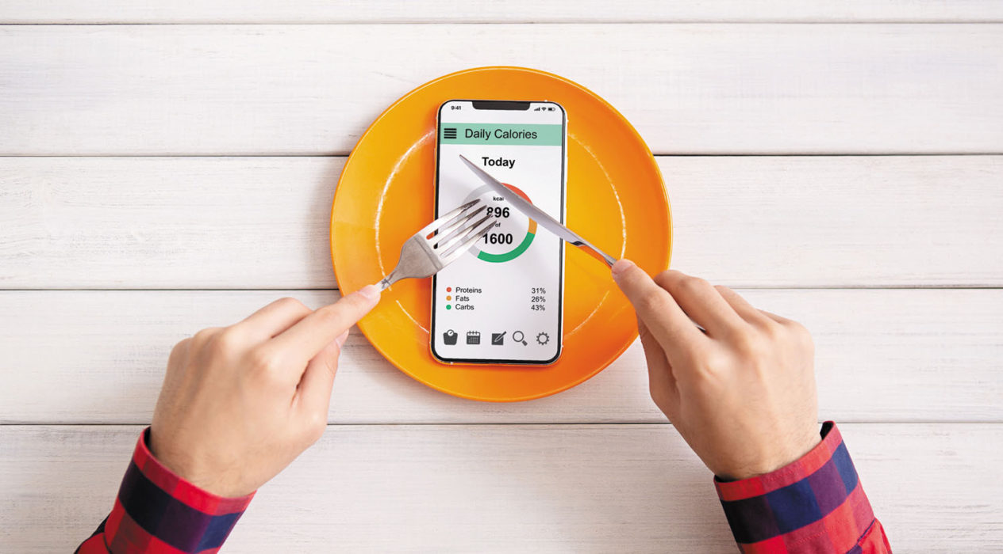
HEALTH MANAGEMENT APP
A Nice GUI-based Web Application for Daily Health Monitoring
AUTHORS: MISBAH ZAHREEN &
SREEDEVI KARTHA

Slide 2

INTRODUCTION
A Smart Daily Health Monitoring Tool
What It Does?
      Tracks calories, water, and nutrients
      Shows progress with bars & rings
      Saves logs automatically
      Updates instantly

Slide 3



MOTIVATION

Slide 4
UPDATE VISUALS
SAVE JSON
START
LOAD CSV
UPDATE TOTALS
END
FLOWCHART
RENAME COLUMNS
USER ACTION
LOAD JSON LOG
INITIALISE UI

Slide 5
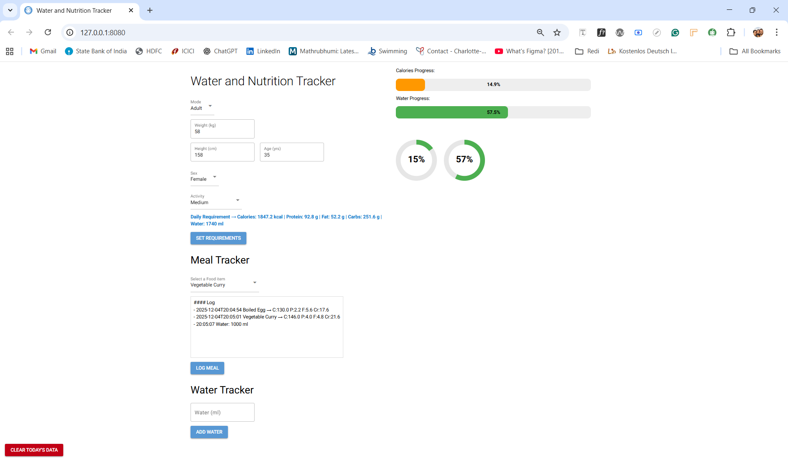

Slide 6
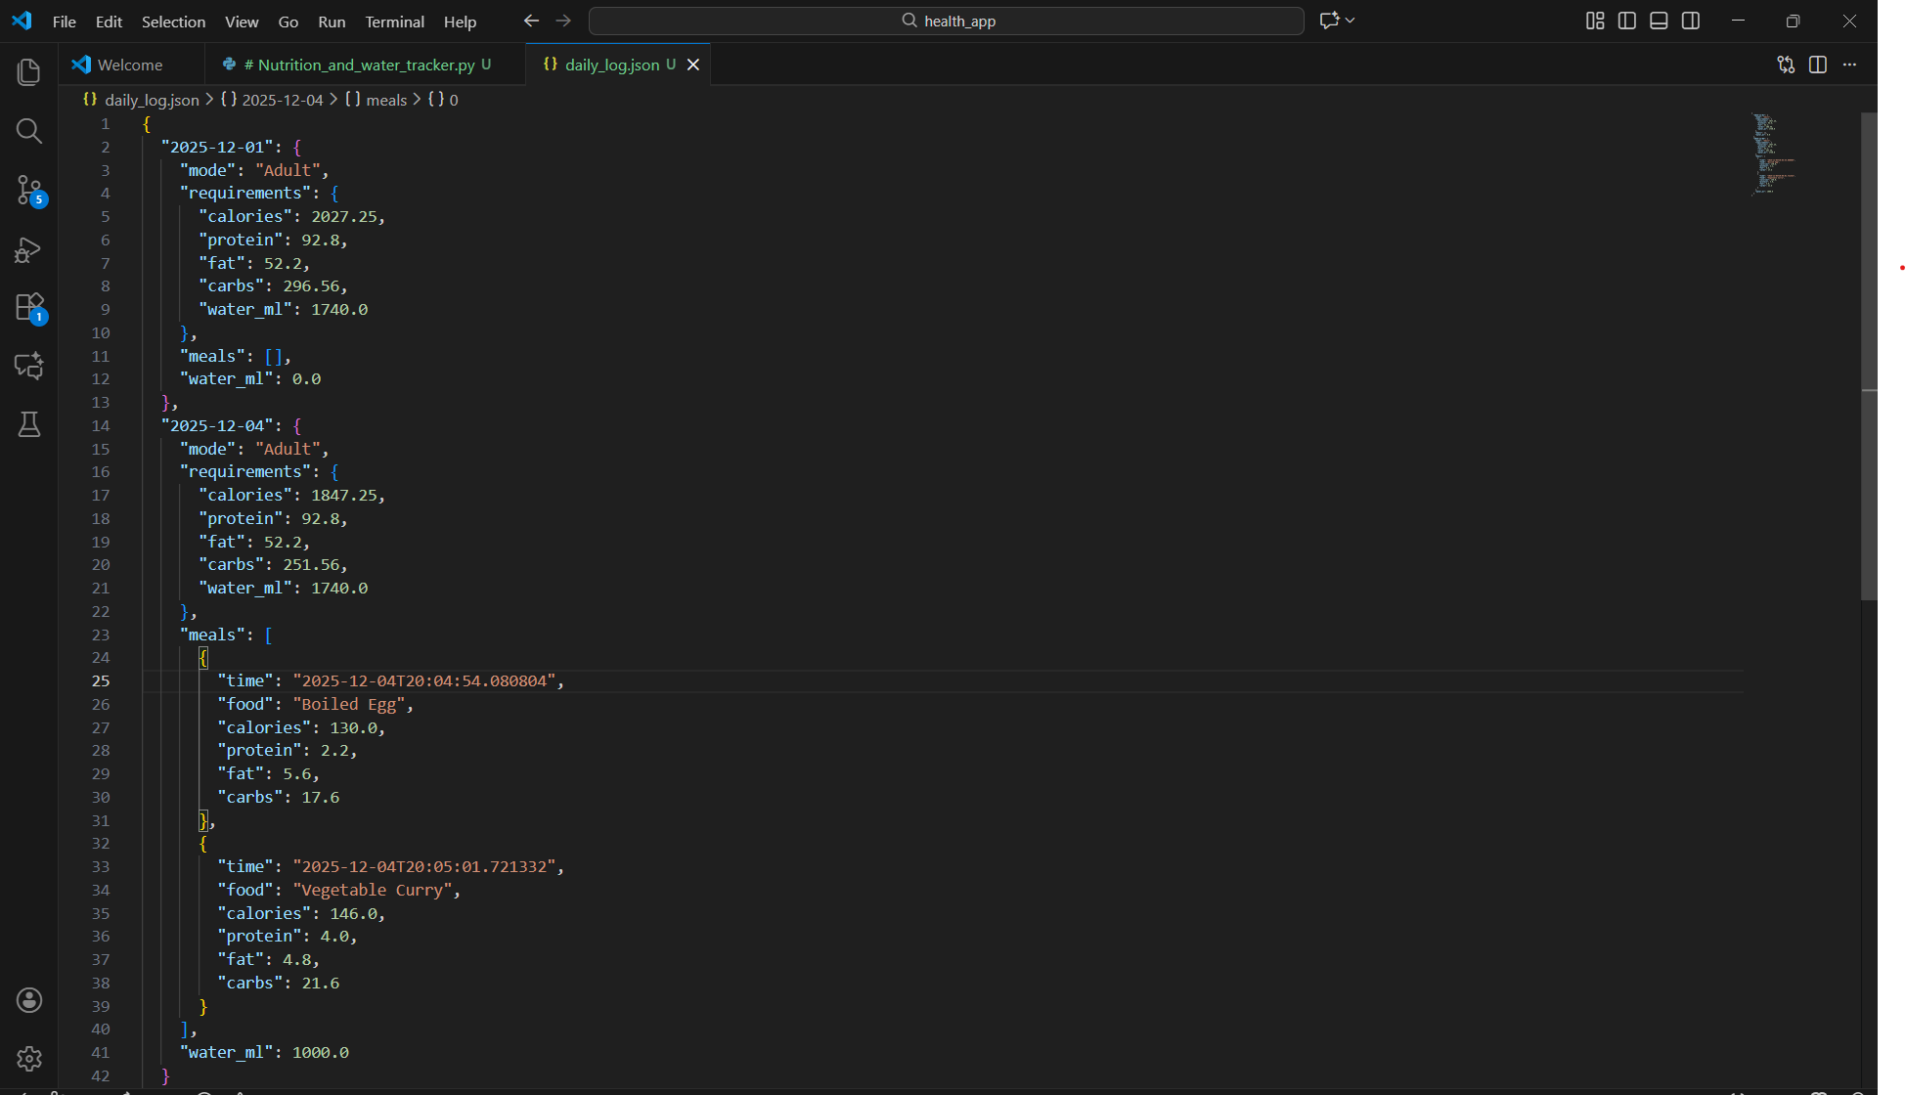

Slide 7
FUTURE ENHANCEMENTS
Weekly or monthly charts
Export data to PDF or CSV
Notifications for hydration
Food database integration
AI-based meal suggestions

Slide 8
CONCLUSION
The Water & Nutrition Tracker offers an easy, visual, and effective way to monitor everyday health.
A simple interface, real-time updates, and flexible design make it suitable for both toddlers and adults.

