Slide 1

Galactico – Intelligent Project Tracking & CI/CD Automation
Streamlining teamwork, commits, and deployments with smart integration

Slide 2
Our Team
Name | ID
MD. Habibullah Misba | 011221373
Syed Mahiul Ahsan | 011221021
Rakibul Hasan | 0112330362
Rabab Bin Karim | 011221227
Mahathir Mohammad | 0112230889

Slide 3
Project Overview
Integrated Platform
Unified Management
Web-based platform for team-based project tracking, integrated with GitHub.
Manages tasks, commits, and contributions in one centralized place.
Automated CI/CD
VS Code Extension
Automates CI/CD pipeline generation for every new project.
Provides a VS Code extension for one-click commit, push, and branch handling.

Slide 4






Core Features
Team Management
Project Management
Add, remove, and assign members with role-based access.
Create, track, and update multiple projects per team.
VS Code Extension
Commit Approval
Automates git add, commit, and push with custom formats.
Team leads approve/reject commits before merge.
Kanban Board
Contribution Tracking
Visual task tracking and progress monitoring.
Measure each member’s contributions in real-time.

Slide 5
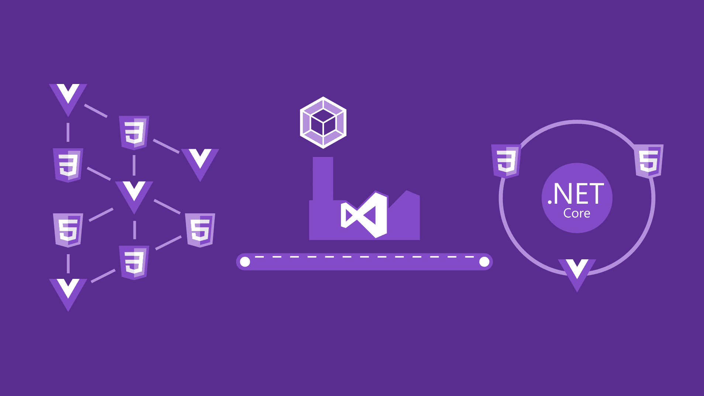
VS Code Extension Features
The AutoTrack VS Code extension simplifies Git operations:
It also enhances in-editor visibility:
Displays task list, timers, and contribution status inside VS Code.
One-click add, commit, push without manual commands.
Automates commit format.
Pushes branches for review instead of direct main merges, preventing conflicts.
Asks for branch name to avoid main branch conflicts.

Slide 6
CI/CD Pipeline Automation
Auto-Generation
Auto-generates GitHub Actions CI/CD workflow files for every project.
Default Support
Supports Java Spring Boot + MySQL builds by default.
Automated Deployment
Runs tests, builds artifacts, and deploys automatically after approval.
Customization
Can be customized per project based on environment needs.
Continuous Flow
Enables continuous integration and continuous deployment without manual setup.

Slide 7
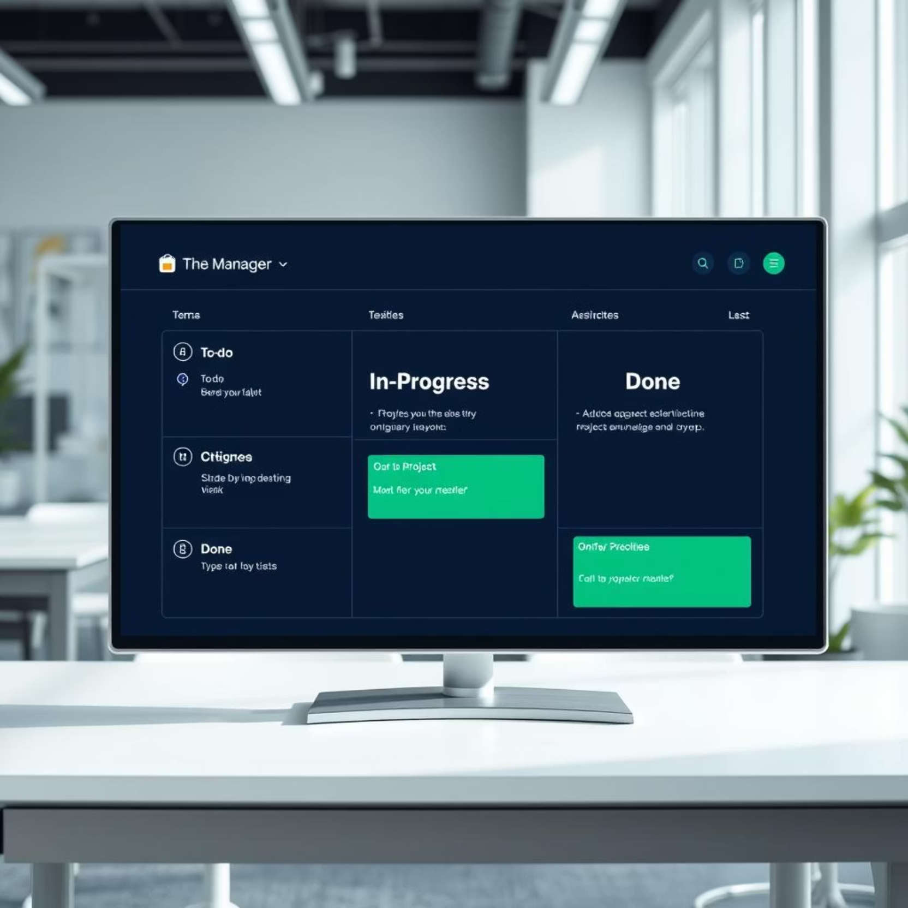
Kanban Board
The Kanban board provides a visual representation of tasks, enhancing project oversight:
Visual representation of To-Do, In Progress, Bug, Review and Done tasks.
Drag-and-drop functionality for easy task updates.
Time tracking for each task to monitor effort.
Integrated with contribution logs for comprehensive performance evaluation.

Slide 8

Commit Approval Workflow
Push to Local Branch
Push to GitHub
Review & Approval
Merge & Record Points

Slide 9
Contribution Tracking inside Galactico
Number of Commits
Merged Branches
Approved Work
Tracks all individual code submissions.
Monitors successful branch merges.
Records all work approved by team leads.
Task Completion
Integrates with task completion percentages.
All contribution logs are available for current and past projects, offering comprehensive performance data.

Slide 10

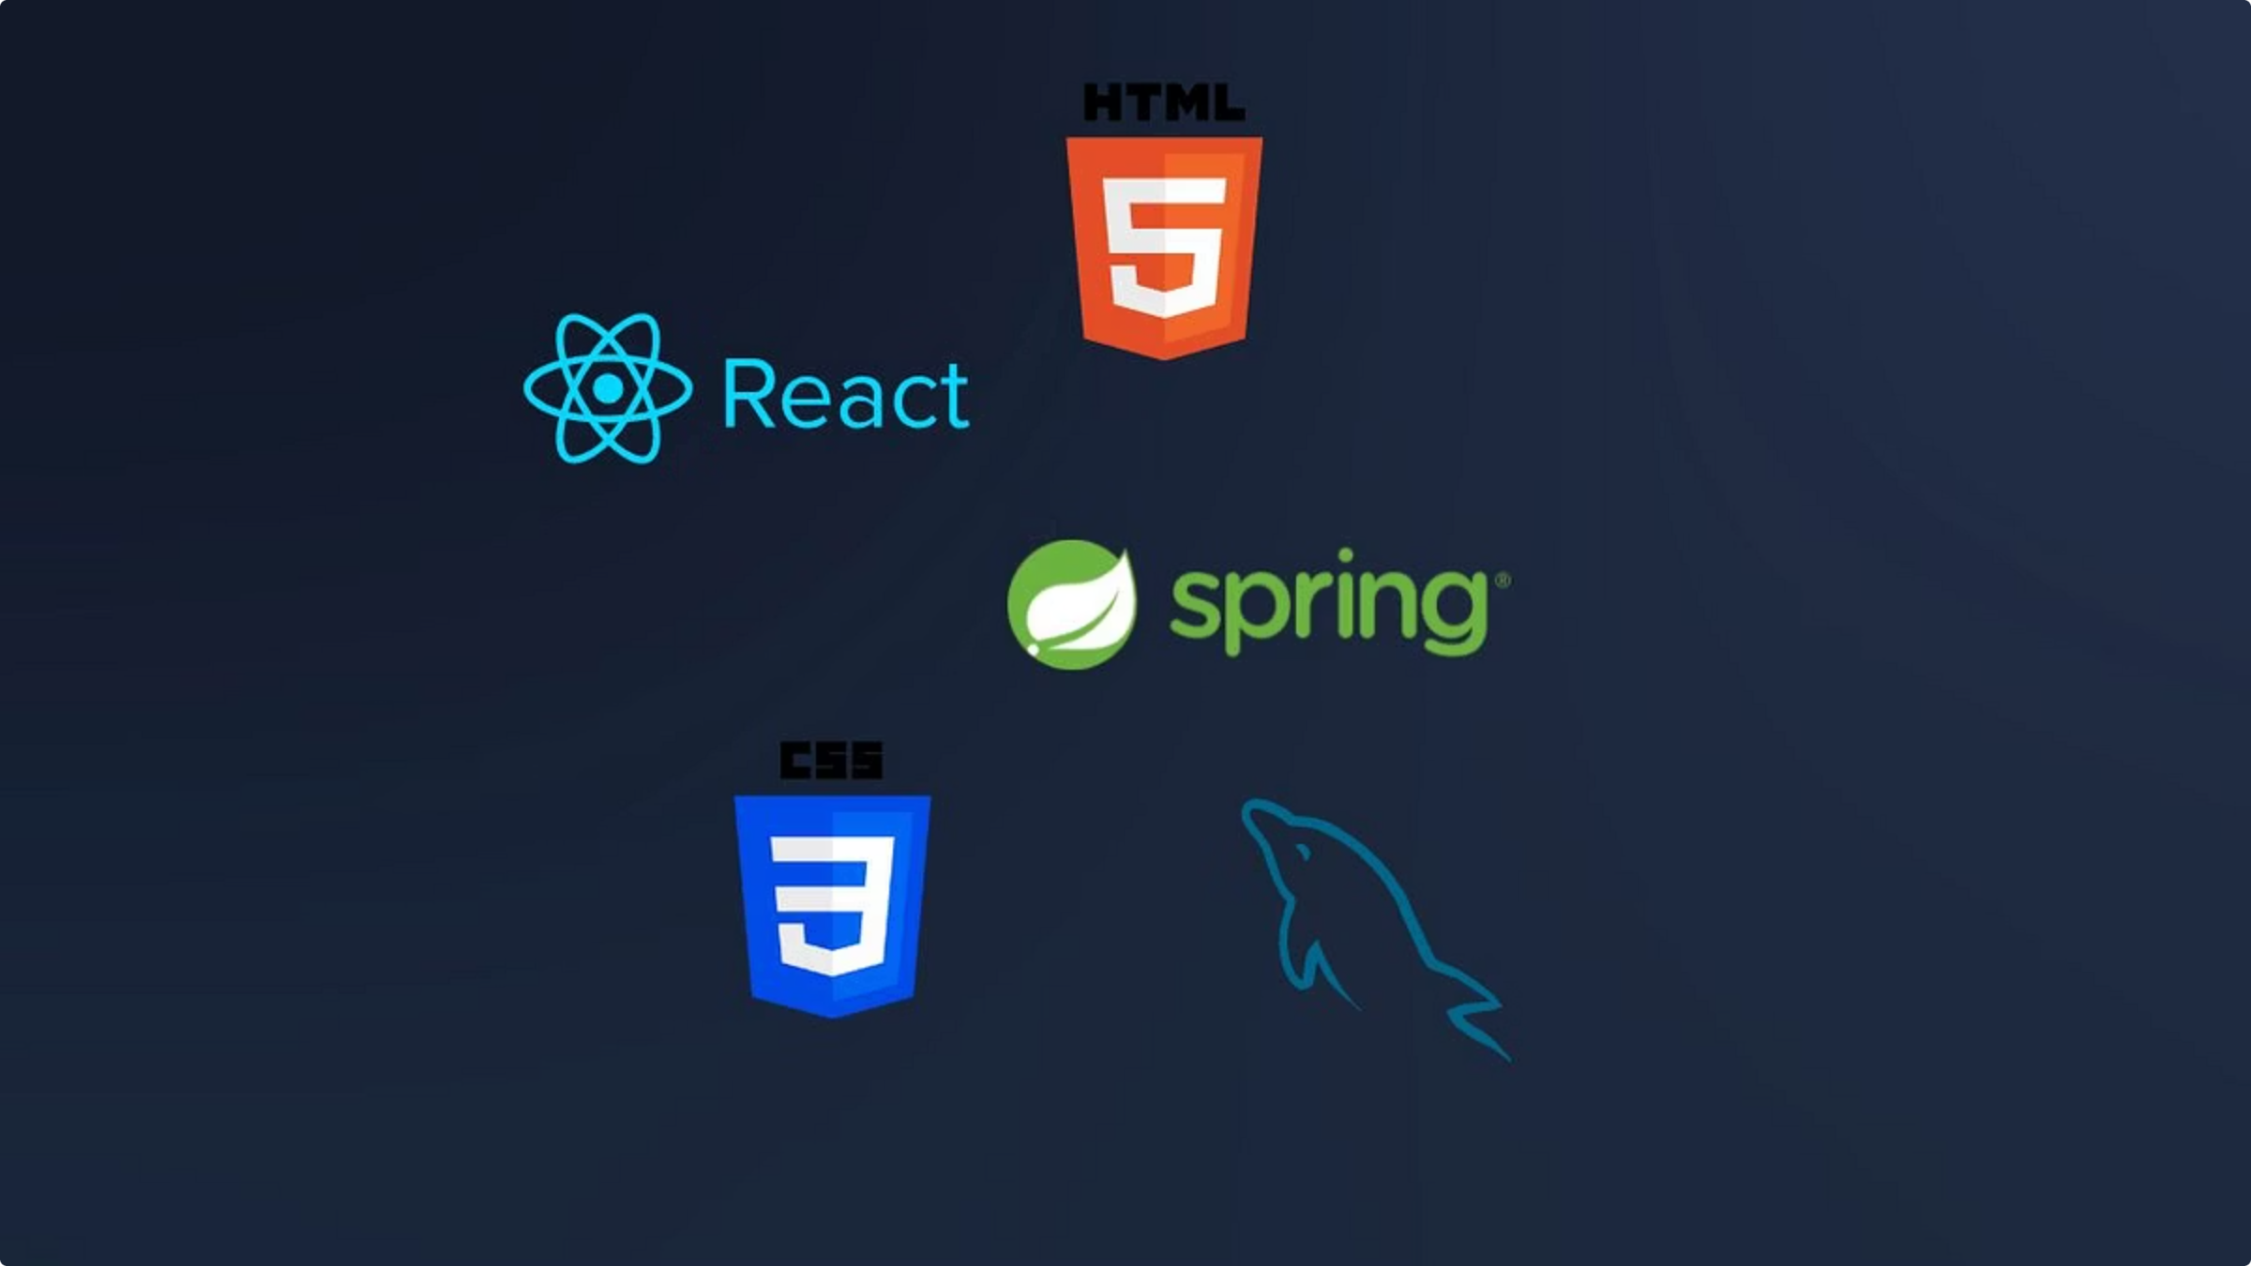
Tech Stack
Backend & Database
Frontend & Integration
Extensions
VS Code: Custom extension for automation
Backend: Java Spring Boot
Frontend: React (optional) or HTML and integrated dashboard in VS Code extension
Database: MySQL
Integration: GitHub API, GitHub Actions, Webhooks

Slide 11
Development Plan (From Scratch)
01
02
03
Setup Core Infrastructure
User Authentication
Database Schema
Setup Spring Boot backend & MySQL database.
Build user authentication (with GitHub OAuth).
Create database schema for users, tasks, commits, projects.
04
05
06
GitHub Integration
Commit Approval Module
CI/CD Generator
Integrate GitHub API for contributor management & listening.
Develop commit approval module.
Build CI/CD generator for GitHub Actions.
07
08
09
Kanban & Tracker
VS Code Extension
Testing & Deployment
Create Kanban board & contribution tracker.
Develop VS Code extension for Git automation.
Final testing and deployment of the platform.

Slide 12





Team & Roles
Our dedicated team brings diverse expertise to ensure Galactico's successful development and deployment:
Backend Developer
GitHub Integration & CI/CD Specialist
VS Code Extension Developer
Drives core backend development, APIs for team, project, and task management, GitHub OAuth, and MySQL database integration.
Manages GitHub API integration, develops auto CI/CD workflow generation, and handles all webhook processing for commits and merges.
Builds the VS Code extension for Git automation, integrating with backend APIs to display tasks and contribution stats in-editor.
Frontend Developer
QA & Integration Engineer
Develops the web dashboard for team and project oversight, including the interactive Kanban board and real-time status displays.
Ensures smooth integration across all modules, performs comprehensive testing, documents APIs and usage, and manages deployment.

Slide 13
Development Plan (Phased Approach)
Our development strategy is divided into six distinct phases, ensuring structured and efficient progression towards a fully functional Galactico platform.
Phase 1: Planning & Setup (Week 1–2)
Phase 5: Web Dashboard & Kanban Board (Week 9–10)
Team: All Members
Team: Frontend Developer, QA & Integration Engineer
Frontend Developer: Build web dashboard (team/project/task management); create Kanban with drag-and-drop;
display approvals, leaderboard, CI/CD status.
Define requirements & architecture.
Finalize tech stack: Spring Boot, MySQL, GitHub API, VS Code, Web.
QA & Integration Engineer: Test backend APIs & frontend integration; identify issues.
Create GitHub repos for all components.
Set up CI/CD for Galactico.
Phase 2: Core Backend & Database (Week 3–4)
Phase 6: Final Integration, Testing & Deployment (Week 11–12)
Team: Backend Developer, GitHub Integration
Team: All Members
Backend Lead: Build Spring Boot, implement core APIs (users, teams, projects, tasks), set up MySQL, basic auth.
Merge all components into a unified system.
GitHub Integration: Develop GitHub OAuth, create API for repos/commits/PRs, store commits.
Deploy backend & frontend to production.
Conduct final end-to-end testing with real GitHub repos.
Prepare final presentation and documentation.
Phase 3: GitHub Webhooks & Commit Approval (Week 5–6)
Team: GitHub Integration, Backend, VS Code Extension
GitHub Integration: Implement webhook listener; store pending commits.
Backend: Create commit approval API; update DB status.
VS Code Extension: Show pending approvals; add Approve/Reject buttons; trigger GitHub merge on approval.
Phase 4: CI/CD Auto Generator & VS Code Extension Core (Week 7–8)
Team: CI/CD Specialist, Extension Developer
CI/CD Specialist: Create dynamic CI/CD YAML generator; push workflow files to project repos.
Extension Developer: Automate add→commit→push; show tasks, due time, and contribution stats in sidebar; sync
with backend.

Slide 14
Thank You
We appreciate your time and interest in Galactico. If you have any further questions, please don't hesitate to reach out.

