Slide 1


Transform your
Customer Conversations with ChatGPT
powered by

Slide 2
Generative AI Market Evolution
Generative AI …
Fastest growing service in tech history: ChatGPT reached 100 Mio. Users in 2 months, 1.3 bln revenue in first year (IDC projects GenAI services to grow by 73% CAGR until 2027)*
Reaches human-level performance on a number of tasks and tests
Very fast evolution of capabilities (multi-modal, use of plug-ins, growth of parameters and context lengths, prompting strategies, addition of memory)
Cloud “giants” Microsoft, Google and AWS but also Meta and SaaS provider are heavily investing into GenAI
Seen by leading analysts (McKinsey, Gartner) as potentially more impactful than tech waves such as Internet, Mobile and Cloud
…transforms Customer Interaction
High volume of relatively low complexity conversations strongly benefit from GenAI automation
Large data (historic communications, documents) available (e. G. website) allows for easy implementation
Perfect leverage of the conversational capabilities of GenAI “Chat”...
Already 15% of enterprises are using GenAI to support their customer interaction according to ISG**
Gartner sees a potential of 20-30% productivity improvement in customer-facing functions through GenAI by 2026***
*IDC https://www.idc.com/getdoc.jsp?containerId=prUS51310423
**ISG https://isg-one.com/articles/state-of-applied-generative-ai-market-report
*** Gartner: https://www.gartner.com/en/newsroom/press-releases/2023-08-03-customer-service-and-support-leaders-should-assess-generative-ai-technology-options-to-enhance-their-organizations-function

Slide 3
Challenges in Customer Functions
Do not reply email addresses are used
Limited opening hours for customer contact
No or limited offer of email channel
Direct contact availability for client not given or only after passing through complex list of questions/answers
Long waiting times/drop offs in contact center
Long waiting times when handing over chat to human agent
Long response time for email
Use of IVR
Use of “first generation” scripted bot
Lot of effort goes into the complex maintenance of Intent-based bots
Poor customer ratings on reachability/customer support
Limited (re-)use of information from client interaction
Inconsistent handling of client interactions depending on the agent (skills)
Client sentiment not constantly measured
Limited capture of client satisfaction/feedback
Significant number of interactions not monitored, not transparent (direct calls, direct emails)
Many organizations today show various indicators of inefficiencies and lack of quality in client communications

Slide 4
Enterprisebot Functionality
Data Sourcing
Connect data
Automated creation and maintenance of data connections to various source systems.
Index data
Creating and maintaining high quality index for superior information retrieval.
Search data
Search and retrieve information and document links/position
Dialogue Manage-ment
Manage workflow
Create and maintain workflows for intent-based communications with no-code environment
Create Natural Dialogue
Manage and maintain the dialogue over GenAI platform
Communicate over E-Mail
Convert the dialogue contents into e-mail format and manage integration
Enable and automate a powerful natural language client dialogue using all available enter-prise contents and contin-uously evolve quality and data sources
Communicate over Chat
Convert the dialogue contents into chat format and manage integration
Communicate over Phone
Convert the dialogue contents into phone format and manage integration
Oper-ation Support
Monitor and report
Store and automatically evaluate and report on client conversations
Secure data
Provide mechanism for compliant and secure data handling
Opti-mization
Train dialogue
Train the model based on client and employee feedback for continuous quality improvement
Evolve content
Identify content quality improvement opportunities and manage

Slide 5


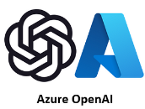
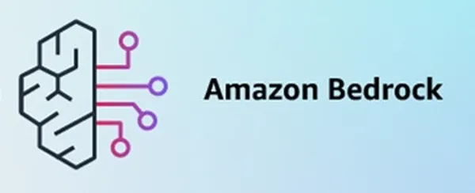
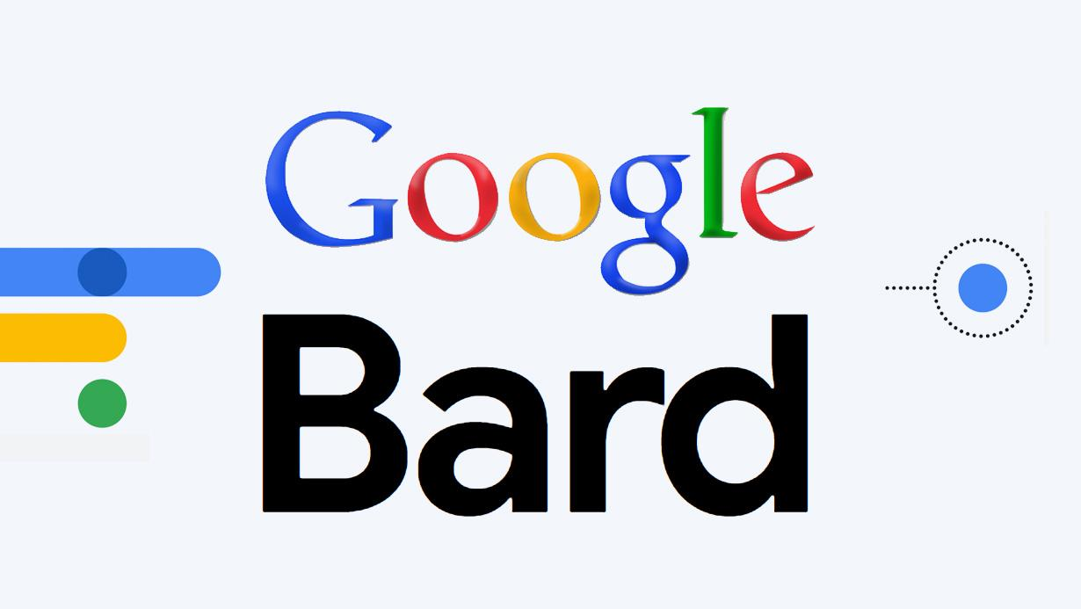
Enterprisebot Technical Architecture
Data
Connectors
Blitzico Workflow Manager
Chat
Web Server
Slack
Database
(Rest API)
Teams
SAP
FB Messenger
ServiceNow
Web-Site Chat
Doc-Brain
Data Management
Generative AI Interface Service
Whats-App
Salesforce
UI Path
Mail
Outlook
Microsoft 365 - Mail
Google Mail
Microsoft 365 - SharePoint
Generative AI Model
Wiki
Phone
Avaya
Jira
Genesys
Other
Teams
Doc-Brain is patent pending proprietary technology fully automating data loading, indexing and management
Various data connectors available
Blitzico enables no-code workflow configuration and integration of intent-based and intentless steps/procedures
Flexible in terms of use of generative AI model, including the use of a private dedicated model
Hosted on Google Cloud Platform in Switzerland or Ireland
Shared or dedicated instance available

Slide 6








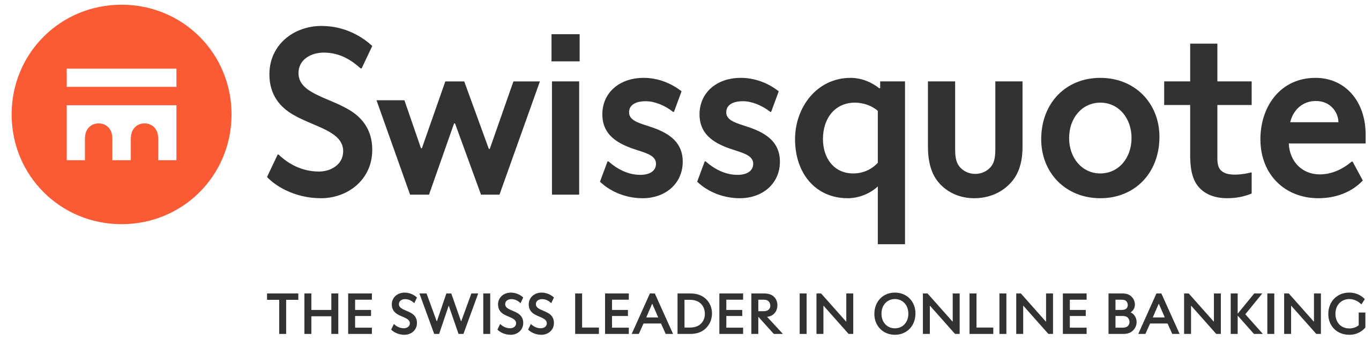







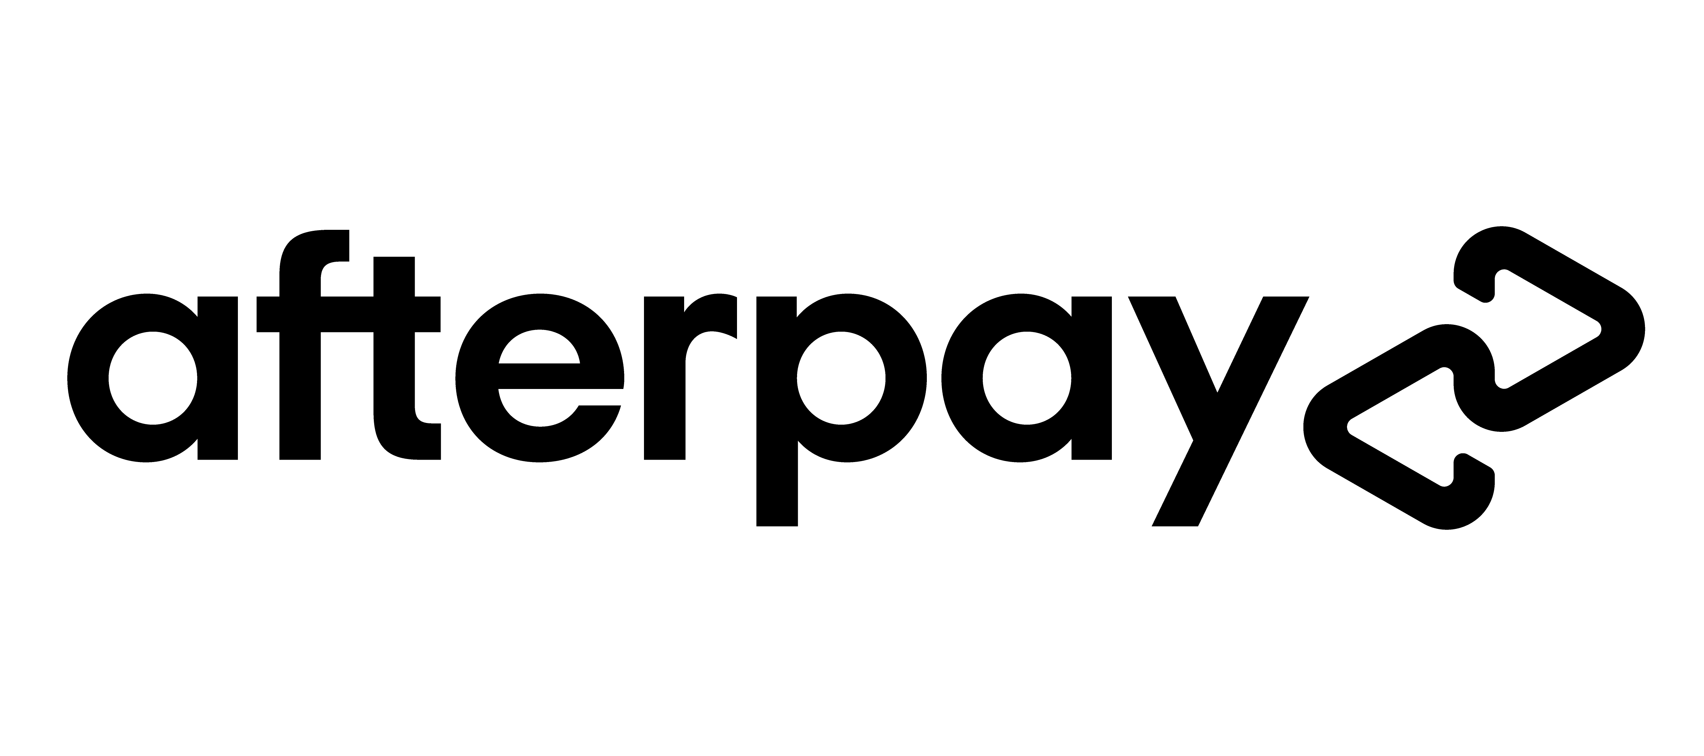

Our Clients
Dutch Railway
SBB
Portugal Rail
Total of over 40 clients
Client base growing at 50% per year

Slide 7
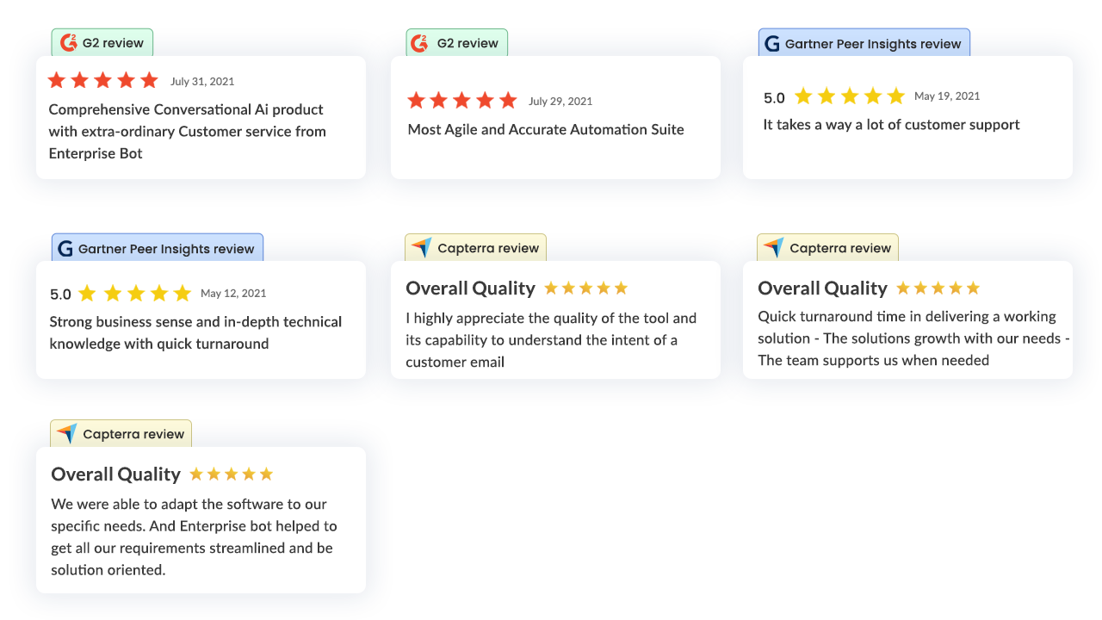
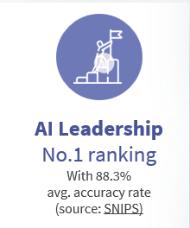
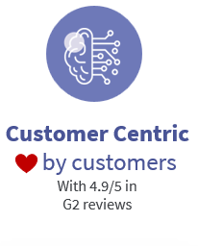
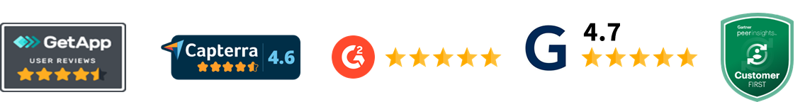
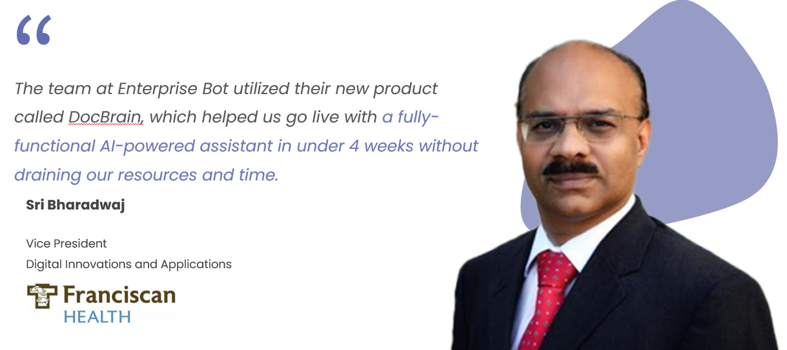

Feedback and Recognition
Enterprisebot was from the beginning a key partner of our innovation in GenerativeAI
Leading Platform in Customer Ratings and User Experience

Slide 8
Productivity Improvements and Business Case
 | Channel Mix % | Time per conversation (min) | % of con-versations handled by the Bot | Bot/Assistant Time Savings % on the con-versations handled by the Bot | Bot/Assistant Time Savings % on the total of con-versations
E-Mail | 40% | 15.0 | 95% | 80% | 76%
Phone/Video/Conference | 30% | 7.0 | 10% | 50% | 5%
Chat | 25% | 5.0 | 100% | 50% | 50%
Personal Meeting | 5% | 30.0 | 0% | 0% | 0%
Total/Average | 100% | 10.9 | 66% | 60% | 44%
51 % of time is assumed communication time
Total time savings amount to 25%
Net of cost of the solution the total cost savings are 23%
Strong business case of 23% cost savings achievable and evidenced

Slide 9
Implementation Project
Project Approach
Envisioning
(pre-sales)
Exploration
(1 day)
Incubation
(4 weeks)
Scale
Build initial value proposition and solution idea
Align functionality and cost of solution
Develop High level use cases and benefits for the organization
Develop Initial high-level business case (using template)
Build foundation and input for a proof of concept
Define Detailed use cases and training data
Identify Interfaces to core systems
Define Architecture and deployment model
Identify Constraints and compliance requirements
Gather all the necessary information for solution design
Build a prototype to validate and market idea
Build Prototype covering one or two use cases
Build Integration of one key core system or setup of hybrid chat system
Turn prototype into market ready solution
Enrich coverage of use cases
Implement deeper Integration into core systems
Perform Ongoing training and improvement of AI
Perform Internal change management
Client Resource Requirements
Required Availability
Client Resources
OnPrem
Cloud
Project Management
40-50% during 1 months
40-50% during 1 months
IT SPOC
20-30% (1-2 days per week) per function for the duration of data analysis and deployment (6 weeks).
20-30% (1-2 days per week) per function for the duration of data analysis and deployment (6 weeks).
Sub-resources
Customer Service Representative
Product and Offer specialists
Legal & Compliance
10% during 4 weeks
10% during 4 weeks
IT Security / Firewall Mgmt.
50% for 2 weeks
IT Operation Team
5% during 4 weeks

Slide 10
Pricing
Provider | Service/Feature | Scope
Enterprise Bot | Cloud Deployment | ✓
 | On Premise Deployment (Option) | Add-on
 | Server and Technology Maintenance | ✓
 | Authenticated Services | ✓
 | Dashboard | ✓
 | Hybrid Chat Capability | ✓
 | User Access Management | ✓
 | Number of included Channels | 2
 | Number of included Environments | 3
 | Number of included Languages | 3
 | SLA Package | Large
 | Hosting, Maintenance and Operation | Included
New Digital Intelligence | Service Management | Included
 | Monitoring and Reporting | Included
 | Content Management | Included
 | Technology evolution (patching, minor releases) | Included
 | Commercial Management and Optimization | Included
Total price for managed service of 0.5 EUR plus VAT
New Digital Intelligence is single contractor, integrator and re-seller
Now one-time or upfront cost
No minimum contract duration
No minimum consumption

Slide 11
Why NDI and Enterprisebot?
Brings you a fast-growing proven market-leading solution, with the highest customer satisfaction
Allows you to leverage the power of ChatGPT to improve client interaction, increase client satisfaction and market share
Enables you to refocus your employee’s valuable client-facing time on high-value complex conversations
Provides you with a strong business case
Gives you a flexible pay-as-you-go model with >90% of savings remaining with you
Ensures constant evolution of the solution up-to-speed with the dynamics of the ChatGPT technology
Evolves your client-facing content dynamically and seamlessly
Gives you full transparency of your client conversations (monitoring)
Allows you a risk-free journey with 0 upfront cost 0 volume commitment 0 minimum contract duration

