Slide 1
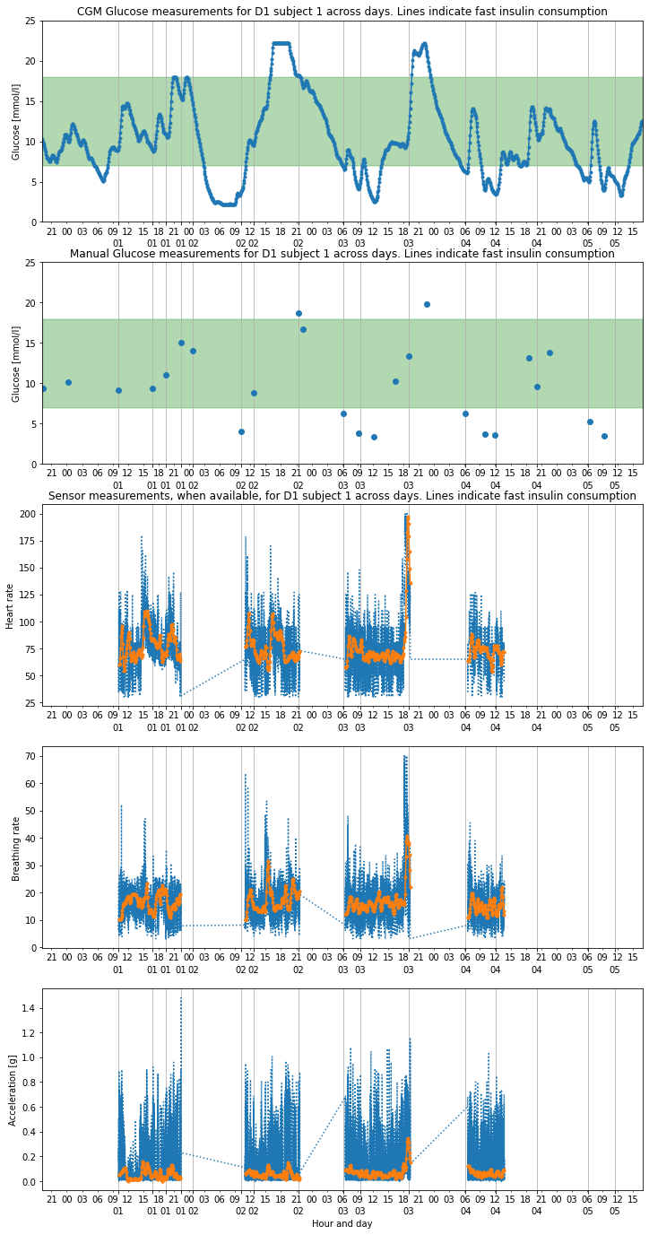
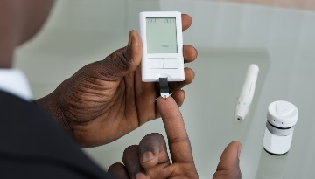
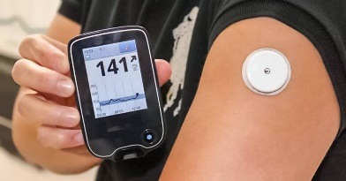
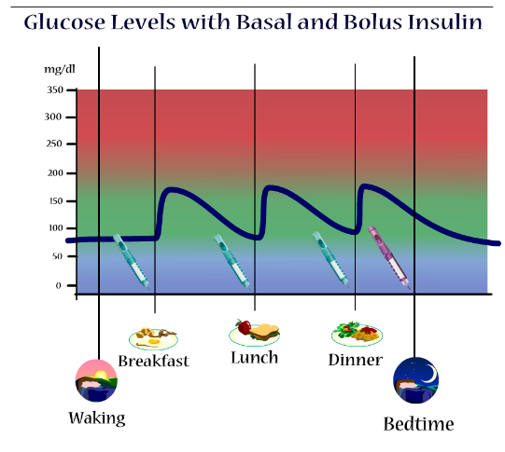
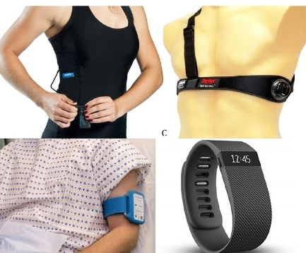
1. THE PROBLEM:
Glucose sensing over multiple days with CGM (green = ‘safe’ zone)
1 out of 10 Americans has diabetes (source: CDC 2020)
< 30% has Continuous Glucose Monitoring
Majority still relies on manual measurements
and on making rough predictions
2. THE CHALLENGE:
Manual glucose meter
Continuous glucose monitoring (CGM)
Glucose evolution depends on many factors:
food consumption, insulin medication,
physical activity, etc.
Glucose level evolution in time
Insulin medication
(timing and dose)
Food consumption
Activity level
Stress
3. THE OPPORTUNITY:
Physiological signals reflect in part the glucose
levels, especially if abnormal
1 out of 3 Americas uses or has used a wearable
Heart signals
(Heart Rate, HRV, ECG)
Breathing
4. THE PROJECT:
Improve forecast and control of glucose in-between manual measurements using wearable sensor data
Matteo Mischiati, TDI Project presentation, 7/29/21
Notes:
In the general analysis problem, we are given the positions and velocities of n-agents (for examples birds in a flock) and we’d like to characterize the collective configuration, how it changes over time, and how individual movements contribute to the collective behavior.
The synthesis problem, instead, that is relevant for example in robotic applications, is to design individual movements so that the collective configuration undergoes desired coordinated transformations over time. For example we may have a team of robots here (outside a building), and we may need them to get safely inside the building.
As the number of agents grows (whether animals to analyze or robots to control) the dimensionality of the configuration space grows linearly with n and attacking these problems directly becomes more and more computationally costly.

Slide 2


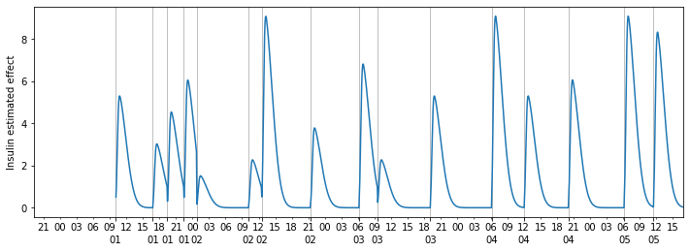
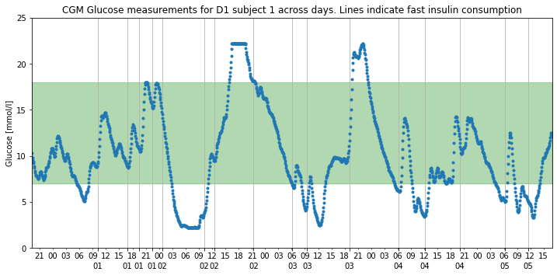


manual glucose
insulin/food
Improved glucose forecast, to be assessed against CGM
HR
THE ‘D1NAMO’ dataset¹
- Insulin & food information
- Manual & CGM
glucose readings
- 1550hrs of wearable data
(Zephyr Bioharness),
- 10 D1 subjects
and 20 healthy ones
breathing
acceleration
ECG, other sensor data
¹ The open D1NAMO dataset: A multi-modal dataset for research on noninvasive type 1 diabetes management, Dubosson et al., 2018
Notes:
In the general analysis problem, we are given the positions and velocities of n-agents (for examples birds in a flock) and we’d like to characterize the collective configuration, how it changes over time, and how individual movements contribute to the collective behavior.
The synthesis problem, instead, that is relevant for example in robotic applications, is to design individual movements so that the collective configuration undergoes desired coordinated transformations over time. For example we may have a team of robots here (outside a building), and we may need them to get safely inside the building.
As the number of agents grows (whether animals to analyze or robots to control) the dimensionality of the configuration space grows linearly with n and attacking these problems directly becomes more and more computationally costly.

