Slide 1
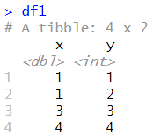
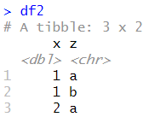


inner_join()

Slide 2
inner_join()

Slide 3
left_join()

Slide 4
left_join()

Slide 5



right_join()

Slide 6
full_join()

Slide 7


semi_join()

Slide 8

anti_join()

