Slide 1
Managing with Big Data “at rest”
Alexander Semenov, PhD

Slide 2
Introduction
Degree in Electrical Engineering, Saint-Petersburg State Electrotechnical University, 2008
PhD thesis “Principles of social media monitoring and analysis software”, defended in May 2013
Main topic is analysis of social media sites and software for it, supervised by Prof. Jari Veijalainen
Visiting scholar in University at Buffalo, NY, USA; University of Memphis, TN, USA
Currently postdoctoral researcher in CS&IS Dept
Previous project: computational logistics, spinned of as NFleet
Current projects: MineSocMed, VISIT

Slide 3
Table of contents
Introduction, Data at rest
Databases, relational databases
PostgreSQL
NoSQL databases
ACID vs BASE, CAP theorem
Examples: Redis, MongoDB, CouchDB
MapReduce
Apache Hadoop
HDFS
Hbase
Pig
Hive

Slide 4
Data at rest
Data at rest is inactive data which is stored physically in any digital form (e.g. databases, data warehouses, spreadsheets, archives, tapes, off-site backups, mobile devices etc.)
Data at Rest generally refers to data stored in persistent storage (disk, tape) while Data in Use generally refers to data being processed by a computer central processing unit
Data in Use – data being used and processed by CPU
Data in Motion – data that is being moved

Slide 5
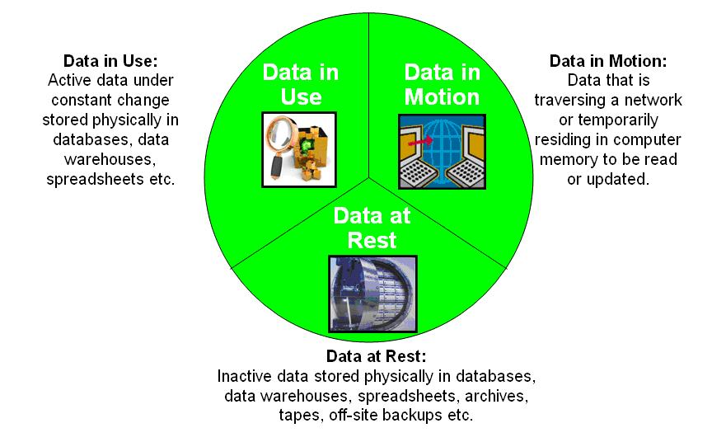
From http://en.wikipedia.org/wiki/Data_at_Rest

Slide 6
Scaling
Recall from previous lecture: from 2013 to 2020, the “digital universe” will grow by a factor of 10 – from 4.4 ZB to 44 ZB. It more than doubles every two years.
zettabyte equals to 10^21 bytes
For handling these data computing performance and data storages should scale
To scale vertically means to add resources to a single node in a system, typically involving the addition of CPUs or memory to a single computer
To scale horizontally (or scale out) means to add more nodes to a system, such as adding a new computer to a distributed software application.

Slide 7
Scaling
Now, manufacturers of CPUs prefer horizontal scaling
Multicore CPU
Multiprocessor CPU
Data are stored in distributed storages
Distributed systems are used to process the data
Distributed computing introduce problems with synchronization

Slide 8
Databases
Data may be stored in the databases
A database is an organized collection of data
Database management systems (DBMSs) are computer software applications that interact with the user, other applications, and the database itself to capture and analyze data.
A relational database management system (RDBMS) is a database management system (DBMS) that is based on the relational model
The relational database model is based on the concept of two-dimensional tables.

Slide 9
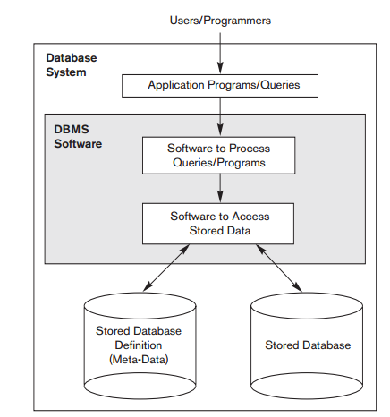
Database architecture
From ”Fundamentals of Database Systems(Elmasri,Navathe), 2010”

Slide 10
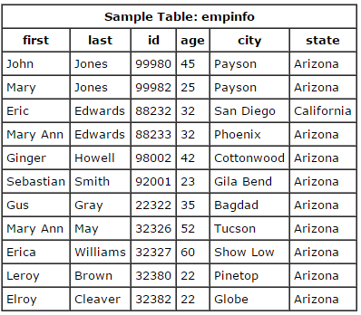
SQL
SQL – standard query language. Language designed for managing data held in RDBMS
select first, last, city
from empinfo;
select last, city, age
from empinfo where
age > 40;
select * from empinfo
where first = 'Eric';
From ”Fundamentals of Database Systems(Elmasri,Navathe), 2010”

Slide 11
SQL
Using SQL rows can be selected from the table based on some predicates
Select * from table_name where a > b and c = 10;
Table can be created
Create table table_name (a int,b int, c int);
Data can be inserted or updated
Insert into table_name(a,b,c) values(1,2,10);
Multiple tables can be joined
Rows can be grouped

Slide 12
SQL support
There are SQL standards: SQL-86, SQL-89, SQL-92, …, SQL:2008, SQL:2011
A number of RDBMS support SQL, some of them add some extensions
Oracle Database
Microsoft SQL Server
MySQL
IBM DB2
PostgreSQL
Sqlite

Slide 13
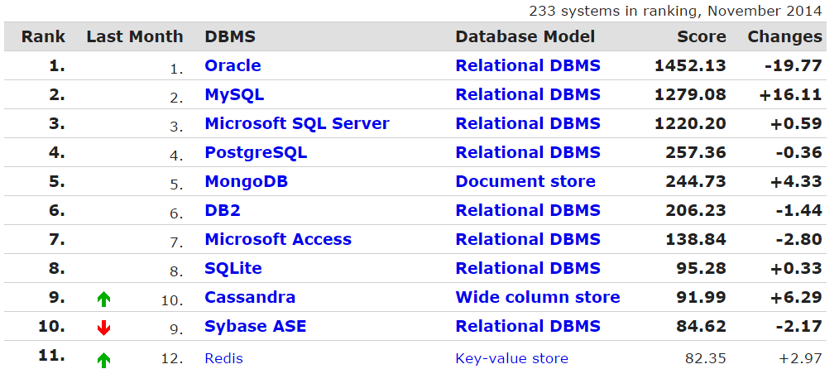
DB rankings
From http://db-engines.com/en/ranking

Slide 14
Example: PostgreSQL
Implements majority of SQL:2011 standard
Free and open source software, can be downloaded from http://postgresql.org
Runs on Linux, FreeBSD, and Microsoft Windows, and Mac OS X
Has interfaces for many programming languages, including C++, Python, PHP, and so on
From 9.2 supports JSON data type
Transactional and ACID compliant
Has many extensions, such as PostGIS (a project which adds support for geographic objects)
Supports basic partitioning
http://www.postgresql.org/docs/current/static/ddl-partitioning.html

Slide 15
Example: PostgreSQL
Maximum Database Size Unlimited
Maximum Table Size 32 TB
Maximum Row Size 1.6 TB
Maximum Field Size 1 GB
Maximum Rows per Table Unlimited
Maximum Columns per Table 250 – 1600
Maximum Indexes per Table Unlimited

Slide 16
NoSQL databases
Carlo Strozzi first used the term NoSQL in 1998 as a name for his open source relational database that did not offer a SQL interface
The term was reintroduced in 2009 by Eric Evans in conjunction with an event discussing open source distributed databases
NoSQL stands for “Not Only SQL”

Slide 17
NoSQL databases
Broad class of database management systems that differ from the classic model of the relational database management system (RDBMS) in some significant ways, most important being they do not use SQL as their primary query language
Do not have fixed schema
Do not use join operations
May not have ACID (atomicity, consistency, isolation, durability)
Scale horizontally
Are referred to as “Structured storages”

Slide 18
ACID properties
A transaction comprises a unit of work performed within a database management system (or similar system) against a database
Must have ACID properties: Atomicity, Consistency, Isolation, Durability
Atomicity
Atomicity requires that each transaction be "all or nothing": if one part of the transaction fails, the entire transaction fails, and the database state is left unchanged.

Slide 19
ACID properties
Consistency
The consistency property ensures that any transaction will bring the database from one valid state to another. Any data written to the database must be valid according to all defined rules
Isolation
The isolation property ensures that the concurrent execution of transactions result in a system state that would be obtained if transactions were executed serially, i.e. one after the other
Durability
Durability means that once a transaction has been committed, it will remain so, even in the event of power loss, crashes, or errors.

Slide 20
ACID vs BASE
ACID is contrasted with BASE
BASE:
Basically available
there will be a response to any request. But, that response could be a ‘failure’ to obtain the requested data or the data may be in an inconsistent or changing state.
Soft-state
The state of the system could change over time, so even during times without input there may be changes going on due to ‘eventual consistency’
Eventual consistency
The system will eventually become consistent once it stops receiving input. The data will propagate to everywhere it should sooner or later

Slide 21
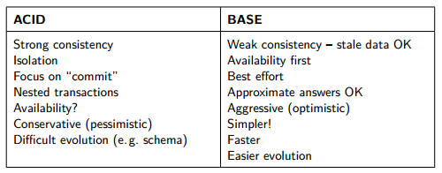
ACID vs BASE
Taken from http://www.christof-strauch.de/nosqldbs.pdf

Slide 22
ACID vs BASE
Strict Consistency
All read operations must return data from the latest completed write operation, regardless of which replica the operations went to
Eventual Consistency
Readers will see writes, as time goes on: "In a steady state, the system will eventually return the last written value".

Slide 23
CAP theorem
States that it is impossible for a distributed computer system to simultaneously provide all three of the following guarantees
Consistency
A distributed system is typically considered to be consistent if after an update operation of some writer all readers see his updates in some shared data source
Availability
a system is designed and implemented in a way that allows it to continue operation
Partition tolerance
These occur if two or more “islands” of network nodes arise which (temporarily or permanently) cannot connect to each other; dynamic addition and removal of nodes

Slide 24
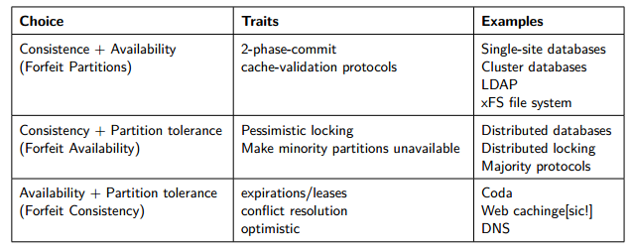
CAP theorem
Taken from http://www.christof-strauch.de/nosqldbs.pdf

Slide 25
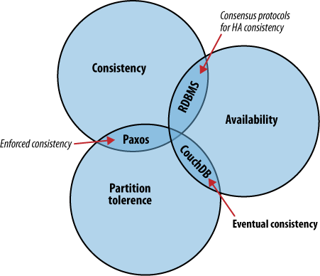
CAP theorem
Taken from http://guide.couchdb.org

Slide 26
NoSQL databases: motives
Avoidance of Unneeded Complexity
Relational databases provide a variety of features and strict data consistency. But this rich feature set and the ACID properties implemented by RDBMSs might be more than necessary for particular applications and use cases
High Throughput
Google is able to process 20 petabyte a day stored in Bigtable via it’s MapReduce approach
Taken from http://www.christof-strauch.de/nosqldbs.pdf

Slide 27
NoSQL databases: motives
Horizontal Scalability and Running on Commodity Hardware
for Web 2.0 companies the scalability aspect is considered crucial for their business
Avoidance of Expensive Object-Relational Mapping
important for applications with data structures of low complexity that can hardly benefit from the features of a relational database
when your database structure is very, very simple, SQL may not seem that beneficial
Taken from http://www.christof-strauch.de/nosqldbs.pdf

Slide 28
NoSQL databases: motives
Movements in Programming Languages and Development Frameworks
Ruby on Rails framework and others try to hide away the usage of a relational database
NoSQL datastores as well as some databases offered by cloud computing providers completely omit a relational database
Cloud computing needs
Taken from http://www.christof-strauch.de/nosqldbs.pdf

Slide 29
NoSQL databases: criticism
Skepticism on the Business Side
As most of them are open-source software they are well appreciated by developers who do not have to care about licensing and commercial support issues
NoSQL as a Hype
Overenthusiasm because of the new technology
NoSQL as Being Nothing New
NoSQL Meant as a Total “No to SQL”

Slide 30
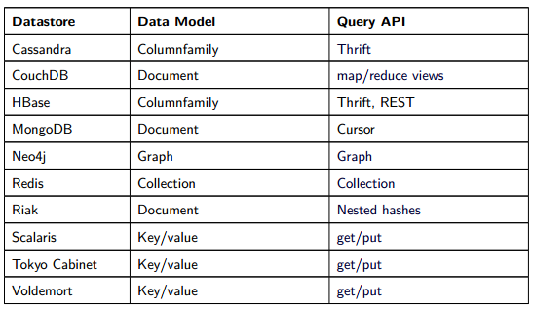
Data and query models
Taken from http://www.christof-strauch.de/nosqldbs.pdf

Slide 31
NewSQL
NewSQL is a class of modern relational database management systems that seek to provide the same scalable performance of NoSQL system, still maintaining the ACID guarantees of a traditional database system
The term was first used by 451 Group analyst Matthew Aslett in a 2011 research paper
One of the most important features is transparent sharding
Examples: dbShards, Scalearc, and ScaleBase

Slide 32
NoSQL example: Redis
REmote DIctionary Server
http://redis.io
Number 1 in db-engines.com key-value stores ranking
Lightweight key-value storage
Stores data in RAM
Supports replication

Slide 33
NoSQL example: Redis
Supports strings, lists, sets, sorted sets, hashes, bitmaps, and hyperloglogs (probabilistic data structure)
> set mykey somevalue
OK
> get mykey
"somevalue"

Slide 34
NoSQL example: Redis
> set counter 100
OK
> incr counter
(integer) 101
> incr counter
(integer) 102
> incrby counter 50
(integer) 152

Slide 35
NoSQL example: Redis
> set key some-value
OK
> expire key 5
(integer) 1
> get key (immediately)
"some-value"
> get key (after some time)
(nil)

Slide 36
NoSQL example: Redis
> rpush mylist A
(integer) 1
> rpush mylist B
(integer) 2
> lpush mylist first
(integer) 3
> lrange mylist 0 -1
1) "first"
2) "A"
3) "B”
rpop mylist
B

Slide 37
NoSQL example: Redis
> hmset user:1000 username antirez birthyear 1977 verified 1
OK
> hget user:1000 username
"antirez"
> hget user:1000 birthyear
"1977"
> hgetall user:1000
1) "username"
2) "antirez"
3) "birthyear"
4) "1977"
5) "verified"
6) "1"

Slide 38
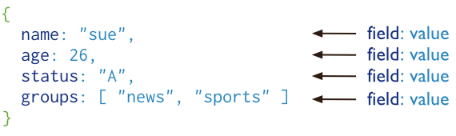
MongoDB
cross-platform document-oriented database
Stores “documents”, data structures composed of field and value pairs
Key features: high performance, high availability, automatic scaling, supports server-side JavaScript execution
Has interfaces for many programming languages
From http://www.mongodb.org/

Slide 39
MongoDB
> use mongotest
switched to db mongotest
>
> j = { name : "mongo" }
{ "name" : "mongo" }
> j
{ "name" : "mongo" }
> db.testData.insert( j )
WriteResult({ "nInserted" : 1 })
>
> db.testData.find();
{ "_id" : ObjectId("546d16f014c7cc427d660a7a"), "name" : "mongo" }
>
>
> k = { x : 3 }
{ "x" : 3 }
> show collections
system.indexes
testData
> db.testData.findOne()

Slide 40
MongoDB
> db.testData.find( { x : 18 } )
> db.testData.find( { x : 3 } )
> db.testData.find( { x : 3 } )
> db.testData.find( )
{ "_id" : ObjectId("546d16f014c7cc427d660a7a"), "name" : "mongo" }
>
> db.testData.insert( k )
WriteResult({ "nInserted" : 1 })
> db.testData.find( { x : 3 } )
{ "_id" : ObjectId("546d174714c7cc427d660a7b"), "x" : 3 }
>
> var c = db.testData.find( { x : 3 } )
> c
{ "_id" : ObjectId("546d174714c7cc427d660a7b"), "x" : 3 }

Slide 41
MongoDB
db.testData.find().limit(3)
db.testData.find( { x : {$gt:2} } )
> for(var i = 0; i < 100; i++){db.testData.insert({"x":i});}
WriteResult({ "nInserted" : 1 })
> db.testData.find( { x : {$gt:2} } )
{ "_id" : ObjectId("546d174714c7cc427d660a7b"), "x" : 3 }
{ "_id" : ObjectId("546d191514c7cc427d660a7f"), "x" : 3 }
{ "_id" : ObjectId("546d191514c7cc427d660a80"), "x" : 4 }
{ "_id" : ObjectId("546d191514c7cc427d660a81"), "x" : 5 }
{ "_id" : ObjectId("546d191514c7cc427d660a82"), "x" : 6 }
> db.testData.ensureIndex( { x: 1 } )

Slide 42
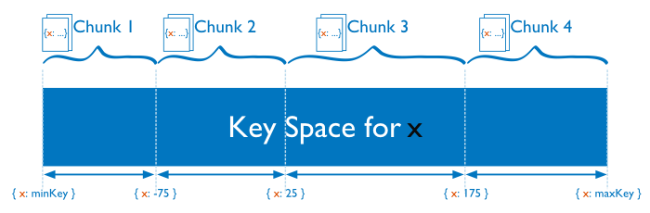
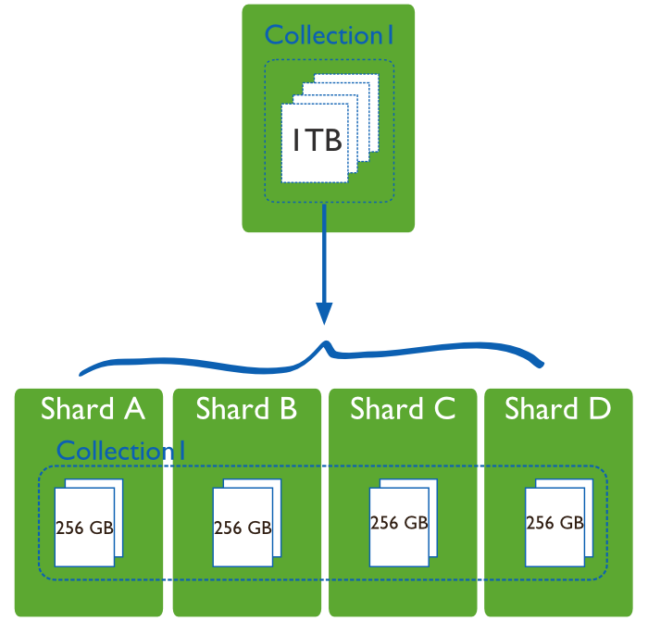
MongoDB sharding
From http://www.mongodb.org/

Slide 43
Example: CouchDB, http://couchdb.org
Open source document-oriented database written mostly in the Erlang programming language
Development started in 2005
In February 2008, it became an Apache Incubator project and the license was changed to the Apache License rather than the GPL
Stores collection of JSON documents
Provides RESTFul API
Query ability is allowed via views:
Map and reduce functions

Slide 44
Example: CouchDB
When view is queried, CouchDB takes the code of view and runs it on every document from the DB
View produces view result
Different views should have different functionalities
Map function:
Written in JavaScript
Has single parameter – document
Can refer to document’s fields

Slide 45
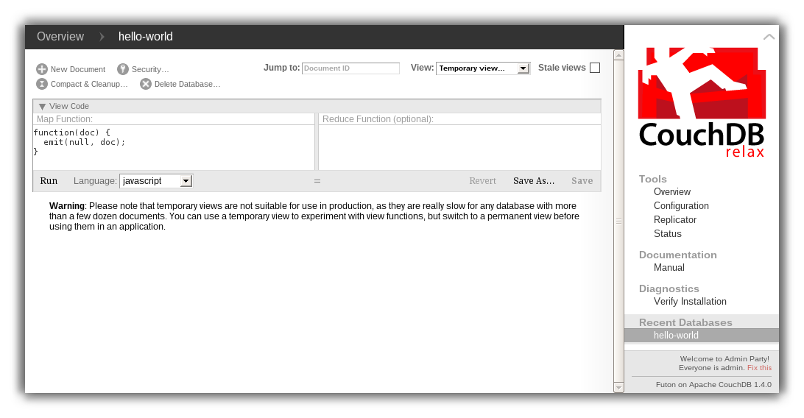
curl -X PUT http://127.0.0.1:5984/albums/6e1295ed6c29495e54cc05947f18c8af -d '{"title":"There is Nothing Left to Lose","artist":"Foo Fighters"}'

Slide 46
Example: CouchDB
"_id":"biking",
"_rev":"AE19EBC7654",
"title":"Biking",
"body":"My biggest hobby is mountainbiking. The other day...",
"date":"2009/01/30 18:04:11"
}
{
"_id":"bought-a-cat",
"_rev":"4A3BBEE711",
"title":"Bought a Cat",
"body":"I went to the the pet store earlier and brought home a little kitty...", "date":"2009/02/17 21:13:39"
} { "_id":"hello-world", "_rev":"43FBA4E7AB", "title":"Hello World", "body":"Well hello and welcome to my new blog...", "date":"2009/01/15 15:52:20" }

Slide 47
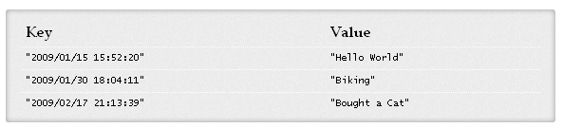
CouchDB: Example
View, Map function:
function(doc) { if(doc.date && doc.title) { emit(doc.date, doc.title); } }

Slide 48
CouchDB: Example
Map result is stored in B-tree
Reduce function operate on the sorted rows emitted by map function
Reduce function is applied to every leaf of B-tree
function(keys, values, rereduce) { return sum(values); }

