Slide 1
Managing with Big Data “at rest”, streams
Alexander Semenov, PhD

Slide 2

Outline
Parallel computing background
MapReduce
Apache Hadoop
HDFS
Hbase
Hive
Pig
Streaming data

Slide 3
Parallel computing
With horizontal scaling (scaling out) the processing is carried out on several computers same time
Parallel computing is a form of computation in which many calculations are carried out simultaneously
Parallel computer programs are more difficult to write than sequential ones
Some algorithms can not be parallelized
Synchronization should be taken into account
increasing the degree of parallelization also increases communication costs

Slide 4
<number>
Speedup
Speedup measures increase in running time due to parallelism.
n denotes number of CPUs
Based on running times, S(n) = ts/tp , where
ts is the execution time on a single processor, using the fastest known sequential algorithm
tp is the execution time using a parallel processor.
For theoretical analysis, S(n) = ts/tp where
ts is the worst case running time for of the fastest known sequential algorithm for the problem
tp is the worst case running time of the parallel algorithm using n PEs.

Slide 5
Speedup
Maximum speedup is equal to n (number of CPU)
Superlinear speedup is also possible
Parallel system may have extra memory
Usually, the best speedup possible for most applications is much smaller than n
Usually some parts of programs are sequential and allow only one CPU to be active.
Sometimes a large number of processors are idle for certain portions of the program.
During parts of the execution, many CPUs may be waiting to receive or to send data.
E.g., blocking can occur in message passing

Slide 6
Speedup
Speedup
ideal
Super-linear
Saturation
Disaster
Number of processors

Slide 7
Amdahl's law
The speedup of a program using multiple processors in parallel computing is limited by the time needed for the sequential fraction of the program
Let f be the fraction of operations in a computation that must be performed sequentially, where 0 ≤ f ≤ 1. The maximum speedup achievable by a parallel computer with n processors is

Slide 8
<number>
Example
95% of a program’s execution time occurs inside a loop that can be executed in parallel. What is the maximum speedup we should expect from a parallel version of the program executing on 8 CPUs?

Slide 9
<number>
Illustration of Amdahl Effect
Speedup
n = 10,000
n = 1,000
n = 100
Processors
n denotes problem size

Slide 10
Gustafson’s law
a counterpoint to Amdahl's law
says that computations involving arbitrarily large data sets can be efficiently parallelized
Amdahl's Law approximately suggests:
“ Suppose a car is traveling between two cities 60 miles apart, and has already spent one hour traveling half the distance at 30 mph. No matter how fast you drive the last half, it is impossible to achieve 90 mph average before reaching the second city. Since it has already taken you 1 hour and you only have a distance of 60 miles total; going infinitely fast you would only achieve 60 mph. ”
Gustafson's Law approximately states:
“ Suppose a car has already been traveling for some time at less than 90mph. Given enough time and distance to travel, the car's average speed can always eventually reach 90mph, no matter how long or how slowly it has already traveled. For example, if the car spent one hour at 30 mph, it could achieve this by driving at 120 mph for two additional hours, or at 150 mph for an hour, and so on. (from Wikipedia)

Slide 11
OpenMP
int main(int argc, char *argv[]) {
const int N = 100000;
int i, a[N];
#pragma omp parallel for
for (i = 0; i < N; i++)
a[i] = 2 * i;
return 0;
}

Slide 12
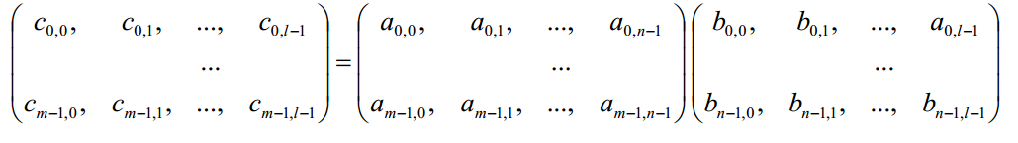

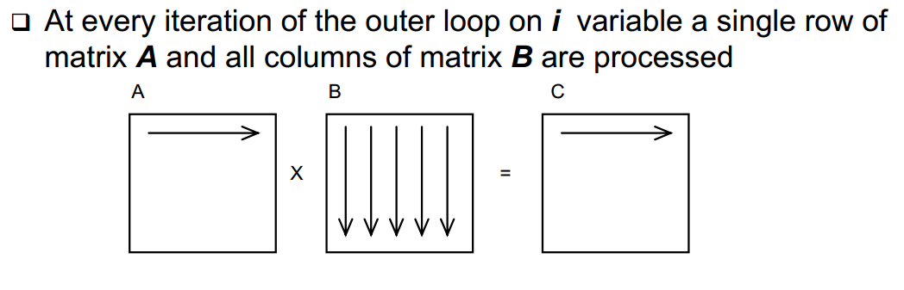
Matrix Multiplication
C = A*B

Slide 13
Synchronization
When parallel program is being developed, typically programmer should care about synchronization
Otherwise same data may be rewritten by parallel sections, etc
There are many mechanisms
Locks
Critical section
Mutexes
etc

Slide 14
MapReduce
MapReduce is a programming model and an associated implementation for processing and generating large data sets (From Jeffrey Dean and Sanjay Ghemawat, 2004)
MapReduce was developed by Google, described in a paper “MapReduce: Simplified Data Processing on Large Clusters”
Allows programmers without any experience with parallel and distributed systems to easily utilize the resources of a large distributed system
inspired by the map and reduce primitives present in Lisp and many other functional languages
map and fold

Slide 15
Map and fold
map takes a function f and applies it to every element in a list
Map takes single argument
fold iteratively applies a function g to aggregate results
Fold takes two arguments (first one may be 0)
Sum of squares x^2 + y^2 + … + z^2
Map takes one parameter and squares it
Fold iteratively sums them up

Slide 16
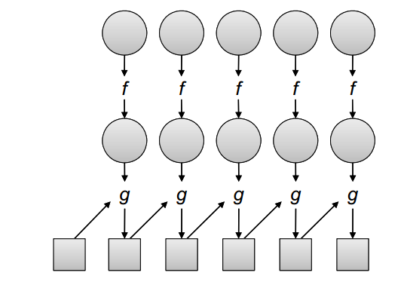
Map and Fold

Slide 17
MapReduce
Users specify a map and a reduce functions
map function processes a key/value pair to generate a set of intermediate key/value pairs
reduce function merges all intermediate values associated with the same intermediate key
Values are in sorted order
programs written in this style are automatically parallelized and executed on a large cluster of commodity machines

Slide 18
MapReduce
The run-time system handles
partitioning the input data
scheduling the program's execution across a set of machines
handling machine failures
managing the required inter-machine communication.
There are many implementations, one of the most popular is Apache Hadoop

Slide 19
MapReduce example
function map(String name, String document):
// name: document name
// document: document contents
for each word w in document:
emit (w, 1)
function reduce(String word, Iterator partialCounts):
// word: a word
// partialCounts: a list of aggregated partial counts
sum = 0
for each pc in partialCounts:
sum += ParseInt(pc)
emit (word, sum)

Slide 20
MapReduce example
Input: Hello World Bye World
Hello Hadoop Goodbye Hadoop
1st map:
< Hello, 1>
< World, 1>
< Bye, 1>
< World, 1>
2nd map:
< Hello, 1>
< Hadoop, 1>
< Goodbye, 1>
< Hadoop, 1>
Reduce:
< Bye, 1>
< Goodbye, 1>
< Hadoop, 2>
< Hello, 2>
< World, 2>

Slide 21
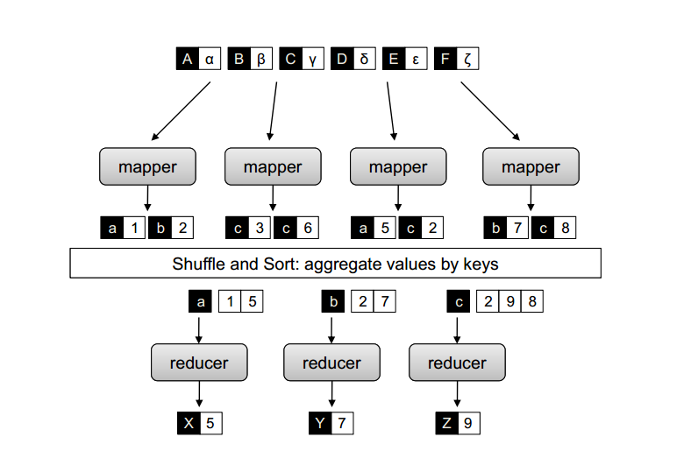
MapReduce

Slide 22
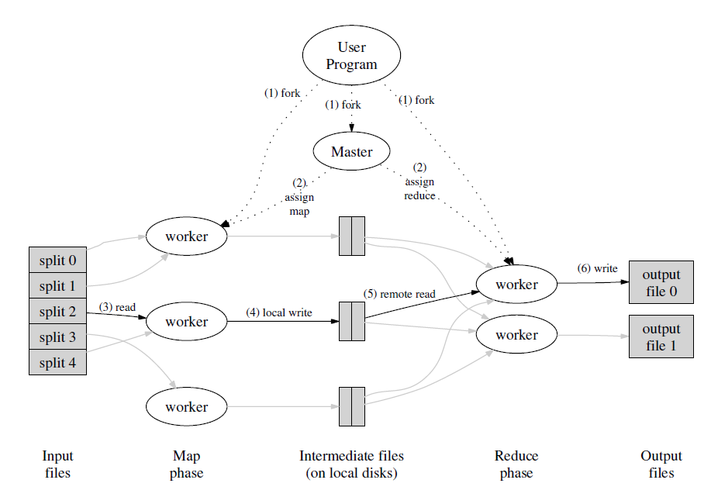
(From Jeffrey Dean and Sanjay Ghemawat, 2004)

Slide 23
Combiners
Word count emits a key-value pair for each word in the collection
all these key-value pairs need to be copied across the network
the amount of intermediate data will be larger than the input collection itself
solution is to perform local aggregation on the output of each mapper
to compute a local count for a word over all the documents processed by the mapper
Combiner is an optimization in MapReduce that allows for local aggregation before the shuffle and sort phase
Might be viewed as “mini-reducer”

Slide 24
Partitioners
Partitioners are responsible for dividing up the intermediate key space and assigning intermediate key-value pairs to reducers
May help to handle imbalance in the amount of data associated with each key

Slide 25
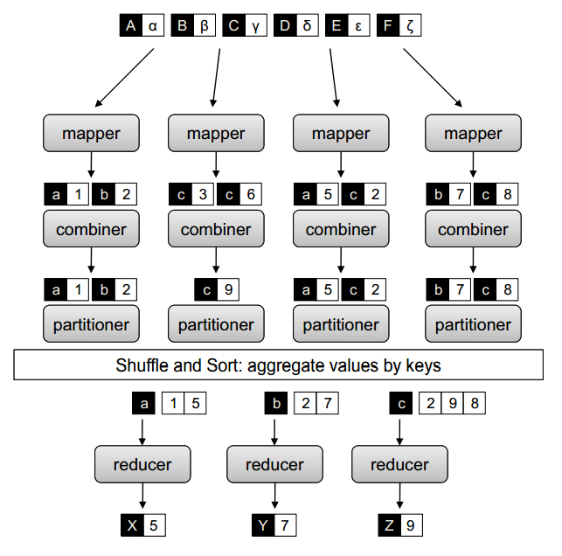

Slide 26
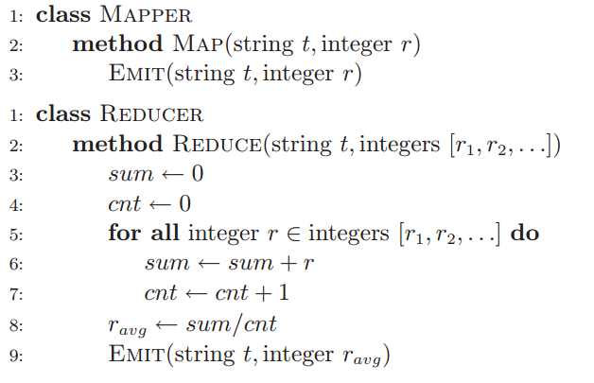
Combiner example
basic MapReduce algorithm that computes the mean of values associated with the same key

Slide 27

Combiner example

Slide 28
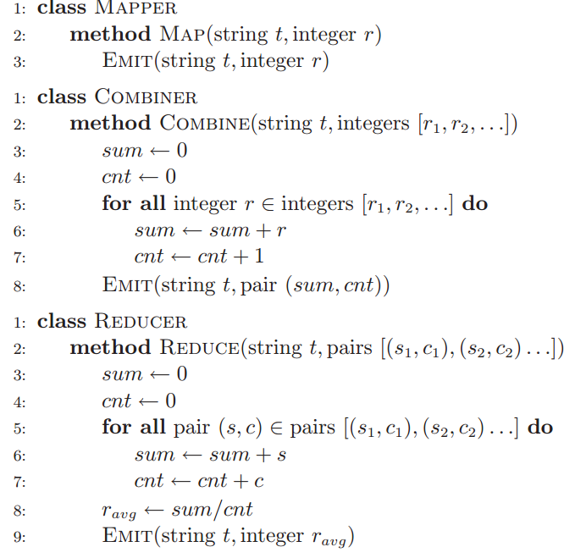
MapReduce example

Slide 29
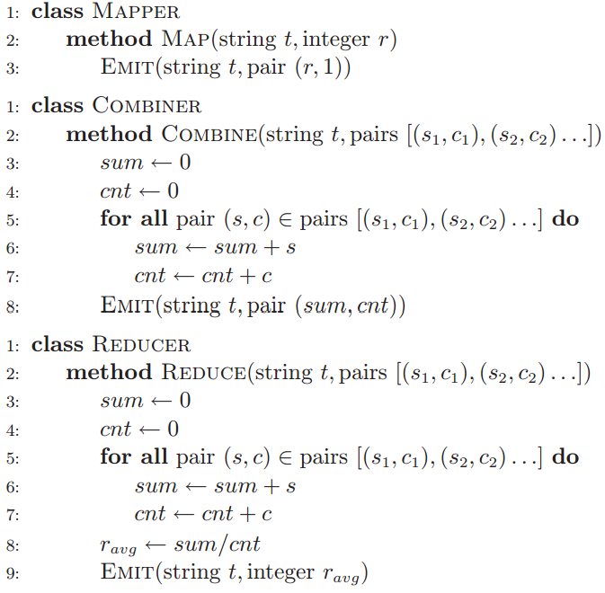

Slide 30
MapReduce applications
Count of URL Access Frequency: The map function processes logs of web page requests and outputs <URL, 1>. The reduce function adds together all values for the same URL and emits a <URL, total count> pair.
ReverseWeb-Link Graph: The map function outputs <target, source> pairs for each link to a target URL found in a page named source. The reduce function concatenates the list of all source URLs associated with a given target URL and emits the pair: <target, list(source)>

Slide 31
Speculative execution
An optimization that is implemented by both Hadoop and Google’s MapReduce implementation
Idea:
the map phase of a job is only as fast as the slowest map task
Similarly, the completion time of a job is bounded by the running time of the slowest reduce task
with speculative execution, an identical copy of the same task is executed on a different machine, and the framework simply uses the result of the first task attempt to finish
Improves the results by 44% (Jeffrey Dean and Sanjay Ghemawat. MapReduce: Simplified data processing on large clusters, 2004)

Slide 32
MapReduce cluster
Machines are typically dual-processor x86 processors running Linux, with 2-4 GB of memory per machine.
Commodity networking hardware is used.  typically either 100 megabits/second or 1 gigabit/second
A cluster consists of hundreds or thousands of machines, and therefore machine failures are common.
Storage is provided by inexpensive IDE disks attached directly to individual machines. A distributed file system developed in-house is used to manage the data stored on these disks
Users submit jobs to a scheduling system.
(From Jeffrey Dean and Sanjay Ghemawat, 2004)

Slide 33
MapReduce
Data locality is important: map tasks should use data available on the present node
For some tasks partitioning is important
One of the refinements is combiner function: reduce function applied after map at each cluster

Slide 34
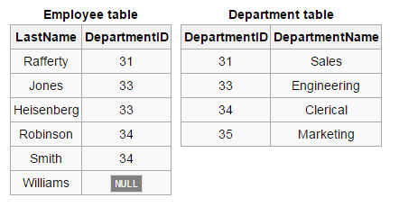
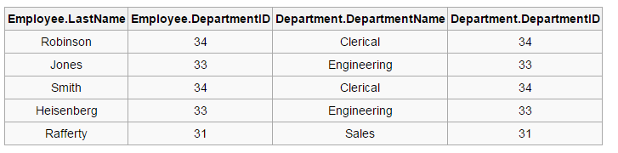
Data joins
SELECT * FROM employee JOIN department ON employee.DepartmentID = department.DepartmentID;

Slide 35
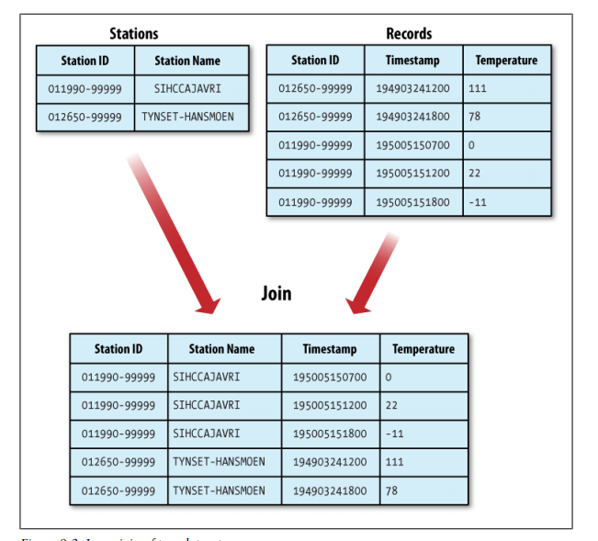

Slide 36
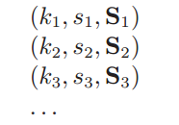
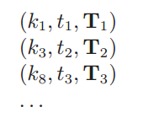
Data joins
Join may be implemented in MapReduce
Idea:
we map over both datasets and emit the join key as the intermediate key, and the tuple itself as the intermediate value
all tuples will be grouped by the join key
This is called reduce-side join

Slide 37
MapReduce algorithms
many algorithms cannot be easily expressed as a single MapReduce job
complex algorithms may be decomposed into a sequence of jobs
output of one job becomes the input to the next
repeated execution until some convergence criteria

Slide 38
MapReduce implementations
Google MapReduce
Apache Hadoop
CouchDB
targeted specifically for multi-core processors
for GPGPUs (He et al., Mars: A MapReduce framework on graphics processors,2008)
And many others

Slide 39
Apache Hadoop
Open-source software framework for distributed storage and distributed processing of Big Data on clusters of commodity hardware
Was created in 2005, developed in Java
http://Hadoop.apache.org
Consists of:
Hadoop Common: The common utilities that support the other Hadoop modules.
Hadoop Distributed File System (HDFS™): A distributed file system that provides high-throughput access to application data.
Hadoop YARN: A framework for job scheduling and cluster resource management.
Hadoop MapReduce: A YARN-based system for parallel processing of large data sets.

Slide 40
Prominent users
EBay
532 nodes cluster (8 * 532 cores, 5.3PB).
Facebook
Apache Hadoop is used to store copies of internal log and dimension data sources and use it as a source for reporting/analytics and machine learning.
2 major clusters:
A 1100-machine cluster with 8800 cores and about 12 PB raw storage.
A 300-machine cluster with 2400 cores and about 3 PB raw storage.
Each (commodity) node has 8 cores and 12 TB of storage.
http://wiki.apache.org/hadoop/PoweredBy

Slide 41
Prominent users
Last.fm
100 nodes
Dual quad-core Xeon L5520 @ 2.27GHz & L5630 @ 2.13GHz , 24GB RAM, 8TB(4x2TB)/node storage.
Used for charts calculation, royalty reporting, log analysis, A/B testing, dataset merging
LinkedIn
~800 Westmere-based HP SL 170x, with 2x4 cores, 24GB RAM, 6x2TB SATA
~1900 Westmere-based SuperMicro X8DTT-H, with 2x6 cores, 24GB RAM, 6x2TB SATA
~1400 Sandy Bridge-based SuperMicro with 2x6 cores, 32GB RAM, 6x2TB SATA
http://wiki.apache.org/hadoop/PoweredBy

Slide 42
Hadoop cluster
Hadoop cluster includes a single master and multiple worker nodes.
The master node consists of a JobTracker, TaskTracker, NameNode and DataNode
May be replicated
A slave or worker node acts as both a DataNode and TaskTracker
Data are placed in HDFS filesystem

Slide 43
Hadoop cluster
Clients submit jobs to JobTracker
JobTracker submits it to available TaskTracker nodes in the cluster
JobTracker knows which node contains the data, and which other machines are nearby
Reduces network traffic because of rack awareness

Slide 44
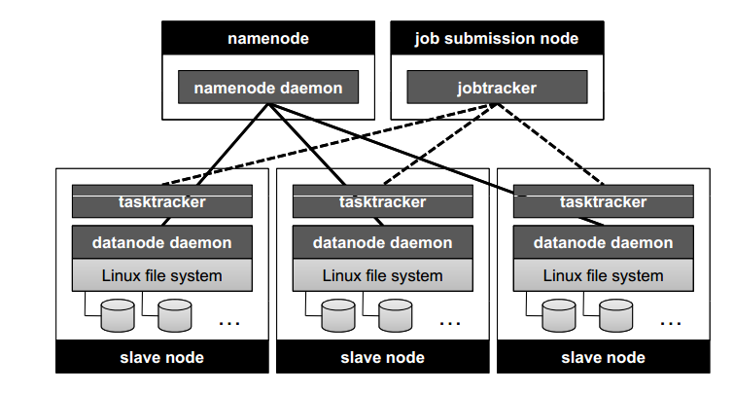
From http://lintool.github.io/MapReduceAlgorithms/

Slide 45
HDFS
HDFS, The Hadoop Distributed File System
distributed file system designed to run on commodity hardware
HDFS is highly fault-tolerant
HDFS provides high throughput access to application data and is suitable for applications that have large data sets
Data in HDFS are automatically replicated
Metadata are stored in Namenode
Data are stored in Datanode
HDFS is not optimized for low-latency data access

Slide 46
HDFS
Each map task is assigned a sequence of input key-value pairs, called an input split in Hadoop.
Input splits are computed automatically and the execution framework strives to align them to HDFS block boundaries so that each map task is associated with a single data block.

Slide 47

http://hadoop.apache.org/docs/r1.2.1/hdfs_design.html

Slide 48
HBase
HBase is a column-oriented database
Runs on top of HDFS
Features
Linear and modular scalability.
Strictly consistent reads and writes.
Automatic and configurable sharding of tables

Slide 49
HBase data model
HBase organizes data into tables
Row: Within a table, data is stored according to its row
Rows are identified uniquely by their row key
Column Family: Data within a row is grouped by column family.
Column families also impact the physical arrangement of data stored in HBase
Column Qualifier: Data within a column family is addressed via its column qualifier, or simply, column
Cell: A combination of row key, column family, and column qualifier uniquely identifies a cell
Values within a cell are versioned
Primary Functions: get, put, scan

Slide 50
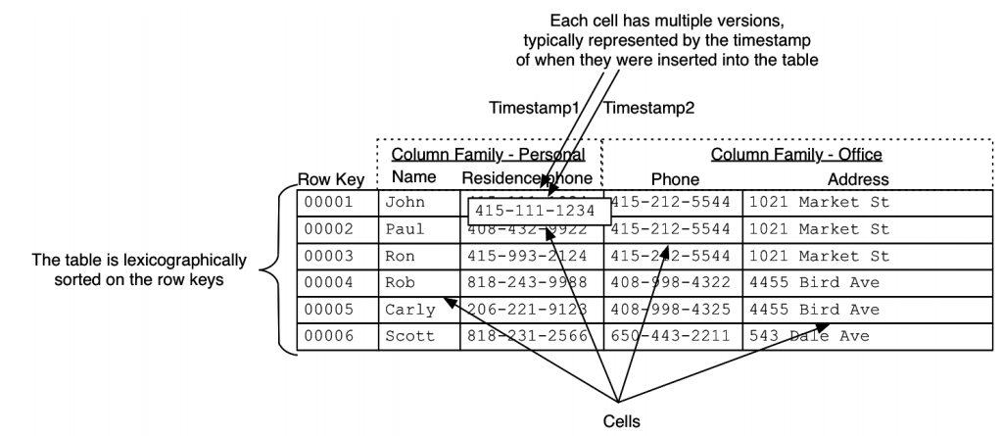
Amandeep Khurana, Introduction to HBase Schema Design, http://0b4af6cdc2f0c5998459-c0245c5c937c5dedcca3f1764ecc9b2f.r43.cf2.rackcdn.com/9353-login1210_khurana.pdf

Slide 51
Apache Hive
Apache Hive is a data warehouse infrastructure built on top of Hadoop for providing data summarization, query, and analysis
Was originally developed by Facebook
supports analysis of large datasets stored in Hadoop's HDFS
HiveQL query language: based on SQL-92 standard but does not fully supports it
A compiler translates HiveQL statements into a directed acyclic graph of MapReduce jobs, which are submitted to Hadoop for execution
Hive should be used for batch processing, not the real time tasks!

Slide 52
HiveQL example
1)
CREATE TABLE a (k1 string, v1 string);
CREATE TABLE b (k2 string, v2 string);
SELECT k1, v1, k2, v2
FROM a JOIN b ON k1 = k2;
2)
SELECT a.* FROM a JOIN b ON (a.id = b.id AND a.department = b.department)

Slide 53
Apache Pig
Pig raises the level of abstraction for processing large datasets
Pig was originally developed by yahoo
Pig consists of:
The language used to express data flows, called Pig Latin.
The execution environment to run Pig Latin programs.
Pig turns the transformations into a series of MapReduce jobs

Slide 54
Apache Pig
-- max_temp.pig: Finds the maximum temperature by year
records = LOAD 'input/ncdc/micro-tab/sample.txt'
AS (year:chararray, temperature:int, quality:int);
filtered_records = FILTER records BY temperature != 9999 AND
(quality == 0 OR quality == 1 OR quality == 4 OR quality == 5 OR quality == 9);
grouped_records = GROUP filtered_records BY year;
max_temp = FOREACH grouped_records GENERATE group,
MAX(filtered_records.temperature);
DUMP max_temp;

Slide 55
Apache Pig
DESCRIBE records;
>> records: {year: chararray,temperature: int,quality: int}
DUMP grouped_records;
>> (1949,{(1949,111,1),(1949,78,1)})
(1950,{(1950,0,1),(1950,22,1),(1950,-11,1)})
DESCRIBE grouped_records;
>> grouped_records: {group: chararray,filtered_records: {year: chararray,
temperature: int,quality: int}}

Slide 56
Apache Pig
grunt> DUMP A;
(2,Tie)
(4,Coat)
(3,Hat)
(1,Scarf)
grunt> DUMP B;
(Joe,2)
(Hank,4)
(Ali,0)
(Eve,3)
(Hank,2)
grunt> C = JOIN A BY $0, B BY $1;
grunt> DUMP C;
(2,Tie,Joe,2)
(2,Tie,Hank,2)
(3,Hat,Eve,3)
(4,Coat,Hank,4)

Slide 57
Apache Pig
grunt> DUMP A;
(Joe,cherry,2)
(Ali,apple,3)
(Joe,banana,2)
(Eve,apple,7)
grunt> B = FOREACH A GENERATE $0, $2+1, 'Constant';
grunt> DUMP B;
(Joe,3,Constant)
(Ali,4,Constant)
(Joe,3,Constant)
(Eve,8,Constant)

Slide 58
Apache Pig
input_lines = LOAD '/tmp/my-copy-of-all-pages-on-internet' AS (line:chararray);
-- Extract words from each line and put them into a pig bag
-- datatype, then flatten the bag to get one word on each row
words = FOREACH input_lines GENERATE FLATTEN(TOKENIZE(line)) AS word;
-- filter out any words that are just white spaces
filtered_words = FILTER words BY word MATCHES '\\w+';
-- create a group for each word
word_groups = GROUP filtered_words BY word;
-- count the entries in each group
word_count = FOREACH word_groups GENERATE COUNT(filtered_words) AS count, group AS word;
-- order the records by count
ordered_word_count = ORDER word_count BY count DESC;
STORE ordered_word_count INTO '/tmp/number-of-words-on-internet';

Slide 59
Stream processing
Stream processing is designed to analyze and act on real-time streaming data, using “continuous queries”
i.e. SQL-type queries that operate over time and buffer windows.
“Big Data” vs “Fast Data”
Essential to stream processing is streaming analytics, or the ability to continuously calculate mathematical or statistical analytics on the fly within the stream

Slide 60
Stream processing examples
Algorithmic trading
300 securities firms and hedge funds that specialize in this type of trading took in a maximum of US$21 billion in profits in 2008
In the U.S., high-frequency trading (HFT) firms represent 2% of the approximately 20,000 firms operating today, but account for 73% of all equity trading volume
computers that execute trades within microseconds, or "with extremely low latency"
light 3.3 milliseconds per 1,000 kilometers of optical fiber
Book: Flash boys, Michael Lewis, 2014

Slide 61


Slide 62
Apache Storm
Hadoop was designed for batch processing, not for the realtime
Apache Storm is an open source framework that provides massively scalable event collection.
was created by Twitter
https://storm.apache.org/

Slide 63
Apache Storm
Broad set of use cases
Storm can be used for processing messages and updating databases (stream processing), doing a continuous query on data streams and streaming the results into clients (continuous computation), parallelizing an intense query like a search query on the fly (distributed RPC), and more. Storm's small set of primitives satisfy a stunning number of use cases.
Scalable
scales to massive numbers of messages per second. To scale a topology, all you have to do is add machines and increase the parallelism settings of the topology. As an example of Storm's scale, one of Storm's initial applications processed 1,000,000 messages per second on a 10 node cluster, including hundreds of database calls per second as part of the topology. Storm's usage of Zookeeper for cluster coordination makes it scale to much larger cluster sizes.
Guarantees no data loss
A realtime system must have strong guarantees about data being successfully processed. A system that drops data has a very limited set of use cases. Storm guarantees that every message will be processed, and this is in direct contrast with other systems like S4.

Slide 64
Apache Storm
Extremely robust
Unlike systems like Hadoop, which are notorious for being difficult to manage, Storm clusters just work. It is an explicit goal of the Storm project to make the user experience of managing Storm clusters as painless as possible.
Fault-tolerant
If there are faults during execution of your computation, Storm will reassign tasks as necessary. Storm makes sure that a computation can run forever (or until you kill the computation).
Programming language agnostic
Robust and scalable realtime processing shouldn't be limited to a single platform. Storm topologies and processing components can be defined in any language, making Storm accessible to nearly anyone.

Slide 65
Apache Storm
A stream is an unbounded sequence of tuples
Basic primitives are are "spouts" and "bolts“
Spouts and bolts have interfaces that programmer implements to run application-specific logic.
A spout may connect to the Twitter API and emit a stream of tweets
A bolt consumes any number of input streams, does some processing, and possibly emits new streams.
Complex stream transformations, like computing a stream of trending topics from a stream of tweets, require multiple steps and thus multiple bolts
Spouts and bolts are connected in topology

Slide 66
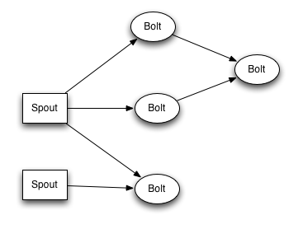
From https://storm.apache.org/

Slide 67
References
http://hadoopbook.com/
http://lintool.github.io/MapReduceAlgorithms/
http://lsd.ls.fi.upm.es/lsd/nuevas-tendencias-en-sistemas-distribuidos/HBase_2.pdf
http://hbase.apache.org/
http://netwovenblogs.com/2013/10/10/hbase-overview-of-architecture-and-data-model/
https://storm.apache.org/

Slide 68
Questions
What is batch processing? What is the difference between batch and realtime processing
What are key differences between Hive and PostgreSQL

Slide 69
Thank You!

