Slide 1
Managing with Big Data “at rest” - Processing
Michael Cochez
Adapted from slides by Alexander Semenov

Slide 2
Scaling
Recall from one of the previous lectures: from 2013 to 2020, the “digital universe” will grow by a factor of 10 – from 4.4 ZB to 44 ZB. It more than doubles every two years.
zettabyte equals to 10^21 bytes
For handling these data computing performance and data storages should scale
To scale vertically means to add resources to a single node in a system, typically involving the addition of CPUs or memory to a single computer
To scale horizontally (or scale out) means to add more nodes to a system, such as adding a new computer to a distributed software application.

Slide 3
Scaling
Now, manufacturers of CPUs prefer horizontal scaling
Multicore CPU
Multiprocessor CPU
Data is stored in distributed storages
Distributed systems are used to process the data
Distributed computing introduce problems with synchronization

Slide 4
Parallel computing
With horizontal scaling (scaling out) the processing is carried out on several computers same time
Parallel computing is a form of computation in which many calculations are carried out simultaneously
Large problems may be decomposed into smaller ones
Parallel computer programs are more difficult to write than sequential ones
Some algorithms can not be parallelized
Synchronization should be taken into account
increasing the degree of parallelization also increases communication costs

Slide 5
5 types of Parallel computing (personal opinion)
Instruction level
Word size, Vector operations
Multiple pipelines
Hyper threading
Multiple cores
Multiple nodes

Slide 6
Parallel computing
Bit level parallelism
Increasing processor word size, which reduces number of instructions that processor should perform in order to process variables that did not fit into a “word” earlier: 8 bit, 16 bit, 32 bit, 64 bit
Instruction level parallelism
Several instructions may execute on one processor in parallel (if they are not dependent on each other)
Performed inside the processor
Example: sum and multiplications operations
a = x*y
b = j + k

Slide 7
Parallel computing
Data parallelism
Each processor performs same task on different parts of the data
data = [1,2,3,4];
if (proc == 1) {
process(data[0:2]);
} else if (proc == 2) {
process(data[2:4]);
}
Task parallelism
Each processor executes its own task

Slide 8
Parallel computing vs Distributed computing (many definitions exist)
Parallel computing:
Typically, all processors or cores have access to the same shared memory
Multi core, symmetric multiprocessing
Distributed computing:
Each processor has its own memory
Interconnected by a network
Communication costs are much higher, involves coordination

Slide 9

Speedup
Speedup measures increase in running time due to parallelism.
Based on running times, S(n) = t_{s}/t_{p} , where
n denotes number of CPUs
t_{s} is the execution time on a single processor, using the fastest known sequential algorithm
t_{p} is the execution time using a parallel processor.
For theoretical analysis, S(n) = t_{s}/t_{p} where
t_{s} is the worst case running time for of the fastest known sequential algorithm for the problem
t_{p} is the worst case running time of the parallel algorithm using n PEs.

Slide 10
Speedup
Maximum speedup is equal to n (number of CPU)
Superlinear speedup is also possible
Parallel system may have extra memory
Usually, the best speedup possible for most applications is much smaller than n
Usually some parts of programs are sequential and allow only one CPU to be active.
Sometimes a large number of processors are idle for certain portions of the program.
During parts of the execution, many CPUs may be waiting to receive or to send data.
E.g., blocking can occur in message passing

Slide 11
Speedup
Speedup
ideal
Super-linear
Saturation
Disaster
Number of processors

Slide 12
Amdahl's law
The speedup of a program using multiple processors in parallel computing is limited by the time needed for the sequential fraction of the program
Let f be the fraction of operations in a computation that must be performed sequentially, where 0 ≤ f ≤ 1. The maximum speedup achievable by a parallel computer with n processors is

Slide 13
Amdahl's law
Amdahl's Law approximately suggests:
“Suppose a car is traveling between two cities 60 miles apart, and has already spent one hour traveling half the distance at 30 mph. No matter how fast you drive the last half, it is impossible to achieve 90 mph average before reaching the second city. Since it has already taken you 1 hour and you only have a distance of 60 miles total; going infinitely fast you would only achieve 60 mph.”

Slide 14
Example 1
50% of a program’s have to be executed sequentially. What is the maximum possible speedup?
Basic idea: when n -> infinity, 50% will still be sequential,
while remaining 50% (parallel part) would be executed in time -> 0
Thus, it will be twice faster

Slide 15
Example 2
95% of a program’s execution time occurs inside a loop that can be executed in parallel. What is the maximum speedup we should expect from a parallel version of the program executing on 8 CPUs?

Slide 16
Parallelizability
Inherently serial problems are those problems which can not be parallelized
Computations depend on each other
Embarrassingly parallel problems can be easily decomposed into parallel tasks
No communication is required between the parts

Slide 17
Multithreading Example: OpenMP
Open Multi-Processing
Library, that adds multiprocessing support to C, C++, and Fortran
http://openmp.org/
C++ version:
Offers sets of preprocessor directives
Program should be compiled with OpenMP support

Slide 18
OpenMP
int main(int argc, char *argv[]) {
const int N = 100000;
int i, a[N];
#pragma omp parallel for
for (i = 0; i < N; i++)
a[i] = 2 * i;
return 0;
}

Slide 19
OpenMP
#include <iostream>
using namespace std;
int main()
{
#pragma omp parallel {
cout<<"Hello"<<endl;
}
return 0;
}

Slide 20
Synchronization
When parallel program is being developed, typically programmer should care about synchronization
Otherwise the same data may be rewritten by parallel sections, etc
There are many mechanisms
Locks
Critical sections
Mutexes
etc

Slide 21
OpenMP
#include <iostream>
using namespace std;
int main()
{
#pragma omp parallel {
#pragma omp critical
cout<<"Hello"<<endl;
}
return 0;
}

Slide 22
Multithreading Java
Runnable task = () -> {
String threadName = Thread.currentThread().getName();
System.out.println("Hello " + threadName);
};
task.run();
Thread thread = new Thread(task);
thread.start();
System.out.println("Done!");
http://winterbe.com/posts/2015/04/07/java8-concurrency-tutorial-thread-executor-examples/

Slide 23
Using multiple nodes: MPI
Message passing interface
Can be used both in distributed and shared memory computers
Programming model allows for good parallel scalability
Programming is quite explicit
Slide source: CSC

Slide 24
Message-passing interface
MPI is an application programming interface (API) for communication between separate processes
The most widely used approach for distributed parallel computing ???
MPI programs are portable and scalable
MPI is flexible and comprehensive
Large (over 120 procedures)
Concise (often only 6 procedures are needed)
MPI standardization by MPI Forum
Slide source: CSC

Slide 25
MPI: Execution model
Parallel program is launched as set of independent, identical processes
The same program code and instructions
Can reside in different nodes
or even in different computers
All communication happen via message passing between these processes

Slide 26
MPI: conclusion
Provides a framework for using a lot of computing nodes
Well supported
Hard to program (low-level)
Hardware failures are not dealt with

Slide 27
MapReduce
MapReduce is a programming model and an associated implementation for processing and generating large data sets (From Jeffrey Dean and Sanjay Ghemawat, 2004)
Inspired by the map and reduce primitives present in functional languages
map and fold
MapReduce was developed by Google, described in a paper “MapReduce: Simplified Data Processing on Large Clusters”
Allows programmers without any experience with parallel and distributed systems to easily utilize the resources of a large distributed system

Slide 28
MapReduce cluster
Machines are typically dual-processor x86 processors running Linux, with 2-4 GB of memory per machine.
Commodity networking hardware is used.  typically either 100 megabits/second or 1 gigabit/second
A cluster consists of hundreds or thousands of machines, and therefore machine failures are common.
Storage is provided by inexpensive IDE disks attached directly to individual machines. A distributed file system developed in-house is used to manage the data stored on these disks
Users submit jobs to a scheduling system.
(From Jeffrey Dean and Sanjay Ghemawat, 2004)

Slide 29
Map and fold
map takes a function f and applies it to every element in a list
Map takes single argument
fold iteratively applies a function g to aggregate results
Fold takes two arguments (first one may be 0), the second is a list
Sum of squares x^2 + y^2 + … + z^2
Map takes one parameter and squares it
Fold gets the list, iteratively sums it up

Slide 30
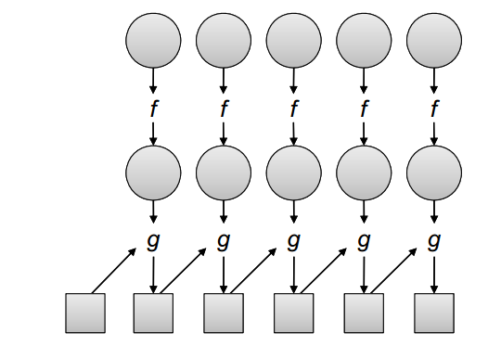
Map and Fold
http://lintool.github.io/MapReduceAlgorithms/index.html

Slide 31
MapReduce
Users specify a map and a reduce functions
map function processes a key/value pair to generate a set of intermediate key/value pairs
Shuffle and sort step:
Groups data by key, orders the values
reduce function merges all intermediate values associated with the same intermediate key
Values are in sorted order
programs written in this style are automatically parallelized and executed by a run time system

Slide 32
MapReduce
The run-time system handles
partitioning the input data
scheduling the program's execution across a set of machines
handling machine failures
managing the required inter-machine communication.
There are many implementations, one of the most popular is Apache Hadoop

Slide 33
MapReduce example
function map(String name, String document):
// name: document name
// document: document contents
for each word w in document:
emit (w, 1)
function reduce(String word, Iterator partialCounts):
// word: a word
// partialCounts: a list of aggregated partial counts
sum = 0
for each pc in partialCounts:
sum += ParseInt(pc)
emit (word, sum)

Slide 34
MapReduce example 1, word count
Input: Hello World Bye World
Hello Hadoop Goodbye Hadoop
map:
< Hello, 1>
< World, 1>
< Bye, 1>
< World, 1>
< Hello, 1>
< Hadoop, 1>
< Goodbye, 1>
< Hadoop, 1>
Shuffle:
<Hello, [1,1]> <World, [1, 1]> <Bye, [1]> <Hadoop, [1,1]> <Goodbye, [1]>
Reduce:
< Bye, 1>
< Goodbye, 1>
< Hadoop, 2>
< Hello, 2>
< World, 2>

Slide 35
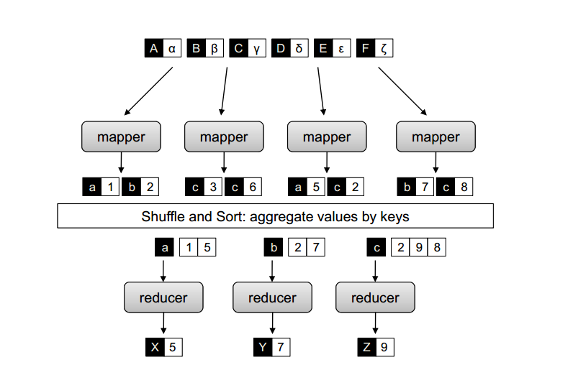
MapReduce, example 2
http://lintool.github.io/MapReduceAlgorithms/index.html

Slide 36
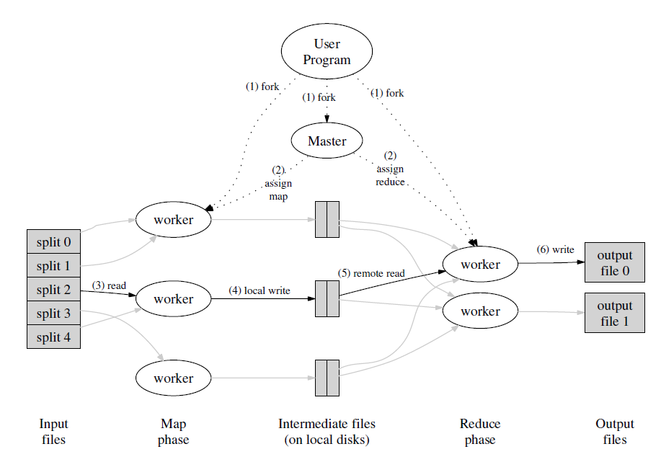
(From Jeffrey Dean and Sanjay Ghemawat, 2004)

Slide 37
Combiners
Word count emits a key-value pair for each word in the collection
all these key-value pairs need to be copied across the network
the amount of intermediate data will be larger than the input collection itself
Solution is to perform local aggregation on the output of each mapper
to compute a local count for a word over all the documents processed by the mapper
Combiner is an optimization in MapReduce that allows for local aggregation before the shuffle and sort phase
Might be viewed as “mini-reducer”
Reducer may be used as a combiner only if it is associative and commutative
In word count example reducer can be used as a combiner due to associativity and commutativity:
A+B+C = A + (B+C)
A+B = B + A

Slide 38
Partitioners
Partitioners are responsible for dividing up the intermediate key space and assigning intermediate key-value pairs to reducers
May help to handle imbalance in the amount of data associated with each key
So that each reducer would have equal number of keys

Slide 39
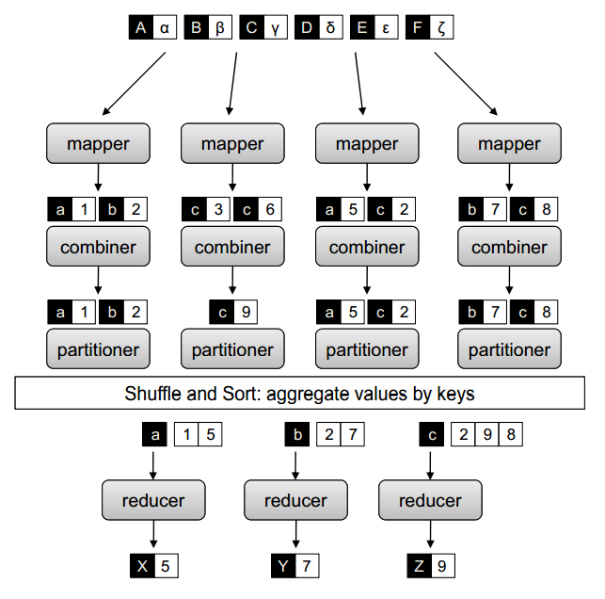
Combiners
http://lintool.github.io/MapReduceAlgorithms/MapReduce-book-final.pdf

Slide 40
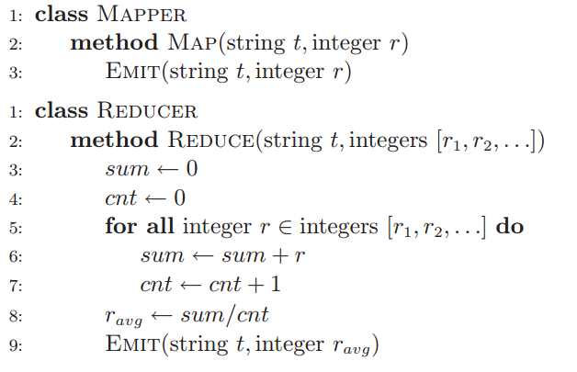
Combiner example
basic MapReduce algorithm that computes the mean of values associated with the same key
1) MapReduce for mean computation (without combiner)
From http://lintool.github.io/MapReduceAlgorithms/index.html

Slide 41

Combiner example
In mean computation, reducer cannot be used as a combiner, since

Slide 42
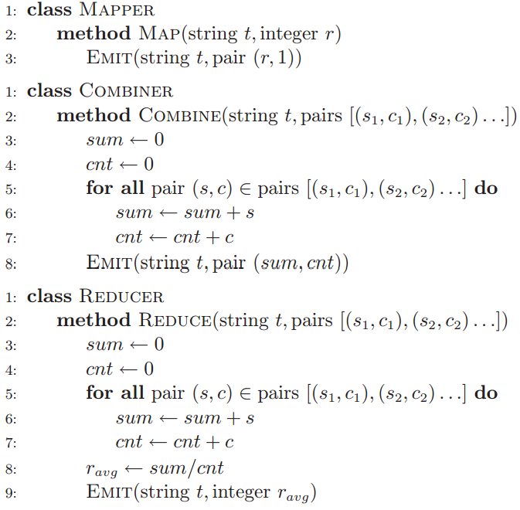
From http://lintool.github.io/MapReduceAlgorithms/index.html

Slide 43
Speculative execution
An optimization that is implemented by both Hadoop and Google’s MapReduce implementation
Idea:
the map phase of a job is only as fast as the slowest map task
Similarly, the completion time of a job is bounded by the running time of the slowest reduce task
with speculative execution, an identical copy of the same task is executed on a different machine, and the framework simply uses the result of the first task attempt to finish
Improves the results by 44% (Jeffrey Dean and Sanjay Ghemawat. MapReduce: Simplified data processing on large clusters, 2004)

Slide 44
MapReduce algorithms
many algorithms cannot be easily expressed as a single MapReduce job
complex algorithms may be decomposed into a sequence of jobs
output of one job becomes the input to the next
repeated execution until some convergence criteria

Slide 45
MapReduce applications
Count of URL Access Frequency: The map function processes logs of web page requests and outputs <URL, 1>. The reduce function adds together all values for the same URL and emits a <URL, total count> pair.
ReverseWeb-Link Graph: The map function outputs <target, source> pairs for each link to a target URL found in a page named source. The reduce function concatenates the list of all source URLs associated with a given target URL and emits the pair: <target, list(source)>

Slide 46
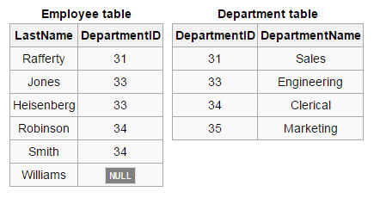
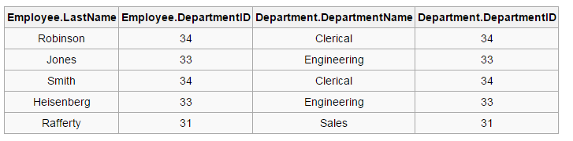
Data joins
SELECT * FROM employee JOIN department ON employee.DepartmentID = department.DepartmentID;

Slide 47
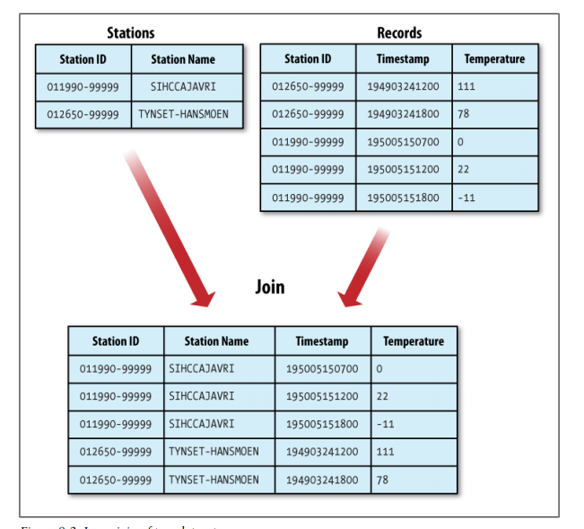

Slide 48
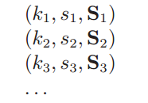
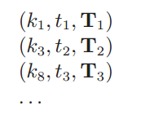
Data joins
Join may be implemented in MapReduce
Idea:
k – key, s – id, S - attributes
we map over both datasets and emit the join key as the intermediate key, and the tuple itself as the intermediate value
all tuples will be grouped by the join key
This is called reduce-side join

Slide 49
MapReduce implementations
Google MapReduce
Apache Hadoop
CouchDB
targeted specifically for multi-core processors
for GPGPUs (He et al., Mars: A MapReduce framework on graphics processors,2008)
And many others

Slide 50
Apache Hadoop
Open-source software framework for distributed storage and distributed processing of Big Data on clusters of commodity hardware
Was created in 2005, developed in Java
http://Hadoop.apache.org
Consists of:
Hadoop Common: The common utilities that support the other Hadoop modules.
Hadoop Distributed File System (HDFS™): A distributed file system that provides high-throughput access to application data.
Hadoop YARN: A framework for job scheduling and cluster resource management.
Hadoop MapReduce: A YARN-based system for parallel processing of large data sets.

Slide 51
Prominent users
EBay
532 nodes cluster (8 * 532 cores, 5.3PB).
Facebook
Apache Hadoop is used to store copies of internal log and dimension data sources and use it as a source for reporting/analytics and machine learning.
2 major clusters:
A 1100-machine cluster with 8800 cores and about 12 PB raw storage.
A 300-machine cluster with 2400 cores and about 3 PB raw storage.
Each (commodity) node has 8 cores and 12 TB of storage.
http://wiki.apache.org/hadoop/PoweredBy

Slide 52
Prominent users
Last.fm
100 nodes
Dual quad-core Xeon L5520 @ 2.27GHz & L5630 @ 2.13GHz , 24GB RAM, 8TB(4x2TB)/node storage.
Used for charts calculation, royalty reporting, log analysis, A/B testing, dataset merging
LinkedIn
~800 Westmere-based HP SL 170x, with 2x4 cores, 24GB RAM, 6x2TB SATA
~1900 Westmere-based SuperMicro X8DTT-H, with 2x6 cores, 24GB RAM, 6x2TB SATA
~1400 Sandy Bridge-based SuperMicro with 2x6 cores, 32GB RAM, 6x2TB SATA
http://wiki.apache.org/hadoop/PoweredBy

Slide 53
Hadoop cluster
Hadoop cluster includes a single master and multiple worker nodes.
The master node consists of a JobTracker, TaskTracker, NameNode and DataNode
May be replicated
A slave or worker node acts as both a DataNode and TaskTracker
Data are placed in HDFS filesystem

Slide 54
Hadoop cluster
Clients submit jobs to JobTracker
JobTracker submits it to available TaskTracker nodes in the cluster
JobTracker knows which node contains the data, and which other machines are nearby
Reduces network traffic because of rack awareness

Slide 55
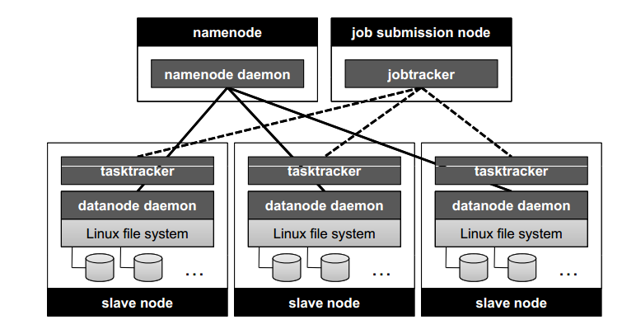
From http://lintool.github.io/MapReduceAlgorithms/index.html

Slide 56
MapReduce
Data locality is important: map tasks should use data available on the present node
For some tasks partitioning is important

Slide 57
HDFS
HDFS, The Hadoop Distributed File System
distributed file system designed to run on commodity hardware
HDFS is highly fault-tolerant
HDFS provides high throughput access to application data and is suitable for applications that have large data sets
Data in HDFS are automatically replicated
Metadata are stored in Namenode
Data are stored in Datanode
HDFS is not optimized for low-latency data access

Slide 58
HDFS
Each map task is assigned a sequence of input key-value pairs, called an input split in Hadoop.
Input splits are computed automatically and the execution framework strives to align them to HDFS block boundaries so that each map task is associated with a single data block.

Slide 59

http://hadoop.apache.org/docs/r1.2.1/hdfs_design.html

Slide 60
Map Reduce
Abstracts away distributed computing
Very scalable
Well supported
Includes suitable file system
Large ecosystem around Hadoop
Hbase
Hive
Pig

Slide 61
HBase
HBase is a column-oriented database
Runs on top of HDFS
Features
Linear and modular scalability.
Strictly consistent reads and writes.
Automatic and configurable sharding of tables

Slide 62
HBase data model
HBase organizes data into tables
Resembles SQL, but has different data model!
Row: Within a table, data is stored according to its row
Rows are identified uniquely by their row key
Column Family: Data within a row is grouped by column family.
Column families also impact the physical arrangement of data stored in HBase
Column Qualifier: Data within a column family is addressed via its column qualifier, or simply, column
Cell: A combination of row key, column family, and column qualifier uniquely identifies a cell
Values within a cell are versioned
Primary Functions: get, put, scan

Slide 63
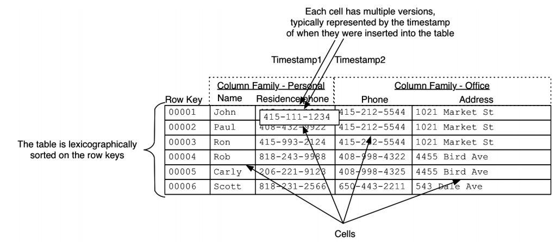
Amandeep Khurana, Introduction to HBase Schema Design, http://0b4af6cdc2f0c5998459-c0245c5c937c5dedcca3f1764ecc9b2f.r43.cf2.rackcdn.com/9353-login1210_khurana.pdf

Slide 64
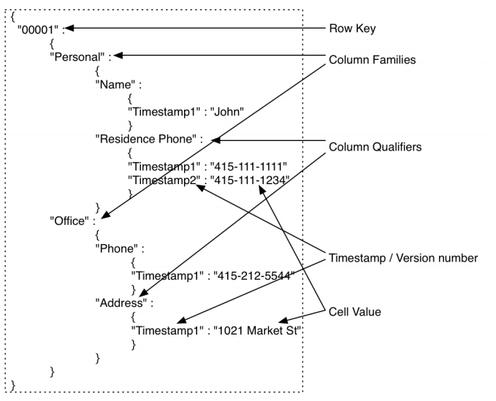
HBase row

Slide 65
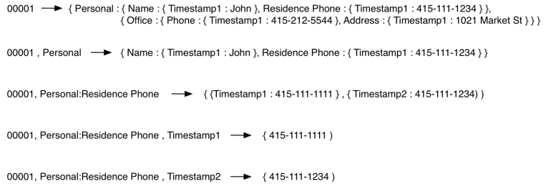
HBase row
Amandeep Khurana, Introduction to HBase Schema Design, http://0b4af6cdc2f0c5998459-c0245c5c937c5dedcca3f1764ecc9b2f.r43.cf2.rackcdn.com/9353-login1210_khurana.pdf

Slide 66
Apache Hive
Apache Hive is a data warehouse infrastructure built on top of Hadoop for providing data summarization, query, and analysis
Was originally developed by Facebook
supports analysis of large datasets stored in Hadoop's HDFS
HiveQL query language: based on SQL-92 standard but does not fully supports it
A compiler translates HiveQL statements into a directed acyclic graph of MapReduce jobs, which are submitted to Hadoop for execution
Hive should be used for batch processing, not the real time tasks!

Slide 67
HiveQL example
1)
CREATE TABLE a (k1 string, v1 string);
CREATE TABLE b (k2 string, v2 string);
SELECT k1, v1, k2, v2
FROM a JOIN b ON k1 = k2;
2)
SELECT a.* FROM a JOIN b ON (a.id = b.id AND a.department = b.department)

Slide 68
Apache Pig
Pig raises the level of abstraction for processing large datasets
Pig was originally developed by Yahoo
Pig consists of:
The language used to express data flows, called Pig Latin.
The execution environment to run Pig Latin programs.
Pig turns the transformations into a series of MapReduce jobs

Slide 69
Apache Pig
-- max_temp.pig: Finds the maximum temperature by year
records = LOAD 'input/ncdc/micro-tab/sample.txt'
AS (year:chararray, temperature:int, quality:int);
filtered_records = FILTER records BY temperature != 9999 AND
(quality == 0 OR quality == 1 OR quality == 4 OR quality == 5 OR quality == 9);
grouped_records = GROUP filtered_records BY year;
max_temp = FOREACH grouped_records GENERATE group,
MAX(filtered_records.temperature);
DUMP max_temp;

Slide 70
Apache Pig
DESCRIBE records;
>> records: {year: chararray,temperature: int,quality: int}
DUMP grouped_records;
>> (1949,{(1949,111,1),(1949,78,1)})
(1950,{(1950,0,1),(1950,22,1),(1950,-11,1)})
DESCRIBE grouped_records;
>> grouped_records: {group: chararray,filtered_records: {year: chararray,
temperature: int,quality: int}}

Slide 71
Apache Pig
input_lines = LOAD '/tmp/my-copy-of-all-pages-on-internet' AS (line:chararray);
-- Extract words from each line and put them into a pig bag
-- datatype, then flatten the bag to get one word on each row
words = FOREACH input_lines GENERATE FLATTEN(TOKENIZE(line)) AS word;
-- filter out any words that are just white spaces
filtered_words = FILTER words BY word MATCHES '\\w+';
-- create a group for each word
word_groups = GROUP filtered_words BY word;
-- count the entries in each group
word_count = FOREACH word_groups GENERATE COUNT(filtered_words) AS count, group AS word;
-- order the records by count
ordered_word_count = ORDER word_count BY count DESC;
STORE ordered_word_count INTO '/tmp/number-of-words-on-internet';

Slide 72
Map Reduce Alternative: Apache Spark
Is a cluster computing platform designed to be fast and general purpose
extends the popular MapReduce model
Developed in the University of California, Berkeley
Development started in 2009
In 2013 the project was donated to Apache Software Foundation
http://spark.apache.org/
Book: Holden Karau, Andy Konwinski, Patrick Wendell & Matei Zaharia, Learning Spark, 2015
Article: http://cacm.acm.org/magazines/2016/11/209116-apache-spark/fulltext

Slide 73
Apache Spark, key features
Run programs up to 100x faster than Hadoop MapReduce in memory, or 10x faster on disk.
Write applications quickly in Java, Scala, Python, R.
Contains API and shell
Combine SQL, streaming, and complex analytics.
Contains libraries, e.g. machine learning and graph processing

Slide 74
Apache Spark, deployment
Can be deployed at Amazon EC2
Standalone Deploy Mode: launch a standalone cluster quickly without a third-party cluster manager
Mesos: deploy a private cluster using Apache Mesos
YARN: deploy Spark on top of Hadoop NextGen (YARN)

Slide 75
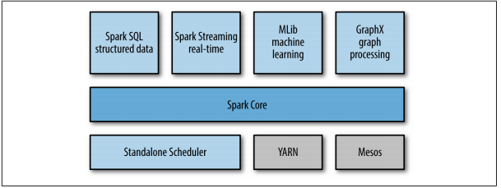
Spark architecture
From Holden Karau, Andy Konwinski, Patrick Wendell & Matei Zaharia, Learning Spark, 2015

Slide 76
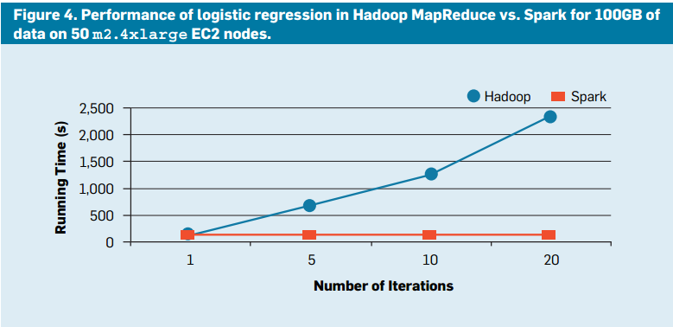
By Matei Zaharia, Reynold S. Xin, Patrick Wendell, Tathagata Das, Michael Armbrust, Ankur Dave, Xiangrui Meng, Josh Rosen, Shivaram Venkataraman, Michael J. Franklin, Ali Ghodsi, Joseph Gonzalez, Scott Shenker, Ion Stoica
Communications of the ACM, Vol. 59 No. 11, Pages 56-65
10.1145/2934664

Slide 77
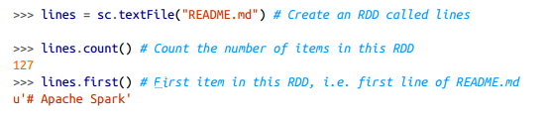
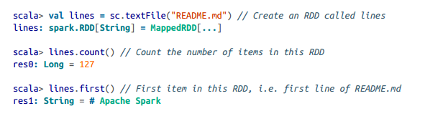
Examples
Python shell, word count
Scala shell, word count
From Holden Karau, Andy Konwinski, Patrick Wendell & Matei Zaharia, Learning Spark, 2015

Slide 78
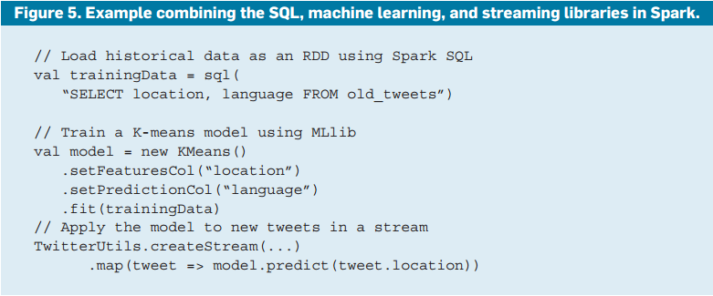

Slide 79
Core concepts
Primary abstraction is a Resilient Distributed Dataset (RDD)
Can be initialized with data, e.g. from CSV file, from database, etc.
Later, different operations can be applied to RDD.
RDD operations
Transformations: return new RDD
Actions: operations that return a final value to the driver program or write data to an external storage system
Spark’s RDDs are by default recomputed each time you run an action on them
RDD.persist() can be used to keep RDD in memory

Slide 80
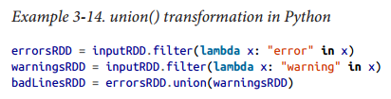
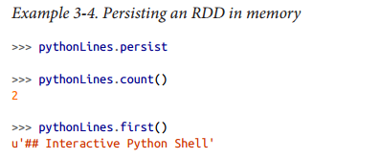
Example: union transformation
Persisting RDD in memory
From Holden Karau, Andy Konwinski, Patrick Wendell & Matei Zaharia, Learning Spark, 2015

Slide 81
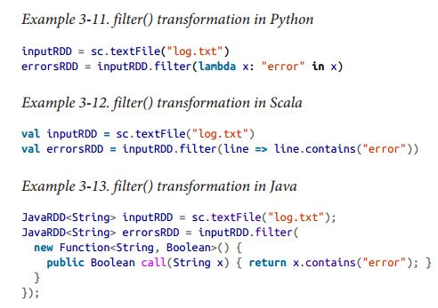
Example: filter transformation
From Holden Karau, Andy Konwinski, Patrick Wendell & Matei Zaharia, Learning Spark, 2015

Slide 82
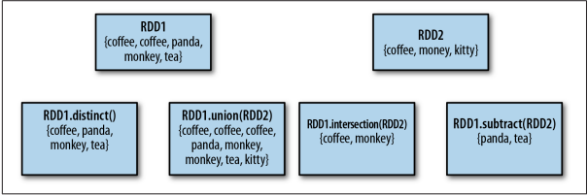
Common RDD operations
map – applies function to all RDD elements
filter - returns only those elements which adhere to filter
Set operations: union, subtract, distinct, intersection
From Holden Karau, Andy Konwinski, Patrick Wendell & Matei Zaharia, Learning Spark, 2015

Slide 83
Common RDD operations
reduce
takes a function that operates on two elements of the type in your RDD and returns a new element of the same type
sum = rdd.reduce(lambda x, y: x + y)
Aggregate
take(n) – returns subset of n elements of RDD
collect – returns all RDD elements
count, countByValue

Slide 84
Key-Value pairs operations
reduceByKey(func)
Combines values with the same key
groupByKey()
Group values with the same key.
keys()
Return an RDD of just the keys.
Join operations:
Inner join, rightOuterJoin, leftOuterJoin

