Slide 1
Managing with Big Data “at rest” - Storage
Michael Cochez
Adapted from slides by Alexander Semenov

Slide 2
Data at rest
Data at rest is inactive data which is stored physically in any digital form (e.g. databases, data warehouses, spreadsheets, archives, tapes, off-site backups, mobile devices etc.)
Data at Rest generally refers to data stored in persistent storage (disk, tape) while Data in Use generally refers to data being processed by a computer central processing unit
Data in Use – data being used and processed by CPU
Data in Motion – data that is being moved

Slide 3
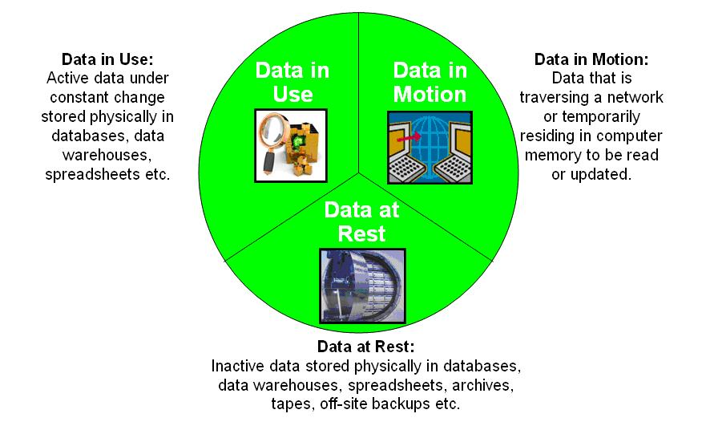
From http://en.wikipedia.org/wiki/Data_at_Rest

Slide 4
File formats
A file format is a standard way that information is encoded for storage in a computer file. It specifies how bits are used to encode information in a digital storage medium. (https://en.wikipedia.org/wiki/File_format)
There are many popular formats
TSV
CSV
JSON
XML
Different binary formats

Slide 5
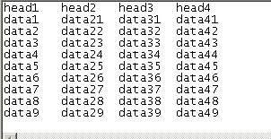
TSV
Tab-Separated Values
simple text format for storing data in a tabular structure

Slide 6
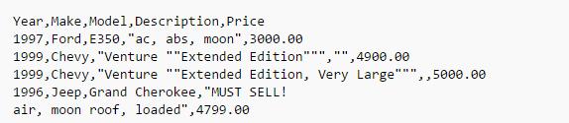
CSV
Comma Separated Values
the term "CSV" is widely used to refer a large family of formats
May be quoted, sometimes semicolon is used instead of comma

Slide 7
Delimiter collision
Delimiter collision is a problem that occurs when an author or programmer introduces delimiters into text without actually intending them to be interpreted as boundaries between separate regions
One method for avoiding delimiter collision is to use escape characters

Slide 8
XML
eXtensible Markup Language
Many APIs are XML-based
RSS (Rich Site Summary), Atom, SOAP (Simple Object Access Protocol)
Consists of tags with elements and attributes
<note>
<to>Tove</to>
<from>Jani</from>
<heading>Reminder</heading>
<body>Don't forget me this weekend!</body>
</note>

Slide 9
XML
<person firstName="John" lastName="Smith">
<address streetAddress="21 2nd Street" city="New York" state="NY" postalCode="10021" />
<phoneNumbers>
<phoneNumber type="home" number="212555-1234"/>
<phoneNumber type="fax" number="646555-4567"/>
</phoneNumbers>
</person>

Slide 10
JSON
Very often, data comes in JSON format
JavaScript Object Notation
Popular; there are JSON parsers in many languages, many sites provide JSON interfaces
Types:
Number
String
Boolean
Null
Object {} (similar to Python dictionary)
Array
Many NoSQL databases can import JSON documents directly

Slide 11
JSON
[ 100, 500, 300, 200, 400 ]
{ "firstName": "John", "lastName": "Smith", "age": 25, "address": { "streetAddress": "21 2nd Street", "city": "New York", "state": "NY", "postalCode": 10021 }, "phoneNumbers": [ { "type": "home", "number": "212 555-1234" }, { "type": "fax", "number": "646 555-4567" } ] }

Slide 12
Why do we need databases?
Assume you need to develop a software system for supermarket chain:
Retrieve every sale in every single store
Retrieve sales per day
Retrieve sale per region
Retrieve sales per product
How do you do it?
How to find the data
How to query the data
How many files you need?
What happens, if several users modify the data?

Slide 13
Databases
Data may be stored in the databases
A database is an organized collection of data
Database management systems (DBMSs) are computer software applications that interact with the user, other applications, and the database itself to capture and analyze data.

Slide 14
Benefits of the databases
Efficient data access
Data independence
Data integrity
Data administration
Concurrent access and crash recovery
Reduced application development time

Slide 15
Historical notes
1960’ies: The basic problem of data management (how to store data, i.e. a bit strings, onto disk and retrieve it later in the same form) was solved using files with records
It was understood that one needs programs and suitable programming languages to store, manipulate, and retrieve data

Slide 16
Historical notes
CODASYL: COnference on DAta SYstems Languages
Founded by industry and US-government (DoD) in 1959 and worked until 1980’ies
Developed COBOL, i.e. Common Business-Oriented Language (1st version Dec.1959)
In 1965, List Processing Task Force was founded within CODASYL to develop COBOL language extensions for processing collections of records

Slide 17
Historical notes
CODASYL developed DB concepts that are still in use
Division into Data Description Language (DDL) and Data Manipulation Language (DML)
DDL is used to specify the schema of the database, i.e. the record types and their relationships
DML is used to manipulate the database (retrieve, insert, delete, update records); but not to compute

Slide 18
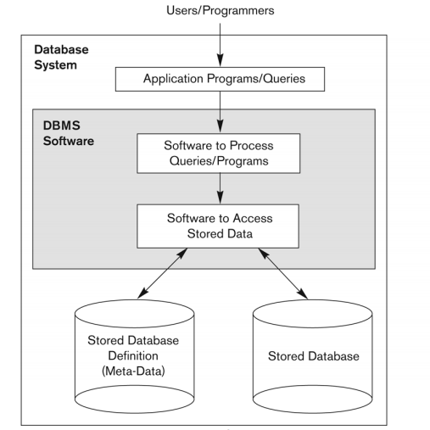
http://www.amazon.com/Fundamentals-Database-Systems-6th-Edition/dp/0136086209

Slide 19
Relational databases
Edgar Frank "Ted" Codd from IBM proposed in 1970’ies that CODASYL modeling ideas should be partially abandoned and one should move to relational model that is based on first-order logic
Record is renamed to row
Manipulation of data is set-oriented
Relational algebra is used as a basis
The central concept in relational model is the relation: set of rows, represented as a table
RelationName(field1:type1, field2:type2, … , fieldN:typeN)

Slide 20
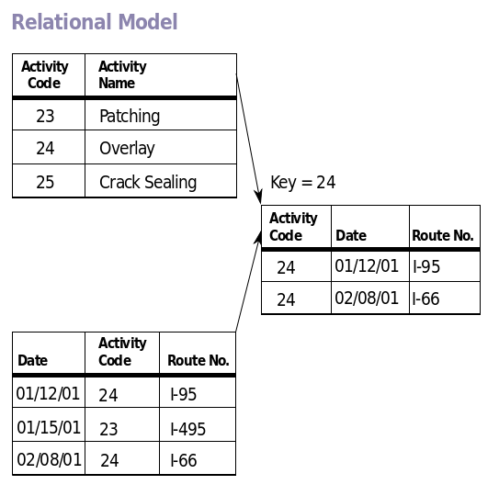
Relational databases

Slide 21
Relational databases
A relational database management system (RDBMS) is a database management system (DBMS) that is based on the relational model
The central concept in relational model is the relation: set of rows, represented as a table
RelationName(field1:type1, field2:type2, … ,fieldN:typeN)
The relational database model is based on the concept of two-dimensional tables.
Proposed by Edgar Frank "Ted" Codd from IBM in 1970.

Slide 22
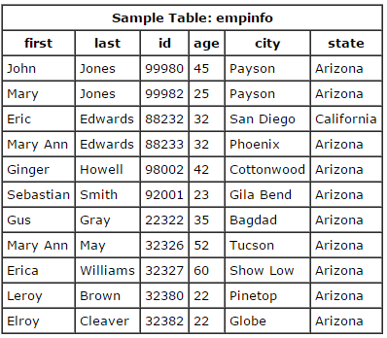
SQL
SQL – standard query language. Language designed for managing data held in RDBMS
select first, last, city
from empinfo;
select last, city, age
from empinfo where
age > 40;
select * from empinfo
where first = 'Eric';
From ”Fundamentals of Database Systems(Elmasri,Navathe), 2010”

Slide 23
SQL
Table can be created
Create table table_name (a int,b int, c int);
Data can be inserted or updated
Insert into table_name(a,b,c) values(1,2,10);
Create statement defines table schema; after that, the data must correspond to this schema
Schema can be edited (“alter table x add column id int”);
Generally, RDBMS require fixed schema

Slide 24
SQL
Using SQL rows can be selected from the table based on some predicates
Select * from table_name where a > b and c = 10;
Table elements can be counted
Select count(*) from table_name;
Multiple tables can be joined
Rows can be grouped

Slide 25
SELECT
SELECT returns a result set of records from one or more table
Retrieves zero or more rows from one or more tables
Results are not ordered, unless you order them explicitly!
The most commonly used command
http://www.postgresql.org/docs/8.4/static/sql-select.html

Slide 26
SELECT
General syntax:
SELECT select_list FROM table_expression [WHERE condition] [sort_specification]
select_list – list of column names (* - everything)
table_expression – table or several tables to select from
WHERE condition – filtering statement
Examples
SELECT * FROM products;
SELECT product_no FROM products;
SELECT * from product, orders where product.id = orders.id;

Slide 27
SELECT
WHERE clause
Syntax: “WHERE search_condition”, search_condition is any value expression (may be constructed using columns of the tables in FROM)
val > 1
val = 2
val1 = 1 AND val2 >3
Examples:
SELECT * FROM orders WHERE customer = 'Alex';
SELECT * FROM orders WHERE day_of_order > '7/31/16‘ and product_id = 4;

Slide 28
SELECT
ORDER (desc|asc)
Orders the results by some column
SELECT * FROM orders WHERE customer = 'Alex‘ order by product_id DESC;
LIMIT
Limits number of results
SELECT * FROM orders WHERE customer = 'Alex‘ LIMIT 10;
OFFSET
Adds offset (says to skip that many rows before beginning to return rows)
SELECT * FROM orders WHERE customer = 'Alex‘ OFFSET 10;
If you want to “scroll” down the results, OFFSET and LIMIT should be used together with “order by”, otherwise order may vary when you do “select” repeatedly
http://www.postgresql.org/docs/8.4/static/queries-limit.html

Slide 29
SELECT
SELECT DISTINCT …
Selects distinct values
SELECT COUNT(…)
Selects number of rows
GROUP BY clause
Groups together those rows which have the same value of grouping column
Select price, count(id) from products group by price;
SELECT x, sum(y) FROM test1 GROUP BY x;

Slide 30
SELECT
SELECT may be nested
SELECT a FROM (SELECT * from table1) as a;
SELECT may be used on several tables
SELECT * from table1, table2, table3, where …
SELECT * from table1, table1 where …
UNION, EXCEPT, and INTERSECT
May be used to combine several selects
SELECT * from table1 where … UNION select * from table2 where …

Slide 31
SQL, JOIN
Combines columns from several tables
CROSS JOIN
Returns Cartesian product of the tables
SELECT * FROM employee CROSS JOIN department;
SELECT * FROM employee, department
INNER JOIN
creates a new result table by combining column values of two (or more) tables
SELECT * FROM weather INNER JOIN cities ON (weather.city = cities.name);
Matches only those values, which exist in both tables

Slide 32
SQL, JOIN
create table employee(id serial, name text, dept int);
create table department(id int, name text);
insert into employee(name, dept) values('Alice', 1), ('Bob', 2), ('Alex', 1);
insert into department (name, id) values('Computer Science', 1), ('Operations Research', 2);
select * from employee join department on employee.dept = department.id;

Slide 33

SQL support
There are SQL standards: SQL-86, SQL-89, SQL-92, …, SQL:2008, SQL:2011
Considered one of the major reasons for the commercial success of relational databases
A number of RDBMS support SQL, some of them add some extensions
Oracle Database
Microsoft SQL Server
MySQL
IBM DB2
PostgreSQL
SQLite
Other tools:
Apache Hive
Big SQL

Slide 34
ACID properties
A transaction comprises a unit of work performed within a database management system (or similar system) against a database
Must have ACID properties: Atomicity, Consistency, Isolation, Durability
Atomicity
Atomicity requires that each transaction be "all or nothing": if one part of the transaction fails, the entire transaction fails, and the database state is left unchanged.

Slide 35
ACID properties
Consistency
The consistency property ensures that any transaction will bring the database from one valid state to another. Any data written to the database must be valid according to all defined rules
Isolation
The isolation property ensures that the concurrent execution of transactions result in a system state that would be obtained if transactions were executed serially, i.e. one after the other
Durability
Durability means that once a transaction has been committed, it will remain so, even in the event of power loss, crashes, or errors.

Slide 36
Summary
SQL offers very powerful querying mechanism
Advanced algorithms are used for query execution
cache
Data in RDBMS should be described by fixed schema
RDBMS software is usually very advanced
ACID properties (atomicity, consistency, integrity, durability)
May add overhead (e.g. while checking consistency, etc)

Slide 37
Example: PostgreSQL
Implements majority of SQL:2011 standard
Free and open source software, can be downloaded from http://postgresql.org
Runs on Linux, FreeBSD, and Microsoft Windows, and Mac OS X
Has interfaces for many programming languages, including C++, Python, PHP, and so on
From 9.2 supports JSON data type
Transactional and ACID compliant
Has many extensions, such as PostGIS (a project which adds support for geographic objects)
Supports basic partitioning
http://www.postgresql.org/docs/current/static/ddl-partitioning.html

Slide 38
Example: PostgreSQL
Maximum Database Size Unlimited
Maximum Table Size 32 TB
Maximum Row Size 1.6 TB
Maximum Field Size 1 GB
Maximum Rows per Table Unlimited
Maximum Columns per Table 250 – 1600
Maximum Indexes per Table Unlimited
Is this a “Big Data”?

Slide 39
Other databases
1980-1990:
Object oriented database systems
Multimedia databases
1990s:
XML databases (support XPath queries)
Distributed databases
2010s:
NoSQL databases
NewSQL databases

Slide 40
NoSQL databases
Carlo Strozzi first used the term NoSQL in 1998 as a name for his open source relational database that did not offer a SQL interface
The term was reintroduced in 2009 by Eric Evans in conjunction with an event discussing open source distributed databases
NoSQL stands for “Not Only SQL”

Slide 41
NoSQL databases
Broad class of database management systems that differ from the classic model of the relational database management system (RDBMS) in some significant ways, most important being they do not use SQL as their primary query language
Do not have fixed schema
Do not use join operations
May not have ACID (atomicity, consistency, isolation, durability)
Scale horizontally
Are referred to as “Structured storages”

Slide 42
NoSQL databases: motives
Avoidance of Unneeded Complexity
Relational databases provide a variety of features and strict data consistency. But this rich feature set and the ACID properties implemented by RDBMSs might be more than necessary for particular applications and use cases
High Throughput
Google is able to process 20 petabyte a day stored in Bigtable via it’s MapReduce approach
Taken from http://www.christof-strauch.de/nosqldbs.pdf

Slide 43
NoSQL databases: motives
Horizontal Scalability and Running on Commodity Hardware
for Web 2.0 companies the scalability aspect is considered crucial for their business
Avoidance of Expensive Object-Relational Mapping
important for applications with data structures of low complexity that can hardly benefit from the features of a relational database
when your database structure is very, very simple, SQL may not seem that beneficial
Taken from http://www.christof-strauch.de/nosqldbs.pdf

Slide 44
NoSQL databases: motives
Movements in Programming Languages and Development Frameworks
Ruby on Rails framework and others try to hide away the usage of a relational database
NoSQL datastores as well as some databases offered by cloud computing providers completely omit a relational database
Cloud computing needs
Taken from http://www.christof-strauch.de/nosqldbs.pdf

Slide 45
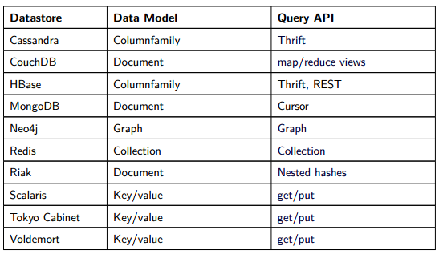
Data and query models
Taken from http://www.christof-strauch.de/nosqldbs.pdf

Slide 46
ACID vs BASE
ACID is contrasted with BASE
BASE:
Basically available
there will be a response to any request. But, that response could be a ‘failure’ to obtain the requested data or the data may be in an inconsistent or changing state.
Soft-state
The state of the system could change over time, so even during times without input there may be changes going on due to ‘eventual consistency’
Eventual consistency
The system will eventually become consistent once it stops receiving input. The data will propagate to everywhere it should sooner or later

Slide 47
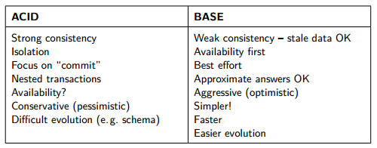
ACID vs BASE
Taken from http://www.christof-strauch.de/nosqldbs.pdf

Slide 48
ACID vs BASE
Strict Consistency
All read operations must return data from the latest completed write operation, regardless of which replica the operations went to
Eventual Consistency
Readers will see writes, as time goes on: "In a steady state, the system will eventually return the last written value".

Slide 49
CAP theorem
States that it is impossible for a distributed computer system to simultaneously provide all three of the following guarantees
Consistency
A distributed system is typically considered to be consistent if after an update operation of some writer all readers see his updates in some shared data source
Availability
a system is designed and implemented in a way that allows it to continue operation
Partition tolerance
These occur if two or more “islands” of network nodes arise which (temporarily or permanently) cannot connect to each other; dynamic addition and removal of nodes

Slide 50
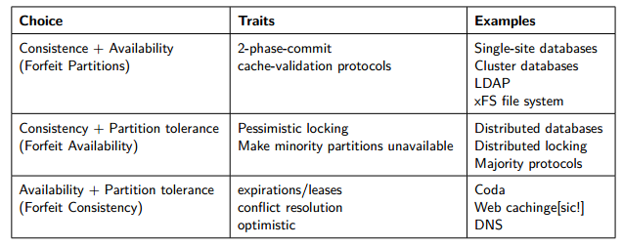
CAP theorem
Taken from http://www.christof-strauch.de/nosqldbs.pdf

Slide 51
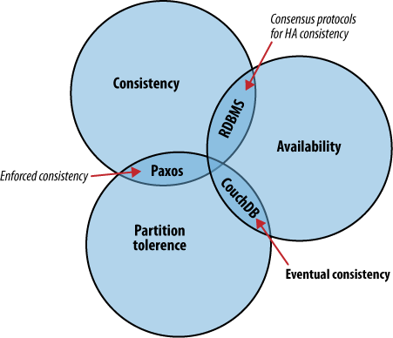
CAP theorem
Taken from http://guide.couchdb.org

Slide 52
NoSQL databases: criticism
Skepticism on the Business Side
As most of them are open-source software they are well appreciated by developers who do not have to care about licensing and commercial support issues
NoSQL as a Hype
Overenthusiasm because of the new technology
NoSQL as Being Nothing New
NoSQL Meant as a Total “No to SQL”

Slide 53
NoSQL example: Redis
REmote DIctionary Server
http://redis.io
http://try.redis.io/ - contains interactive tutorial
Number 1 in db-engines.com key-value stores ranking
Lightweight key-value storage
Stores data in RAM
Supports replication

Slide 54
NoSQL example: Redis
Supports strings, lists, sets, sorted sets, hashes, bitmaps, and hyperloglogs (probabilistic data structure used for approximate count of distinct elements)
See http://redis.io/topics/data-types-intro
http://try.redis.io/
> set mykey somevalue
OK
> get mykey
"somevalue"

Slide 55
NoSQL example: Redis
> set counter 100
OK
> incr counter
(integer) 101
> incr counter
(integer) 102
> incrby counter 50
(integer) 152

Slide 56
NoSQL example: Redis
> set key some-value
OK
> expire key 5
(integer) 1
> get key (immediately)
"some-value"
> get key (after some time)
(nil)

Slide 57
NoSQL example: Redis
> rpush mylist A
(integer) 1
> rpush mylist B
(integer) 2
> lpush mylist first
(integer) 3
> lrange mylist 0 -1
1) "first"
2) "A"
3) "B”
rpop mylist
B

Slide 58
NoSQL example: Redis
> hmset user:1000 username antirez birthyear 1977 verified 1
OK
> hget user:1000 username
"antirez"
> hget user:1000 birthyear
"1977"
> hgetall user:1000
1) "username"
2) "antirez"
3) "birthyear"
4) "1977"
5) "verified"
6) "1"

Slide 59
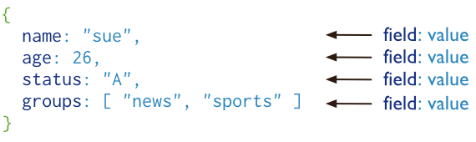
MongoDB
cross-platform document-oriented database
Stores “documents”, data structures composed of field and value pairs
Key features: high performance, high availability, automatic scaling, supports server-side JavaScript execution
Has interfaces for many programming languages
https://www.mongodb.org/
From http://www.mongodb.org/

Slide 60
MongoDB
> use mongotest
switched to db mongotest
>
> j = { name : "mongo" }
{ "name" : "mongo" }
> j
{ "name" : "mongo" }
> db.testData.insert( j )
WriteResult({ "nInserted" : 1 })
>
> db.testData.find();
{ "_id" : ObjectId("546d16f014c7cc427d660a7a"), "name" : "mongo" }
>
>
> k = { x : 3 }
{ "x" : 3 }
> show collections
system.indexes
testData
> db.testData.findOne()

Slide 61
MongoDB
> db.testData.find( { x : 18 } )
> db.testData.find( { x : 3 } )
> db.testData.find( { x : 3 } )
> db.testData.find( )
{ "_id" : ObjectId("546d16f014c7cc427d660a7a"), "name" : "mongo" }
>
> db.testData.insert( k )
WriteResult({ "nInserted" : 1 })
> db.testData.find( { x : 3 } )
{ "_id" : ObjectId("546d174714c7cc427d660a7b"), "x" : 3 }
>
> var c = db.testData.find( { x : 3 } )
> c
{ "_id" : ObjectId("546d174714c7cc427d660a7b"), "x" : 3 }

Slide 62
MongoDB
db.testData.find().limit(3)
db.testData.find( { x : {$gt:2} } )
> for(var i = 0; i < 100; i++){db.testData.insert({"x":i});}
WriteResult({ "nInserted" : 1 })
> db.testData.find( { x : {$gt:2} } )
{ "_id" : ObjectId("546d174714c7cc427d660a7b"), "x" : 3 }
{ "_id" : ObjectId("546d191514c7cc427d660a7f"), "x" : 3 }
{ "_id" : ObjectId("546d191514c7cc427d660a80"), "x" : 4 }
{ "_id" : ObjectId("546d191514c7cc427d660a81"), "x" : 5 }
{ "_id" : ObjectId("546d191514c7cc427d660a82"), "x" : 6 }
> db.testData.ensureIndex( { x: 1 } )

Slide 63
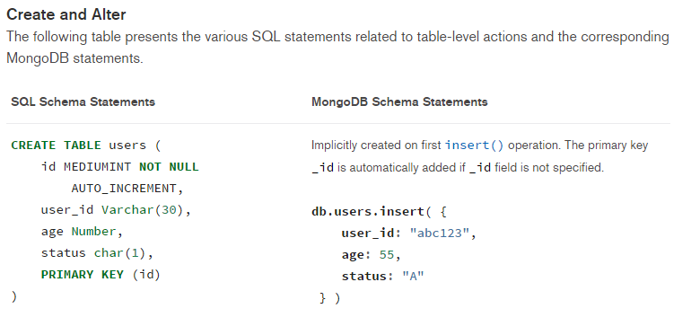
MongoDB vs SQL
https://docs.mongodb.org/manual/reference/sql-comparison/

Slide 64
Example: CouchDB, http://couchdb.org
Open source document-oriented database written mostly in the Erlang programming language
Development started in 2005
In February 2008, it became an Apache Incubator project and the license was changed to the Apache License rather than the GPL
Stores collection of JSON documents
Provides RESTFul API
Query ability is allowed via views:
Map and reduce functions

Slide 65
Example: CouchDB
When a view is queried, CouchDB takes the code of view and runs it on every document from the DB
View produces view result
Map function:
Written in JavaScript
Has single parameter – document
Can refer to document’s fields

Slide 66
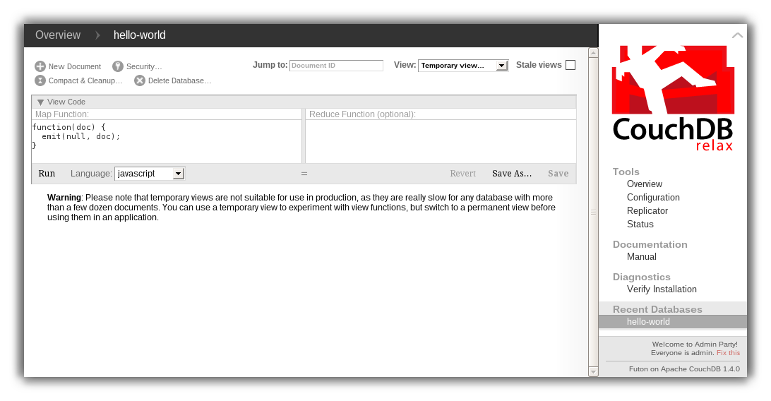
curl -X PUT http://127.0.0.1:5984/albums/6e1295ed6c29495e54cc05947f18c8af -d '{"title":"There is Nothing Left to Lose","artist":"Foo Fighters"}'

Slide 67
Example: CouchDB
"_id":"biking",
"_rev":"AE19EBC7654",
"title":"Biking",
"body":"My biggest hobby is mountainbiking. The other day...",
"date":"2009/01/30 18:04:11"
}
{
"_id":"bought-a-cat",
"_rev":"4A3BBEE711",
"title":"Bought a Cat",
"body":"I went to the the pet store earlier and brought home a little kitty...", "date":"2009/02/17 21:13:39"
} { "_id":"hello-world", "_rev":"43FBA4E7AB", "title":"Hello World", "body":"Well hello and welcome to my new blog...", "date":"2009/01/15 15:52:20" }

Slide 68
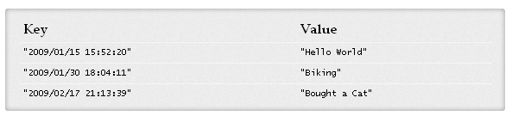
CouchDB: Example
View, Map function:
function(doc) { if(doc.date && doc.title) { emit(doc.date, doc.title); } }

Slide 69
CouchDB: Example
Map result is stored in B-tree
Reduce function operate on the sorted rows emitted by map function
Reduce function is applied to every leaf of B-tree
function(keys, values, reduce) { return sum(values); }

Slide 70
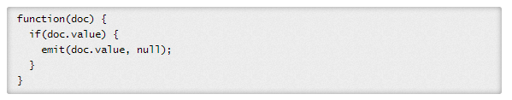
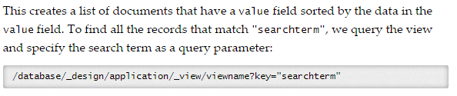
CouchDB vs SQL
http://guide.couchdb.org/draft/cookbook.html

Slide 71
Conclusions
PostgreSQL: Fixed schema, SQL query language. Database has different tables with data
MongoDB: stores JSON data, database has different collections, which store JSON documents
CouchDB: stores JSON data, database contains documents; view functions define the queries

