Slide 1
Cotiviti Clinical Intelligence Platform
Clinical Decision Making and Pattern Recognition in Health Care
Misgana Okbagaber
University of Washington

Slide 2
Problem Statement
Challenges
📄 Large amounts of patient data
⏳ Manual chart review
⚠️ High-risk patients
💰 Documentation & Payment Integrity
Goal
Support Treatment • Payment • Operations

Slide 3





Solution
Patient Data
Clinical Analysis
Decision Support
Treatment, Payment, Operations
Clinical Risk Scoring
Decision Support
Documentation Review
Payment Integrity
Operations Recommendations

Slide 4



Technologies Used
Python
Streamlit
Rule-Based Clinical Engine
Healthcare Analytics
Fast Prototype
Transparent Logic
Healthcare Focus

Slide 5



System Workflow
Patient Information
Clinical Risk Analysis
Documentation Review
Operations Recommendation
Export Report

Slide 6



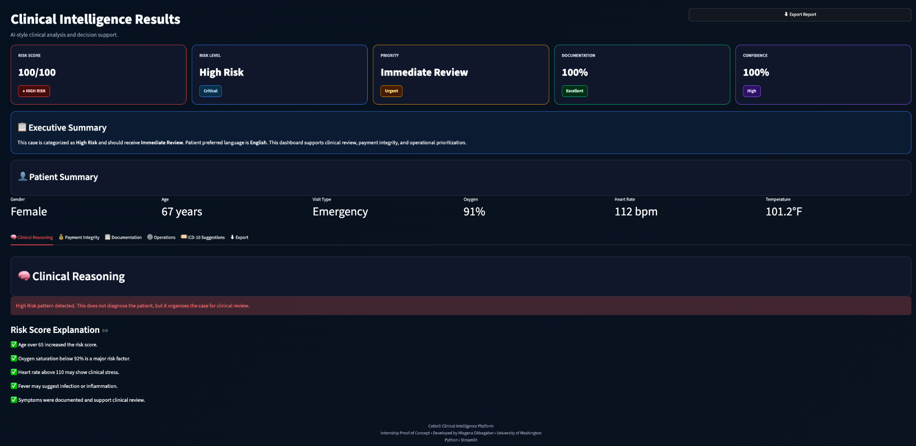


Proof of Concept

Slide 7





Key Features
Clinical Risk
Score
Clinical
Reasoning
Documentation
Review
Payment
Integrity
ICD-10 suggestions
Export
Report

Slide 8

Benefits
Treatment
Payment
Operations
Faster Clinical review
Risk prioritization
Decision support
Better documentation
Payment integrity
Coding consistency
Improved workflow
Resource planning
Operational efficiency

Slide 9


Future Improvements
Electronic
Heath Record
Integration
Large
Language
Models
Predictive
Analytics
Multilingual
Patient
Support

Slide 10



Conclusion
Built a Clinical Intelligence Dashboard
Demonstrated Clinical decision Support
Supported Treatment, Payment & Operations
Thank You!
Questions?
Misgana Okbagaber
University of Washington

