Slide 1
AgroEcoAdvisor
CO-DESIGN WORKSHOP · SODO · NOVEMBER 2026
Agroecology-based practice advice for Ethiopian farms — a prototype for your feedback
Misganu Tuse · Alliance of Bioversity International and CIAT
CGIAR Multifunctional Landscapes
Notes:
Welcome. Set the tone: this is a prototype and today is about their judgement, not a demonstration to approve.

Slide 2
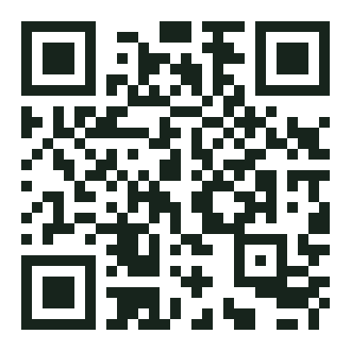



This is a prototype. We need your judgement.
WHY WE ARE HERE
We built a tool that turns field evidence into practice advice for a specific farm. Before we go further, we want to know whether it answers the questions you and farmers actually ask.
At the end you test it yourselves
Does it answer real questions?
The challenges and goals farmers bring to you — are they the ones in the tool?
What is missing?
Information it should ask for, practices it does not know, advice it gets wrong.
agroecoadvisor.duckdns.org
Who should use it, and how?
Works on your phone, in English, Amharic and Afaan Oromoo
A development agent with a farmer, an expert in the office, a farmer alone, or a printed sheet?
Nothing today is final. Wherever you see a green box, your input shapes the next version.

Slide 3
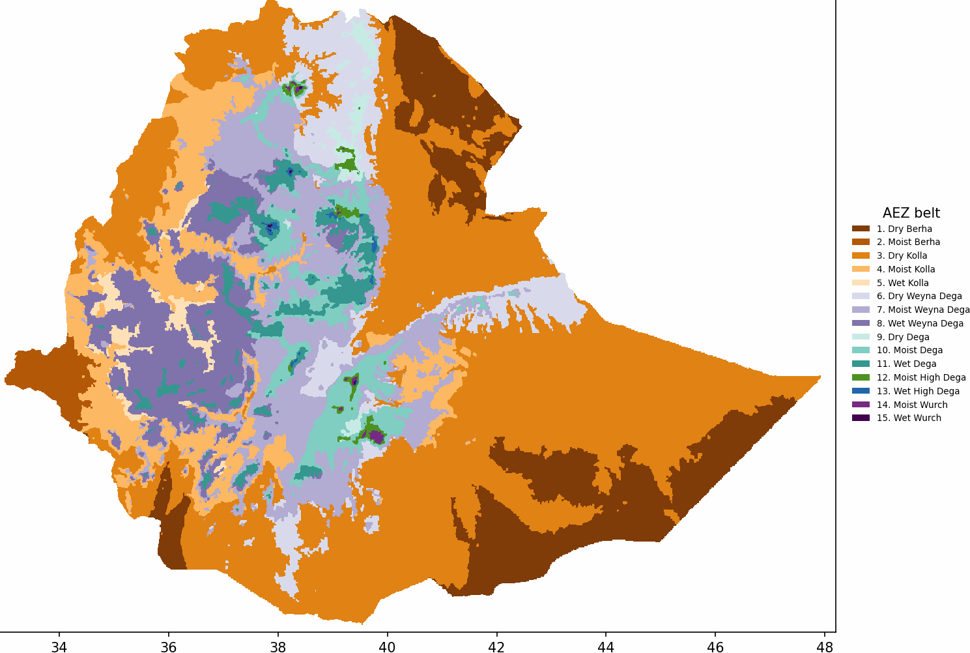
The right practice depends on where the farm is
THE PROBLEM
Ethiopia has 15 agro-ecological belts, from hot lowlands to cold highlands. A stone bund that halves erosion on a steep Dega slope is the wrong advice on a flat Vertisol plain.
Hundreds of field trials have measured what practices deliver in each setting. But that evidence sits in papers and databases, and it rarely reaches the development agent standing in the field with a farmer.
The question we try to answer: for this farm, this challenge and this goal, which practices does the evidence support, and how sure can we be?
Ethiopia's agro-ecological belts (altitude × moisture)

Slide 4
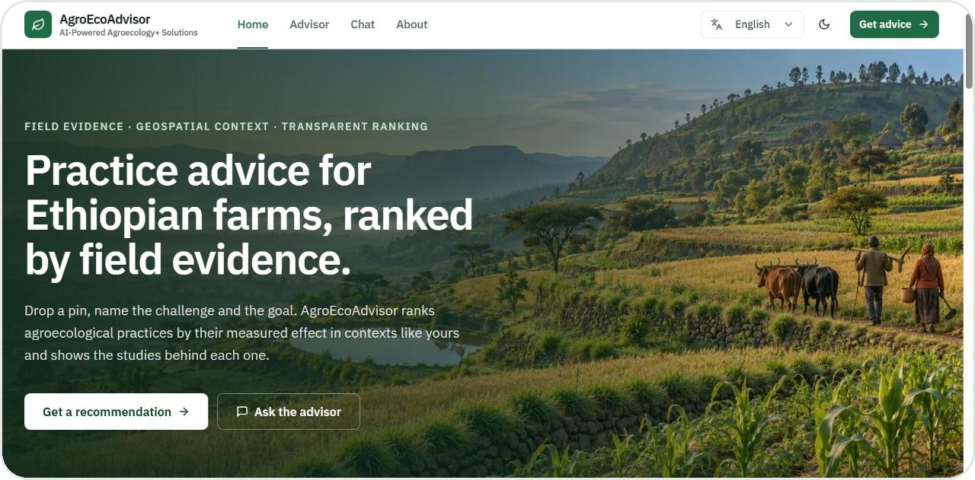
What the tool does, in three steps
WHAT IT IS
1
Set the location
Click the map or search the place. Rainfall, soil, slope and the belt are read automatically — nobody has to type them.
2
Choose the challenge and the goal
Five challenge areas; goals such as more yield, less soil loss, more income, better soil.
3
Review the ranked practices
The prototype's home page
Practices ordered by the evidence for that context, each with its confidence, the studies behind it, and how to implement it.
Guided advisor
Chat with voice
English · አማርኛ · Afaan Oromoo
Print or share the advice

Slide 5





Where the evidence comes from
HOW IT WAS BUILT · 1
Field trials in Ethiopia
8,664 paired observations from 337 studies: the same field with and without a practice. From the ERA database (Evidence for Resilient Agriculture) and an Ethiopian compilation of practice trials (Adimassu et al.).
Maps of the farm's context
11 layers on a 250 m grid: rainfall, temperature, rainfall seasonality, growing period, altitude, slope, soil clay, pH, soil carbon, land cover and the agro-ecological belt.
Research papers
Full text of 208 of the trial studies, so the advisor can explain the mechanisms behind a result.
Practical guidance
1,459 CGIAR guidance documents, the how-to layer: steps, conditions, labour.
Documented practices worldwide
WOCAT records of land-management technologies from 110+ countries. Coming next — access requested.
All sources are cited in the tool; dataset studies carry their full reference, guidance documents link to the CGSpace page.

Slide 6
From field trials to a model, in five steps
HOW IT WAS BUILT · 2
1
2
3
4
5
Collect and clean
One common measure
Add the farm's context
Train the model
Test it honestly
Two sources with different names and units became one table. Duplicates, impossible coordinates and zero-value entries were dropped; every removal is a written rule.
Each record compares the same field with and without a practice: effect = with ÷ without. Yield gains and erosion reductions can then sit in one model.
For every trial site, the 11 map layers were read at its coordinates — the same way the tool reads them for a user's pin.
A gradient-boosted model learns how a practice's effect changes with context: crop, belt, rainfall, slope, soil…
Judged only on studies it never saw during training, so the score reflects what a new farm gets.
Result: 8,664 observations · 337 studies · 100 practices · 80 crops · 12 belts with evidence — one clean table, nothing missing, every row traceable to its study.

Slide 7
What the model gives, and how far to trust it
HOW IT WAS BUILT · 3
For one farm, one challenge and one goal, the model scores every practice and puts them in order: a ranked list, an expected effect for each, and a confidence level.
We judge it as a ranking tool: does it put the right practice first?
The best practice is ranked first about half the time, where guessing would get it right one time in four.
The best practice lands in the top half three times out of four.
The order is more reliable than the exact percentage, so the tool says “about 70% less” and shows its confidence.
Where it is weak: yield and biomass rest on thousands of trials; income, soil carbon, runoff and soil loss on a few hundred. The tool labels those “thin evidence”.
Scored on 68 trial comparisons the model never saw in training

Slide 8
What the model knows about a farm
YOUR INPUT · THE MODEL'S VARIABLES
Uses today
Does not use yet
Practice and its challenge area
Crop
Goal (yield, soil loss, income, soil carbon, runoff, water use, biomass)
Agro-ecological belt and land cover
Rainfall, temperature and rainfall seasonality
Altitude, slope and soil clay content
Soil fertility status, pH, drainage, waterlogging
Labour and cost of the practice
Availability of inputs: seed, fertilizer, planting material
Farm size, livestock, household situation
Market access and prices
The farmer's own goal in his or her words
For discussion: Which of these change the advice you give in your woreda? Which three should the tool ask for first? What is missing from both lists?

Slide 9
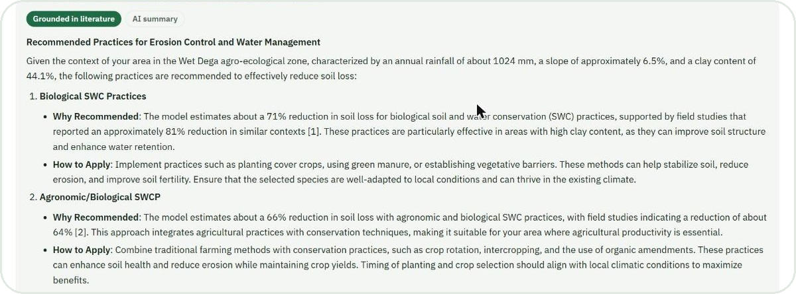
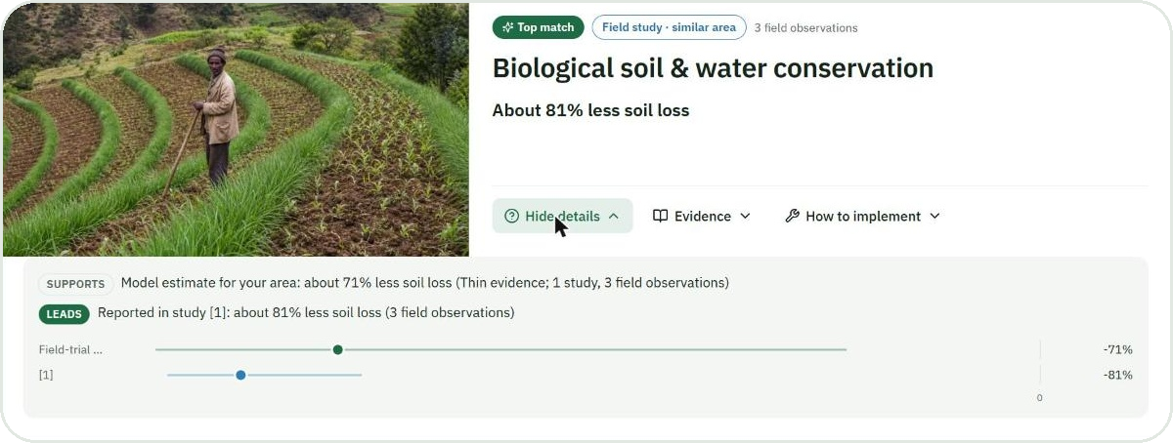
It reads the papers so you do not have to
HOW IT WAS BUILT · 4
1
How it was built
The 208 papers and 1,459 guidance documents were cut into about 21,000 short passages and indexed, so the tool can find the right passage for any practice and context.
2
How it works
For each recommended practice, the tool finds the passages about that practice in similar settings. An AI writer then explains why it fits and how to implement it, using only those passages, with a citation on every statement.
The Evidence panel: why the practice fits this farm, and how to apply it, each with its source
3
The safety rule
The AI writer is never allowed to invent a number. Every figure must come from the model, a study, or the farm's own context; a sentence without a source is removed.
“Why this?” — the model's estimate and what a nearby study measured, side by side

Slide 10
Which study measured what, and where
HOW IT WAS BUILT · 5
Every study, practice, crop, belt and outcome is a point, and the links between them say who measured what, where. This is what lets the tool answer questions like:
Study
measured effect
Practice
made of
Component
How many trials of this practice happened in a belt like yours?
What did each of those studies actually measure?
Which related practices have evidence for other goals, and could still be worth trying?
Where does every number come from?
trial site
for this goal
same as
Belt
Outcome
WOCAT
measure
Why it matters for you: when a study from a setting like yours exists, the tool shows that study's result and names it, instead of relying on the model alone.
337 studies · 100 practices · 44 components · 12 belts · 7 goals, with the source of every link recorded

Slide 11


Several kinds of evidence, one recommendation
HOW IT ALL COMES TOGETHER
Model leads
Field-trial model
when its evidence for this goal is solid and includes trials in your zone.
Study results
A study leads
when the model is thin but a trial measured this practice and goal in a setting like yours. The tool names it.
Research papers
One advice
ranked · explained · cited
Documents propose
Guidance documents
when no trial numbers exist: guidance and records suggest practices, with sources and without invented numbers.
Evidence map
Always
WOCAT records (next)
thin evidence is said plainly, and every number can be traced to its source in one click.

Slide 12
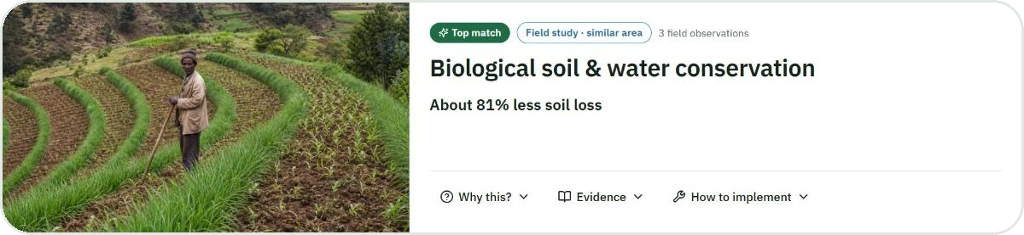
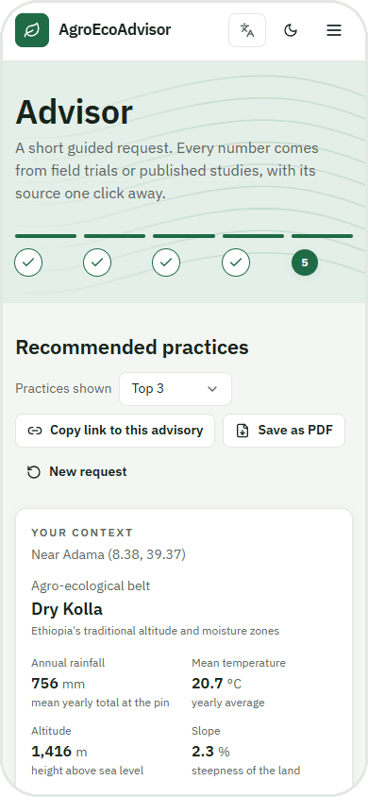
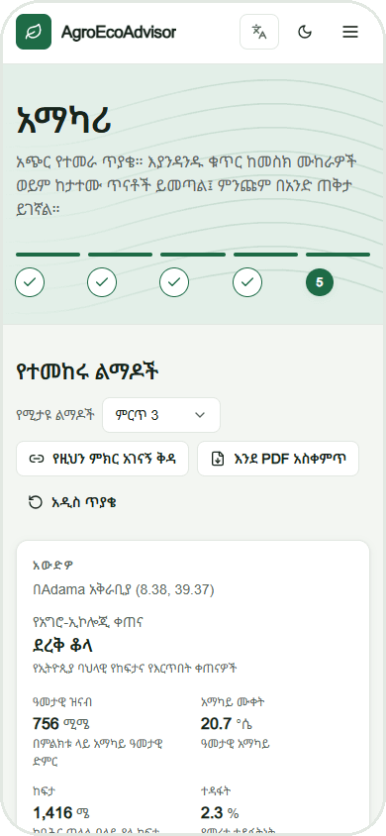
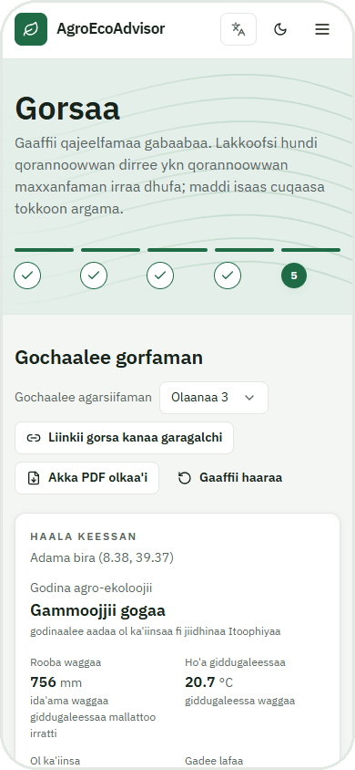
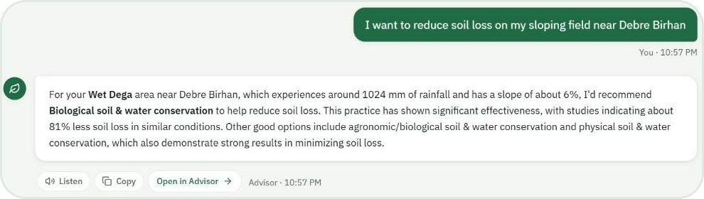
What a development agent sees
THE PROTOTYPE
A ranked practice: the headline in words, where the number comes from, and three buttons — Why this? · Evidence · How to implement
English
አማርኛ
Afaan Oromoo
Same tool on a phone, in three languages
Ask yourself: would you open this with a farmer? What would you change first?
The chat: ask in plain words, by typing or by voice; ask “why?” and it shows the evidence

Slide 13


What it does not do yet
THE PROTOTYPE
It is Ethiopian evidence only
Trials from Ethiopia, maps of Ethiopia. Going beyond is the next step, not today.
Some goals rest on few trials
Income, soil carbon, runoff and soil loss have hundreds of observations, not thousands. The tool says “thin evidence” rather than hiding it.
It does not know costs, labour or inputs
A practice can rank first and still be out of reach for a household. That judgement is yours, and we want to learn how to build it in.
It needs a phone with internet
The map loads only when opened to save data, but the advice itself needs a connection. A printed sheet is possible today; SMS or offline is a question for you.
It is advice, not a prescription
A starting point for the conversation between a development agent and a farmer, with the evidence open for both to see.

Slide 14

Beyond Ethiopia, and beyond trials
WHAT COMES NEXT
WOCAT practice records
Worldwide coverage
Your feedback → the next version
The World Overview of Conservation Approaches and Technologies documents land-management practices from more than 110 countries, with the compilers' ratings of their impact. Access has been requested; one account covers every country.
Global map layers and a wider evidence base, so the same evidence-first ranking can serve farms outside Ethiopia.
Today's input decides what we build first: the variables the tool asks for, the goals it offers, the languages, and how it reaches farmers.
Adds: practices that have no trial yet, cross-country context, how-to detail
Adds: the same tool for other countries and programmes
Adds: a tool shaped by the people who will use it

Slide 15
Help us shape it: seven questions
FOR DISCUSSION
1
Who uses it?
2
Which goals matter most here?
A development agent with the farmer, a woreda expert in the office, the farmer alone, or a printed sheet from the kebele office?
Yield, soil loss, income, soil fertility, water? Are there goals the tool does not offer?
3
What should it ask that it does not?
4
Are the practice names right?
Soil condition, labour, cost, inputs, farm size, livestock, market, the farmer's own words?
Do the practices and their names match what you and farmers call them locally?
5
Languages and voice
6
What makes you trust an answer?
Are English, Amharic and Afaan Oromoo enough? Would Wolaytta or another language change who can use it? Is voice useful?
Seeing the studies? A local example? A known expert's endorsement? A confidence label?
7
How should it reach farmers?
Phone app, SMS, radio script, printed advisory, training for DAs?

Slide 16
Now try it yourselves
HANDS-ON
1
Pick a real place
Search a kebele or town you know, or click the map. Check the belt, rainfall and soil it shows: is that right?
2
Ask a real question
Choose a challenge and goal a farmer brought to you this season. Or type it in the chat, in any of the three languages.
3
Read the evidence
Open “Why this?” and “Evidence”. Would you give this advice? What is wrong, missing, or surprising?
agroecoadvisor.duckdns.org
Tell us
Scan with your phone camera, or type the address
4
Fill the feedback sheet: one thing to keep, one thing to change, one thing to add.
The prototype runs on a test server for this workshop. Nothing you type is stored beyond the session.

Slide 17
Over to you
THANK YOU
Your experience shapes what we build next. The evidence is in the tool; whether it is useful depends on you.
Misganu Tuse · m.tuse@cgiar.org
Alliance of Bioversity International and CIAT · CGIAR Multifunctional Landscapes

