Slide 1
AgroEcoAdvisor
ALLIANCE OF BIOVERSITY INTERNATIONAL & CIAT · ETHIOPIA
AI-Powered Agroecology+ Solutions
Debre Birhan · Wet Dega
1,024 mm · 2,821 m · pH 6.4
Practice advice for farms, ranked by field evidence and explained from the studies behind it — a field-trial model, published studies, retrieval and a knowledge graph fused into one answer.
Misganu Tuse · Alliance of Bioversity International & CIAT · November 2026
Notes:
Opening. AgroEcoAdvisor is the renamed, expanded AgroGuide: the same evidence base, now fused with study-level evidence, retrieval and a knowledge graph, delivered in three languages.

Slide 2
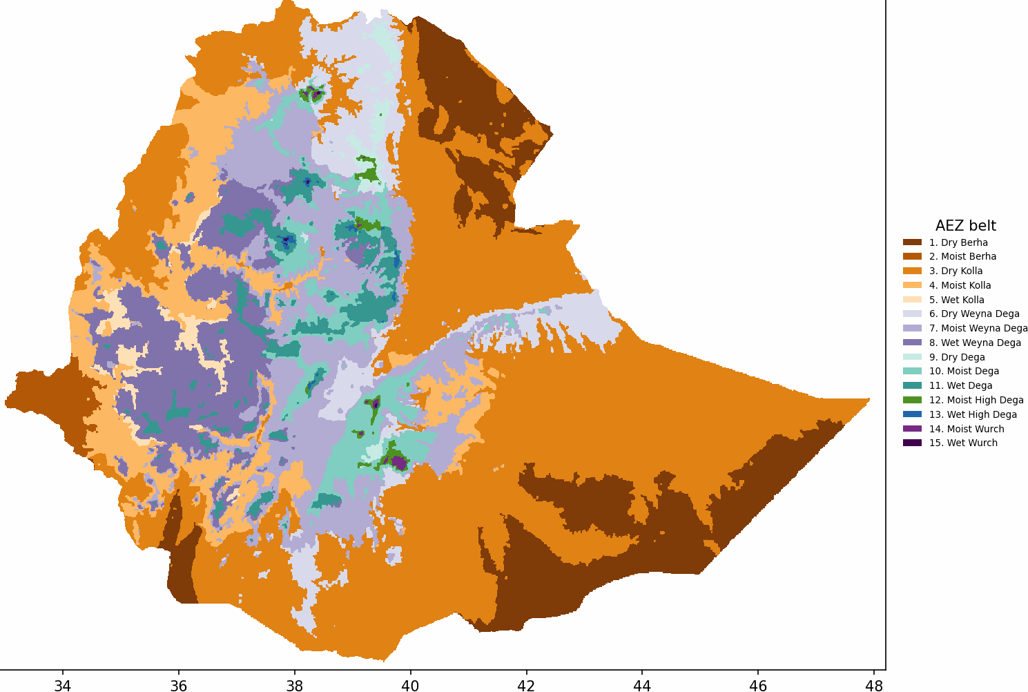
The right practice depends on where you farm
WHY THIS MATTERS
Ethiopia spans 15 agro-ecological belts, from hot arid Berha lowlands to cold Wurch highlands. A soil bund that halves erosion on a steep Dega slope is the wrong advice on flat Vertisol plains; drought-tolerant varieties matter in Dry Kolla, drainage in the wet highlands.
Hundreds of field experiments have measured what practices deliver, but that evidence sits in scattered datasets and papers, and extension advice rarely reaches farm-level context.
The question: for this location, this challenge and this objective, which practices does the evidence support, and how sure can we be?
12
100
7
5
Ethiopia's agro-ecological belts (altitude × moisture) — the anchor of the geospatial context
belts with evidence
practices
objectives
challenge families
Notes:
Context: location-specific practice advice. Evidence exists but is scattered and not delivered at farm context.

Slide 3

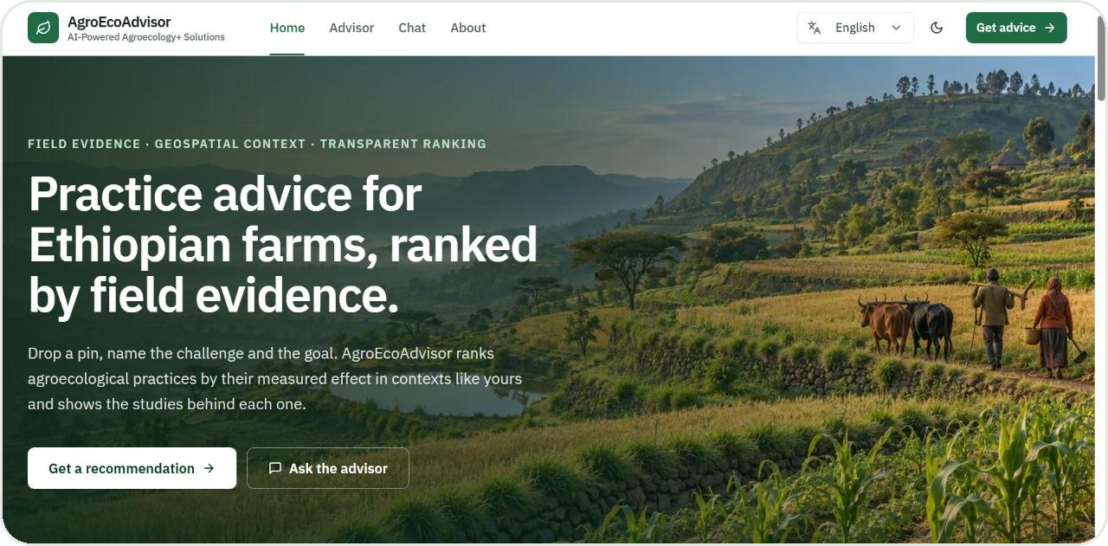


From a map pin to ranked, evidence-backed practices
WHAT WE BUILT
Set the location
Click the map, search a place or use your position. Rainfall, soil, terrain and the agro-ecological belt are read from 11 geospatial layers automatically.
Choose the challenge and the objective
One of five challenge families and the outcome to change: yield, biomass, income, soil loss, runoff, water use or soil carbon.
Review the ranked practices
Practices ordered by the best evidence for that context, each with its confidence, the studies behind it, a cited explanation and how-to steps.
The home page of the live system (localhost build, November 2026)
Advisor · guided request
Chat · plain language and voice
English · Amharic · Afaan Oromoo
Print / PDF advisory

Slide 4






The evidence behind every answer
AT A GLANCE
8,664
337
208
paired field observations
field studies
full-text papers
with / without a practice, Ethiopia
from two harmonised corpora
1,191 retrievable evidence passages
1,459
720
11
guidance documents
knowledge-graph nodes
geospatial layers
19,997 passages from CGIAR knowledge products
1,961 provenance-carrying edges
on one 250 m grid, read from the pin
Counts as of 1 November 2026; the model-ready dataset, the retrieval corpora and the knowledge graph are versioned in the repository.

Slide 5


Two evidence corpora, one common currency
EVIDENCE BASE
ERA — Evidence for Resilient Agriculture
CSA compilation (Adimassu et al.)
CGIAR meta-analysis database, Ethiopia subset
Context-specific CSA trials across Ethiopia's agro-ecological zones
7,250 observations
1,414 observations
Strong on productivity: yield and biomass; global practice taxonomy
Strong on soil and water: soil loss, runoff, soil carbon; Ethiopian practice names
Common currency: the response ratio. Every record compares the same field with and without a practice. The model learns ln(with ÷ without): a symmetric, unit-free effect size that lets yield gains, erosion reductions and income effects live in one model.
8,664 rows · 337 studies · 100 practices · 80 crops · 12 belts

Slide 6
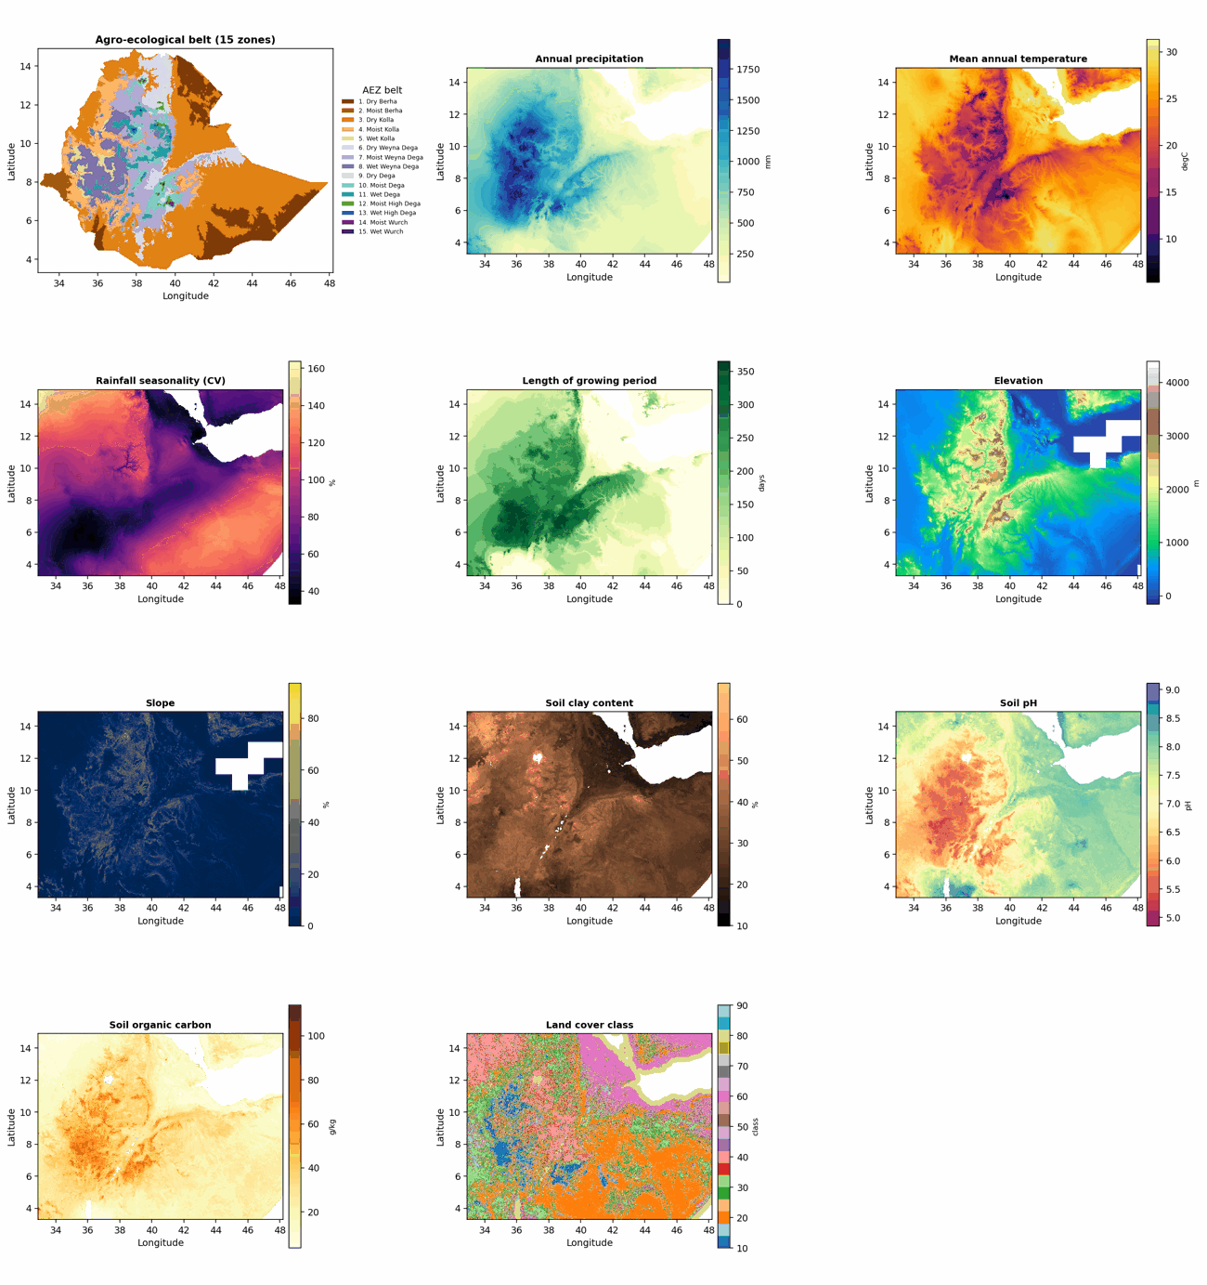




One pin replaces a form full of numbers
GEOSPATIAL CONTEXT
No farmer knows their soil clay share or rainfall seasonality index, so the system never asks. Every context feature is read from the map pin, and the same routine serves training and live prediction.
Climate
Annual rainfall · mean temperature · rainfall seasonality · length of growing period
Terrain
Elevation · slope
Soil
Clay content · pH · soil organic carbon
Land
Land cover · agro-ecological belt (altitude × moisture)
WorldClim · SoilGrids · Copernicus DEM · ESA WorldCover · FAO growing period · Ethiopian AEZ belts — 250 m grid
The feature stack, wall to wall across Ethiopia

Slide 7
A field-trial model that ranks practices for a context
THE RANKING MODEL
A gradient-boosted model (HistGBM) learns the log response ratio from 13 inputs: practice and family, crop, objective, agro-ecological belt, land cover, rainfall, temperature, seasonality, altitude, slope and clay. For one pin it scores every practice in the chosen family and orders them.
A ranking tool is judged by its ranking skill, scored on held-out studies inside (study × objective) cells that compare three or more practices:
0.70
0.51
pairwise concordance (C-index; 0.50 = coin flip)
median Spearman ρ, predicted vs observed order
Fit, for reference. R² = 0.51 on a random train / test split. Half of the variance in field outcomes is site, season and management, so the ranking metrics, not R², are the headline for a tool that orders practices.
68 cells, 584 comparable pairs; mean ± sd over 10 repetitions of 5 study-grouped folds

Slide 8
Confidence is part of the answer
HONEST BY DESIGN
Evidence depth differs by objective. Yield and biomass rest on thousands of observations; soil loss, runoff, income and soil carbon on a few hundred. The advisor carries that difference into every card instead of hiding it.
What the farmer sees
Field-trial model
Field study · your zone
Objective | Observations | Model confidence
Yield | 5,910 | Medium
Biomass yield | 1,525 | Medium
Runoff | 359 | Thin
Soil loss | 296 | Thin
Water use efficiency | 255 | Thin
Income | 208 | Thin
Soil organic matter | 111 | Thin
Field study · similar area
Thin evidence
One source chip per practice says where its headline number comes from.
Thin evidence is said plainly: “a starting point, not a forecast.”
Out-of-zone evidence is labelled “similar area” or “similar rainfall”, never passed off as local.
The same vocabulary is used in the Advisor, the chat and the printed advisory.

Slide 9
For most requests, the model alone is not enough
BEYOND ONE MODEL
We scored 1,330 advisories — 38 pins across Ethiopia × 35 challenge-objective pairs — and asked how deep the field evidence is behind the model's own top practices.
Model-led 294 advisories · 22%
the top practices rest on ≥ 3 studies, ≥ 10 observations, with evidence in the user's zone
Hybrid 846 advisories · 64%
the model ranks, but its evidence is thin or measured elsewhere
Knowledge-led 190 advisories · 14%
the dataset cannot rank at all: documented practices are the answer
In 78% of requests the honest answer needs more than the model: that is why AgroEcoAdvisor fuses evidence.
Mode report, 1 November 2026 (conservative ordering); 0 errors, 0 numeric-guard failures

Slide 10

Six sources, one answer
EVIDENCE FUSION
Field-trial model
Study-level field evidence
Study passages
Context-conditioned effect estimate, confidence and ranking for the pin.
Each study's measured effect for the practice, with its belt, crop and observation count — aggregated from dataset rows, never generated.
Mechanisms, conditions and reported results from the papers the model learned from (Tier 1).
8,664 observations
337 studies
208 papers · 1,191 passages
Guidance documents
Knowledge graph
Practice records
How-to, conditions, costs and labour from CGIAR knowledge products (Tier 2, GARDIAN / CGSpace).
Links studies, practices, components, belts, crops and indicators; every edge carries provenance.
WOCAT Global SLM Database technologies and approaches, cross-country context (CC BY-NC-SA).
1,459 documents · 19,997 passages
720 nodes · 1,961 edges
planned · API access requested
The AI writer explains and instructs. It is never a source of numbers.

Slide 11



A knowledge graph with provenance on every edge
KNOWLEDGE GRAPH
Counts the evidence
Per practice and objective: studies, field observations, and how many fall in the user's belt and moisture zone.
Study
337
Practice
100
Component
44
REPORTS_EFFECT
COMPOSED_OF
Holds measured effects
REPORTS_EFFECT edges carry each study's aggregated effect, so a context-matched study can lead a recommendation.
STUDIED_IN
IN_FAMILY
MAPS_TO
Proposes documented practices
Same-family components with evidence for other objectives; the WOCAT crosswalk maps them to standard SLM measures.
AEZ belt
12
Family
5
WOCAT measure
30
Keeps provenance
Every edge names the rows, manifest or record it came from. Numbers on edges are aggregates, never generated.
Also in the graph: 69 impact variables, 40 context classes, 32 degradation types, 14 crop groups, 7 indicators

Slide 12


The best evidence for your context leads — the rest supports
WHICH EVIDENCE LEADS
Model-led
Study-led
Documented
The model's confidence for this objective is at least medium and the practice has observations in your moisture zone.
The model is thin or has no in-zone evidence, but a study measured this outcome for this practice in your zone, belt or context class.
No quantitative evidence for this objective here. Guidance, practice records and graph relations propose the practice with citations.
Headline: the model estimate for your area
Headline: the effect reported in that study
Headline: none — sources shown, no invented number
When sources disagree — opposite directions, or more than 25 points apart — the headline becomes a range or “evidence varies”, and both values are shown.
Conservative ordering — practices are ordered by estimate − k · uncertainty, so a well-studied practice is no longer buried under a thinly-evidenced combination.

Slide 13
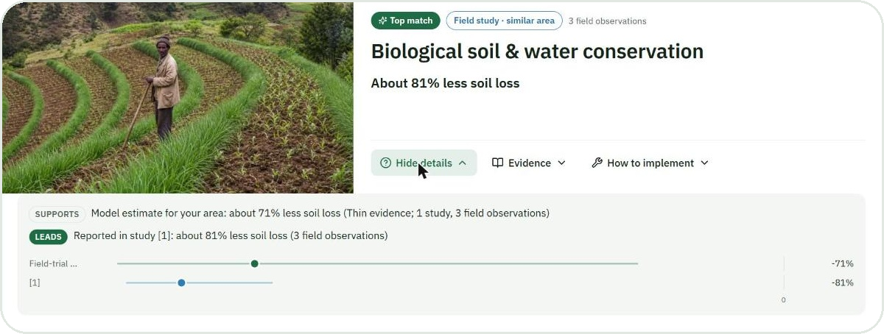
Every number has a source
TRUST
A number shown to a user must be one of:
the model's estimate for this request,
a study-level effect computed from the dataset,
a figure stated verbatim in a cited passage, in the same sentence as its citation,
a value of the user's own context, or a count.
A sentence-level guard removes any sentence with an unsourced number; if too much is removed, a deterministic, citation-built text takes over. Every number travels with its provenance — value, unit, source, reference — and the interface decides when to show the label.
Model estimate for your area: about 71% less soil loss (thin evidence; 1 study, 3 field observations)
SUPPORTS
LEADS
Reported in study [1]: about 81% less soil loss (3 field observations)
Plain language by default; the labels and citations appear in “Why this?”, “Evidence”, the printed advisory, and in chat when someone asks why.
“Why this?” on a live card: the study leads, the model supports, both labelled, with a 0-anchored dot-and-interval chart

Slide 14
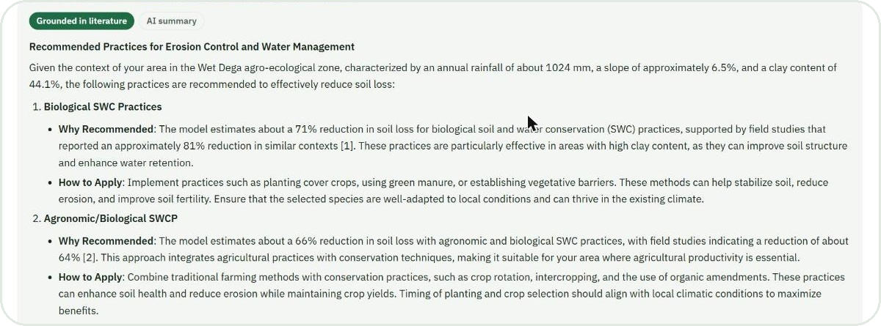

Retrieval explains, never invents
RETRIEVAL-AUGMENTED EXPLANATION
Two tiers, never mixed
Study passages (Tier 1) carry evidence and citations [n]; guidance passages (Tier 2) inform how-to steps, cited [Gn]. Hybrid dense + keyword retrieval over a Chroma index.
Cite or stay silent
Every statement is grounded in retrieved passages with provenance (ERA code, DOI, handle). If grounding fails, a deterministic template takes over.
The Evidence panel: a grounded explanation with the context, the why and the how-to, each cited to the study or guidance document
Clean sources
0
62%
1,248
A quality gate removes reference lists and boilerplate (10% of guidance chunks); titles, years and handle pages come from CGSpace metadata; dataset studies carry their full reference.
numeric-guard failures in 1,330 advisories
of evaluation queries find a relevant passage in the top 16
guidance documents resolved to CGSpace titles and handles

Slide 15
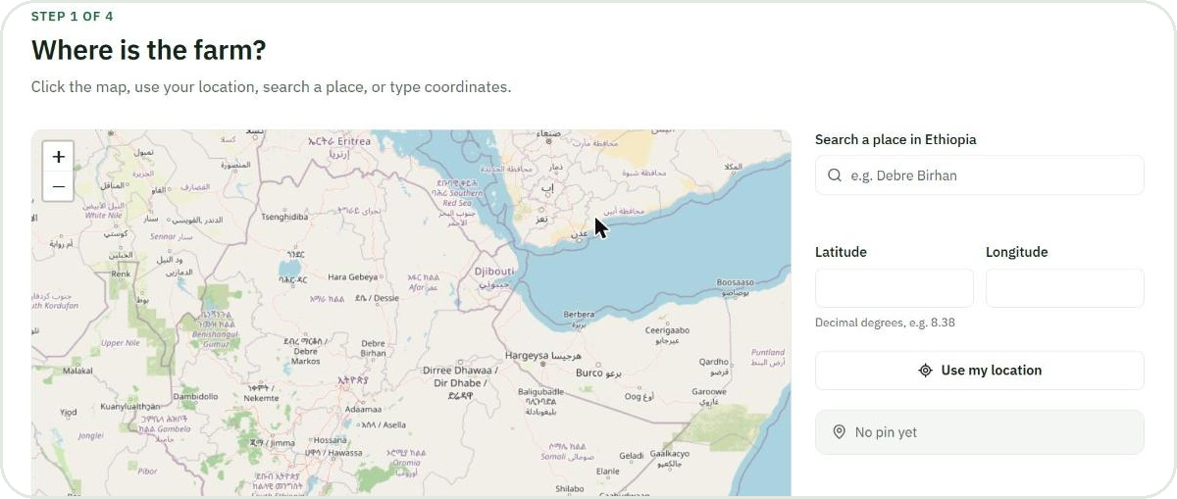
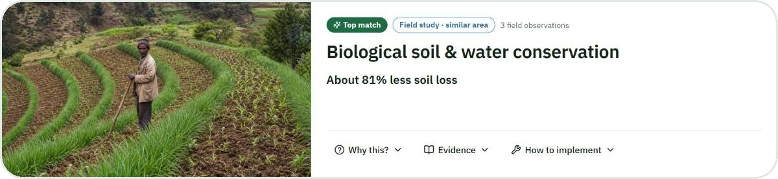

Four steps from pin to ranked practices
THE PRODUCT · ADVISOR
Location
Belt, rainfall, temperature, soil and growing period read from the pin; the place name shown with the coordinates.
Challenge and objective
Five challenge families; the objectives the evidence actually covers for that family.
Results
Step 1 — map, place search, coordinates or “use my location”
Top 3 by default, Top 5 on request. Documented practices appear when field evidence is thin.
Keep it
Copy a link to the advisory, or save it as a PDF with the sources and full references.
Step 4 — a ranked card: headline in words, source chip, Why / Evidence / How to implement

Slide 16
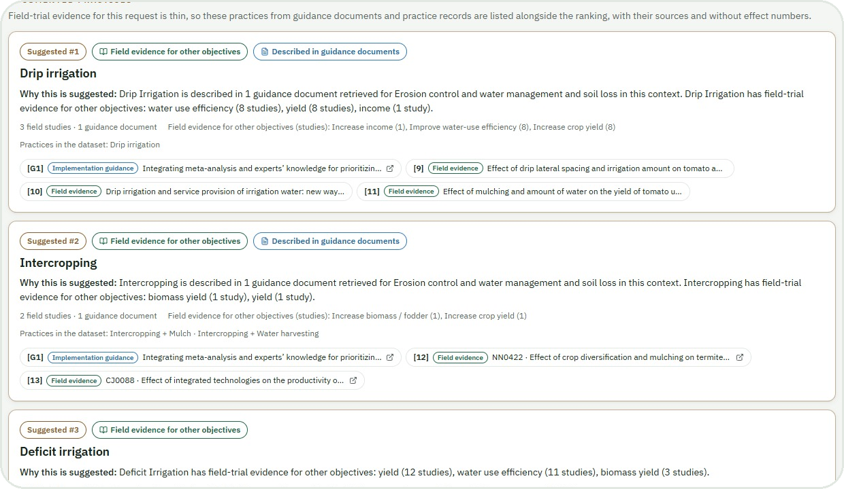
When evidence is thin, the advisor says so
THE PRODUCT · THIN EVIDENCE
A request in Dry Kolla for less soil loss: the ranking rests on few observations, so the advisory is marked hybrid and documented practices are listed alongside it, each with its sources and without an invented number.
Suggested practices come from the same challenge family, with field evidence for other objectives or a description in guidance documents.
Each card shows the sources: field studies with their reference, guidance documents with their CGSpace handle.
Ranked and documented lists never overlap; one citation registry keeps the labels consistent across the page and the PDF.
Documented practices on the live results page (end-to-end test fixture, Dry Kolla)

Slide 17
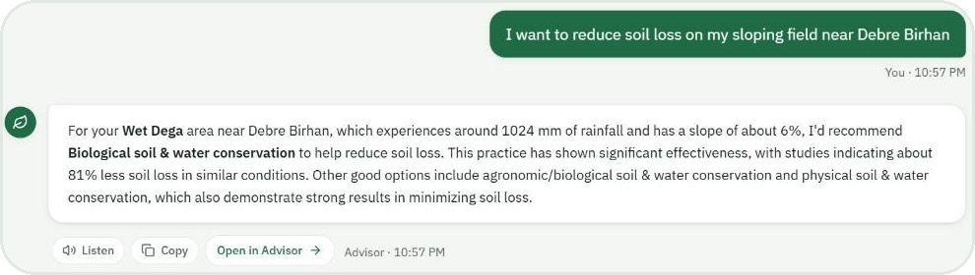


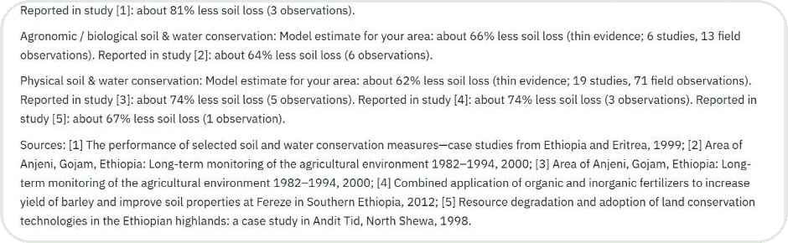
Ask in plain language — the evidence comes when you ask for it
THE PRODUCT · CHAT
Understands the request
Place names, coordinates, crops, objectives and soil constraints (“my soil is acidic”) are parsed into the same engine the Advisor uses.
Voice in, voice out
Speech recognition and read-aloud in English, Amharic and Afaan Oromoo, with numbers spoken as words.
A conversational answer: the zone, the context and the leading practice, in plain words
Two registers
Plain language by default; “why” or “evidence” switches to the labelled, cited register. “Open in Advisor” shows the full ranking.
“Why? What is the evidence?” — the same answer with labelled model and study values and the sources

Slide 18
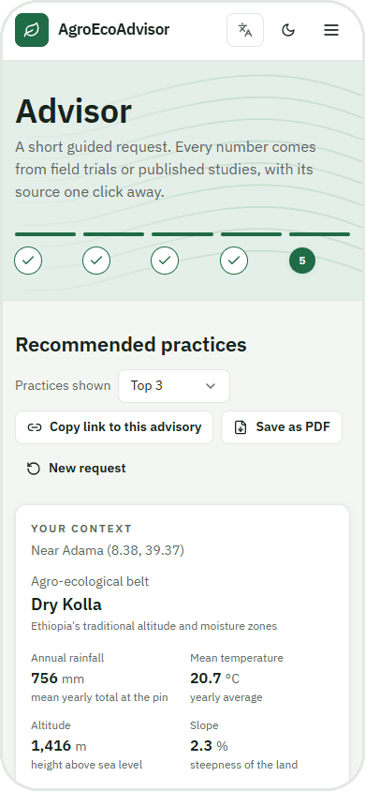
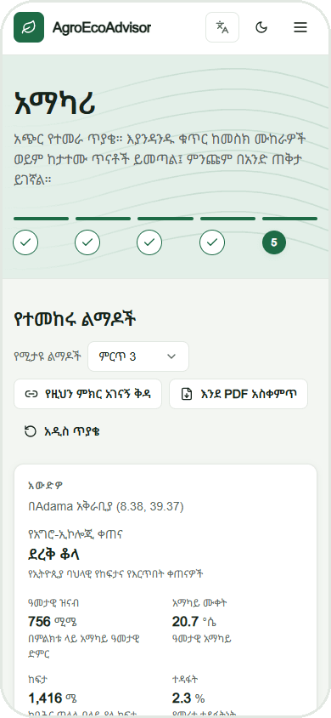
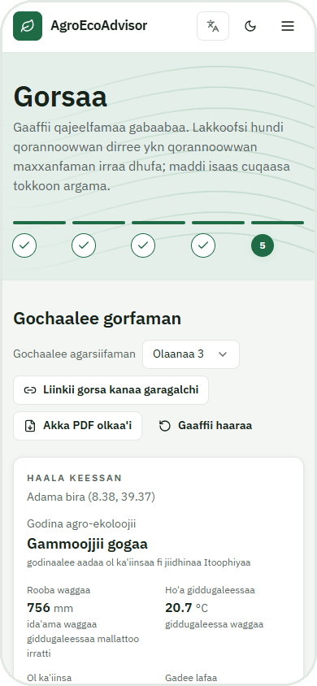


Three languages, phone first
THE PRODUCT · REACH
Every string translated
413 interface strings in each language, with a glossary for practice and zone names and a review workflow for the machine drafts.
Voice for low-literacy use
Speech in and out in all three languages; Ethiopic fonts self-hosted so the app works without external services.
Dark mode and accessibility
WCAG AA contrast checked with axe in every language and theme; keyboard and screen-reader paths tested end to end.
Works where connectivity is poor
The map loads only on request; the advisory can be saved as a PDF and shared as a link.
English
Amharic · አማርኛ
Afaan Oromoo

Slide 19
Architecture
UNDER THE HOOD
Frontend — Next.js 16, TypeScript, Tailwind
Advisor (guided request), Chat (voice), About · en / am / om with next-intl · Leaflet map · citation registry · print sheet · Playwright + axe tests
Backend — FastAPI (Python 3.12)
/advise · /recommend · /explain · /chat (streaming) · /speech · /geocode · /metadata — fusion service, evidence service, numeric guard v2, i18n catalogs, caching
Ranking engine
Retrieval and graph
Language model
HistGBM model on the log response ratio · 250 m raster stack (11 layers) · same feature routine for training and serving
Chroma hybrid index: Tier 1 study passages, Tier 2 guidance · quality gate · NetworkX knowledge graph with provenance · WOCAT crosswalk
Explanation, how-to steps, chat and speech · grounded in retrieved passages · guarded: never a source of numbers · deterministic fallback
Working rules: wrap the canonical engine, never fork it · fail fast, degrade gracefully · data-contract names frozen · secrets only in .env

Slide 20
Built to production standard
ENGINEERING
309
268
47
backend tests
front-end unit tests
end-to-end tests
pytest — engine, fusion, guard, i18n, speech
vitest — components, registry, protocol
Playwright + axe in en / am / om, light and dark
0
133
AA
guard failures
dataset studies referenced
contrast and keyboard
in 1,330 scored advisories and 5,207 rationales
every CSA study id mapped to its citation
WCAG 2 AA on every page, phone and desktop
Deterministic, study-grouped cross-validation folds are versioned with the data, so every model number is reproducible.
Additive API changes only; dataset column names and the model artefact format are a frozen contract.
Provenance everywhere: citation registry per page, CGSpace metadata for guidance, full references for dataset studies, licences and privacy on the About page.

Slide 21
What the numbers say
EVALUATION
Layer | Measure | Result | Reference
Ranking model | Best practice ranked first (top-1 hit rate) | 52% | chance 27.5%
Ranking model | Best practice in the top half | 77% | chance 50%
Ranking model | Pairwise concordance (C-index) | 0.70 | 0.50 = coin flip
Ranking model | Beneficial vs harmful (ROC AUC) | 0.68 | 0.50 = coin flip
Retrieval | Relevant passage in the top 16 (45 scenarios) | 62% | top 8: 56%
Evidence fusion | Best-studied practice in the top 3 | 63% | 51% with model ordering
Evidence fusion | Disagreements between model and studies | 772 | 1,238 with model ordering
Numeric guard | Ungrounded numbers in generated text | 0 | 1,330 advisories
How to read this
Model metrics are on held-out studies: what a new pin gets, not what the model memorised.
Conservative ordering puts well-studied practices in the top 3 more often and halves the disagreements with field studies.
The guard is binary: a number is sourced or the sentence is gone.
Model: model/artifacts/model_eval.json (10 × 5 study-grouped folds) · retrieval: rag/eval/results · fusion and guard: rag/eval/results/mode_report_u9_* (1 Nov 2026)

Slide 22



Where this goes next
NEXT
01
02
03
04
05
WOCAT practice records
Production deployment
Expert study
Worldwide coverage
Manuscript
API access requested; one account covers all countries. Documented SLM technologies join the fused evidence with the compiler's impact ratings.
Hosting, monitoring, a keyed map-tile provider and a release pipeline on the current test suite.
Agronomists rate advisories blind across the 35 challenge-objective cells; faithfulness run on the generated explanations.
Global geospatial layers and a wider evidence base, so the same evidence-first ranking serves farms beyond Ethiopia.
Evidence fusion of meta-analytic machine learning, field-study evidence, retrieval-augmented generation and a knowledge graph for agroecological advisory.
Working title: “AgroEcoAdvisor: evidence fusion of meta-analytic machine learning, field-study evidence, retrieval-augmented generation and a knowledge graph for agroecological advisory — a case study from Ethiopia”

Slide 23






Evidence in. Advice out.
Field-trial model
Field studies
Study passages
One answer
ranked · explained · cited
8,664 field observations · 337 studies · 1,459 guidance documents · one knowledge graph · one honest advisor — so that the next practice decision on an Ethiopian farm starts from what the evidence already knows.
Guidance documents
Knowledge graph
Misganu Tuse · m.tuse@cgiar.org
Alliance of Bioversity International & CIAT, Addis Ababa
Practice records

