Slide 1
Unit3 - Cascading Style Sheet (CSS)

Slide 2
Unit Plan
What are Style Sheets, Its syntax and working
Cascading Style sheets (CSS) with HTML doc
Same related tags - <SPAN> and <DIV>
Style Sheet properties

Slide 3
Cascading Style sheets (CSS)
In 1996, W3C announced style sheets.
Two cascading style sheet standards exist:
CSS1 was a set of rules to format and enhance text, paragraphs and documents.
CSS2 the current standard adds to the CSS1 base a set of styles for visual browsers, aural devices, printers and so on.
Features
  Separates the presentation and contents of the HTML document.
  Provide numerous attributes to create dynamic effects.
  Simple.
  Reusable.
Style Sheet
  A set of statements that specify presentation of a document.
  A powerful mechanism for adding styles.
  Styles can be assigned by the <STYLE> </STYLE> tag.
Notes:
Style Sheets is a breakthrough in Web design because it allows developers to control the style and layout of multiple Web pages all at once. A web developer can define a style for each HTML element and apply it to as many Web pages as you want. To make a global change, simply change the style, and all elements in the web are updated automatically.
Style sheets are said to cascade when they combine to specify the web page.
A style sheet is made up of style rules that tell a browser how to present a document.
The simplest way of using style sheet with HTML document is embed styles in <STYLE> element.
This element is placed in the document HEAD, and it contains the style rules for the page.
Each rule is made up of a selector--usually an HTML element such as BODY, P, or H1.

Slide 4
Advantages
Good control over the presentation.
Consistency : A Standard flow, look & feel can be maintained for all pages of a Web Site
Ability to make global changes to all the documents from a single location.
Reduces the time spent on maintaining HTML Document
Less Cluttered
Notes:
Advantages
Since style sheets support a wide variety of properties. It has a good control over the presentation.
With the external style sheets the contents and the presentation can be separated. The same style sheet can be linked to one or more web pages. This maintains a standard look and feel for all the pages of a web site.
Changes made to the external style sheet reflect globally in all the connected web pages. This helps in reducing the effort and time spent for web site maintenance.

Slide 5
How do Style Sheets Work?
Separate Section is defined to place the Style Properties of the Document
  Section consists of two parts
    Selectors
    Declarations
Defined sections in the document are attached with their respective properties
<STYLE > tag is used to define styles.
<STYLE>
P{ color:red; }
</STYLE>
Properties
Selector
Value
Notes:
The selector is normally the HTML element/tag you wish to define, the property is the attribute you wish to change, and each property can take a value. The property and value are separated by a colon and surrounded by curly braces.
The selector is simply the element that is linked to a particular style .
The example above is a simple CSS rule. A rule consists of two main parts: selector (‘P') and declaration ('color: red'). The declaration has two parts: property ('color') and value (‘red'). While the example above tries to influence only one of the properties needed for rendering an HTML document .

Slide 6
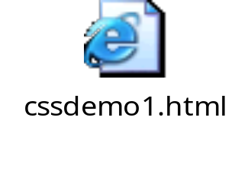
Selectors
A selector identifies elements on an HTML page
Element Selector (Type Selector)
- An Element selector matches the name of a document language element.
Eg. <H1> , <P>
Inheritance
- Style properties are inherited from the parent element to the child element .
<BODY>
<H1> H1 inherits to BODY style <H1>
</BODY>
Notes:
The selector is the link between the HTML document and the style sheet, and all HTML element types are possible selectors.
Inheritance
Virtually all selectors which are nested within selectors will inherit the property values assigned to the outer selector unless otherwise modified. For example, a color defined for the BODY will also be applied to text in a paragraph.
<html>
<head>
<style>
h2{
color:blue;
font-size:80pt;
}
</style>
</head>
<body>
<h2> This is CSS style</h2>
</body>
</html>

Slide 7
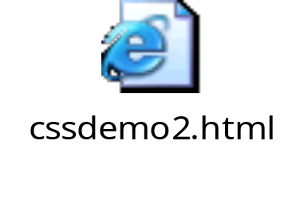
Selectors
Class selectors
- With the class selector you can define different styles for the same type of HTML element.
Eg: <H1 class=“head1”>Hello</h1>
ID selectors
- The ID attribute of a document language allows authors to assign an identifier to one element .
- An ID attribute must be unique within the document.
Eg: <P id=“para1”>First para</P>
Notes:
Class Selector.
A simple selector can have different classes, thus allowing the same element to have different styles. For example, an author may wish to display code in a different color depending on its language:
code.html { color: #191970 }
code.css { color: #4b0082 }
Classes may also be declared without an associated element:
.css { color: red}
ID Selector.
ID selectors are individually assigned for the purpose of defining on a per-element basis. This selector type should only be used sparingly due to its inherent limitations. An ID selector is assigned by using the indicator "#" to precede a name.
#top1{ color: red}
<P ID=“top1”>The Top Paragraph</P>
<html><head>
<style>
H1 { color:red; font_size:20pt;}
h1.c { color:blue; }
</style><head>
<body>
<h1> First H1 Tag</h1>
<h1 class="c"> Second H1 Tag with class attribute</h1>
</body>
</html>

Slide 8
Selectors and Comments
Contextual Selectors
- Contextual selectors are merely strings of two or more simple selectors separated by white space.
Eg. P EM { background: yellow }
Grouping
- In order to decrease repetitious statements within style sheets, grouping of selectors and declarations is allowed.
Eg: H1, P, TD { color:red;}
Comments
- Comments are denoted within style sheets with the same conventions that are used in C programming.
/* COMMENTS CANNOT BE NESTED */
Notes:
Contextual Selectors
For example, the contextual selector
P EM { background: yellow }
This rule says that emphasized text within a paragraph should have a yellow background; emphasized text in a heading would be unaffected.
Grouping.
For example, all of the headings in a document could be given identical declarations through a grouping:
H1, H2, H3, H4, H5, H6 {
color: red; font-family: sans-serif
}

Slide 9

Pseudo-classes
Pseudo-classes are special "classes" that are automatically recognized by CSS-supporting browsers. Pseudo-classes distinguish among different element types (e.g., visited links and active links represent two types of anchors).
Anchor Pseudo-classes
Pseudo-classes can be assigned to the A element to display links, visited links and active links differently.
A:link { color: blue; }
A:active { color: green; }
A:visited { color: red; }
A:hover { color: cyan; }
Notes:
Rules with pseudo-classes take the form
selector:pseudo-class { property: value }
Pseudo-classes and pseudo-elements should not be specified with HTML's CLASS attribute.
Normal classes may be used with pseudo-classes as follows.
selector.class:pseudo-class { property: value }
The anchor element can give the pseudo-classes link, visited, or active. A visited link could be defined to render in a different color and even a different font size and style.
<html>
<head><style>
a:link{ color:blue; }
a:hover{ color:red; }
</style>
<head><body>
<h2> Open sparsh <a href="http://sparsh">Sparsh</a></h2>
</body></html>

Slide 10
Ways of specifying styles
Inline
Embedded (Internal styles sheet)
3) External Style sheets (Linking)
4) Importing

Slide 11
Ways of specifying styles
1) Inline
<P style=“color:blue; margin-right: 10px;”>
Styled paragraph
</P>
Can be applied to a single occurrence of an element
Mixes content with presentation
Should be used sparingly
Notes:
Style Sheets allow style information to be specified in many ways. Styles can be specified inside a single HTML element, inside the <HEAD> element of an HTML page, or in an external CSS file. Even multiple external Style Sheets can be referenced inside a single HTML document.

Slide 12
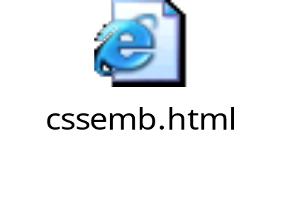
Ways of specifying styles
2) Embedded (Internal styles sheet)
Can be used by single document.
Enclosed within the HEAD tag.
<HEAD>
<!—
<STYLE TYPE=“text/css”>
HR{color:blue}
P{margin-right:10px}
</STYLE>
-->
</HEAD>
Notes:
Embedded Style : The style definition is part of the HTML doc - typically within the HEAD tags. This is much better than inline. If a change has to be made to a certain tag e.g. H1 in the page, you need to make it only in one place i.e. in the style definition (unlike inline styles where the change has to be made at every occurrence of H1). However embedded styles still have the drawback of not providing automatic consistency over a set of HTML pages.
<html><head>
<style>
/* Using Embedded style */
h2{
color:blue;
font-size:40pt;
letter-spacing :10pt;
}
</style></head><body>
<!-- Comments : Using inline style -->
<h2 style="color:red;">Using Inline and Embedded</h2>
</body></html>

Slide 13
Ways of specifying styles
3) External Style sheets (Linking)
Style Properties are defined and placed in external files and is saved with extension .css
These files are then Cascaded with the HTML Documents and properties are suitably applied.
<HEAD>
<LINK REL=“stylesheet” TYPE=“text/css” HREF=“mystyle.css”>
</HEAD>
Notes:
An external style sheet is ideal when the style is applied to many pages. With
an external style sheet, you can change the look of an entire Web site by
changing one file.
All the style definitions are stored in a separate css file and referenced from the HTML document using a LINK tag..
<LINK REL=stylesheet HREF="myStyle.css“ TYPE=text/css>
REL is the relationship specifier
HREF specifies the URL of the style sheet to use.
TYPE specifies the content type. e.g: "text/html", "image/png", "image/gif", "video/mpeg", "text/css",
The above line can be kept in the HEAD tag.
The browser will read the style definitions from the file mystyle.css, and format the document according to it.
This is best way to use CSS because the same .css file can be used for the entire web site.

Slide 14
Ways to cascade style sheets
4) Importing
By importing the Style sheet
  @import url(“<filename>.css ”)
Multiple websites can use the same style sheet.
<style type="text/css">
@import url(http://www.xyz.com/style2.css)
</style>
Notes:
Apart from the <LINK> tag ,importing a style to a document is another way to use a
document –wide style. An external style sheet is referenced ; but, in this case, the
reference is similar to a macro expansion inline.
The syntax is : @import followed by the URL of the style sheet to import.
e.g . @import “http://www.mywebsite.com/styles/mystyle.css”
What style will be used when there is more than one style specified for an HTML
element?
Generally speaking we can say that all the styles will "cascade" into a new "virtual“
Style Sheet by the following rules, where style one has the highest priority:
Inline Style (inside HTML element)
Internal Style Sheet (inside the <head> tag)
External Style Sheet
Browser default
So, an inline style (inside an HTML element) has the highest priority, which means
that it will override every style declared inside the <head> tag, in an external style
sheet, and in a browser (a default value).

Slide 15
Related Tags
Tags used to apply styles to parts of the HTML document
<SPAN>
  The SPAN element was introduced into HTML to allow authors
  to give style that could not be attached to a structural HTML
  element. It is a Inline element
<SPAN CLASS="greensection" STYLE="color: lime">text within a span tag</SPAN>
<DIV>
The DIV element is similar to the SPAN element in function, with the main difference being that DIV (short for "division") is a block-level element.
<div ALIGN="right" CLASS="greensection" STYLE="color: lime” width=“300” height=“100”> text</div>
Notes:
The DIV and SPAN elements, in conjunction with the id and class attributes, offer a generic mechanism for adding structure to documents. These elements define content to be inline (SPAN) or block-level (DIV) but impose no other presentational idioms on the content. Thus, web page authors may use these elements in conjunction with style sheets, ., to tailor HTML to their own needs and tastes
DIV element:
The DIV element is an all-purpose, generalized HTML block structure. Use this element when you wish to define a block or section of Styled text.
The DIV Formatting element is with an implied line break before and after the enclosed contents.
The DIV element is nestable to allow hierarchies of sections, subsections or chapters to be defined.
DIV element Attributes:
ALIGN :This indicates the horizontal alignment of the division block text in the browser window. These values can be over-ridden by style sheets values
COLS :It indicates the number of evenly distributed columns the contained content will be split into.
HEIGHT and WIDTH :This attribute explicitly specifies the height and width of this block element in pixels.
NOWRAP :If False, normal line breaking behavior is used. If set to True, the element will not wrap to the rendering viewport unless explicit line breaking elements are added.

Slide 16
Style properties
Color Properties
Background Properties
Font Properties
Text Properties
Margin Properties
Border Properties
Classification Properties
Position Properties
Notes:
All of the above are the style properties that are supported. In this unit we will be looking at all these properties and their corresponding attributes in detail.
Most of the above properties have attributes that require length values to be specified. Lets look at the length values in detail.
Length values
It can have positive or negative values, have a numerical value followed by a unit of measurement.
Two kind of length unit, relative and absolute
The units of measurement are :
In the table above Em, Ex and pixel are relative units, rest are absolute.
NOTE : Absolute units should be used only when the physical characteristics of the output device is known.

Slide 17
Background and Color Properties
background
  background : “color” / “#rrggbb” / url(“*.gif”)
color
  color : “color name” / “#rrggbb”
Eg. BODY{ Background:”red”;}
Properties |  | Values
background-attachment |  | scroll ,fixed
background-image |  | URL, none
background-repeat |  | repeat, repeat-x, repeat-y, no-repeat
background-color |  | color-rgb, color-hex, color-name, transparent
Notes:
Color properties
CSS supports a variety of properties that can be used to control the color and backgrounds.
It supports three basic forms of color specifications:
Color names : 16 colors keywords are supported by browsers. These are the same predefined colors from the HTML specifications.
Hexadecimal : Supports standard 6-digit color form #RRGGBB same as used within the <FONT> and <BODY> tag.
RGB values : The RGB format is also specified in the form rgb (R,G,B), where R,G and B values range from 0 to 255.
CSS supports the color property, which is used to set the text color.
e.g. BODY {color:blue }
H1 { color: #FF0088}
The Background properties allow you to control the background color of an element, set an image as the background, repeat a background image vertically or horizontally, and position an image on a page. The properties and their description is summarized in the table below.

Slide 18
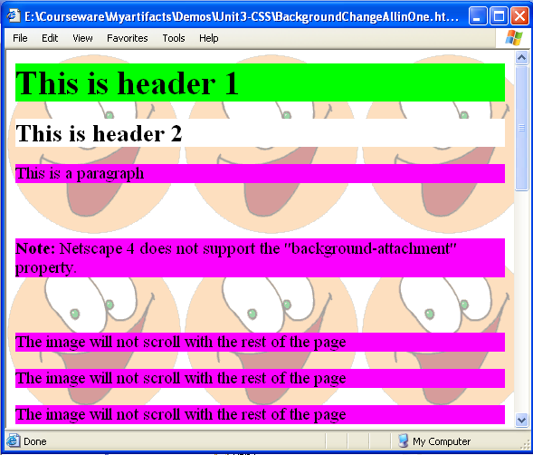
Background Properties -Example
Notes:
NOTE: Try out the code given below in the browser.
<HTML><HEAD>
<STYLE>
body {
background: url (“smiley.jpg");
}
h1 {background-color: #00ff00;}
h2 {background-color: white;}
p {background-color: rgb(250,0,255);}
}
</STYLE></HEAD>
<BODY>
<H1>This is header 1</H1>
<H2>This is header 2</H2>
<P>This is a paragraph</P> <BR><BR> <BR>
<p><b>Note:</b> Netscape 4 does not support the "background-attachment" property.</p> <BR><BR>
<P>The image will not scroll with the rest of the page</P><BR><BR>
<P>The image will not scroll with the rest of the page</P><BR><BR>
<P>The image will not scroll with the rest of the page</P><BR><BR>
<P>The image will not scroll with the rest of the page</P><BR><BR>
</BODY>
</HTML>

Slide 19
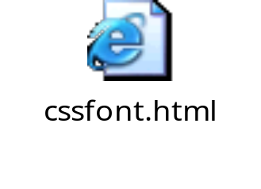
Font Properties
Properties Values
Font-family Arial, Monospace, ….
Font-style Normal, italic, oblique
Font-variant normal, small-caps
Font-size x-small, small, medium,large
Font-weight normal, bold, bolder, light, x-large
CSS measurements
When you manipulate text and other objects with a style sheet, you often must specify a length or size. CSS supports measurements such as
1) inches (in) 2) centimeters (cm) 3) millimeters (mm)
4) point size (pt) 5) pixels (px)
Notes:
CSS provides numerous font oriented properties to set the family, style, size and variations of the font used.
font-family : Is used to set the font-family that is used to render text. This property may be set to specific font like Arial , to a generic family, such as sans serif or a coma delimited sequence of font family names.
font-size : Is used to set the relative or physical size of the font used.
font-style : is used to specify normal,italic or oblique font style for the font being used
font-weight: Selects the weight or darkness of the font. Value rages fron 100 to 900, in increments of 100. Keywords are also supported
<html>
<head>
<style type="text/css">
p.fontstyle {font-style:italic;}
p.fontfamily {font-family:"comic sans ms", arial;}
p.fontweight {font-weight:bold;}
p.fontsize {font-size:xx-small;}
</style>
</head>
<body>
<p class="fontfamily">what type of font is this - comic sans or arial???</p>
<p class="fontstyle">this is now italicized</p>
<p class="fontweight">the bold and the beautiful</p>
<p class="fontsize">small is beautiful</p>
</body>
</html>

Slide 20
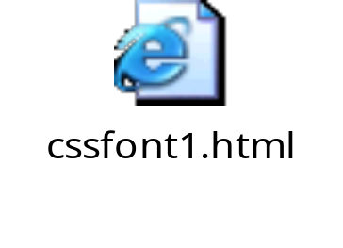
Text Properties
Properties
word-spacing
letter-spacing
text-decoration
vertical-align
text-transform
text-align
text-indent
Values
measurement (px/cm)
measurement (px/cm)
None, underline, overline, line-through
top,text-bottom,super,sub
none, capitalize,uppercase, lowercase
left, right, center, justify
measurement
Notes:
Text properties allow you to control the appearance of text. It is possible to change the color of a text, increase or decrease the space between characters in a text, align a text, decorate a text, indent the first line in a text, and more.
The word-spacing property defines an additional amount of space between words
The letter-spacing property defines an additional amount of space between characters.
The text-decoration property allows text to be decorated.
The vertical-align property may be used to alter the vertical positioning of an inline element.
The text-transform property allows text to be transformed by one of four properties.
The text-align property can be applied to block-level elements (P, H1, etc.) to give the alignment of the element's text.
The text-indent property can be applied to block-level elements, to define the amount of indentation that the first line of the element should receive.
<html><head>
<style>
h2{
letter-spacing:25pt;
font-size:100pt;
text-align:center; }
</style>
<head><body>
<h2>Infosys</h2>
</body></html>

Slide 21

Margin and Box Properties
Properties | Values
margin-top margin-right margin-bottom margin-left margin border-width border-color Border-style width height Float border | measurements (in terms px,cm, mm, in) measurement thick, medium, thin #rrggbb dotted, dashed, solid, groove, ridge, inset, outset measurement measurement right, left, none border-width, border-style, border-color
Notes:
The Margin properties define the space around elements. It is possible to use negative values to overlap content. The top, right, bottom, and left margin can be changed independently using separate properties. A shorthand margin property can also be used to change all of the margins at once.
Eg. DIV { margin: 1em 2em 3em 4em }
/* top margin 1em, right margin 2em, bottom margin 3em, left margin 4em */
The Border properties allow you to specify the style, color and width of an block level element's border. In HTML we use tables to create borders around a text, but with the CSS Border properties we can create borders with nice effects, and it can be applied to any element.
The border property is a shorthand for setting the width, style, and color of an element's border.
Eg. A:active { border: thick double red }
<html>
<head><style>
h2{ text-align:center;
border-width:thick;
border-color:red;
Border-style:solid; }
</style>
<head><body>
<h2>Border Demo</h2>
</body></html>

Slide 22
Classification Properties
Properties | Values
cursor | auto, crosshair ,pointer
display | inline, block, list-item
float | left , right , none
list-style-type | disc, circle, square, decimal, lower-roman, upper-roman, lower-alpha, upper-alpha
list-style-image | url(“*.gif”)
list-style-position | Inside, outside
Notes:
The Classification properties allow you to control how to display an element, set where an image will appear in another element, position an element relative to its normal position, position an element using an absolute value, and how to control the visibility of an element. Most often used properties are briefly described in the table below.

Slide 23
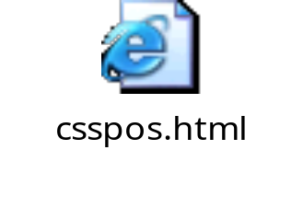
Position Properties
Properties | Values
Position | absolute, relative, static, fixed
top | measurement
bottom | measurement
left | Measurement
right | Measurement
visibility | visible, hidden
Z-index | -1,1
Notes:
CSS Positioning properties define the position of an element.
The Positioning properties allow you to specify the left, right, top, and bottom position of an element. It also allows you to set the shape of an element, place an element behind another, and to specify what should happen when an element's content is too big to fit in a specified area.
Position: Places an element in a static, relative, absolute or fixed position .
Z-index: Sets the stack order of an element.
visibility: The visibility property sets if an element should be visible or invisible.
Invisible elements takes up space on the page. Use the "display" property to create invisible elements that do not take up space.
This property is used with scripts to create Dynamic HTML.

Slide 24
Summary
What are Style Sheets, Its syntax and working
Cascading Style sheets with HTML doc
Some related tags - <SPAN> and <DIV>
Various style sheet properties
Notes:
<html>
<head><style>
h1{
color:blue;
position: absolute;
top:0px; }
h2{
color:red;
position: absolute;
top:20px; }
</style>
<head><body>
<h1>Infy</h1><h2>Infy</h2>
</body></html>

