Slide 1
Women in Tech Bot thingy
Misha Ahmad, Aaliyah Muhammad Sindhi, Ajan Mudey, Hibah Kainat Hussain

Slide 2
Agenda
INTRODUCTION 3
PRIMARY GOALS 4
AREAS OF GROWTH 5
TIMELINE 10
SUMMARY 13

Slide 3

Introduction
At Contoso, we empower organisations to foster collaborative thinking to further drive workplace innovation. By closing the loop and leveraging agile frameworks, we help business grow organically and foster a consumer-first mindset.​

Slide 4
primary goals

Slide 5
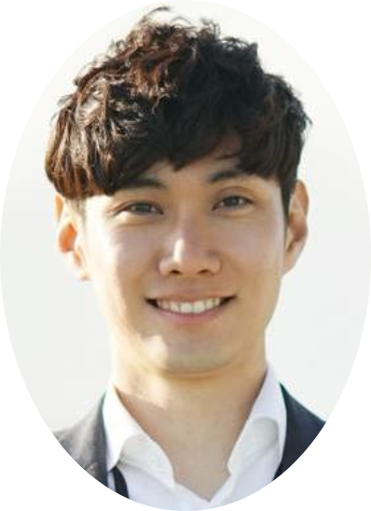
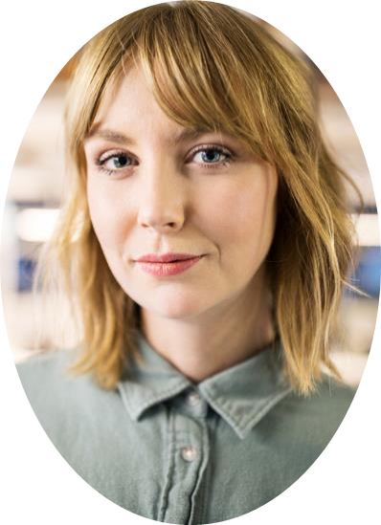
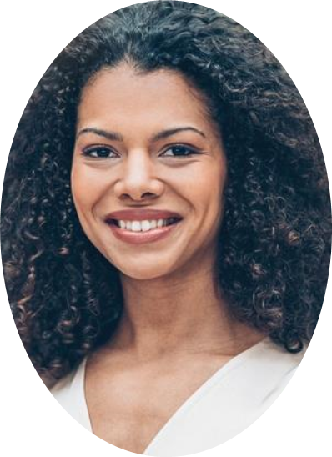
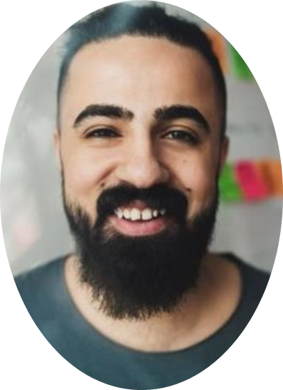
Meet our team
Misha Ahmad
Ajan MUDEY
HIBAH KAINAT
AALIYAH MUHAMMAD SINDHI

Slide 6
how we get there
ROI
NICHE MARKETS
SUPPLY CHAINS
Envision multimedia-based expertise and cross-media growth strategies
Visualise quality intellectual capital
Engage worldwide methodologies with web-enabled technologies
Pursue scalable customer service through sustainable strategies
Engage top-line web services with cutting-edge deliverables
Cultivate one-to-one customer service with robust ideas
Maximise timely deliverables for real-time schemas

Slide 7
Future Developments

Slide 8

summary
At Contoso, we believe in giving 110%. By using our next-generation data architecture, we help organisations virtually manage agile workflows. We thrive because of our market knowledge and great team behind our product. As our CEO says, "Efficiencies will come from proactively transforming how we do business."​

Slide 9
Thank you
mirjam nilsson
mirjam@contoso.com
www.contoso.com

