Slide 1

Hello Everyone
A presentation on Chrome Extension development
Presented By :- Misha Sethi
B.tech CSE B
1222111

Slide 2


Slide 3


Slide 4


Slide 5
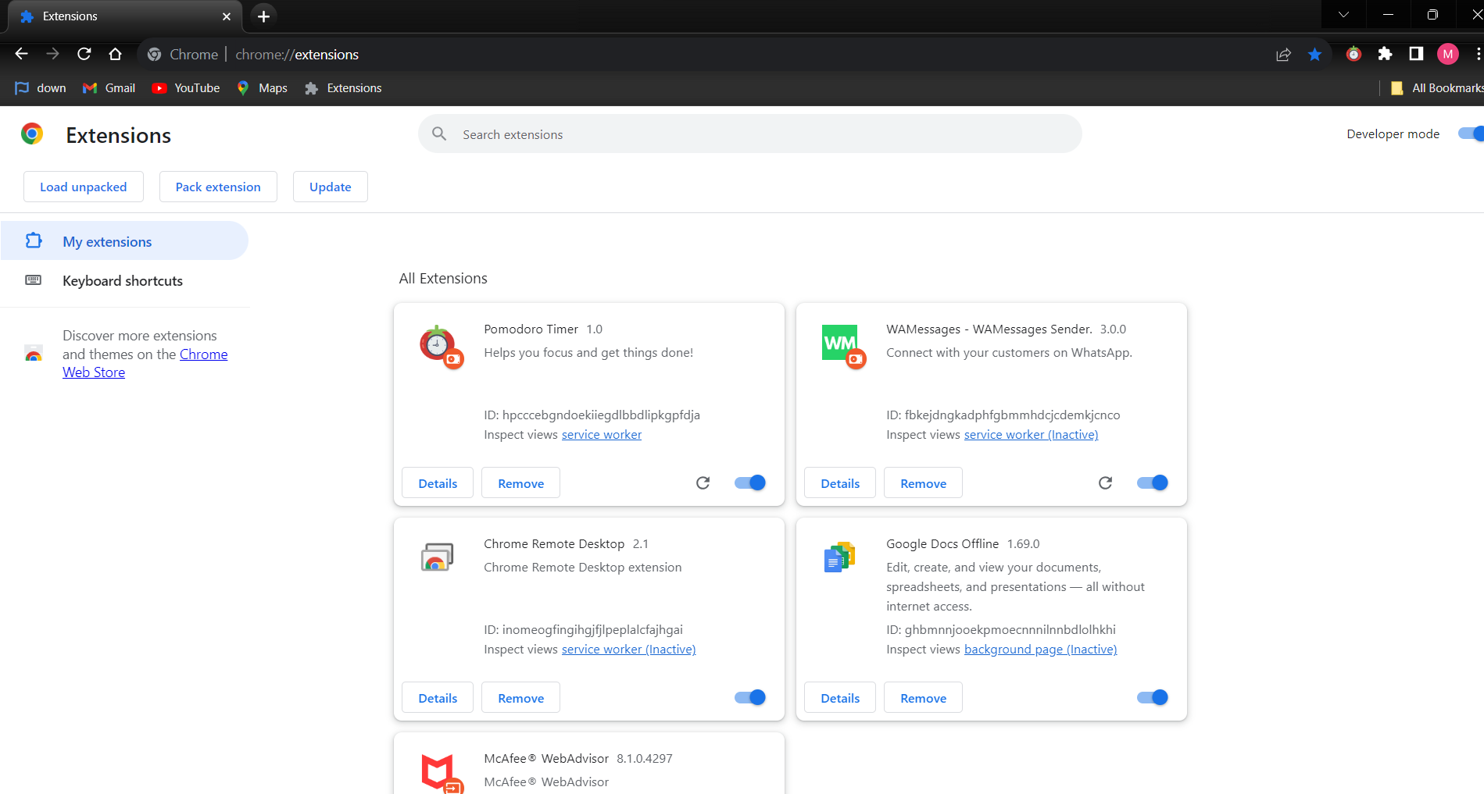


Slide 6
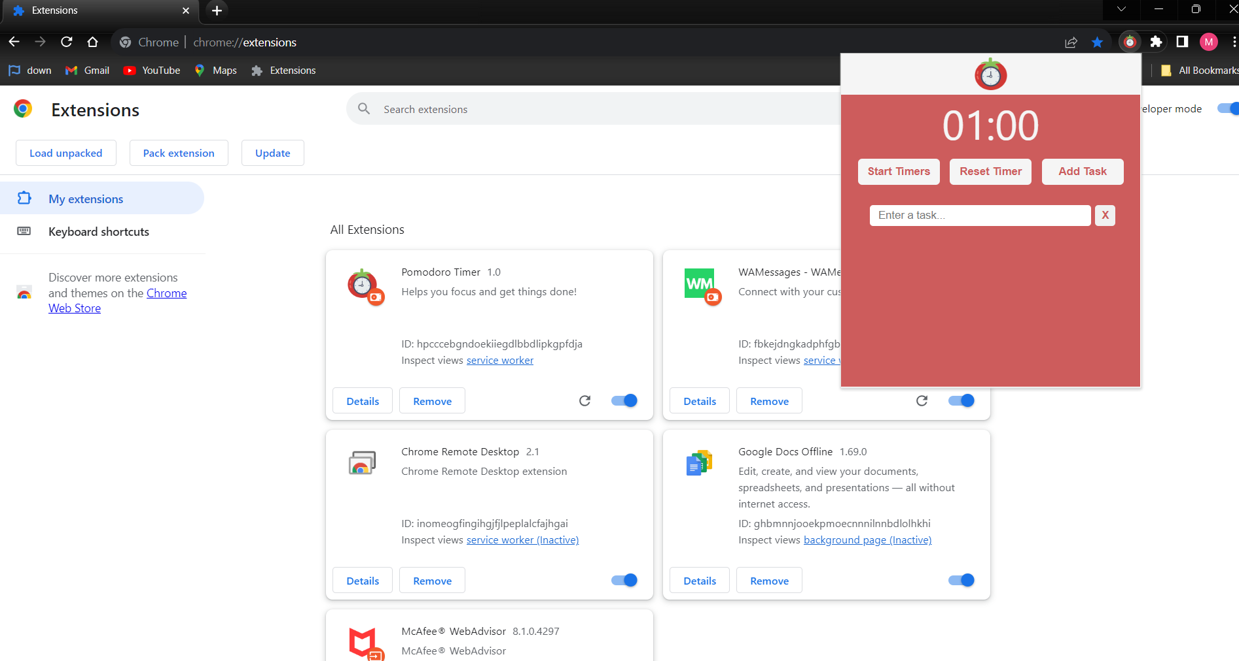

Slide 7
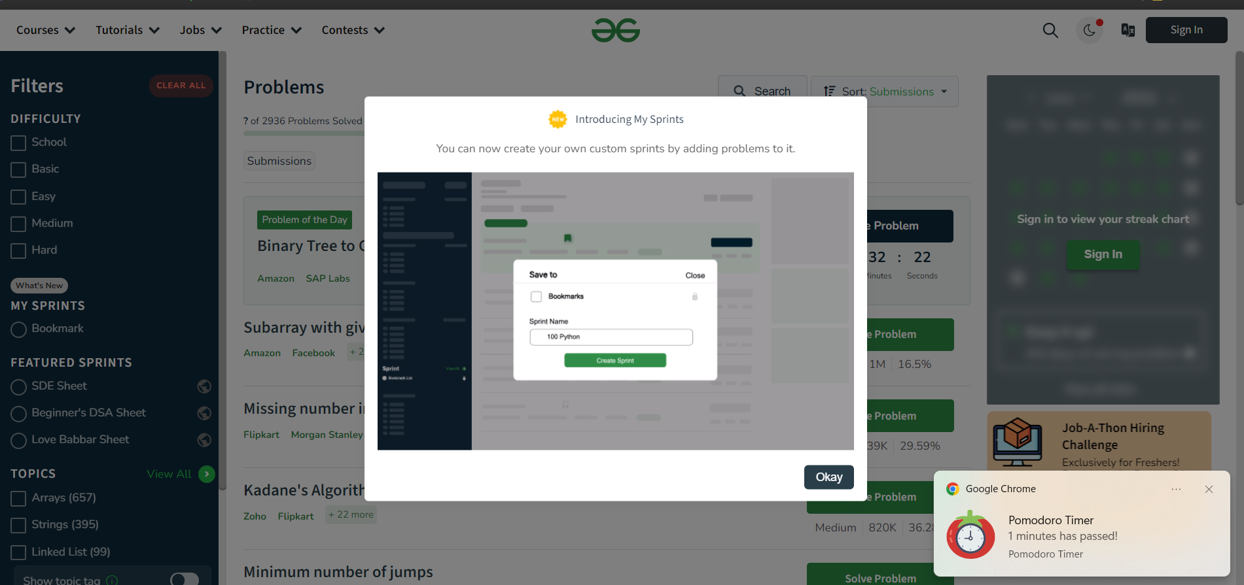

Slide 8
Thankyou
Do have a look - https://chromewebstore.google.com
Learn More - https://developer.chrome.com
Happy coding !

