Slide 1
AI – Early Diseases Prediction

Slide 2






Slide 3
Heart Dieases
Corona
Hepatitis C
Cirrhosis
Diseases Detection System
Heart Stroke
Select the Diseases to check the early detection of diseases based on given parameters and explainable
reasons behind the prediction and provide remedies of the diseases.
Chronic Kidney
Diabetes
Parkinson
Body Fat

Slide 4
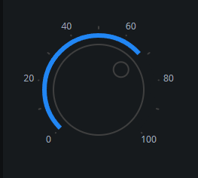

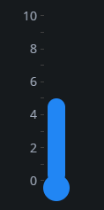
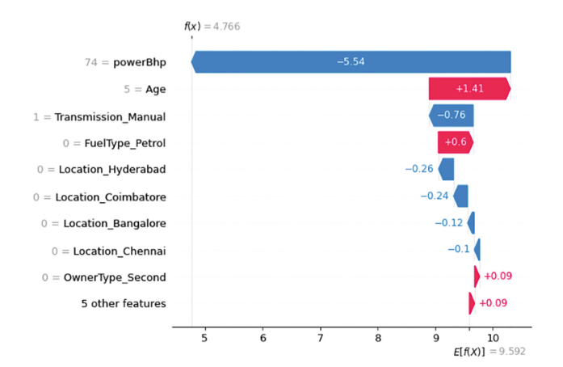
Heart Stroke Prediction
Select the Gender
Select the Glucose Level
Select the Age
Select the BMI
Select the Work Type
Select the Residence Type
Select the Smoking Status
Hypertension
Heart Disease
Probability of likelihood of stroke
Effect of parameters on Prediction
Ever Married

Slide 5
Hepatitis C Prediction
Select the Gender
Select the Glucose Level
Select the Age
Select the BMI
Select the Work Type
Select the Residence Type
Select the Smoking Status
Hypertension
Heart Disease
Probability of likelihood of stroke
Effect of parameters on Prediction
Ever Married

