Slide 1
Customer Segmentation Using K-Means
Prepared by: Mishab Muthalib
Company: Zaalima Development

Slide 2
Objective
• Identify customer groups
• Analyze spending & behavior
• Support targeted marketing
Mishab Muthalib | Zaalima Development

Slide 3
Dataset Overview
• 2,240 customers
• 29 attributes
• Includes demographics, spending, behavior
Mishab Muthalib | Zaalima Development

Slide 4
Feature Engineering
• Age, Total Spend, Family Size
• Total Purchases, Customer_For_Days
• Log transforms
• Standard scaling
Mishab Muthalib | Zaalima Development

Slide 5
Clustering Approach
• K-Means tested for k = 2–10
• Best k = 2 (Silhouette Score)
• PCA visualization
Mishab Muthalib | Zaalima Development

Slide 6
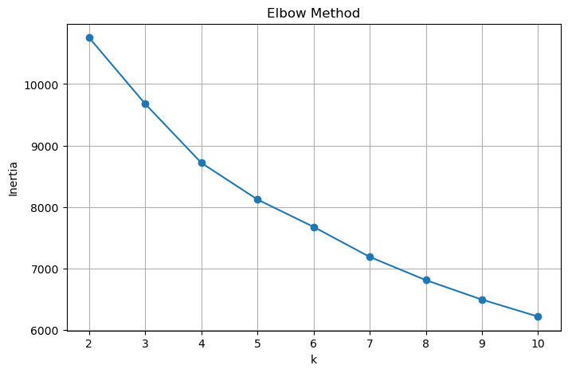
Elbow Method Plot
Mishab Muthalib | Zaalima Development

Slide 7
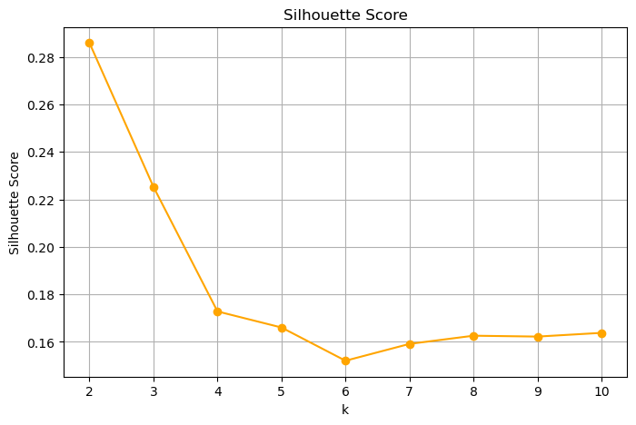
Silhouette Score Plot
Mishab Muthalib | Zaalima Development

Slide 8
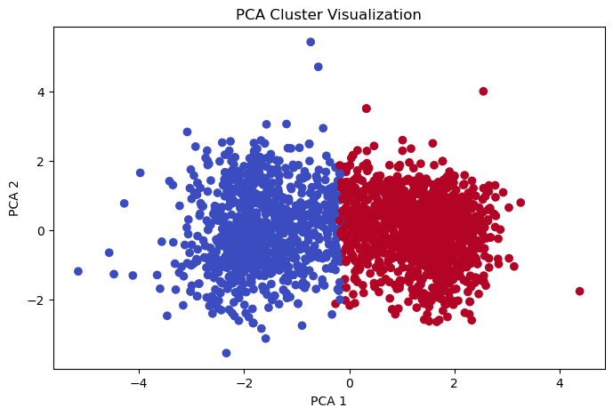
PCA Cluster Visualization
Mishab Muthalib | Zaalima Development

Slide 9
Cluster 0 — Value-Conscious Shoppers
• Lower income & low spending
• Larger families
• Low frequency purchases
• Strategy: Discounts, bundles, reactivation
Mishab Muthalib | Zaalima Development

Slide 10
Cluster 1 — Premium Spenders
• High income & very high spending
• Frequent buyers
• Premium product preference
• Strategy: VIP loyalty, exclusive events
Mishab Muthalib | Zaalima Development

Slide 11
Business Recommendations
• Focus premium offers on Cluster 1
• Boost Cluster 0 engagement
• Personalized marketing for both clusters
Mishab Muthalib | Zaalima Development

Slide 12
Conclusion
• Two distinct customer segments identified
• Enables targeted marketing
• Supports business growth
Mishab Muthalib | Zaalima Development

