Slide 1
Predictive Analytics for
Customer Churn
Perpared By Data Science Intern Mishal Sadiq

Slide 2
Project Objective
Solve complex analytical problems using advanced machine learning workflows and business intelligence.
1
Data Collection
Acquire a real-world, business-relevant dataset
2
Data Cleaning
Fix types, handle missing values, remove duplicates
3
Feature Engineering
Derive business-meaningful predictive signals
4
Model Training
Compare 5 candidate algorithms
5
Hyperparameter Tuning
Cross-validated search on top performers
6
Model Evaluation
Accuracy, precision, recall, F1, ROC-AUC
7
Business Insights
Translate results into retention actions
2

Slide 3
Dataset Selection & Justification
Why This Dataset
Telco Customer Churn
High business relevance retention is far cheaper than acquisition
7,043 customer records
21 columns (mixed numeric + categorical)
Mixed feature types exercise the full preprocessing pipeline
26.5% churn rate (realistic class imbalance)
Realistic data quality issues (blank TotalCharges values)
Source: IBM Sample Dataset (public, Kaggle/UCI-style)
Class imbalance forces proper use of precision / recall / AUC
A telecommunications company's customer base the classic, high-ROI churn-prediction business problem.
Right-sized to clearly demonstrate overfitting (Question 01)
3

Slide 4
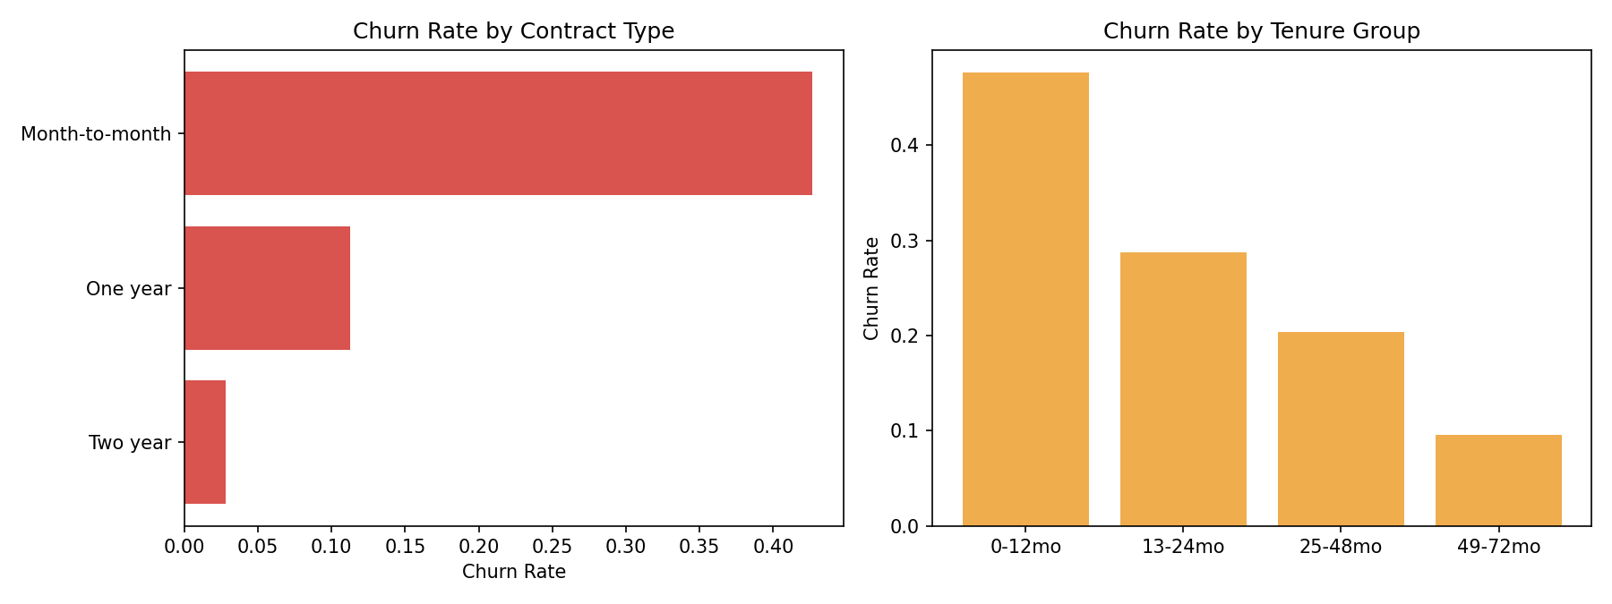
Exploratory Insight: Who Churns?
Month-to-month contracts and low tenure are the two strongest churn signals in the raw data.
4

Slide 5
Data Cleaning & Feature Engineering
Engineered Features
Data Cleaning
•
Coerced TotalCharges from string to numeric (blanks -> 0)
tenure_years
Tenure in years (business-friendly units)
Dropped customerID (identifier, zero predictive value)
avg_monthly_spend
TotalCharges / tenure (leak-safe)
•
num_services
Count of subscribed add-on services
•
Encoded Churn to binary (1 = churned)
is_new_customer
Flag: tenure <= 3 months (highest risk)
•
Removed 22 exact duplicate rows
charge_per_service
Price sensitivity per service
•
Result: 7,021 clean rows, 0 missing values
5

Slide 6
Model Comparison
Five candidate algorithms, baseline + cross-validated hyperparameter tuning on the top two
6

Slide 7
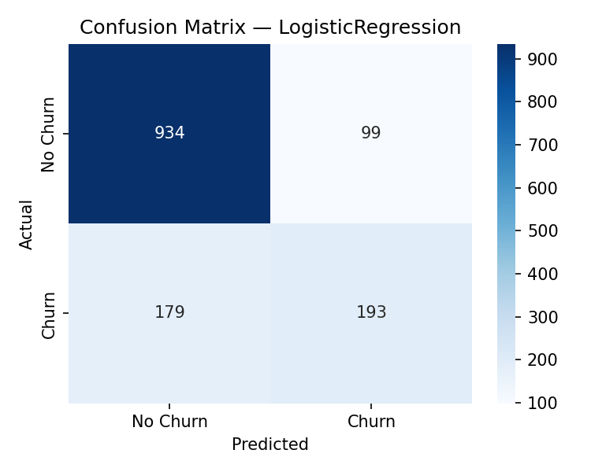
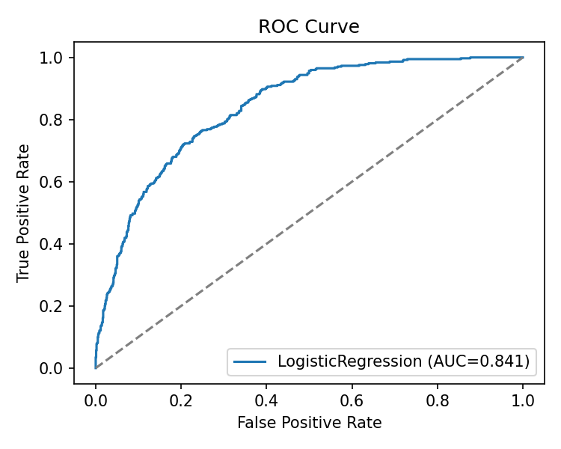
Final Model: Logistic Regression (Tuned)
80.2%
0.841
66.1%
51.9%
0.7 pt
Test Accuracy
ROC-AUC
Precision
Recall
Train/Test Gap
Why this model?
Best test ROC-AUC among all candidates, with the smallest train/test gap of any competitive model i.e., it generalizes rather than memorizes. In a churn use case, ranking customers by risk (AUC) matters more than raw accuracy.
7

Slide 8
Business Recommendations
1
2
3
Contract Migration
New-Customer Onboarding
Bundle Security & Support
Incentivize month-to-month customers to move to 1-2 year contracts with modest discounts the top churn driver.
Launch a structured first-90-day engagement program; churn risk is concentrated in the first year of tenure.
Offer discounted Online Security / Tech Support add-ons to fiber customers, who churn more without them.
4
5
Promote Autopay
Deploy Monthly Risk Scoring
Encourage enrollment in automatic payment methods over electronic check, correlated with lower churn.
Operationalize the model as a monthly job; route top-decile risk customers to the retention team.
8

Slide 9
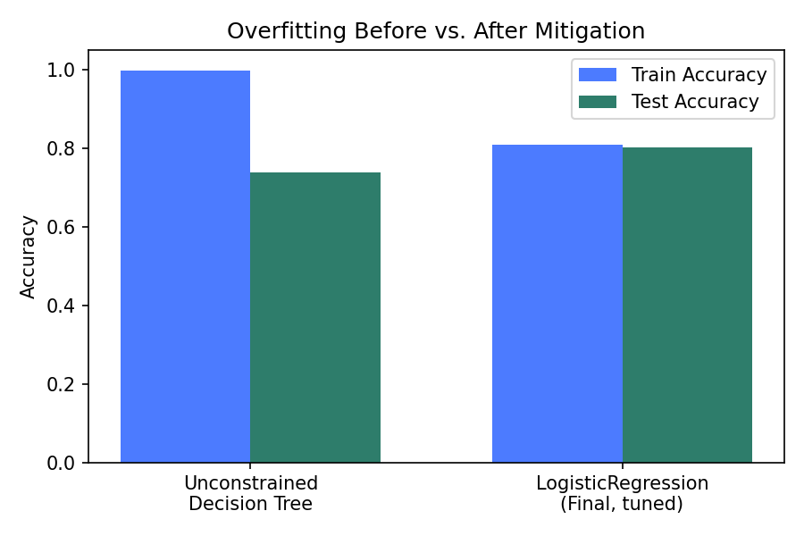
Question 01
99% Training Accuracy,
74% Testing Accuracy Why?
Diagnosis: Overfitting (High Variance)
•
Not underfitting underfitting shows LOW accuracy on both sets
•
Model fits training noise instead of generalizable patterns
•
Unconstrained tree depth -> near-perfect train, poor test score
•
Reproduced exactly: 99.8% train vs 73.8% test on an
unconstrained Decision Tree

Slide 10
Why Overfitting Happens
No Regularization
Excess Model Capacity
An unconstrained tree can keep splitting until every leaf is pure memorizing rows instead of learning boundaries.
No depth limit, minimum leaf size, or complexity penalty to discourage fitting noise.
Small Data, Flexible Model
High-Cardinality Splits
Many categorical levels + limited rows give a flexible
model room to fit spurious patterns.
min_samples_leaf=1 lets the tree create a leaf for a single unusual customer zero generalization value.
10

Slide 11
Techniques to Improve Generalization
1
Regularization (limit depth, min_samples_leaf, L1/L2 penalties, ccp_alpha pruning)
2
Ensembling (Random Forest, Gradient Boosting) to reduce variance
3
k-fold cross-validation for robust hyperparameter selection
4
More / better training data, especially for underrepresented segments
5
Feature selection to remove noisy, redundant, or leaky columns
6
Early stopping for iterative learners (boosting, neural nets)
7
Bagging (bootstrap aggregation) to reduce variance without adding bias
8
Proper handling of class imbalance (weighting, resampling, scale_pos_weight)
11

Slide 12
Question 02
Redesigning the Workflow
for 50 Million Records
From a single-machine pandas pipeline to a distributed, cost-optimized architecture
Data Lake
(Parquet)
Distributed ETL
(Spark)
Feature Store
Distributed Training
(LightGBM/Spark ML)
Bayesian HPO
(Optuna)
Model Registry
+ Monitoring

Slide 13
Scaling Strategy at a Glance
Storage
Model Training
Parquet / Delta Lake, partitioned by date or region, columnar + compressed
LightGBM / XGBoost (hist / distributed), Spark MLlib; prototype on samples
Loading
Hyperparameter Tuning
Dask / Polars / PySpark for out-of-core, lazy, distributed reads
Bayesian optimization (Optuna) + successive halving, not full grid search
Preprocessing
Evaluation
Distributed vectorized transforms; push cleaning into the ETL/warehouse layer
Time-based split, distributed metric aggregation, versioned test set
Feature Engineering
Cost Control
Vectorized computation, target/hash encoding, cached feature store
Spot instances, autoscaling, incremental (delta) processing only
13

Slide 14
Conclusion
Built a complete, reproducible churn-prediction pipeline on 7,021 real customer records
Compared 5 algorithms; selected Logistic Regression (Tuned) 80.2% test accuracy, 0.841 AUC, ~0.7pt train/test gap
Diagnosed and fixed a classic overfitting scenario (99% train -> 74% test), reduced to a ~1pt gap
Delivered contract, tenure, and service-bundle recommendations directly to the retention team
Designed a distributed, cost-optimized architecture to scale the same workflow to 50M+ records

