Slide 1
Intro to JavaScript
by M. Lisivskyi

Slide 2
Agenda

Slide 3
1. History of JS
2. JS standards

Slide 4
History of JS

Slide 5


1994. JS: Origin
In 1994, Marc Andreesen, a graduate of Illinois Institute of Technology and founder of Netscape Navigator, hired Brendan Eich to create a scripting language which could dynamically change HTML.
JS was created in 10 days!
In mid-1995, Netscape Navigator natively supported JavaScript.

Slide 6
1996. Microsoft, IE3 and JScript
In 1996, Microsoft reverse engineered JavaScript and called it Jscript because Java and Javascript were trademarks of Sun Microsystems (now Oracle).
Microsoft shipped JScript as part of IE3, thus starting the “1st Browser War”.

Slide 7
AJAX
In 1999, Microsoft created a library called ActiveX, which came as a feature for Jscript.
xmlhttp = new ActiveXObject(“Microsoft.XMLHTTP”);
And since, basically, JavaScript and JS were the same thing, Mozilla Foundation recreated it and came up with something we today know as AJAX.
xmlhttp = new XMLHttpRequest();

Slide 8



2005: Popularisation of AJAX
While AJAX was available since 1999, it was not very well known and used.
In 2004-2005, Google built large cross browser applications like Gmail and Google Maps that used AJAX extensively.
Jesse James Garrett
Used the word “Ajax” for the first time

Slide 9
2005-2009
AJAX inspired new life into JavaScript and started “Second Browser Wars”.
DOM manipulation was not available across brosers.
JQuery, Prototype, Mootools became popular libraries to mitigate the issue.
Node.js was invented.

Slide 10
2005-2009
AJAX inspired new life into JavaScript and started “Second Browser Wars”.
DOM manipulation was not available across brosers.
JQuery, Prototype, Mootools became popular libraries to mitigate the issue.
Node.js was invented.

Slide 11

Node.js
Invented by Ryan Dahl;
Made JavaScript server-easy;
Helped build various tools using vanilla JavaScript;
Took JavaScript to unimaginable heights.

Slide 12

2015
Year 2015 marked the significant release of the ECMAScript 2015, or ES6, which was being developed for the last 6 years.
Around the same time, JS frameworks gained outstanding popularity.

Slide 13
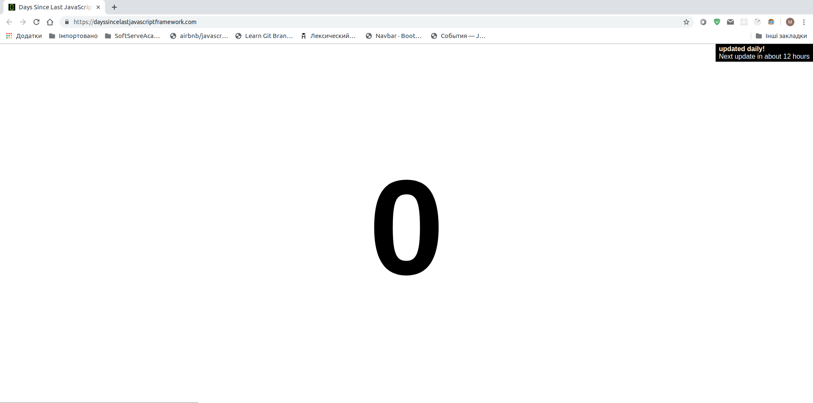
JavaScript Fatigue

Slide 14
Standards

Slide 15


EcmaScript
In 1996, Netscape entrusted Ecma International (a standardisation company) with creation of a standard based on JS.
What we know today as ECMAScript was born in 1997.
Year later, the second edition came to existence, and in 1999 already the 3rd edition was created.

Slide 16
EcmaScript does not create new features for JS! EcmaScript is tasked to create a new standard, whereas JS developers are tasked to implement them!

Slide 17
ECMAScript 1
Release date: June 1997.
Lined out five primitive types in JavaScript:
Numbers;
Strings;
Boolean;
Null;
Undefined.
The numeric data type in ECMAScript corresponds to the 64-bit floating-point number format defined by the IEEE 754-2008 standard, except that the various Not-a-Number values defined in the standard are represented in this language by the unique special value NaN.

Slide 18
ECMAScript 2
Release date: June 1998.
Editorial changes to keep the specification fully aligned with ISO/IEC 16262 international standard

Slide 19
ECMAScript 3
Release date: December 1999.
Changes:
RegExp;
Better string handling, new control statements, try/catch exception handling, tighter definition of errors;
Formatting for numeric output;
and other enhancements...

Slide 20
ECMAScript 5
Release date: December 2009.
Additions:
Strict mode;
Clarifies ambiguities in the 3rd edition specification;
Getters and setters;
Built-in support for JSON file types;
More complete reflection on object properties.

Slide 21
ECMAScript 6 (later renamed into ES2015)
Release date: June 2015.
Changes:
Class declarations;
Java-like imports;
for/of loops;
Arrow function expressions, which made possible creation of truly anonimous functions like (() => { ... });
Introduction of let and const variable declarations;
New collections: Map, Set;
Array.find();
Array.findIndex();
Exponentiation (**);
Default parameter values when no argument is passed into a function;
Template strings;
And some more...

Slide 22
ES2016
Release date: June 2016.
Changes:
Block-scoping of variables and functions;
Destructuring patterns;
Proper tail calls;
await, async

Slide 23
ES2017
Release date: June 2017.
Changes:
async/awaitconstructions work using generators and promises;
Object.values();
Object.entries();
Completing strings to a given length with padStart; padEnd;
Completing params with trailing commas;

Slide 24
ES2018
Release date: June 2017.
Changes:
Shared memory and atomics;
Rest/spread;
Promise.prototype.finally();
Asynchronous iteration (for-await-of);

Slide 25
Useful Links
https://habr.com/ru/company/ruvds/blog/353174/
https://www.w3schools.com/js/js_versions.asp
https://medium.com/@benastontweet/lesson-1a-the-history-of-javascript-8c1ce3bffb17
https://en.wikipedia.org/wiki/ECMAScript#Versions

Slide 26
Any questions?

Slide 27
Thanks!

