Slide 1
Chilren in React
by M. Lisivskyi

Slide 2
Children Types

Slide 3
In JSX expressions that contain both an opening tag and a closing tag, the content between those tags is passed as a special prop: props.children. There are several different ways to pass children

Slide 4
String Literals
You can put a string between the opening and closing tags and props.children will just be that string. This is useful for many of the built-in HTML elements. For example:
This is valid JSX, and props.children in MyComponent will simply be the string "Hello world!". HTML is unescaped, so you can generally write JSX just like you would write HTML in this way:

Slide 5
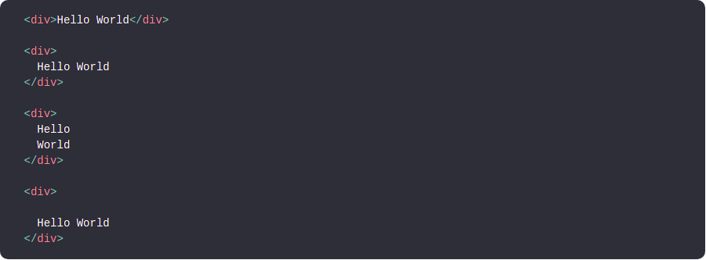
JSX removes whitespace at the beginning and ending of a line. It also removes blank lines. New lines adjacent to tags are removed; new lines that occur in the middle of string literals are condensed into a single space. So these all render to the same thing:

Slide 6
JSX Children

Slide 7
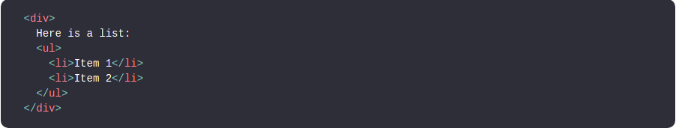
You can provide more JSX elements as the children. This is useful for displaying nested components:
You can mix together different types of children, so you can use string literals together with JSX children. This is another way in which JSX is like HTML, so that this is both valid JSX and valid HTML:

Slide 8
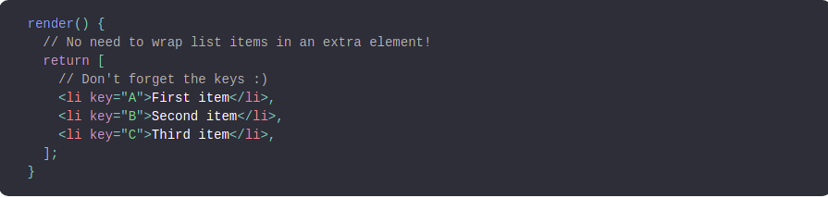
A React component can also return an array of elements:

Slide 9
JS Expressions as Children

Slide 10
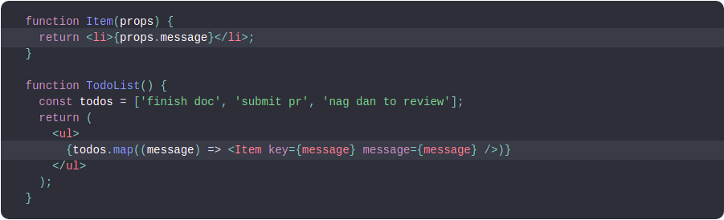
You can pass any JavaScript expression as children, by enclosing it within {}. For example, these expressions are equivalent:
This is often useful for rendering a list of JSX expressions of arbitrary length. For example, this renders an HTML list:

Slide 11

JavaScript expressions can be mixed with other types of children. This is often useful in lieu of string templates:

Slide 12
Functions as Children

Slide 13
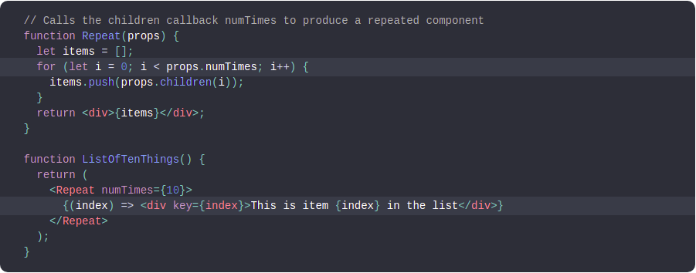
Normally, JavaScript expressions inserted in JSX will evaluate to a string, a React element, or a list of those things. However, props.children works just like any other prop in that it can pass any sort of data, not just the sorts that React knows how to render. For example, if you have a custom component, you could have it take a callback as props.children:

Slide 14
Children passed to a custom component can be anything, as long as that component transforms them into something React can understand before rendering. This usage is not common, but it works if you want to stretch what JSX is capable of.

Slide 15
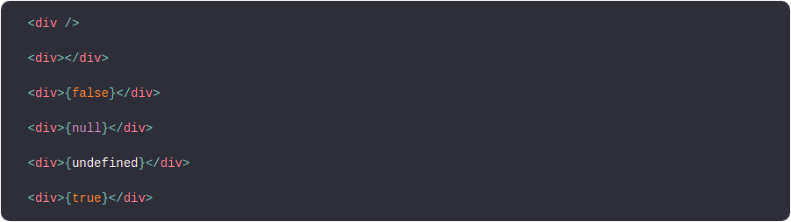
Booleans, Null, and Undefined Are Ignored
false, null, undefined, and true are valid children. They simply don’t render. These JSX expressions will all render to the same thing:

Slide 16
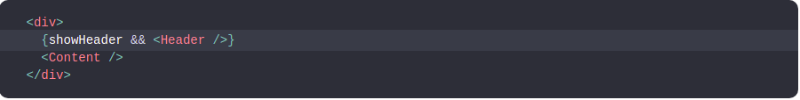
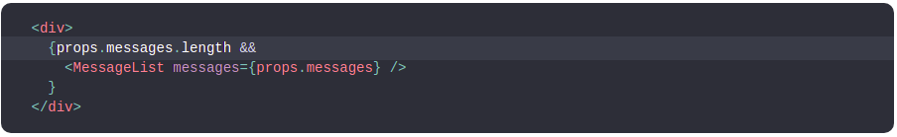
This can be useful to conditionally render React elements. This JSX only renders a <Header /> if showHeader is true:
One caveat is that some “falsy” values, such as the 0 number, are still rendered by React. For example, this code will not behave as you might expect because 0 will be printed when props.messages is an empty array:

Slide 17
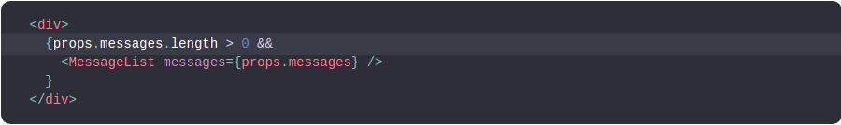

To fix this, make sure that the expression before && is always boolean:
Conversely, if you want a value like false, true, null, or undefined to appear in the output, you have to convert it to a string first:

Slide 18

Imagine you had to fetch some data from a server. You could do this in a variety of ways, but it’s possible with this function-as-a-child pattern:

Slide 19
Children passed to a custom component can be anything, as long as that component transforms them into something React can understand before rendering. This usage is not common, but it works if you want to stretch what JSX is capable of.

Slide 20
Array as Children

Slide 21
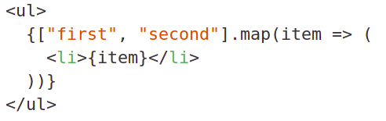

Providing an array as children is a very common.
It's how lists are drawn in React.
We use map() to create an array of React Elements for every value in the array.
That's equivalent to providing a literal array.

Slide 22
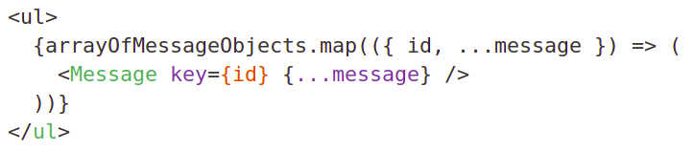
This pattern can be combined with destructuring, JSX Spread Attributes, and other components, for some serious terseness.

Slide 23
Useful Methods

Slide 24
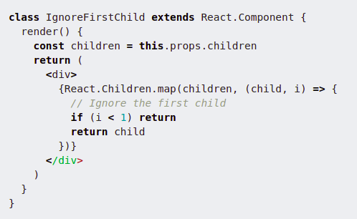
Looping over children
The two most obvious helpers are React.Children.map and React.Children.forEach. They work exactly like their array counterparts, except they also work when a function, object or anything is passed as children.

Slide 25
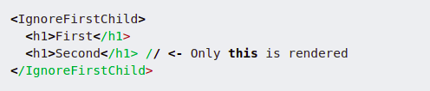
The <IgnoreFirstChild /> component here maps over all its children, ignoring the first child and returning all the others.
In this case, we could’ve also used this.props.children.map. But what would’ve happened if somebody passed a function as a child? this.props.children would’ve been a function instead of an array, and we would’ve had an error! With the React.Children.map function though, this is no problem whatsoever.

Slide 26
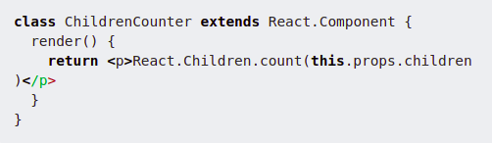
Counting children
Since this.props.children can be any type, checking how many children a component has turns out to be rather hard! Naïvely doing this.props.children.length would break when passed a String or a function. We’d have one child, "Hello World!", but the .length would be reported as 12 instead!
That’s why we have React.Children.count:

Slide 27
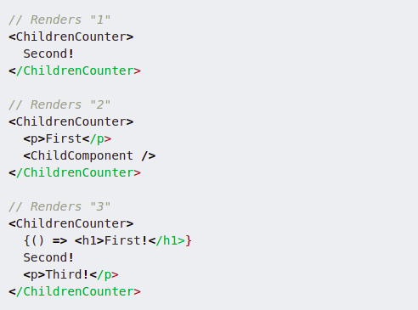
It returns the number of children no matter what type they are:

Slide 28
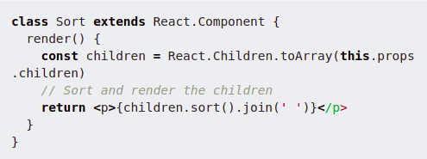
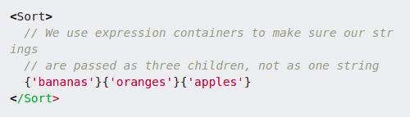
Converting children to an array
As a last resort, if none of the above methods fit your need, you can convert your children to an array with React.Children.toArray. This would be useful if you needed to e.g. sort them:

Slide 29
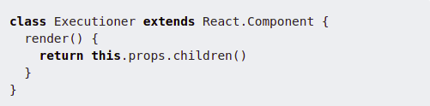

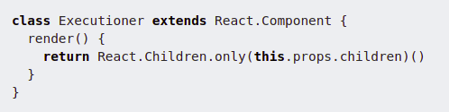
Enforcing a single child
If you think back to our <Executioner /> component above, it expects only a single child to be passed, which has to be a function.
We could try to enforce this with propTypes, which would look something like this:
That would log a message to the console though, something developers could ignore. Instead, we can use React.Children.only inside our render method!

Slide 30
Please see more methods at https://mxstbr.blog/2017/02/react-children-deepdive/

Slide 31
Useful Links
1. https://mxstbr.blog/2017/02/react-children-deepdive/
2. https://reactpatterns.com/#children-types
3. https://reactjs.org/docs/jsx-in-depth.html#children-in-jsx

Slide 32
Any questions?

Slide 33
Thanks!

