Slide 1
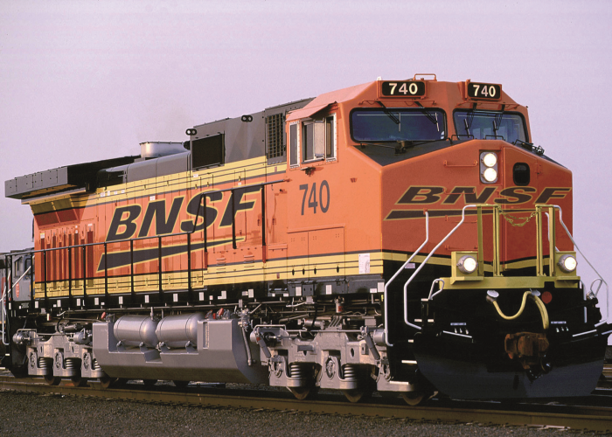
(Introduction to the topic & why it excited/inspired/motivated you, key takeaways from the article, what you got out of it).
BNSF Railway presented with the 2018 INFORMS Prize for Operations Research
Excited? / Inspired?
https://www.joc.com/sites/default/files/field_feature_image/BNSF-Locomotive_300dpi-700.png

Slide 2
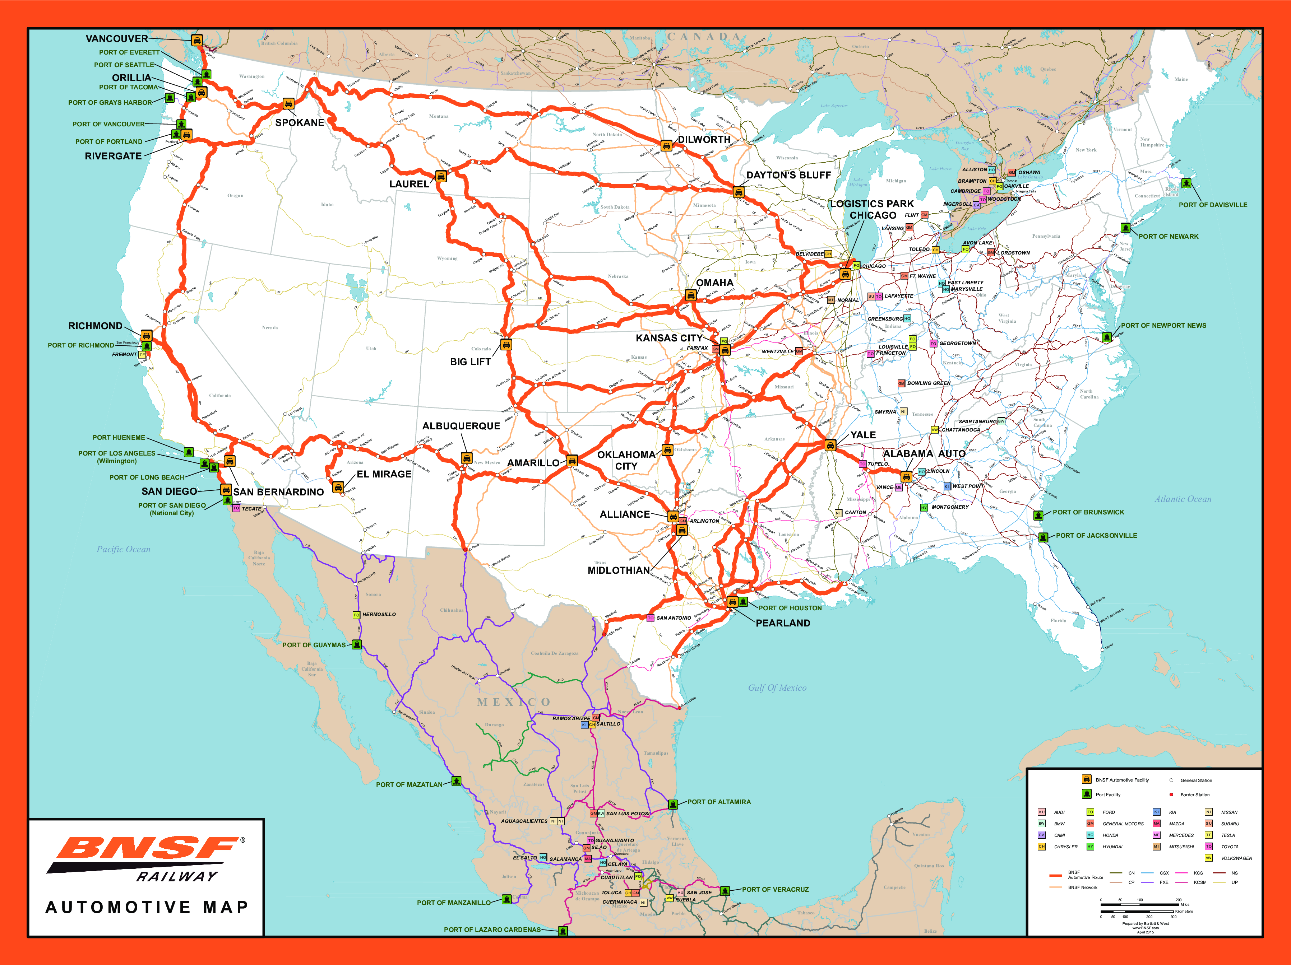
Rail freight transportation system
32,500 miles
47,000 employees
8,000 locomotives
$110 million annually
12-years team
BLU Acceleration (Quick and Fast)
Crew System (Human Resource)
Positive Train Control (Safety)
http://www.bnsf.com/ship-with-bnsf/maps-and-shipping-locations/pdf/automotive-map-0.png

Slide 3
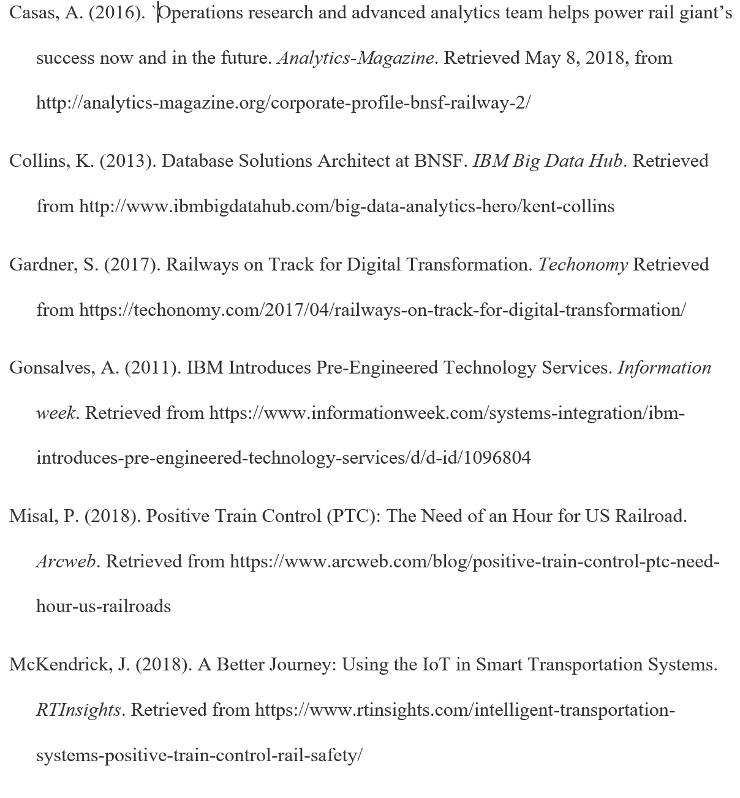
Reference

