Slide 1

Introduction to RNA-seq
bioDSC workshop
13 & 15 April 2026

Slide 2
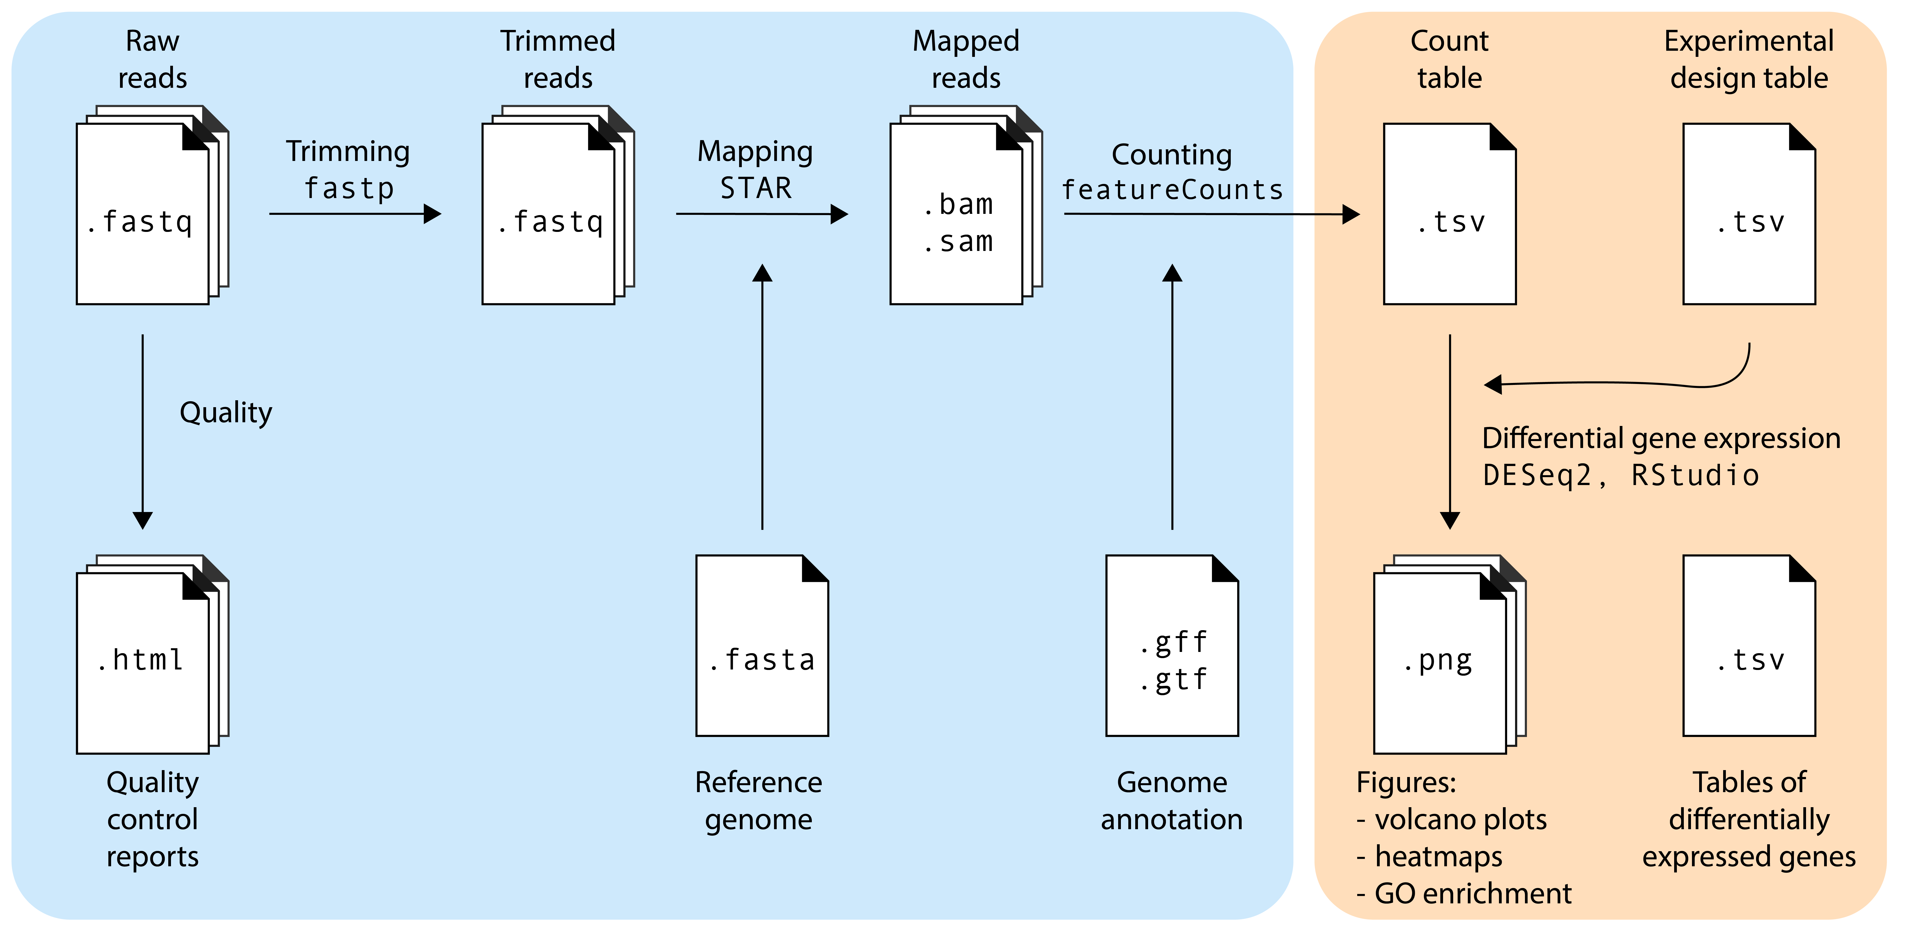
Day 1
Day 2

Slide 3
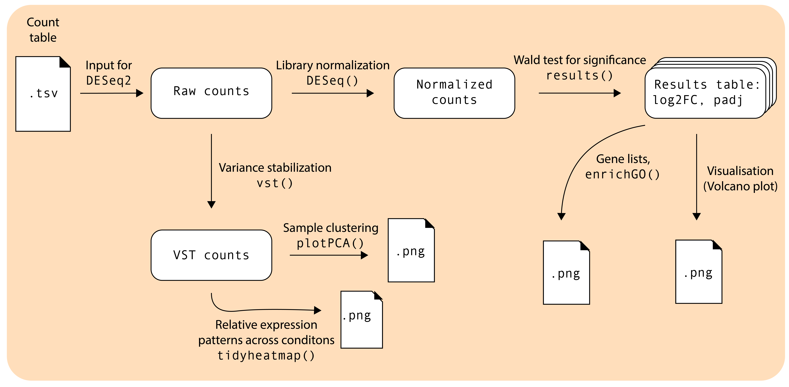
Day 2 in more detail…

Slide 5
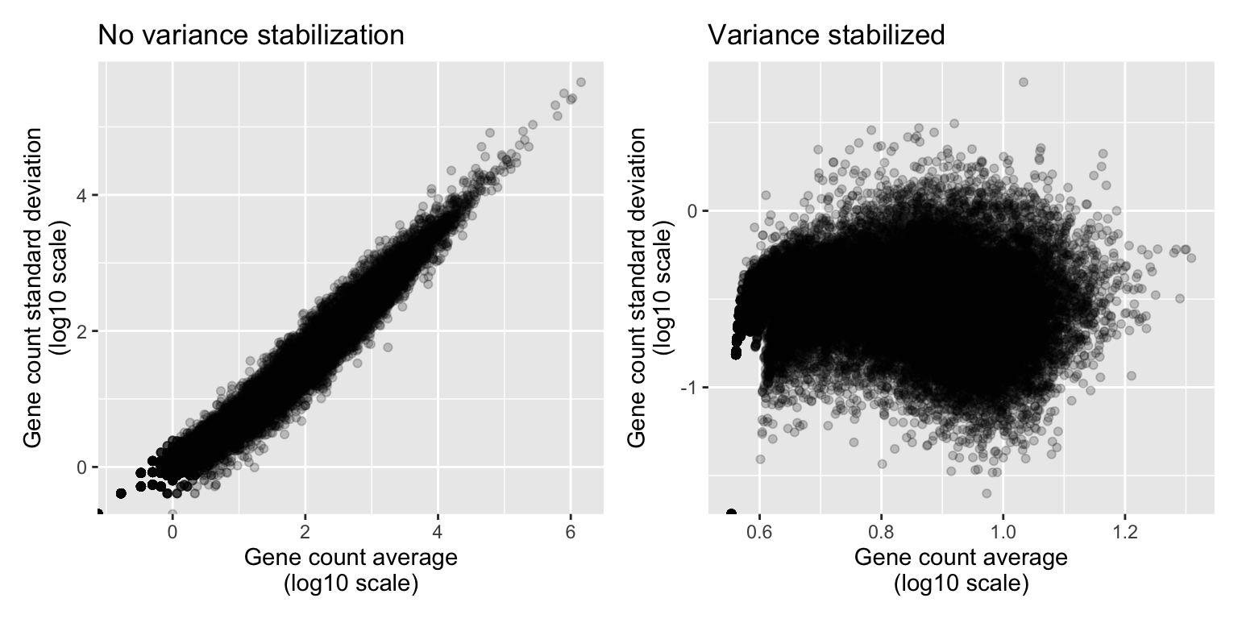
Plotting the effect of variance stabilizing transformation:

Slide 7
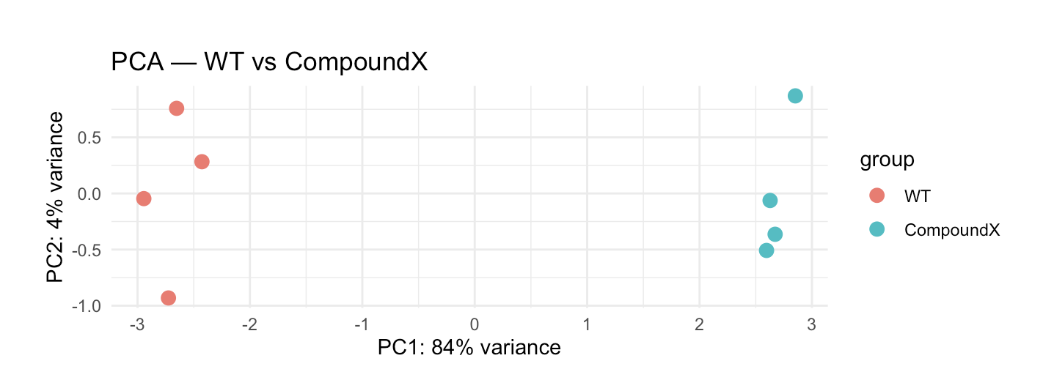
Synthetic dataset
V. scarious treated with compound X
5 upregulated gene
5 downregulated gene
90 unaffected genes
vst()
plotPCA()

Slide 9
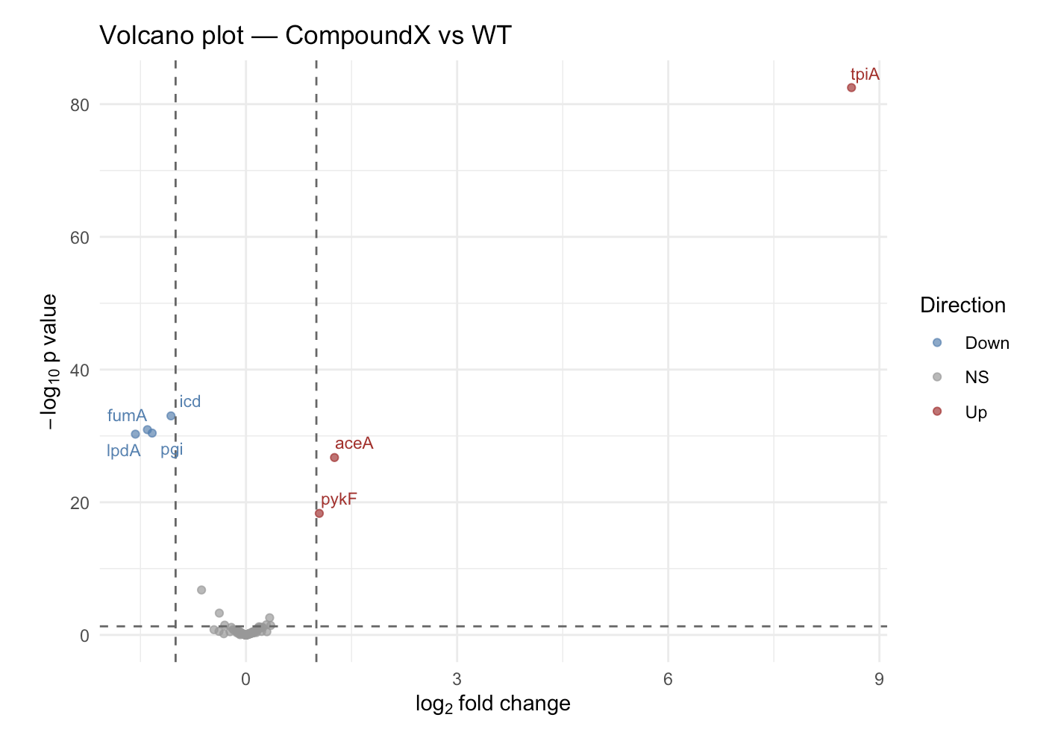
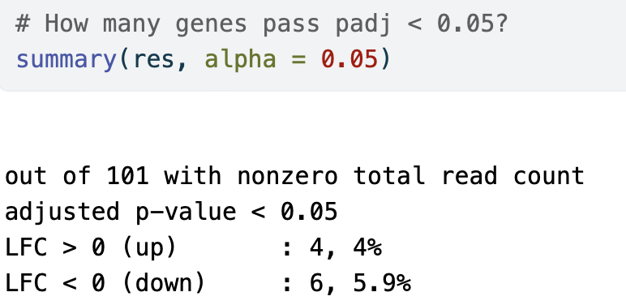
Synthetic dataset
V. scarious treated with compound X
5 upregulated gene
5 downregulated gene
90 unaffected genes

Slide 11
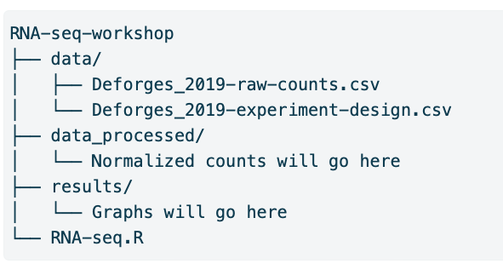
Workshop logistics: On your laptop, create folder structure like this:

