Slide 2
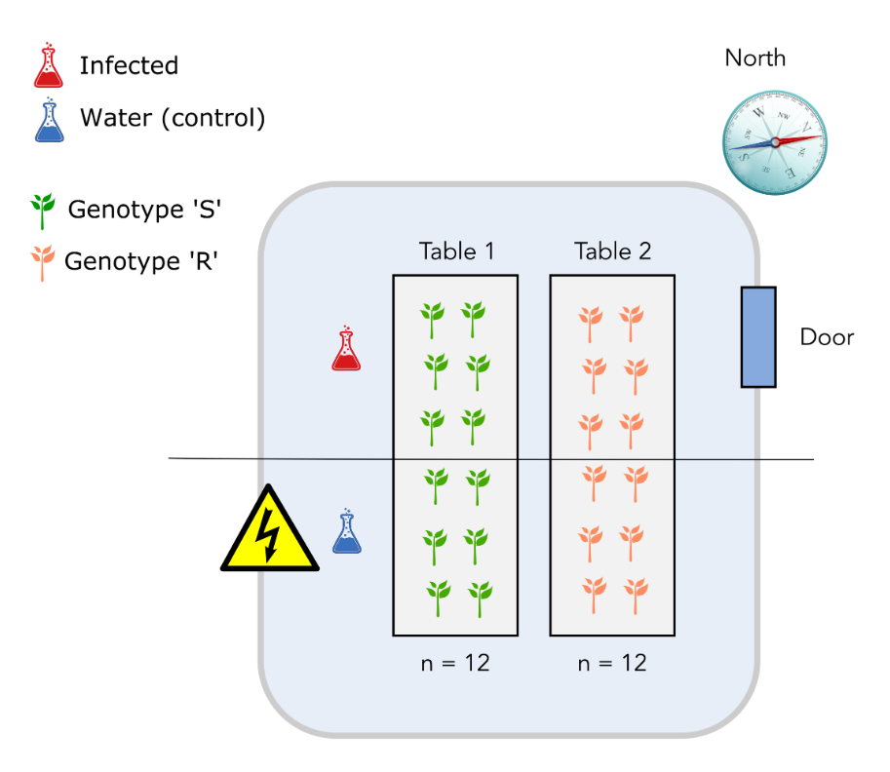
Design 1
Table effect the same as genotype effect!

Slide 3
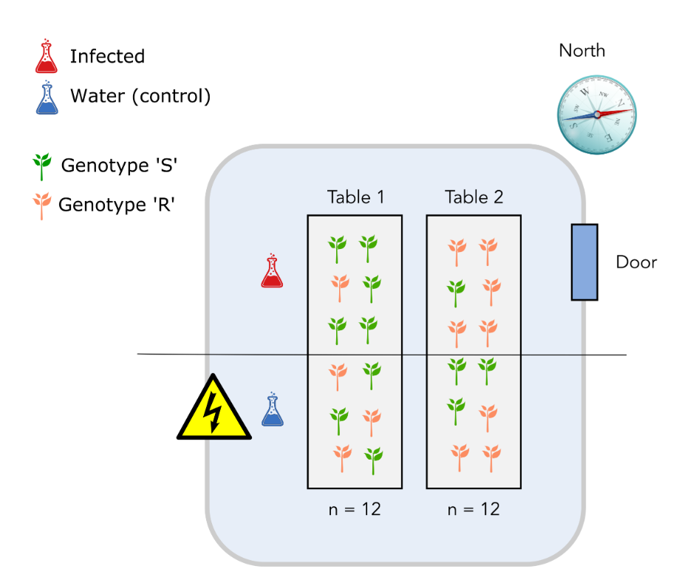
Design 2
'North-south’ effect the same as infection effect!

Slide 4
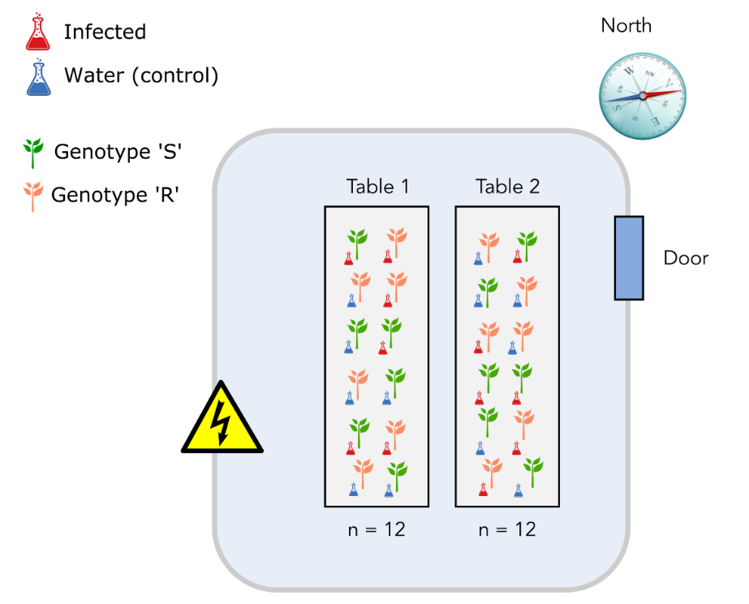
Design 3
Properly randomized design ☺

Slide 5
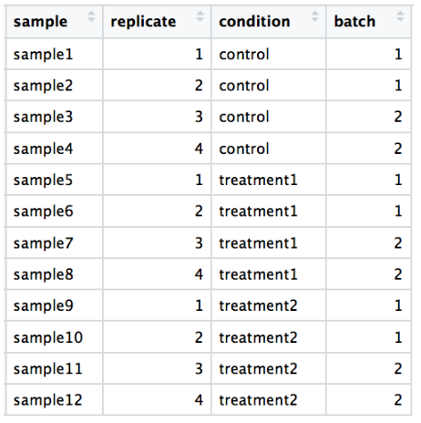
Design 2

