Slide 1
Module introduction
Molecular Data Analysis & Bioinformatics
Lecture 28 sept 2026

Slide 2
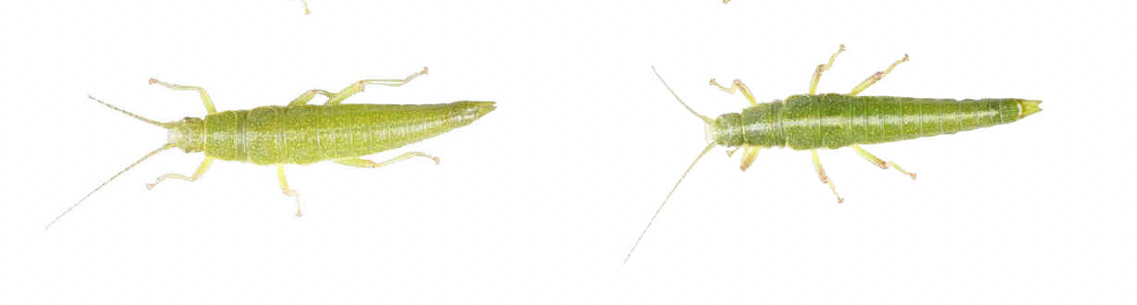
You will learn how to answer questions like…
What is the molecular mechanism of color polymorphisms in stick insects?
Fill in your favourite phenotype and favourite organism
Bioinformatics tool you learn here will be useful in almost all fields in biology, but also in industry.

Slide 3
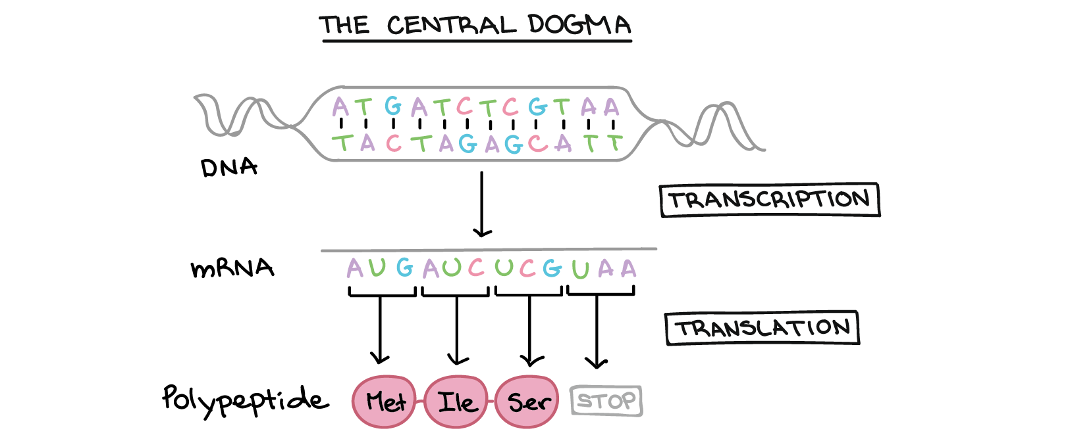
Module: Molecular Data Analysis & Bioinformatics
Genome assembly & annotation
Which genetic features does this organism have?
RNA-seq
Which genes are affected by a certain treatment or mutation?
Single-cell RNA-seq
Specialized cell types perform specialized functions
Phenotype of interest

Slide 4
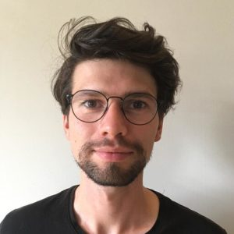
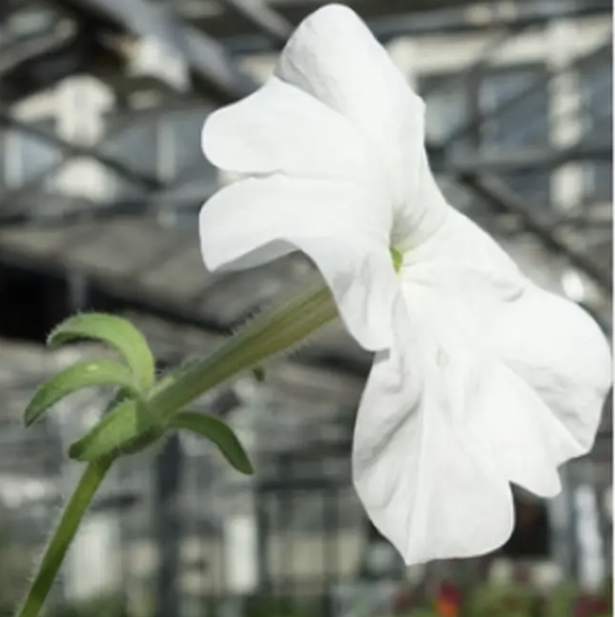
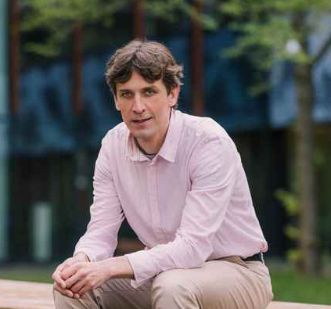
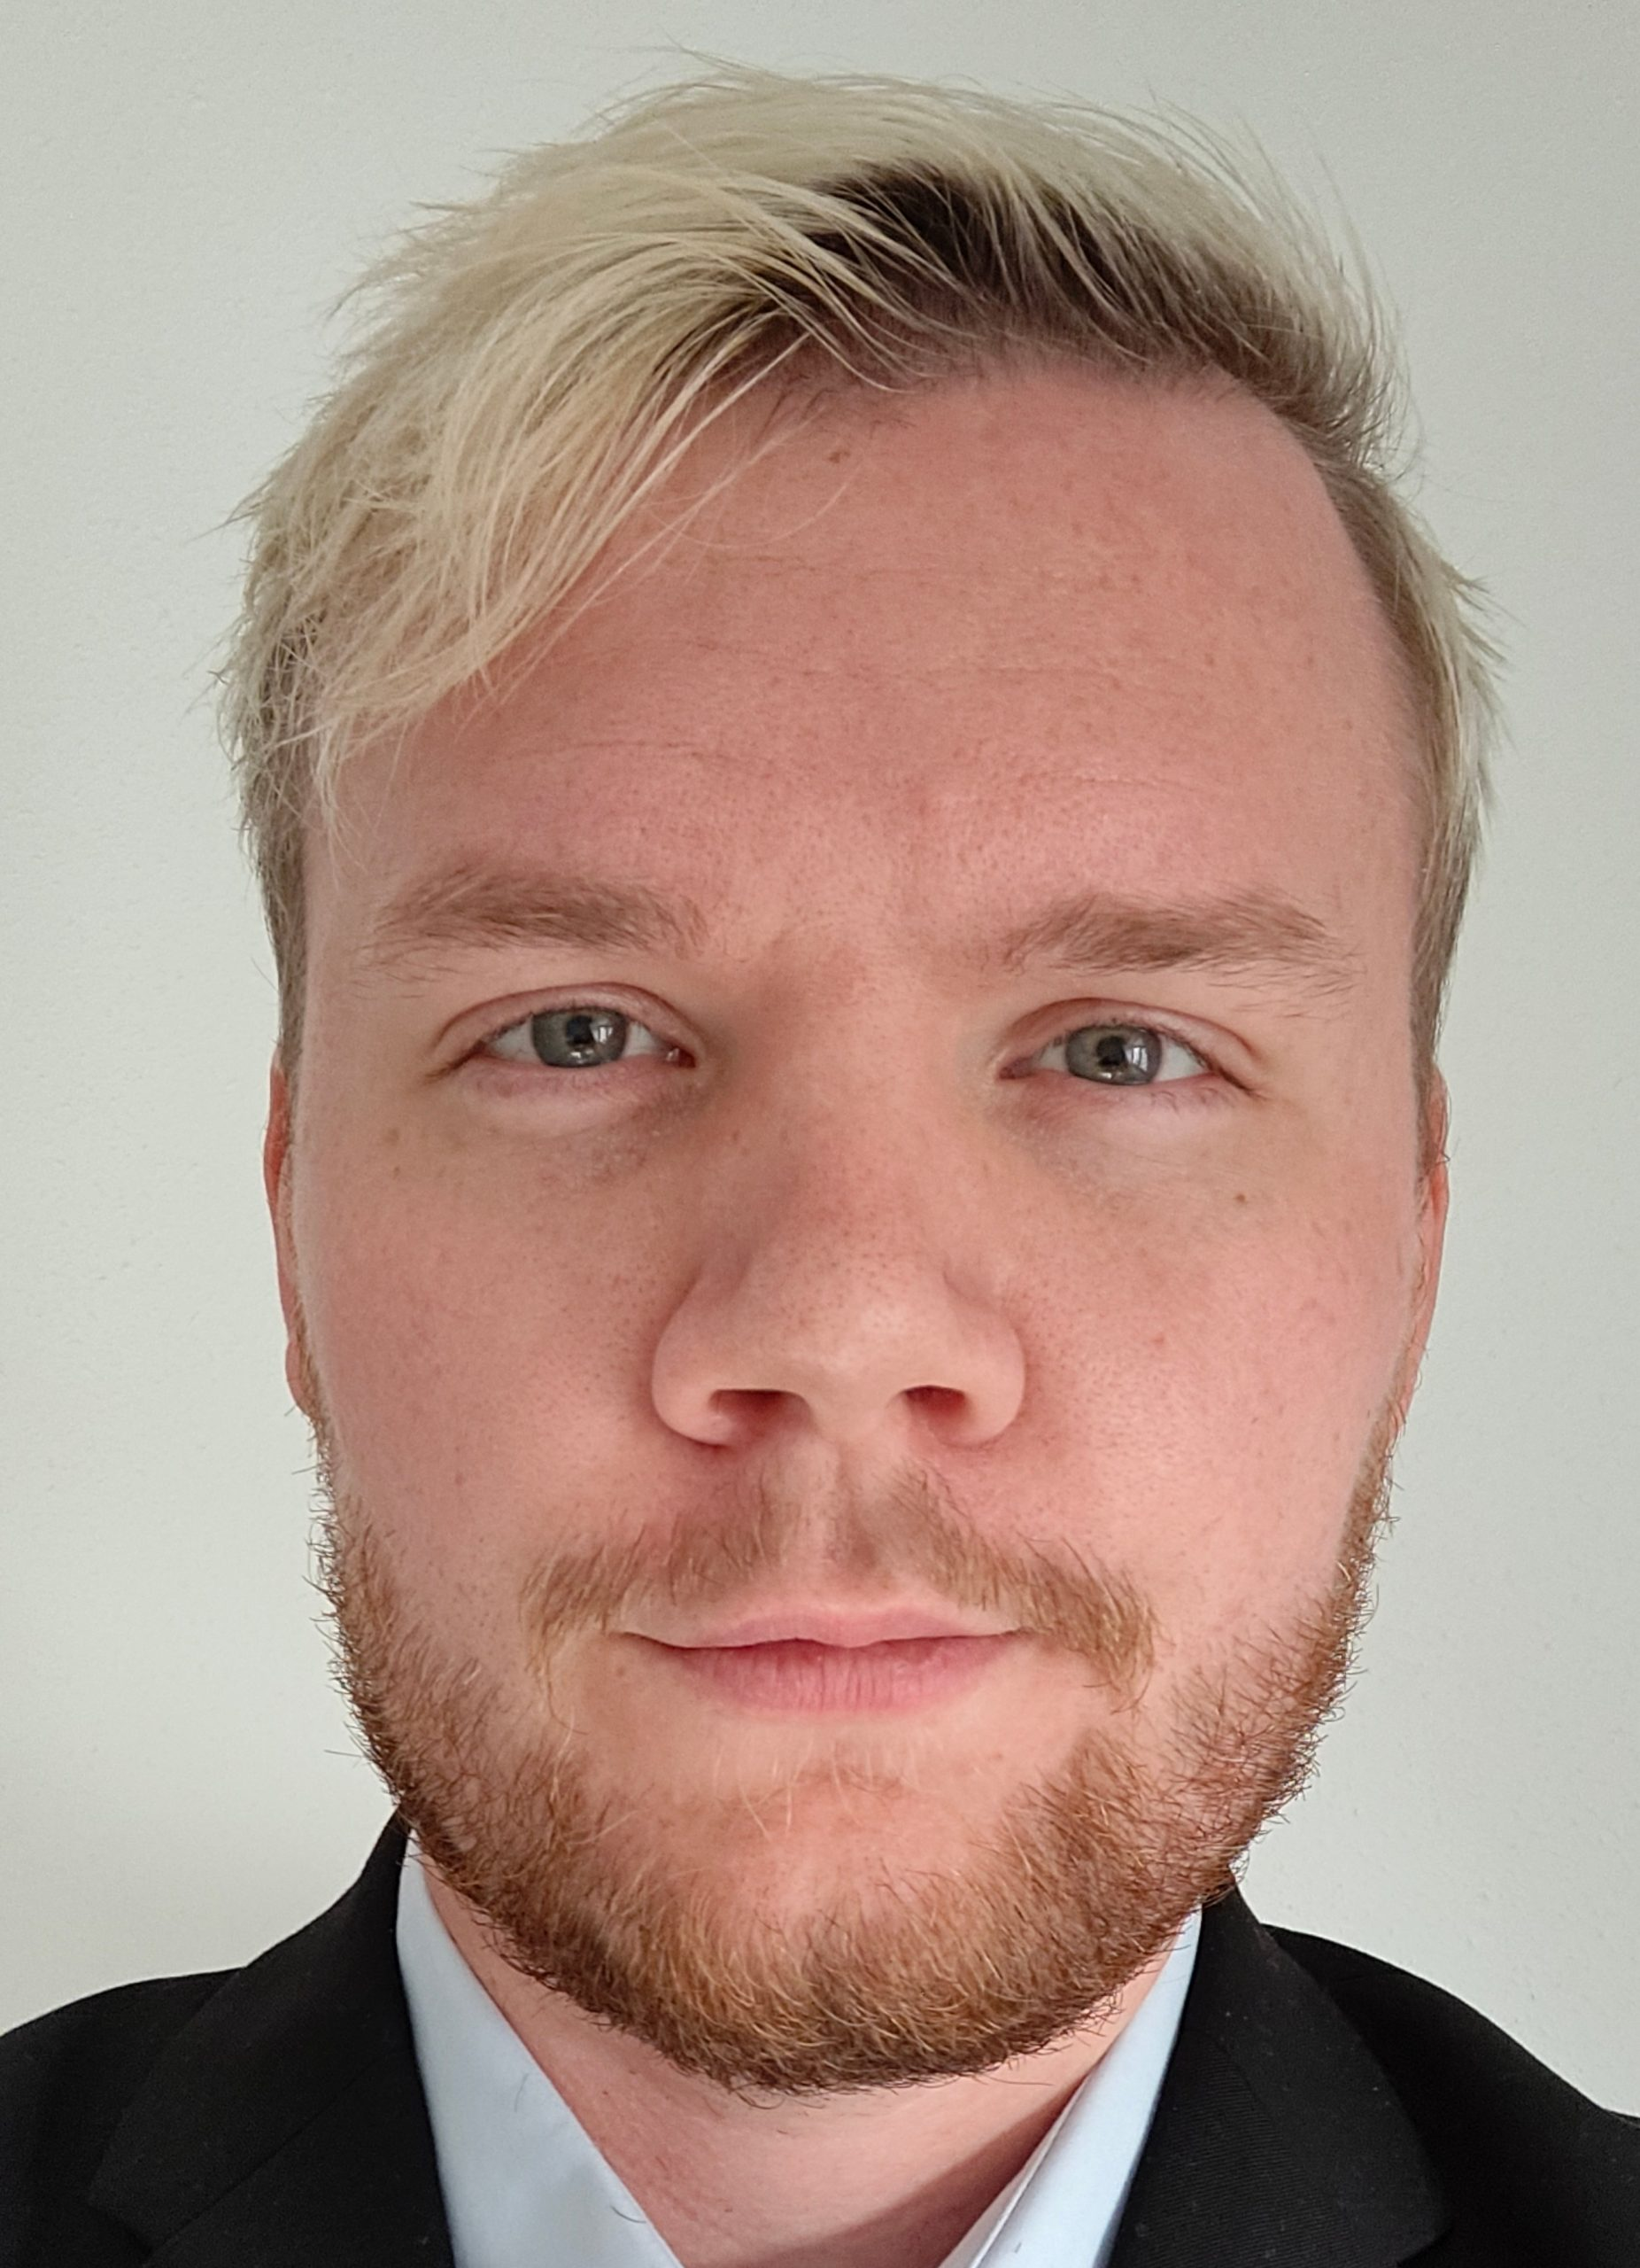
Teacher team
Misha Paauw (coordinator)
m.m.paauw@uva.nl
Plant Physiology
Intro to command line
Data visualization
RNA-seq
Genome assembly
Tijs Bliek
m.bliek@uva.nl
Plant Development & Genetics
Intro to command line
Data visualization
RNA-seq
Genome assembly
Prof. Aalt-Jan van Dijk
a.d.j.vandijk@uva.nl
Biosystems Data Analysis
Single-cell transcriptomics
Gene regulatory networks
Kyran Wissink
k.wissink@uva.nl
Biosystems Data Analysis
Single-cell transcriptomics
Gene regulatory networks

Slide 5
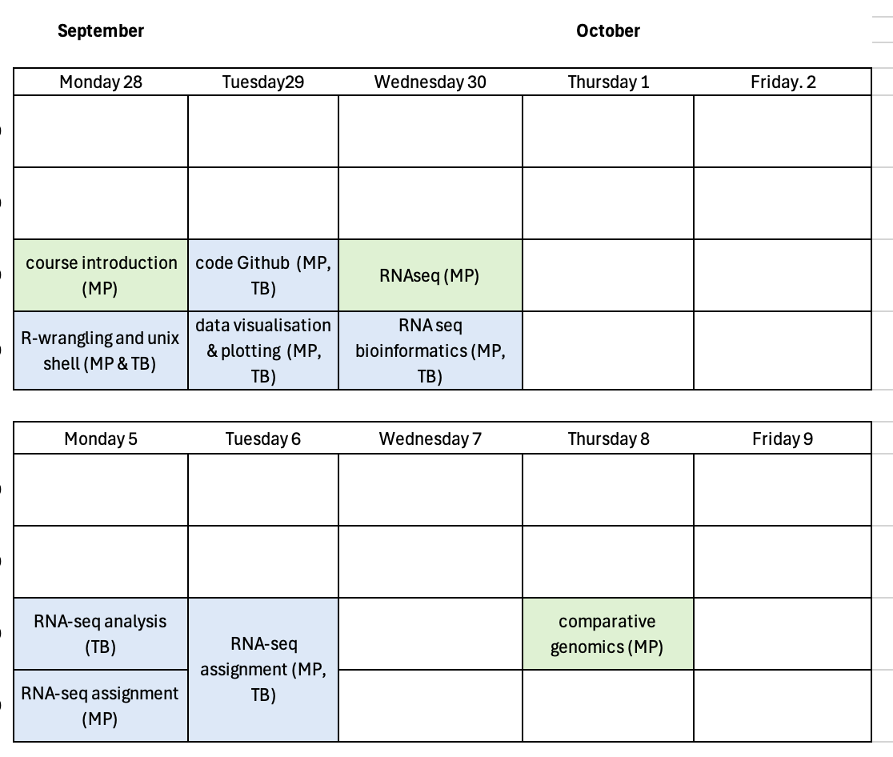
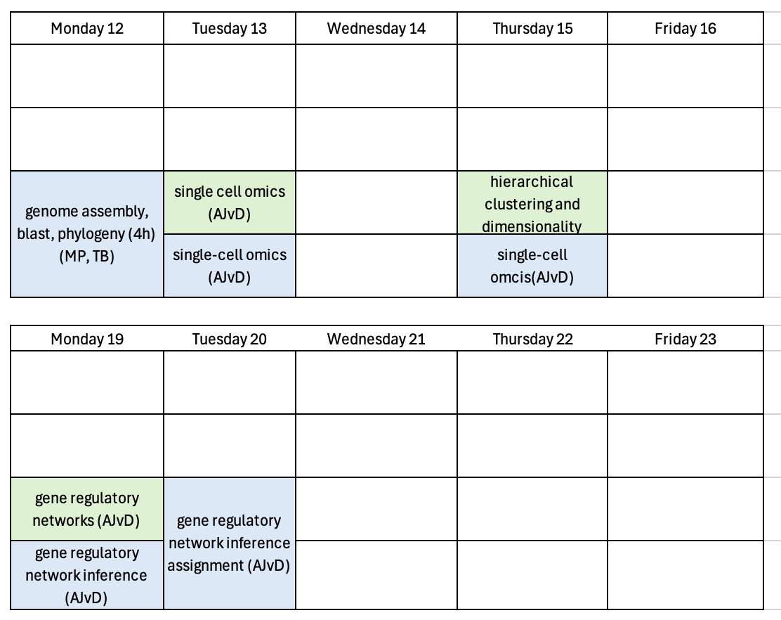

Slide 7
Schedule & assessment
Assessment
2x analyzing a new dataset; hand in code + interpretations
1x mini (5min) oral exam; pass or fail (and try again)

Slide 8
Assessment
The grade is an average of the two assignments you hand in on Canvas.
You work in pairs; different pair in each assignment.
Both assignments need to be at least 5.5 to pass
You need to pass the mini oral test
You need to be present at all tutorials to get a grade
Resits are only possible in emergency situations; make an appointment with the respective teacher.

Slide 9
Teaching materials
Lectures: Canvas
Tutorial materials:
  Online (for my tutorials): https://mishapaauw.github.io/molecular-data-analysis/
  Canvas (For Aalt-Jan’s tutorials)

Slide 10
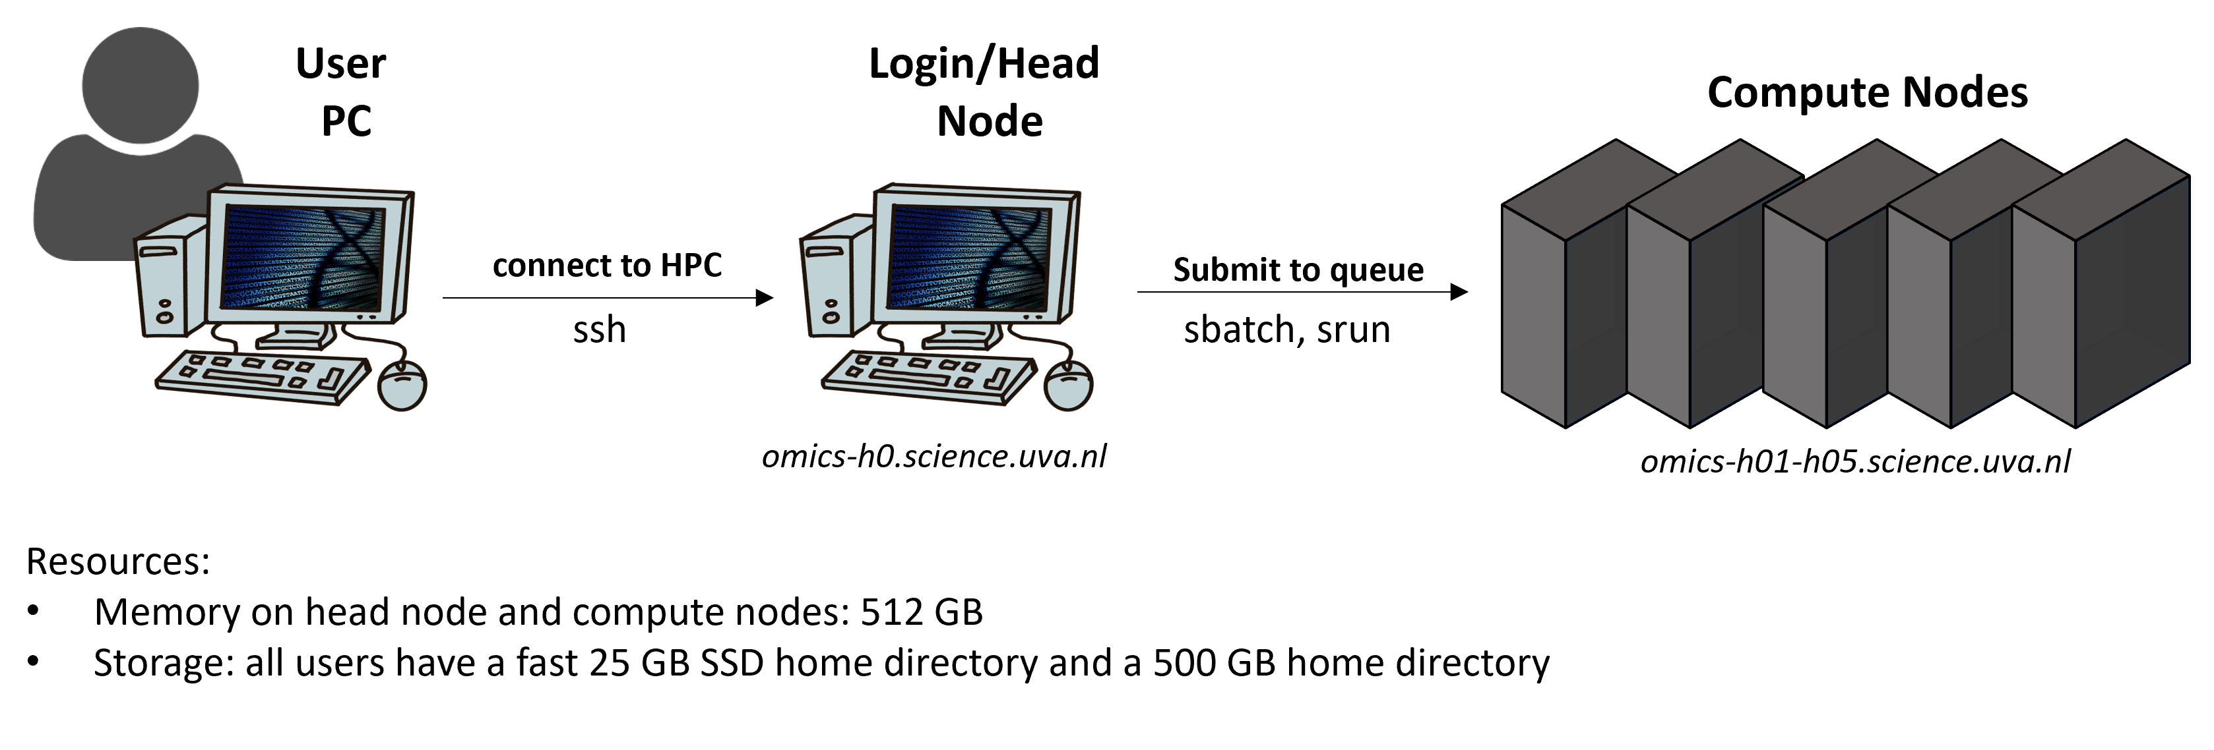
We will work on a High Performance Computer (HPC)
Crunchomics: a shared computer system that provides more memory, CPUs, and storage space than your laptop
Image by: Nina Dombrowski (IBED, UvA)

Slide 11
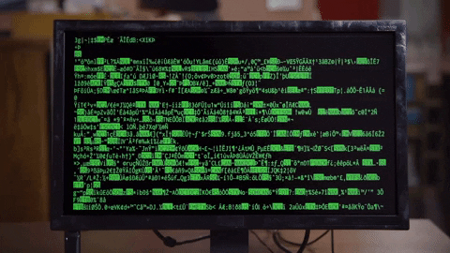

Working on a command line & RStudio
Enables us to work with big datasets efficiently
Gives us access to many bioinformatics tools
Allows us to document and reproduce our workflows (in contrast to point-and-click workflows!)
Is actually really fun ☺

Slide 12
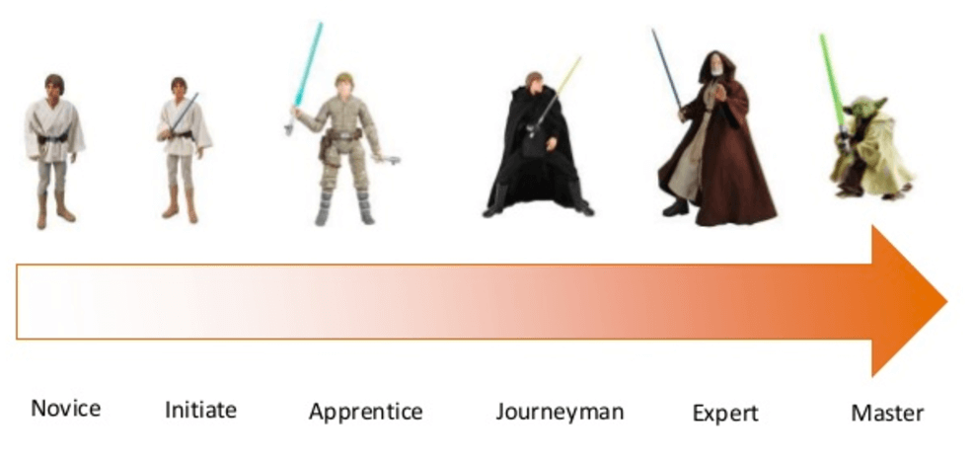
Q1: what is your experience level with coding?
1
2
3
4
5
6

Slide 13
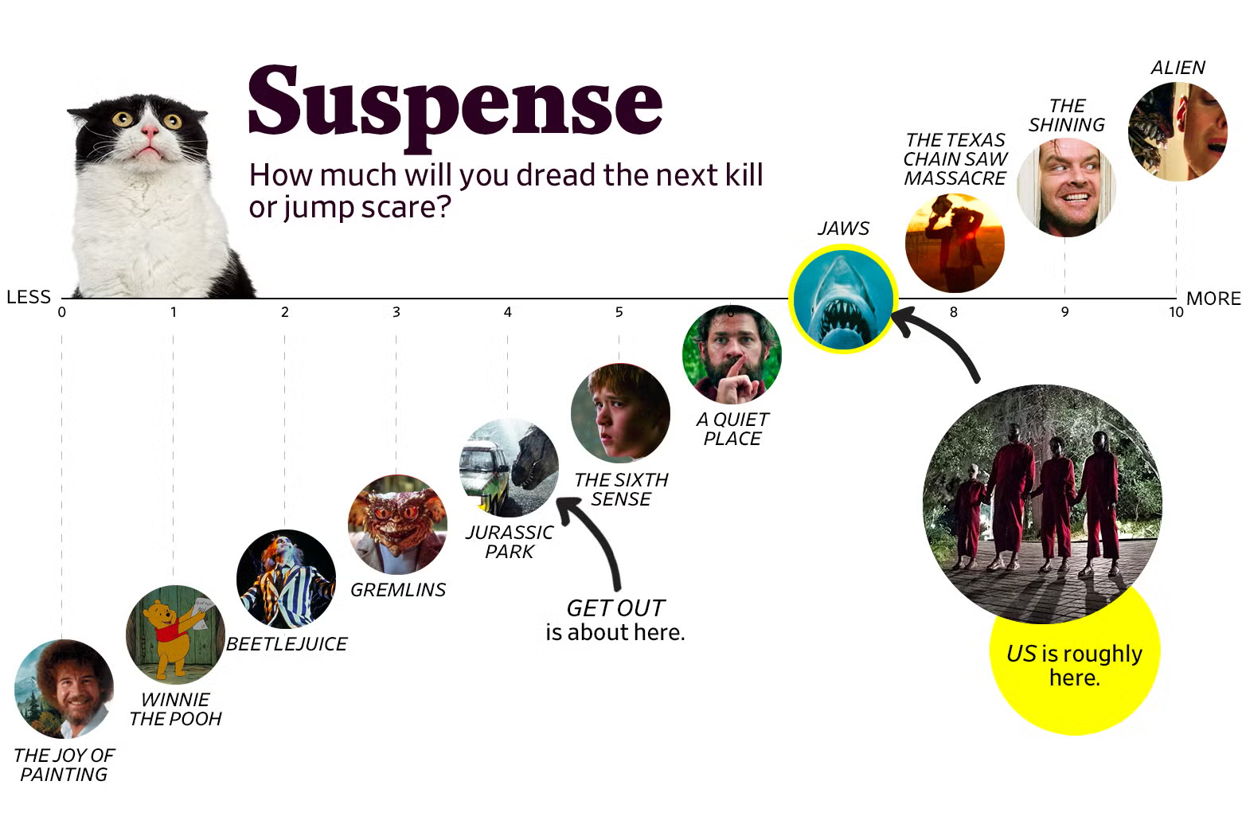
Q2: what is your suspense level regarding coding?

Slide 14

Tutorials will be partly in “Carpentries” style
Carpentries:
https://carpentries.org/
Evidence based teaching practices
Live coding, type along

Slide 15
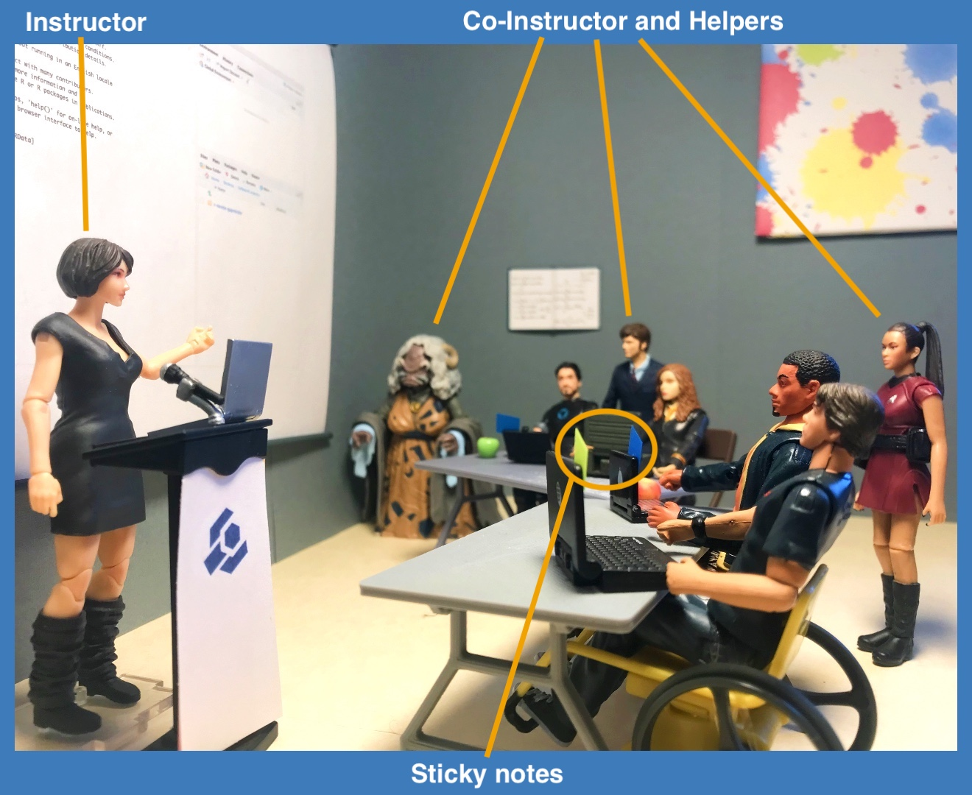
Tutorials will be partly in “Carpentries” style
Carpentries Code of conduct
  Growth mindset
  Be respectful
  Here to learn
  Mistakes are to learn from
Stickies
  Blue = done
  Yellow = help needed

Slide 16
A note on genAI #1
genAI is super useful and powerful for bioinformatics
But
You need a solid basic understanding of the tools and way of bioinformatics thinking, before you can harness the power of genAI
Use this module to get that understanding!

Slide 17
A note on genAI #2
I care about you learning bioinformatics; not about receiving flawless and smooth assignments
I don’t want to spend time reading, much less providing feedback on, something written by a machine
Doing bioinformatics ‘by hand’ is the learning process. Don’t bypass this with AI, we have seen examples of this over the last years.

Slide 18
A note on genAI #3
You are allowed to use genAI tools to support your learning and understanding of the course materials
You are not allowed to use genAI to replace your work and critical thinking, and to generate full solutions to assignment.
“If we view assignments as a critical tool for learning, both the instructor and the student need to invest their own thoughts and efforts in the process.” (MIT AI and Education report, august 2026)

Slide 19
Today: introduction to command line
https://mishapaauw.github.io/molecular-data-analysis/part0-setup/
(link available on Canvas)

Slide 20
