Slide 1
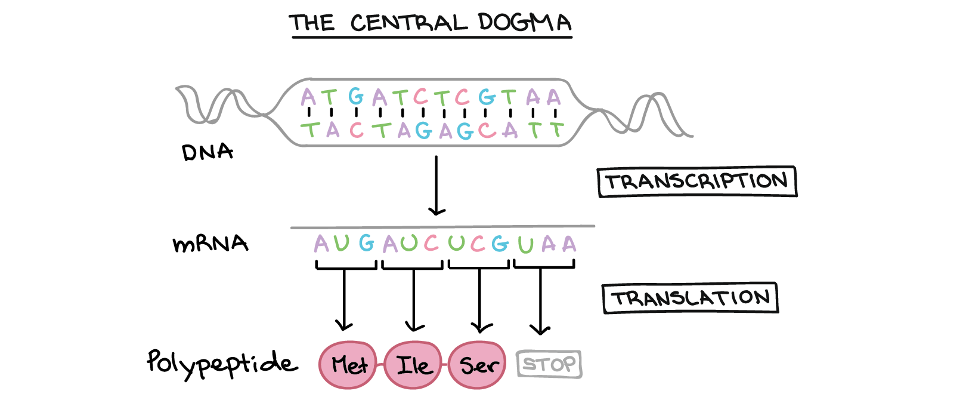

Module: Molecular Data Analysis & Bioinformatics
Genome assembly & annotation
Which genetic features does this organism have?
RNA-seq
Which genes are affected by a certain treatment or mutation?
How can we build gene regulatory networks?
Single-cell RNA-seq
Specialized cell types perform specialized functions
Phenotype of interest
Coordinator: Misha Paauw (m.m.paauw@uva.nl)
Petra Bleeker (p.m.bleeker@uva.nl)
Notes:
Central dogma figure: Khan academy

Slide 2
MDA is a good fit for you if you…
want to understand the molecular mechanisms that underly the diversity of form and function of organisms
want to mine genome-wide datasets to generate new hypotheses
are curious about working with truly ‘big data’ datasets
Pre-requisites:
some experience in with programming in R
familiar with with basic concepts in molecular biology & genetics
Coordinator: Misha Paauw (m.m.paauw@uva.nl)
Petra Bleeker (p.m.bleeker@uva.nl)

Slide 3
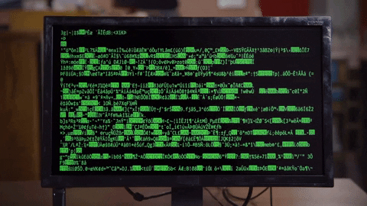
What you will learn and do in this module
In this submodule, you will learn how to…
Work on a command-line interface
Document & share your work in a reproducible manner
Perform RNA-seq analysis, both bulk and at single-cell resolution
Assemble & annotate a bacterial genome
Infer gene-regulatory networks
These skills are highly relevant and sought after in academic research and industry (drug development, plant breeding, conservation ecology)
Coordinator: Misha Paauw (m.m.paauw@uva.nl)
Petra Bleeker (p.m.bleeker@uva.nl)
Notes:
Shell gif: https://levelup.gitconnected.com/in-your-shell-ls-l-2ba54eecb024

Slide 4
Molecular Data Analysis and Bioinformatics
Teaching activities (% of total workload):
Lectures 25%
Tutorials (live-coding computer practicals): 50%
Assignment: 25%
Teachers:
Misha Paauw (Plant Physiology, SILS)
Tijs Bliek (Plant Development & Genetics. SILS)
Aalt-Jan van Dijk (Biosystems Data Analysis, SILS)
Kyran Wissink (Biosystems Data Analysis, SILS)
Assessment:
2x assignment
Materials:
Most materials available at: https://mishapaauw.github.io/molecular-data-analysis/
Reach out to the coordinator if you have any questions before making your choice (m.m.paauw@uva.nl or p.m.bleeker@uva.nl )

