Slide 1
Genome assembly tutorial
12-10

Slide 2
RNA-seq assignment
Well done!
Grades between 7 and 9, everyone passed ☺

Slide 3
Today: genome assembly tutorial
My last tutorial in the MDA module! Aalt-Jan & Kyran will take over for the last four days
When you leave today, please write down some informal feedback on your sticky note:
  One thing you enjoyed during the last few weeks
  One thing that could be improved for next year

Slide 4
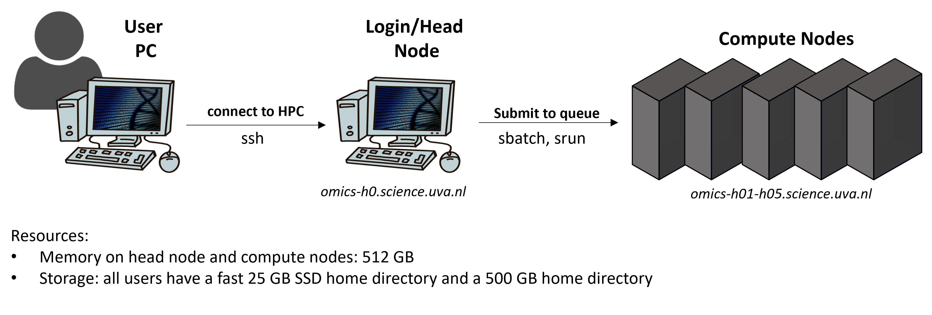
Today: genome assembly tutorial
Setup today: no live coding, follow the materials by yourself / in pairs. Take breaks at your own rhytm.
1. you will assemble a genome using the compute nodes!
2. register assembly statistics in google sheet
3. create a plot, discuss with teacher (mini oral exam)
4. annotate the genome using webtools

Slide 5
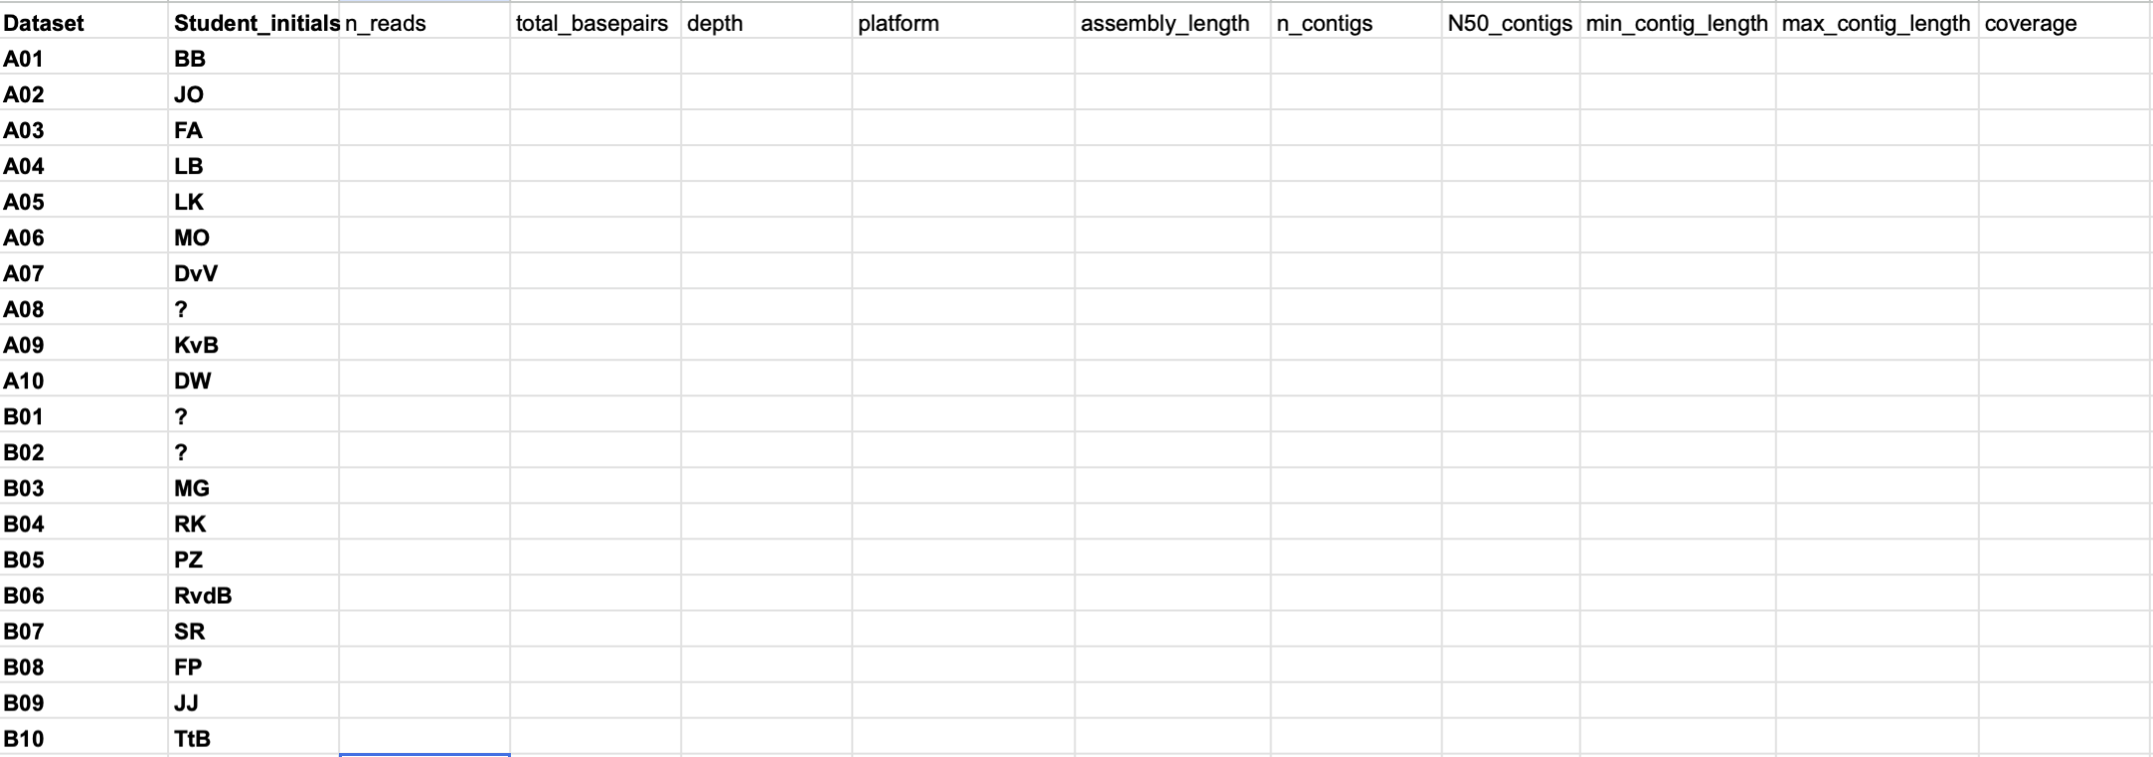
Each student gets a different read dataset!
https://docs.google.com/spreadsheets/d/1ARB0ZgmnG-mSbV5gqsJOfApGxxUxZHZ4i7HYs34aAPU/edit?gid=0#gid=0

