Slide 1
Reproducible science & data visualization theory
Molecular Data Analysis & Bioinformatics
Lecture 29 september 2026

Slide 2
Next lecture
Next lecture (tomorrow) will be recorded with a 360-degree camera as part of my BKO qualification to reflect on my teaching competence. An important part of this, is the interaction with students.
This video will:
  ónly be viewed by me, my BKO-peer, my BKO-coach and the assessors.
  not be used for any other purposes.
  archived in accordance with the UvA retention periods.
If you don't want to be on camera, please tell me before the class, and we can arrange the seating so you can be blurred.

Slide 3
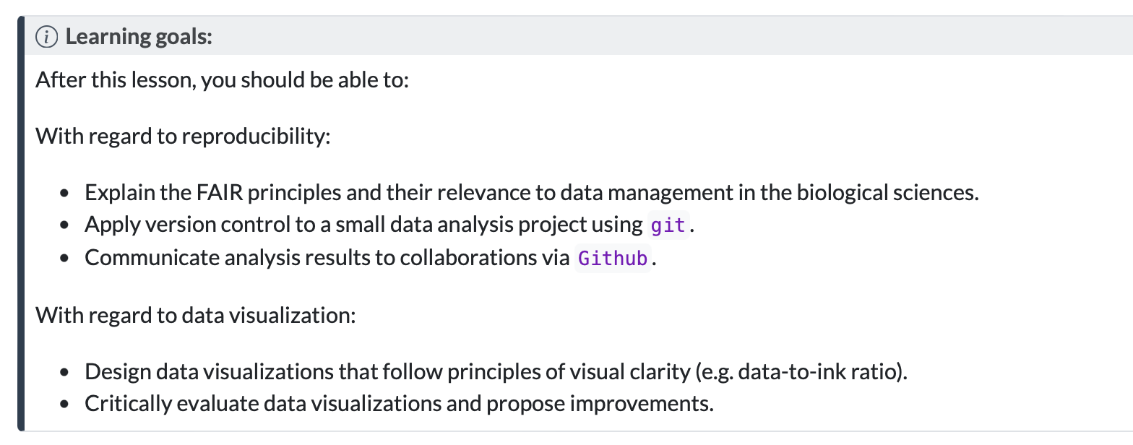

Slide 4
Timetable
13:00 – 13:15: Mini lecture on reproducible science & Github
13:15 – 13:50: Setting up a Github repository on Crunchomics
14:00 – 14:20: mini lecture on data visualisation theory
14:20 – 14:50: coding in R, data visualisation
15:00 – 15:30: more coding and data visualization
15:20 – 15:50: explanation & start assignment
16:00 – 16:50: Create the ugliest plot with palmerpenguins dataset, submit to Google Sheets, short presentations.

Slide 5
Timetable
13:00 – 13:15: Mini lecture on reproducible science & Github
13:15 – 13:50: Setting up a github repository on Crunchomics
14:00 – 14:20: mini lecture on data visualisation theory
14:20 – 14:50: coding in R, data visualisation
15:00 – 15:30: more coding and data visualization
15:20 – 15:50: explanation & start assignment
16:00 – 16:50: Create the ugliest plot with palmerpenguins dataset, submit to Google Sheets, short presentations.

Slide 6

Reproducible science: why?
Strive to make it easy to reproduce your computational analysis.
For others, incuding:
  Your colleagues
  Your supervisor
  Other scientists in the field
  … yourself in six months from now!

Slide 7
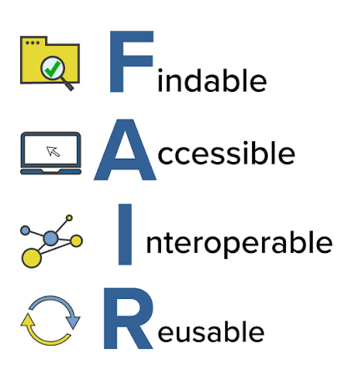
Reproducible science is FAIR
Others should be able to find your scripts.
The raw data of a project should become accessible at some point
Others should be able to operate/run the scripts on another computer system
Others should be able to reuse your scripts for similar purposes

Slide 8
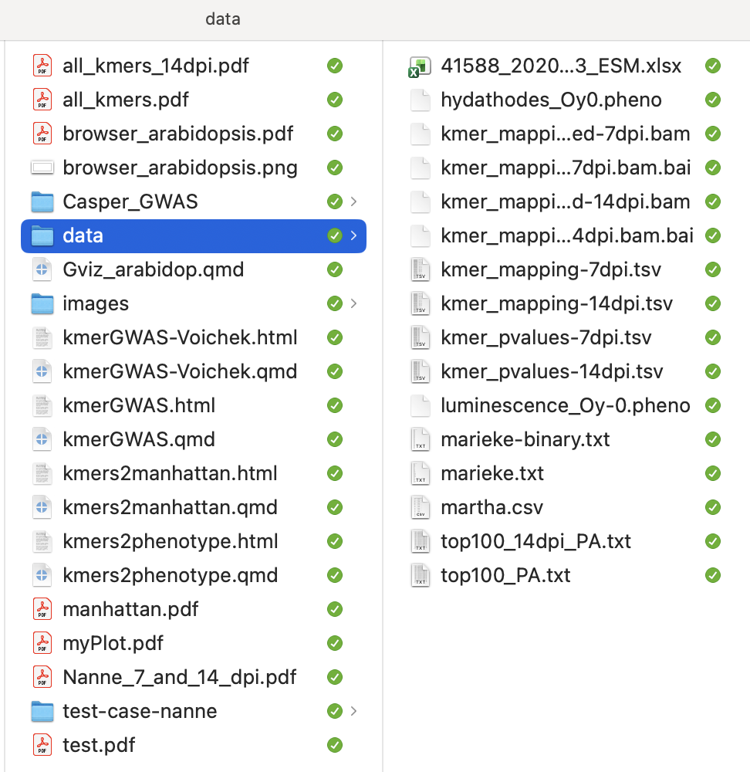
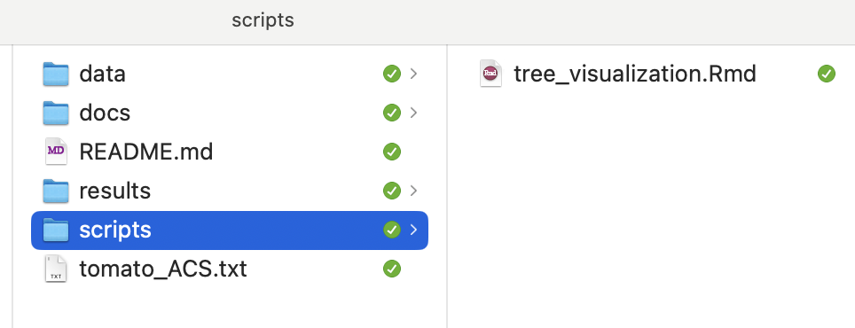
A clear folder structure helps reusibility
Bad:
Good:

Slide 9

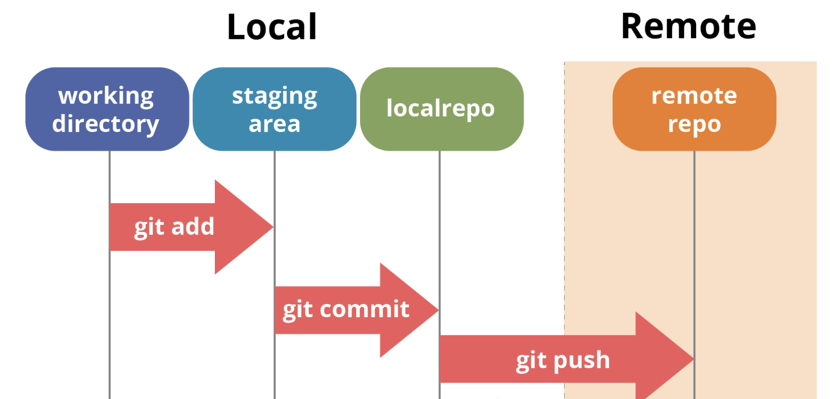
Version control with Git and Github
Your laptop or cluster folder

Slide 10
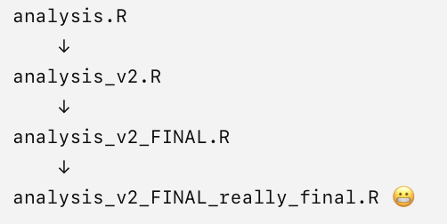
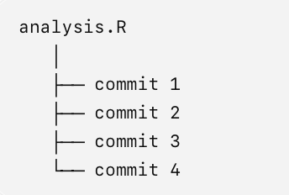
Version control with Git and Github
Git helps you track changes of files and datasets via commits instead of filenames

Slide 11
Version control with Git and Github for scientific projects
Labjournal style, work-in-progress: https://github.com/mishapaauw/PPPlasmids
Paper repository:
https://github.com/BleekerLab/Riboflavin

Slide 12
Timetable
13:00 – 13:15: Mini lecture on reproducible science & Github
13:15 – 13:50: Setting up a github repository on Crunchomics
14:00 – 14:20: mini lecture on data visualisation theory
14:20 – 14:50: coding in R, data visualisation
15:00 – 15:30: more coding and data visualization
15:20 – 15:50: explanation & start assignment
16:00 – 16:50: Create the ugliest plot with palmerpenguins dataset, submit to Google Sheets, short presentations.
Go to teaching materials website:
https://mishapaauw.github.io/molecular-data-analysis/part1-dataviz/01-github.html

Slide 13
Timetable
13:00 – 13:15: Mini lecture on reproducible science & Github
13:15 – 13:50: Setting up a github repository on Crunchomics
14:00 – 14:20: mini lecture on data visualisation theory
14:20 – 14:50: coding in R, data visualisation
15:00 – 15:30: more coding and data visualization
15:20 – 15:50: explanation & start assignment
16:00 – 16:50: Create the ugliest plot with palmerpenguins dataset, submit to Google Sheets, short presentations.

Slide 14

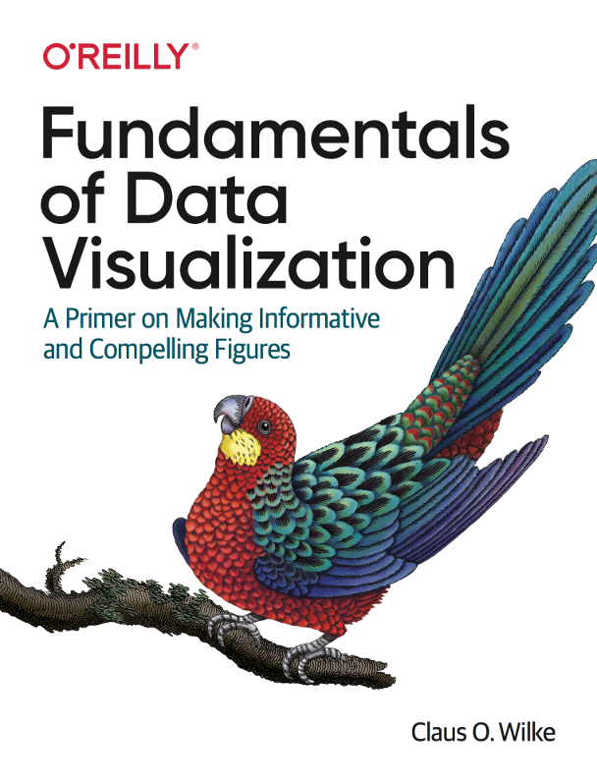
(1983)
https://clauswilke.com/dataviz/

Slide 15
Tufte’s principles from the 80s are highly relevant for modern biology
Graphical excellence ”consists of complex ideas communicated with clarity, precision, and efficiency”
Graphical excellence is “giving the viewer the greatest number of ideas in the shortest time”
Graphical excellence ”requires telling the truth about the data”

Slide 16
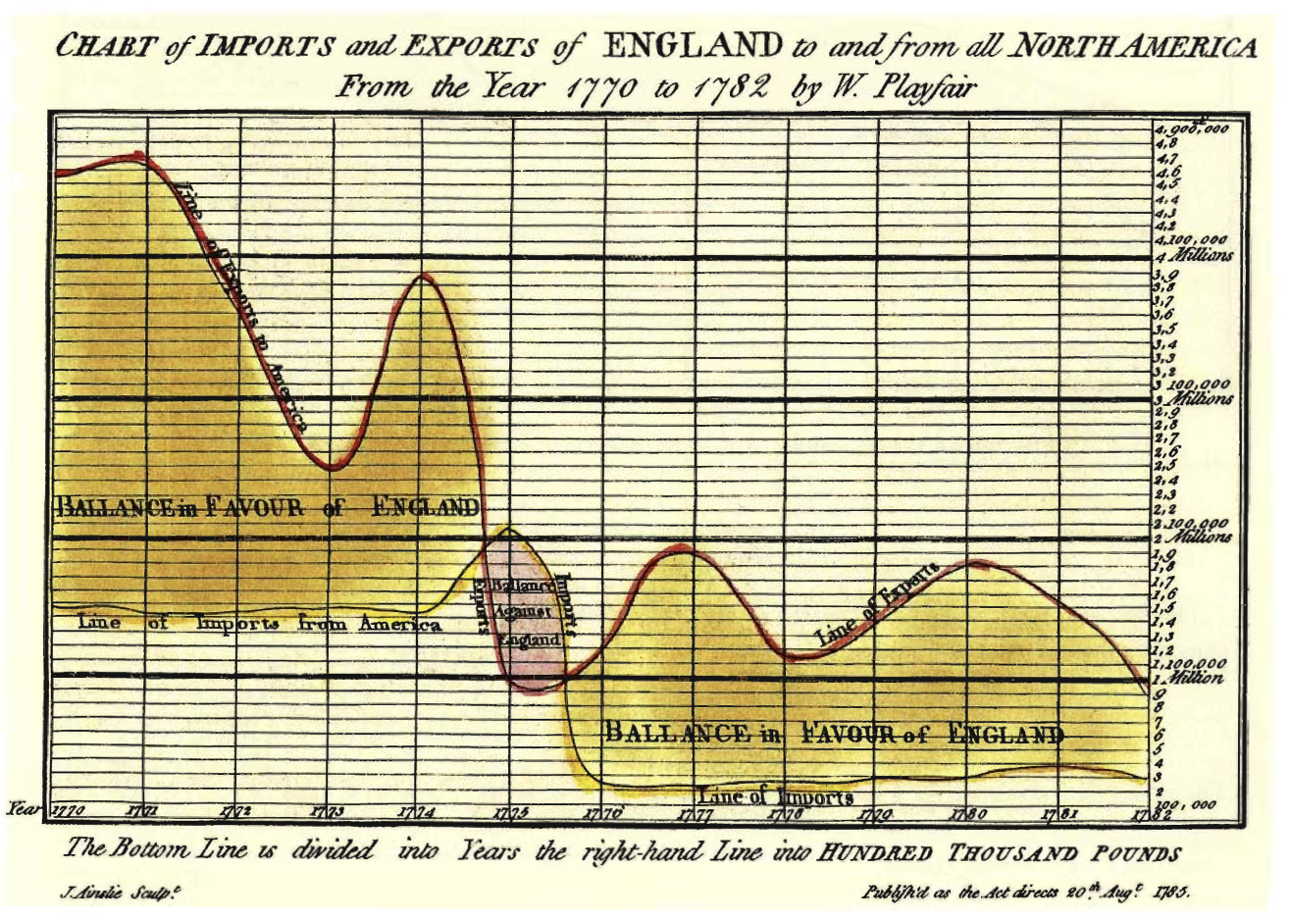
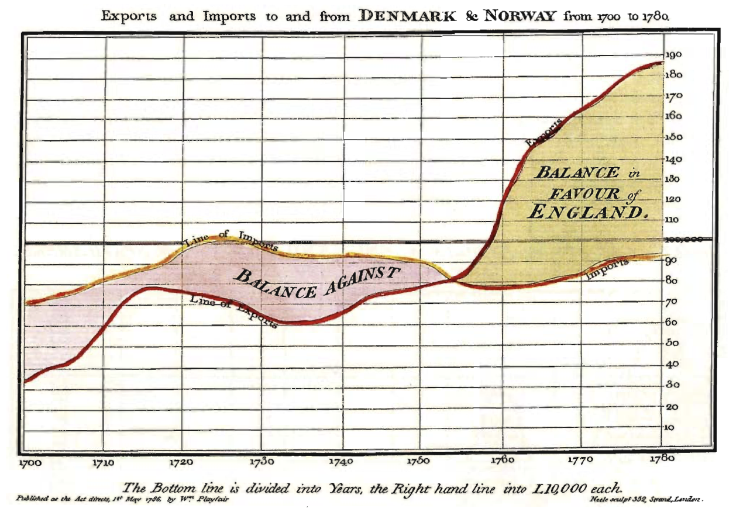
Design principle 1: above all else, show the data
William Playfair (1785)
William Playfair (1786)

Slide 17
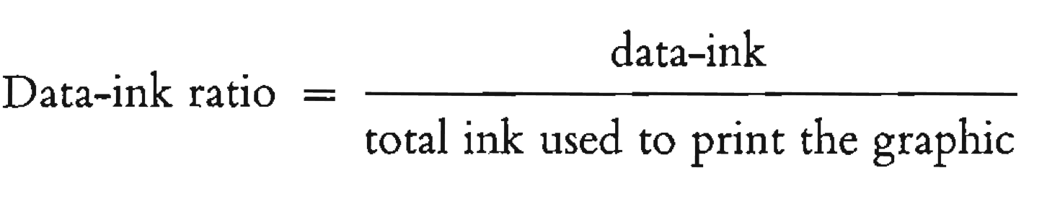
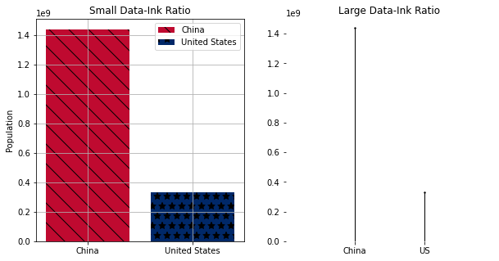
Erase non-data-ink, within reason
Erase redundant data ink, within reason
Notes:
https://towardsdatascience.com/data-visualization-theory-an-introduction-a077c0d80498/

Slide 18
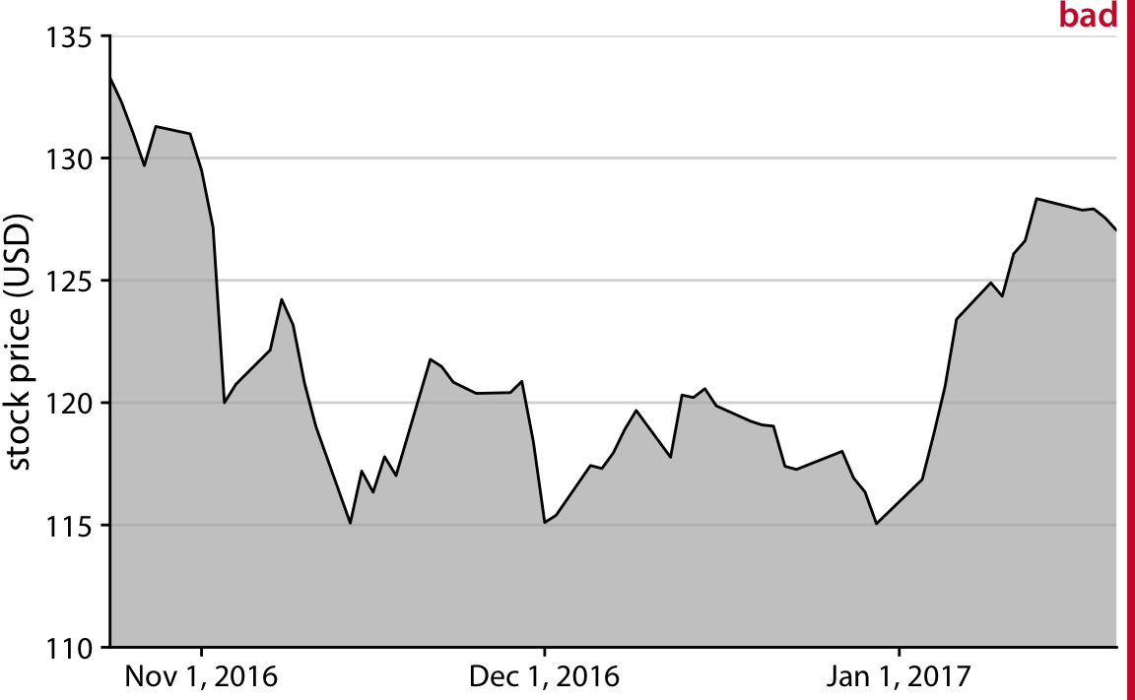
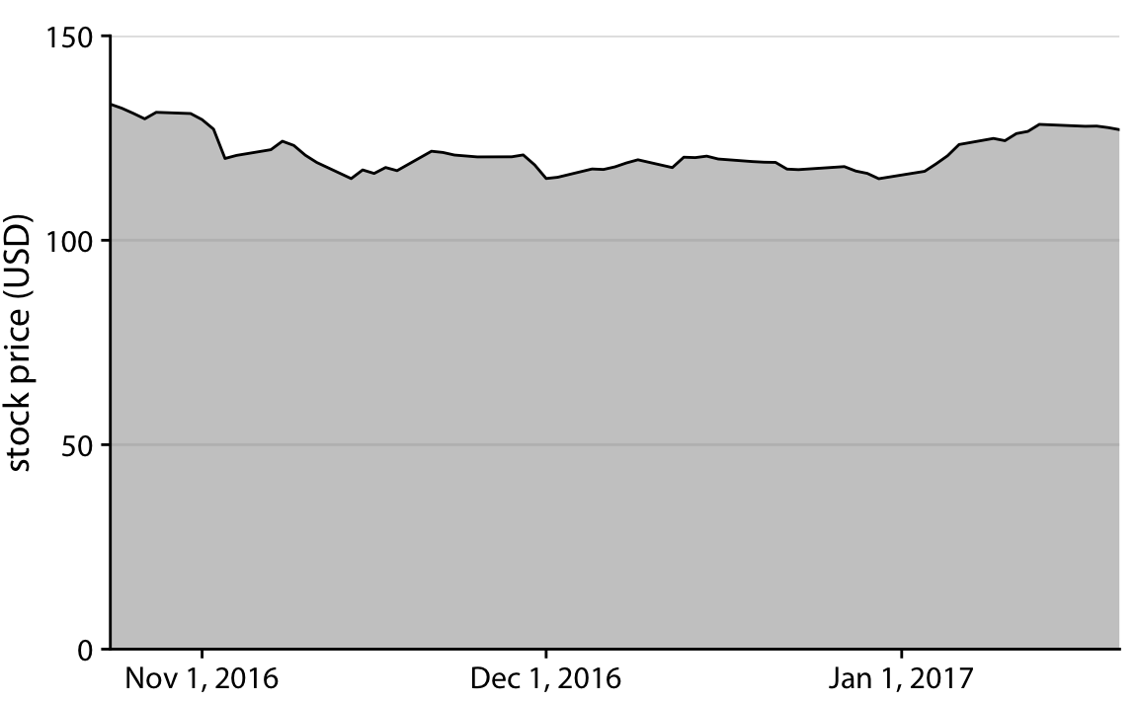
Design principle 2: principle of proportional ink
“the sizes of shaded areas in a visualization need to be proportional to the data values they represent.”
Notes:
https://callingbullshit.org/tools/tools_proportional_ink.html
https://clauswilke.com/dataviz/proportional-ink.html#ref-BergstromWest2016

Slide 19
How would you visualize this list of city populations?
Notes:
https://clauswilke.com/dataviz/proportional-ink.html
Also add some graphics from points of view
https://towardsdatascience.com/data-visualization-theory-an-introduction-a077c0d80498/
https://www.nature.com/articles/nmeth0910-665/figures/1

Slide 20
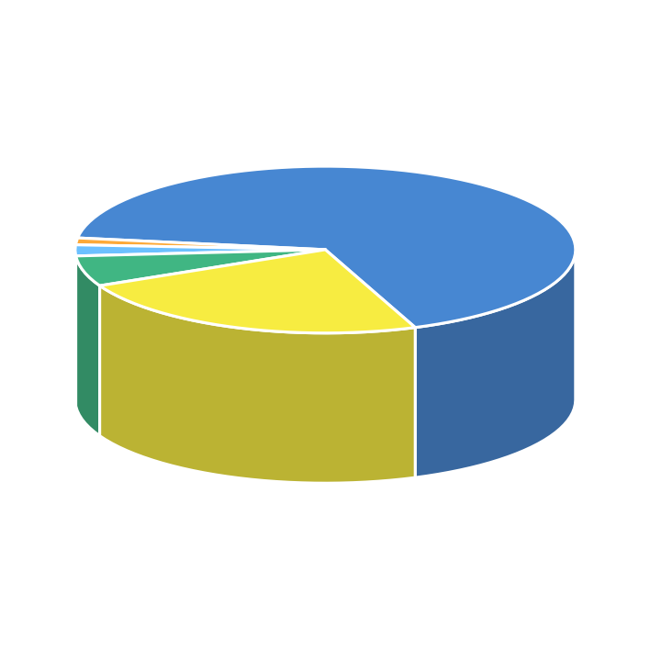
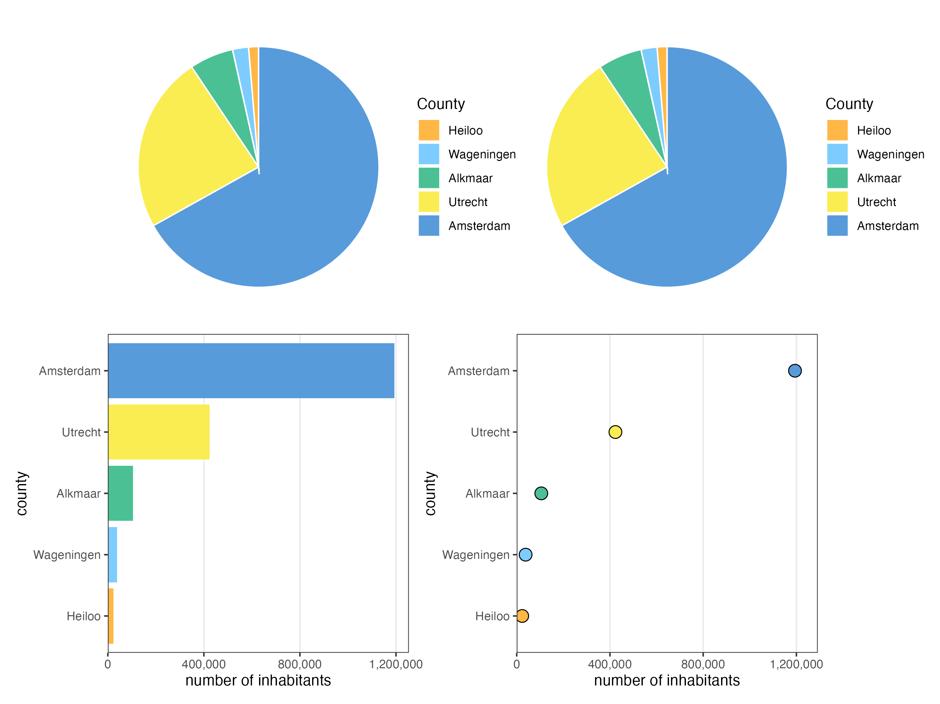

Slide 21
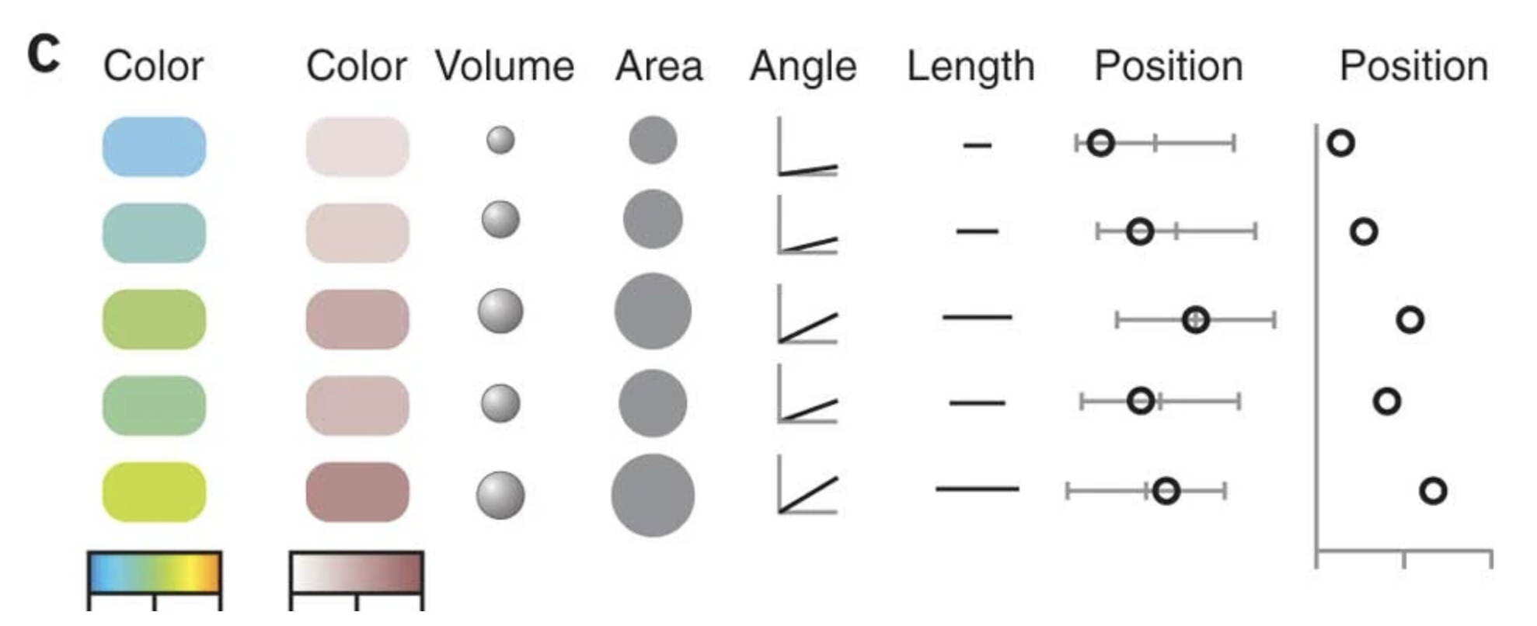
Encoding a continuous variable
Effectiveness

Slide 22
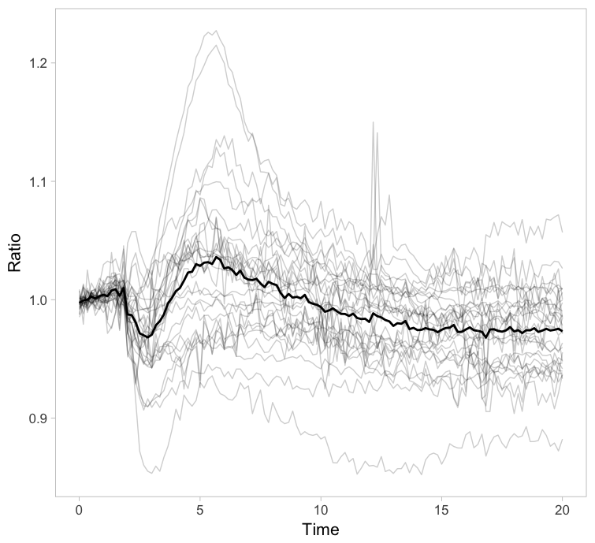
Small multiples: multiple similar plots arranged together
This plot displays a timeseries (x axis) and a certain ratio (y axis) is measured.
Each line represents a cell.
It is messy!
Notes:
https://thenode.biologists.com/visualizing-heterogeneity-of-imaging-data/research/

Slide 23
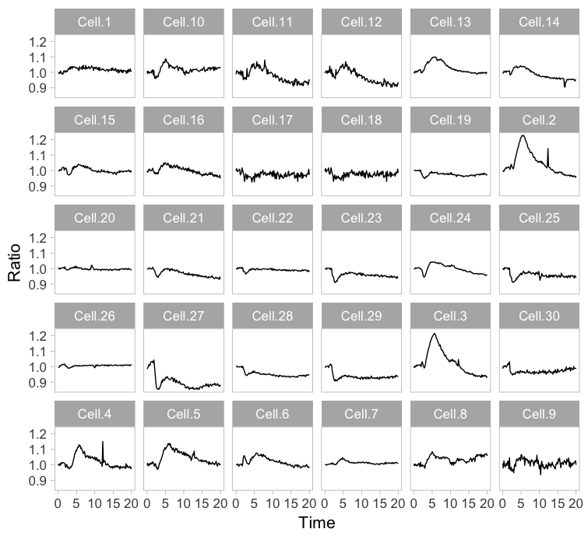
Small multiples: multiple similar plots arranged together
A concept called “small multiples”
Plotting each cell separately using ‘facetting’ in ggplot2

Slide 24
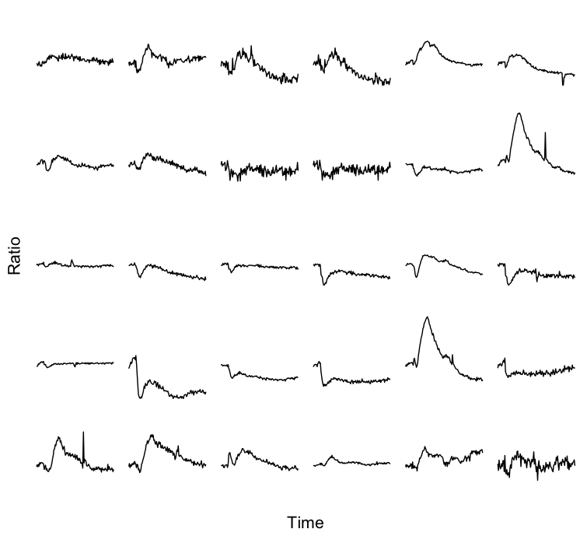
Small multiples: multiple similar plots arranged together
Applying Tufte’s design principles to achieve a high data-ink ratio

Slide 25
Timetable
13:00 – 13:15: Mini lecture on reproducible science & Github
13:15 – 13:50: Setting up a github repository on Crunchomics
14:00 – 14:20: mini lecture on data visualisation theory
14:20 – 14:50: coding in R, data visualisation
15:00 – 15:30: more coding and data visualization
15:20 – 15:50: explanation & start assignment
16:00 – 16:50: Create the ugliest plot with palmerpenguins dataset, submit to Google Sheets, short presentations.

Slide 26
Timetable
13:00 – 13:15: Mini lecture on reproducible science & Github
13:15 – 13:50: Setting up a github repository on Crunchomics
14:00 – 14:20: mini lecture on data visualisation theory
14:20 – 14:50: coding in R, data visualisation
15:00 – 15:30: more coding and data visualization
15:20 – 15:50: explanation & start assignment
16:00 – 16:50: Create the ugliest plot with palmerpenguins dataset, submit to Google Sheets, short presentations.

Slide 27
Assignment: create the worst possible visualization
Create a terrible data visualisation; go crazy
Commit your changes to github
Place your visualisation in google sheet
Present visualisation in one or two minutes once submitted

