Slide 1
RNA-seq
Molecular Data Analysis & Bioinformatics
Lecture 30 september 2026

Slide 2
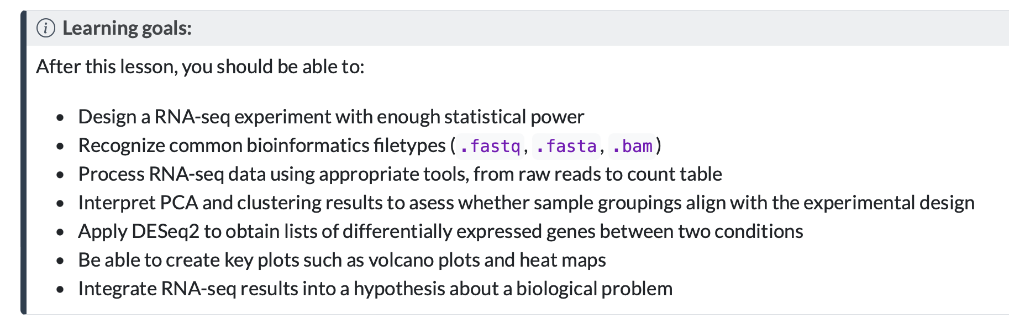

Slide 3
Why study the transcriptome of organisms?

Slide 4

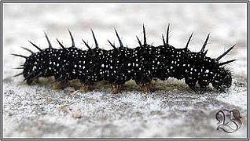
One genome, many forms
https://en.wikipedia.org/wiki/Aglais_io#/media/File:DA_ph_husenica.jpg
https://nl.wikipedia.org/wiki/Dagpauwoog#/media/Bestand:Inachis_io_Lill-Jansskogen.JPG

Slide 5
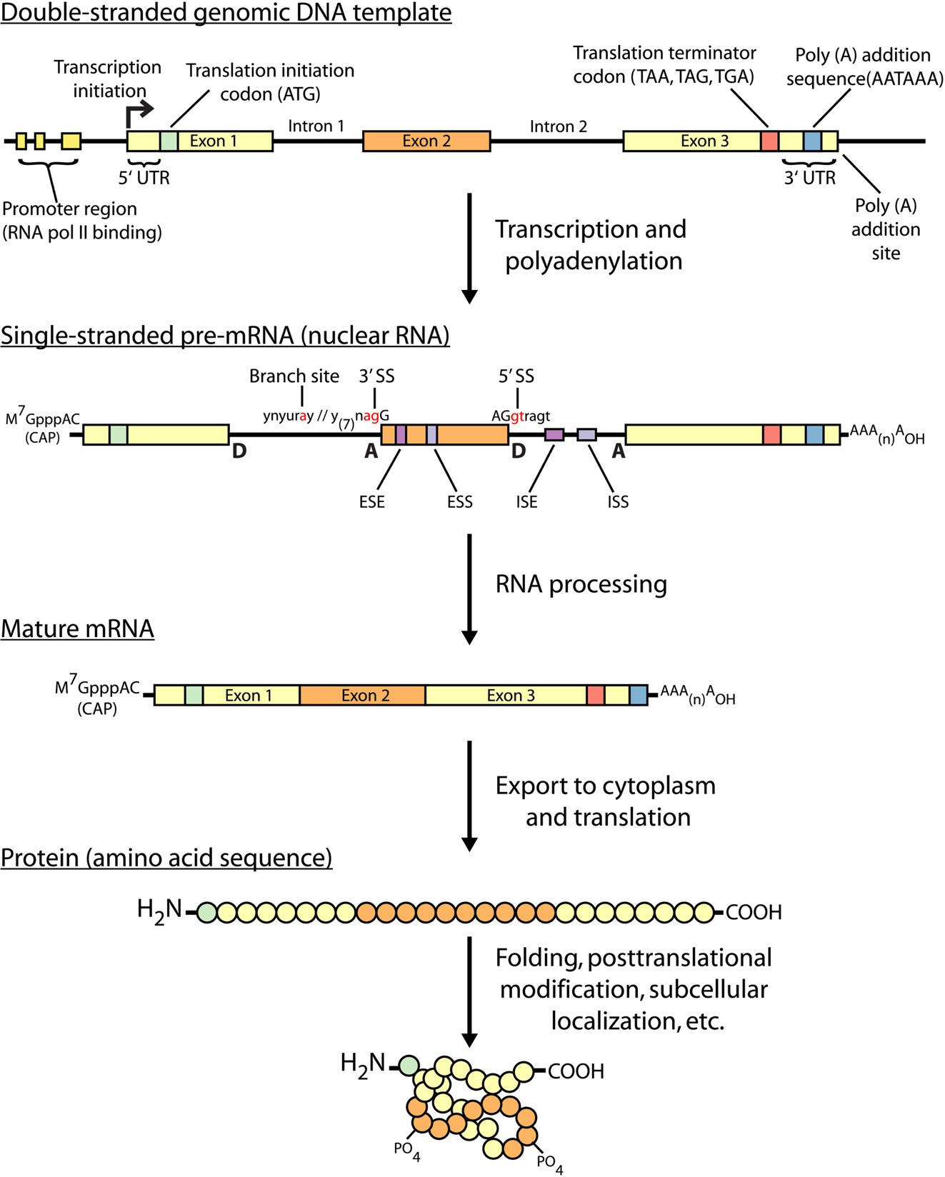
Gene expression
Griffith et al. PLOS Computational Biology 2015 https://doi.org/10.1371/journal.pcbi.1004393
Organisms regulate their transcriptome
  as part of development
  in response to changed conditions

Slide 6
Question posed in RNA-seq studies
Which genes are differentially expressed after a treatment or in individuals with/without a certain mutation?
When/where are a group of genes expressed?
Does the regulation of gene expression still work, if I experimentally interfere with a
potential signalling/regulatory/feedback molecule?
Is gene expression regulated at the transcription, localization, translation, and/or degradation level?
Which part of the genome are transcribed/translated?
Which RNAs interact physically with each other or a protein?
What is the function of this transcript/gene?

Slide 7
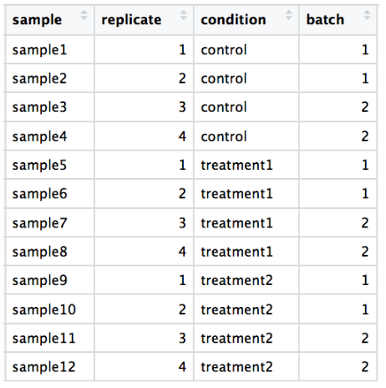
From sample to reads
Extract RNA
Generate cDNA
Add sequencing adapters
Next generation sequencing

Slide 8
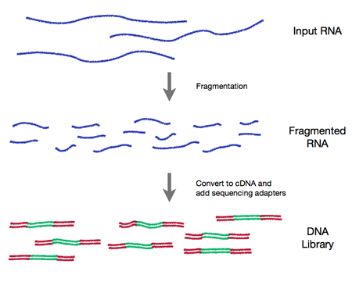
RNA sample to library prep (simplified)

Slide 9
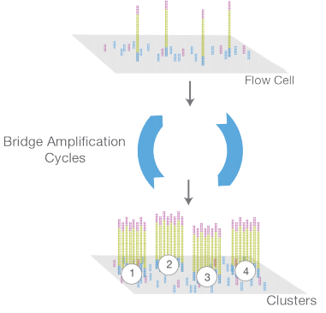
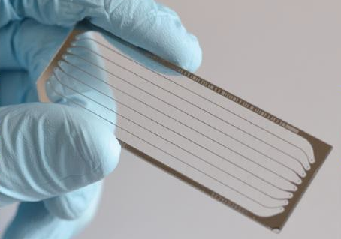
Library is loaded on a flow cell and amplified in clusters

Slide 10
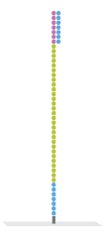

Slide 16
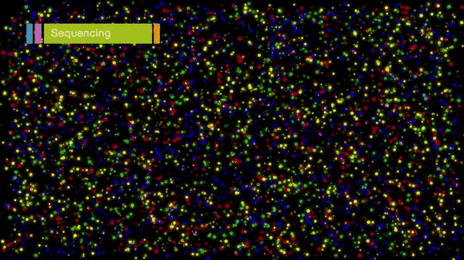
Typically a run consists of 50 to 150 cycles.
> This determines read length

Slide 17
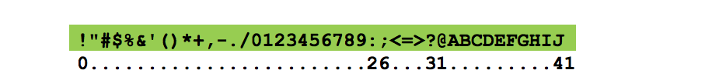
Every sequencing cycle for each spot a base is called and a quality value is given.
(for Illumina, from 0 to 40)

Slide 18
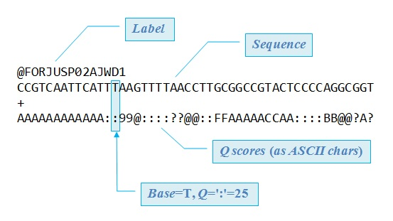
Results: .fastq file with millions of entries like this:

Slide 19
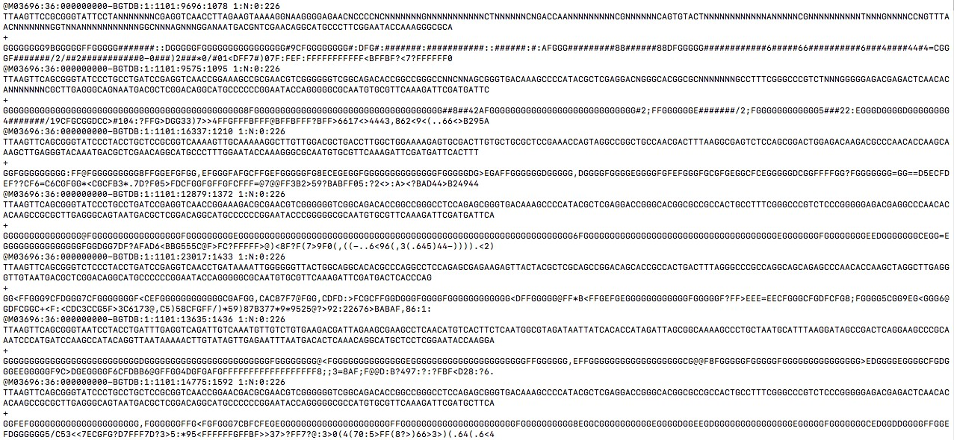
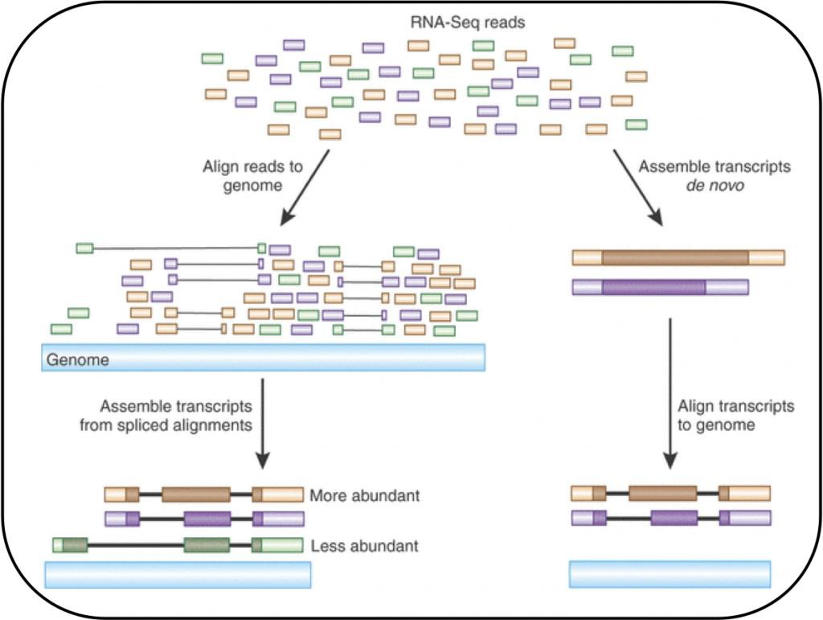
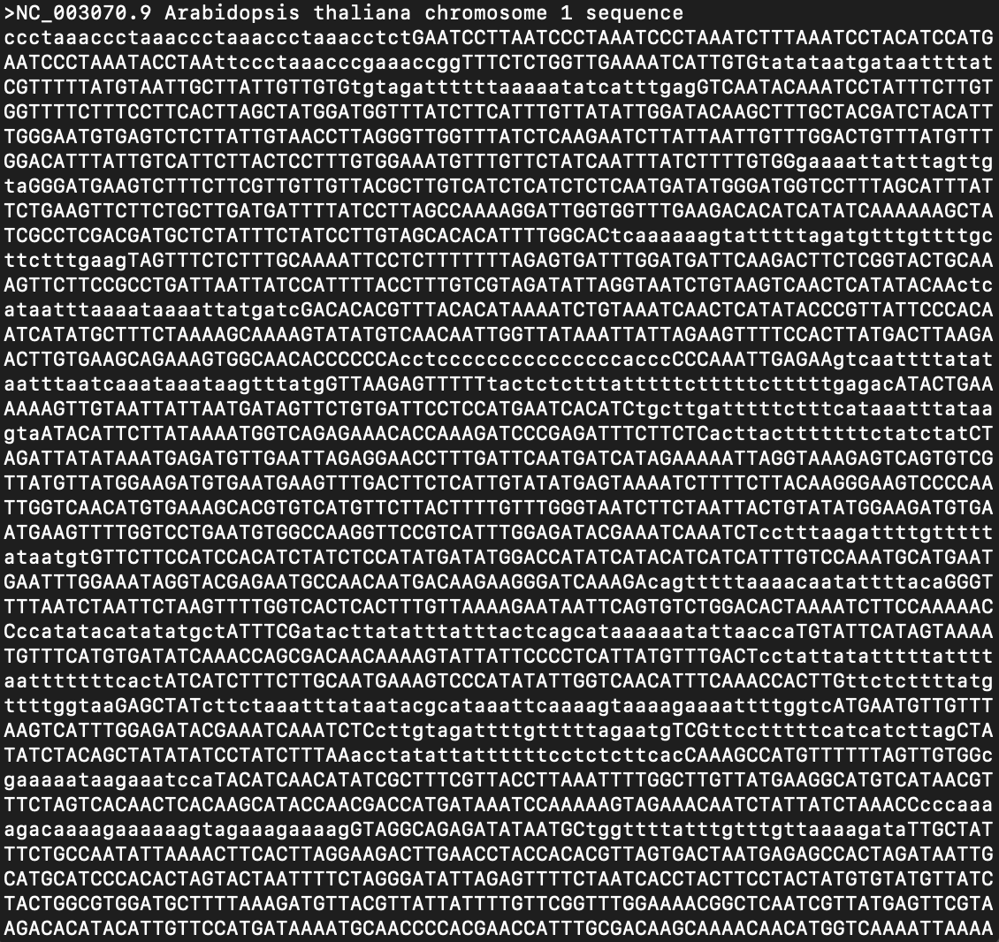
We need to find out where each read came from in the genome
EBI
https://www.ebi.ac.uk/training/online/courses/functional-genomics-ii-common-
technologies-and-data-analysis-methods/rna-sequencing/performing-a-rna-seq-experiment/data-analysis/read-mapping-or-alignment/
RAW DATA
GENOME
25

Slide 20
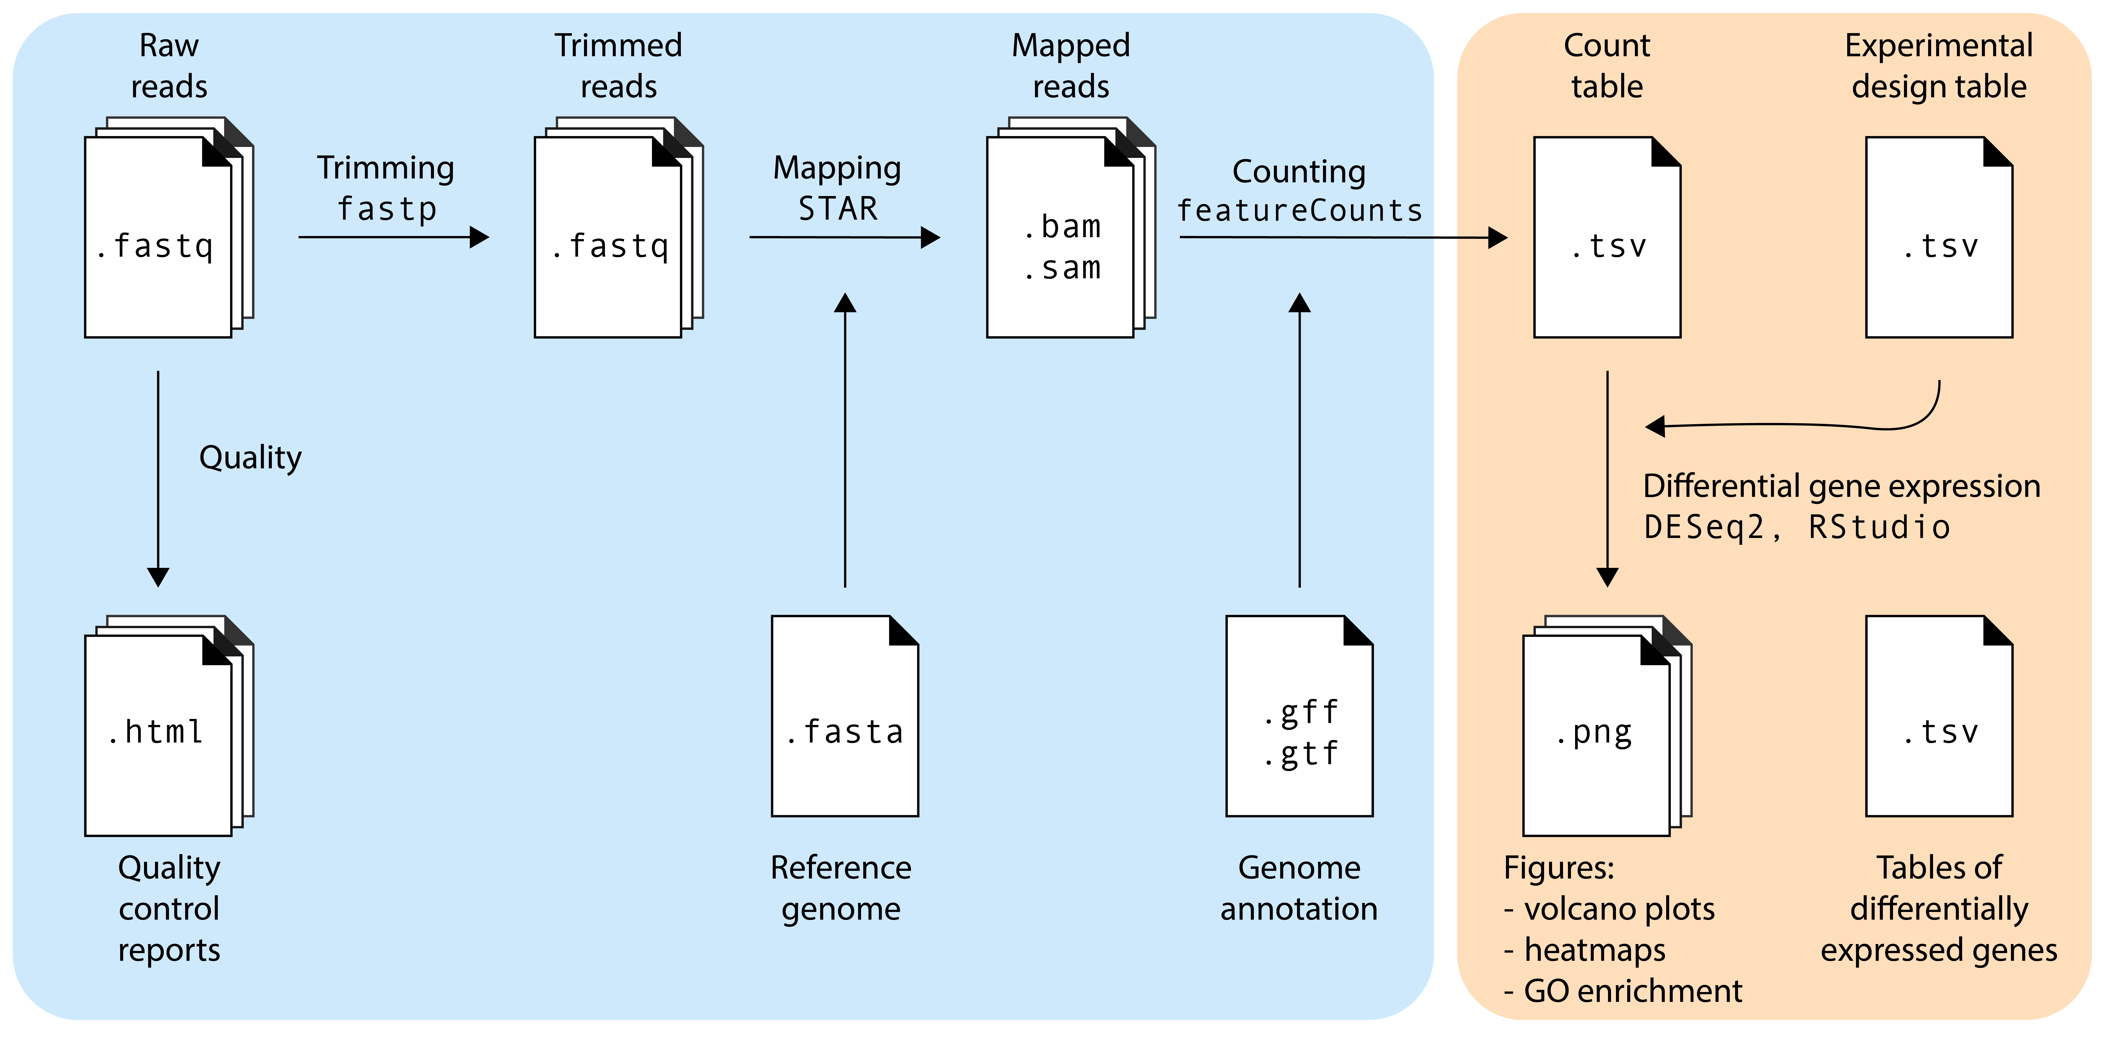
Typical RNA-seq pipeline
Tools run on a command line
In R

Slide 21
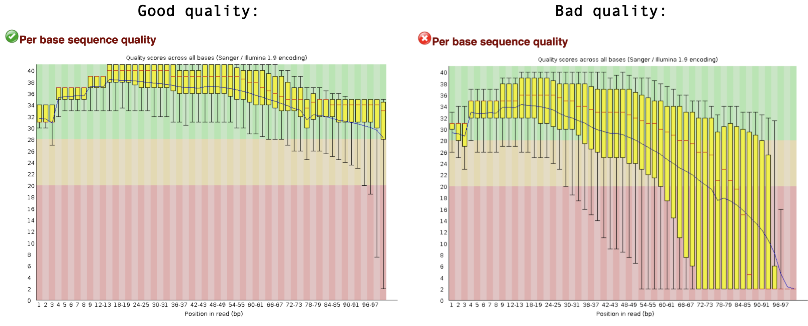
Quality control: fastqc

Slide 22
Read trimming: fastp
Removal of sequencing adapters
Removal of (parts of) bad quality reads
This gives you a new .fastq file!

Slide 23
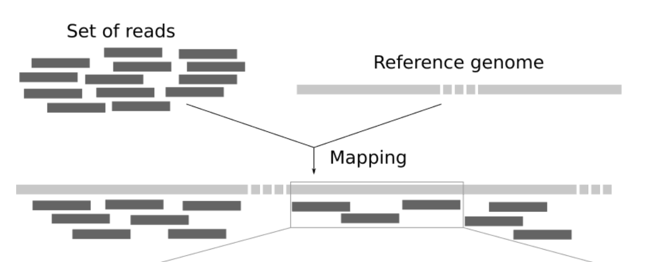
Read mapping: STAR (or equivalent tools)
https://training.galaxyproject.org/training-material/topics/sequence-analysis/tutorials/mapping/tutorial.html

Slide 24
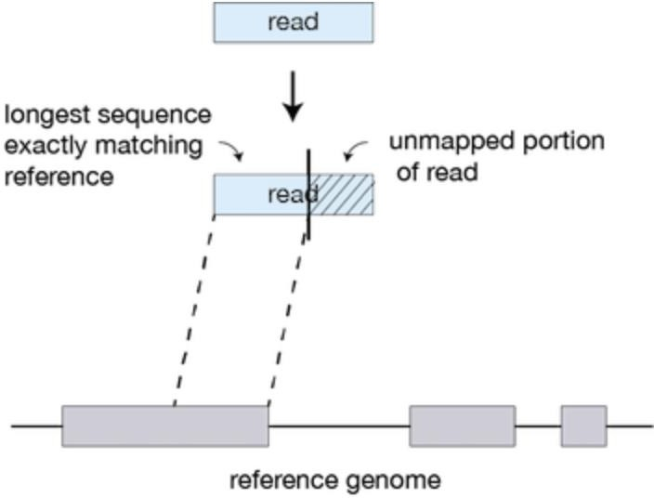
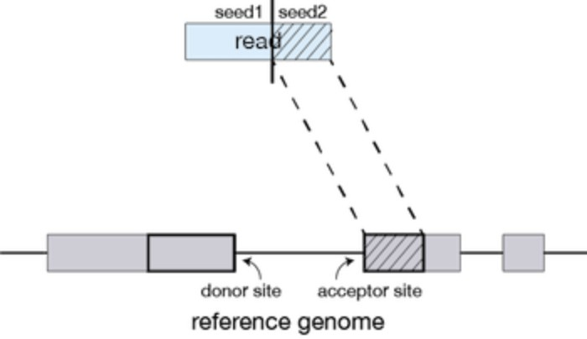
Read mapping: STAR (or equivalent tools)
https://hbctraining.github.io/Intro-to-rnaseq-hpc-O2/lessons/03_alignment.html

Slide 25
Counting: featureCounts
Genome annotation
Gene X
Gene Y
10s to 100s of samples
 | Sample1 | Sample2 | … | sample n
Gene X | 6 | 120 |  | 7
Gene Y | 4 | 70 |  | 16
…
Gene N | 12 | 300 |  | 13
1000s of genes
Notes:
13

Slide 26
RNA-seq data challenges: library size
10s to 100s of samples
 | Sample1 | Sample2 | … | sample n
7 | 6 | 120 |  | 7
Gene Y | 4 | 70 |  | 16
…
Gene N | 12 | 300 |  | 13
1000s of genes
Is gene X higher expressed in Sample2 than in Sample1?
  No, we just sequenced way more reads in sample2.
  The absolute number of reads needs to be normalized

Slide 27
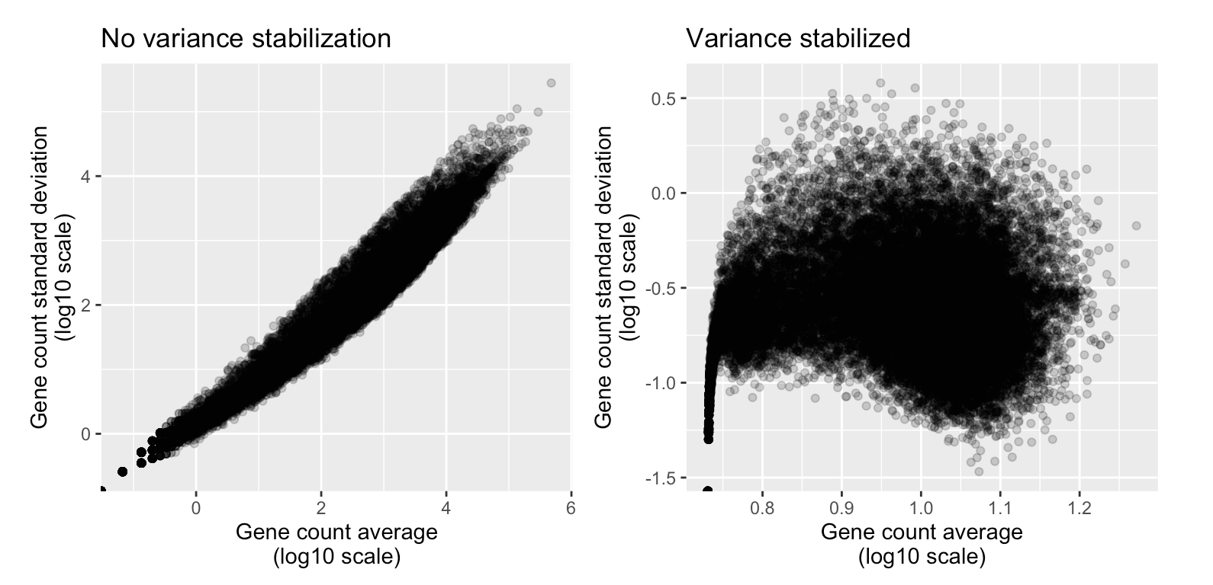
RNA-seq data challenges: highly expressed genes tend to have a higher variation

Slide 28
RNA-seq data challenges: there are many many genes!
In an RNA-seq experiment, you will measure the expression of 1000s of genes
  Risk of false positives
Essentially, we try to answer the question ”Is Gene x differentially expressed and higher in treatment y than treatment z?” many times

Slide 29
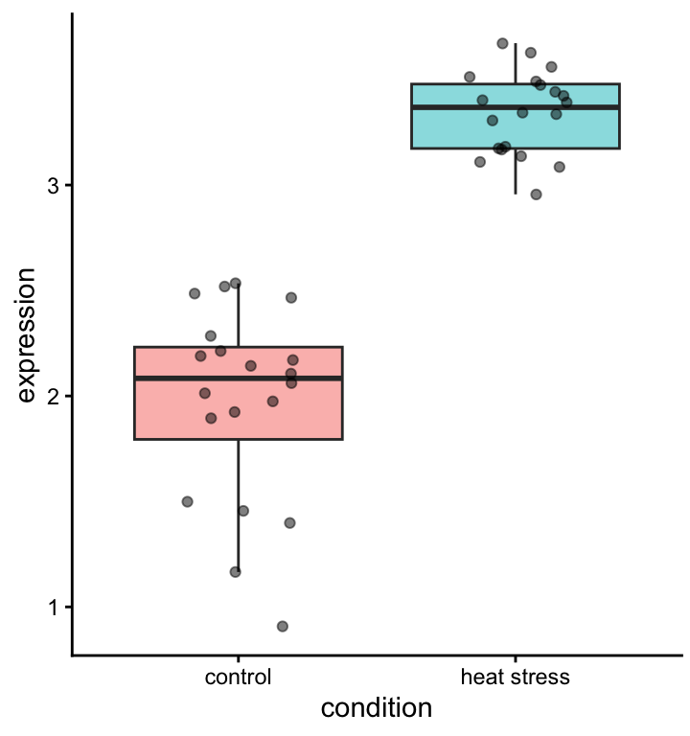
Median: measure of central tendency
Alternative: ?
Quantiles: measure of spread
Alternative: ?

Slide 30
Fold change: how far are the group means apart from each other?

Slide 31
Is this difference significant?
t-test / GLM / …. gives p-value
The power of a statistical test depends on:
  The spread in the data
  The effect size (log2 fold change)
  The number of replicates

Slide 32
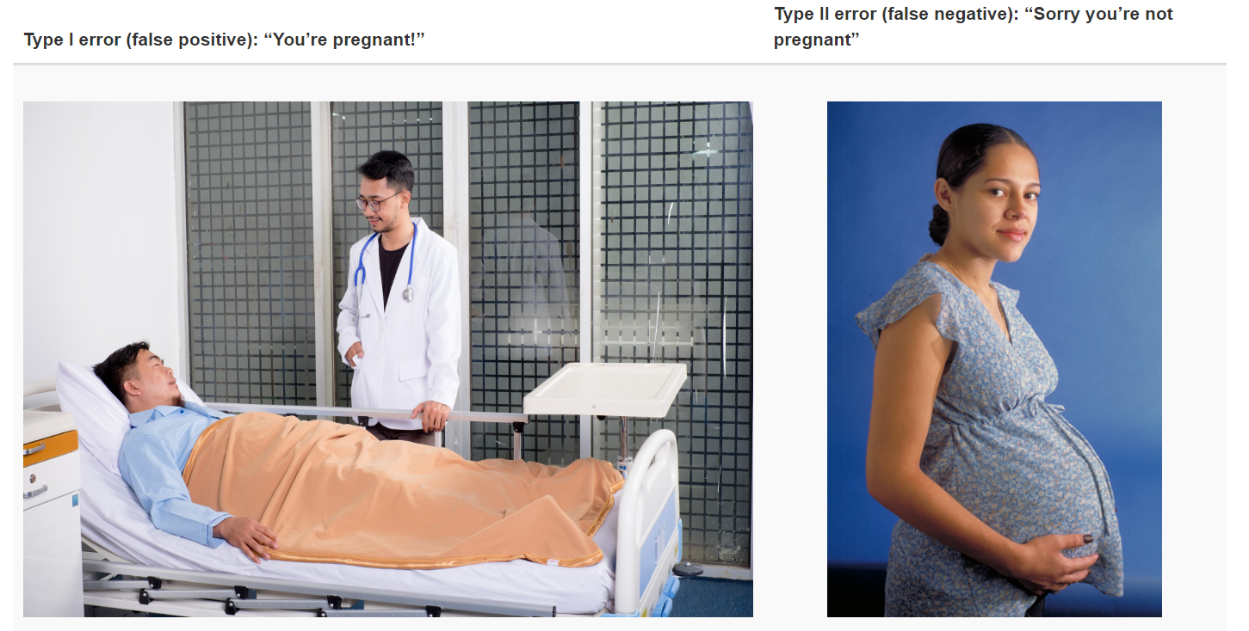
Type I and type II errors

Slide 33
Power analysis for RNA-seq
https://rnaseq-power.serve.scilifelab.se/app/rnaseq-power

Slide 34
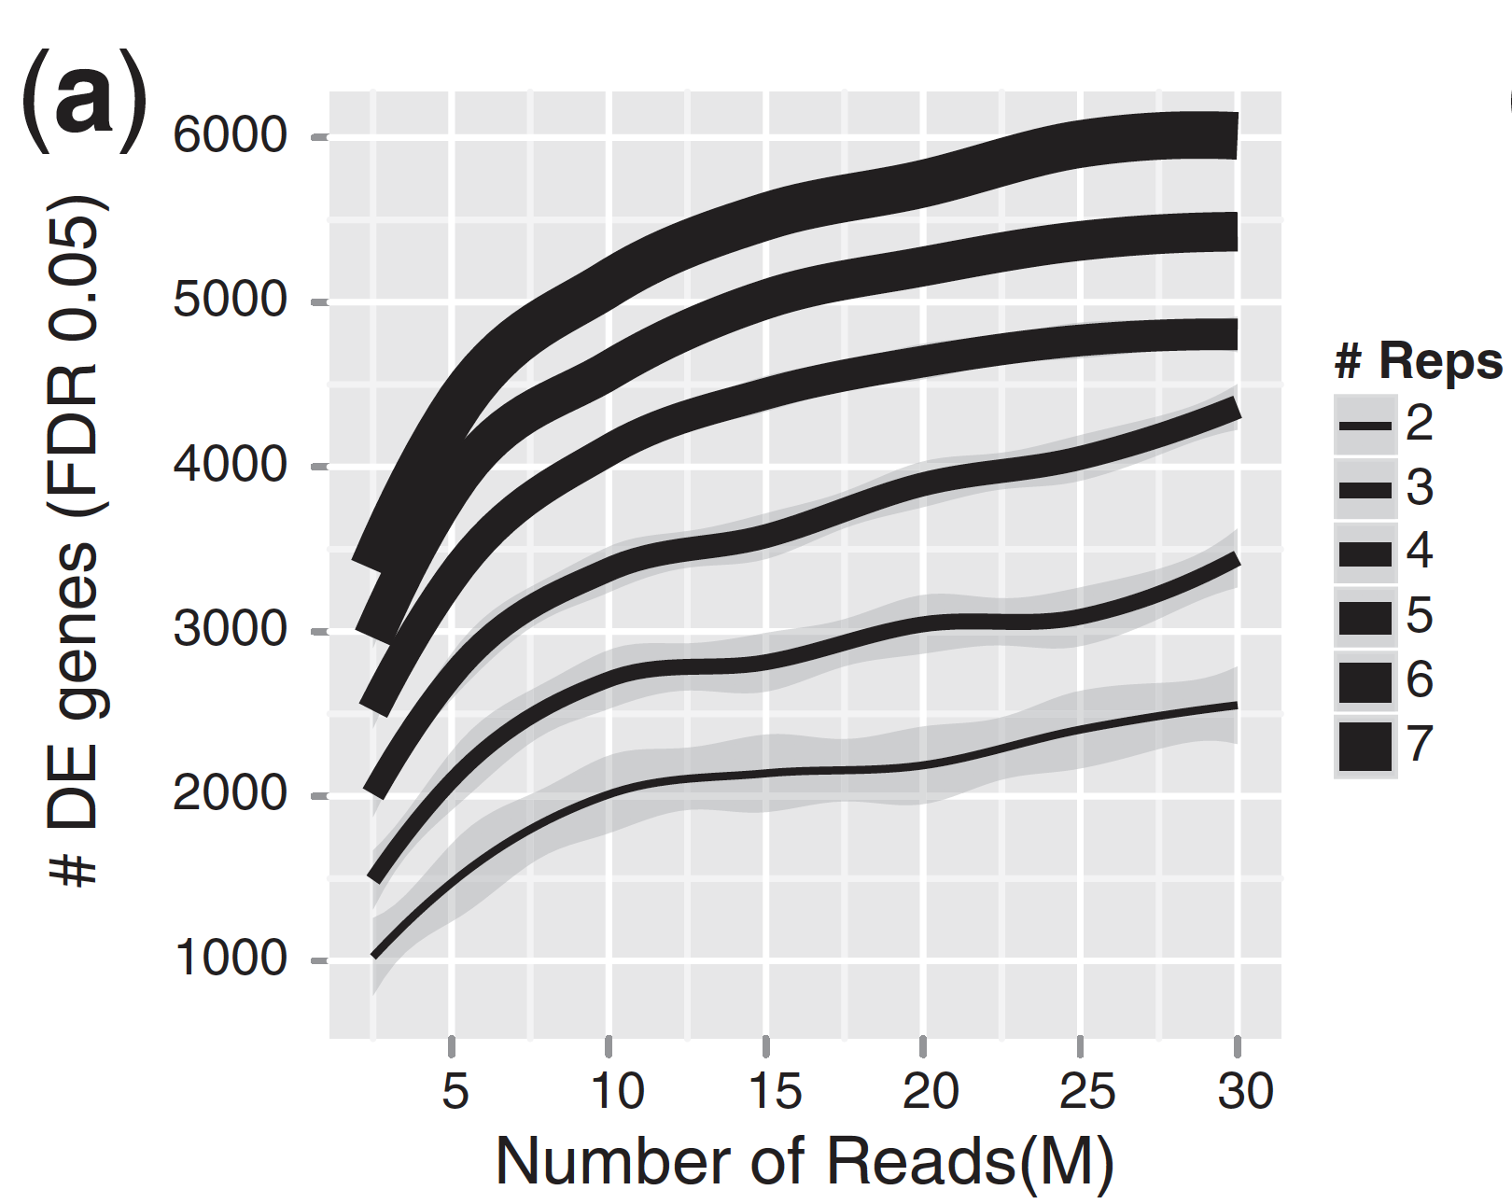
This is not just theoretical: results from down-sampled experiment

Slide 35
Between two conditions, we can visualize all differentially expressed genes in a volcano plot
Fold change and stat test p-value
X 20,000 genes

Slide 36
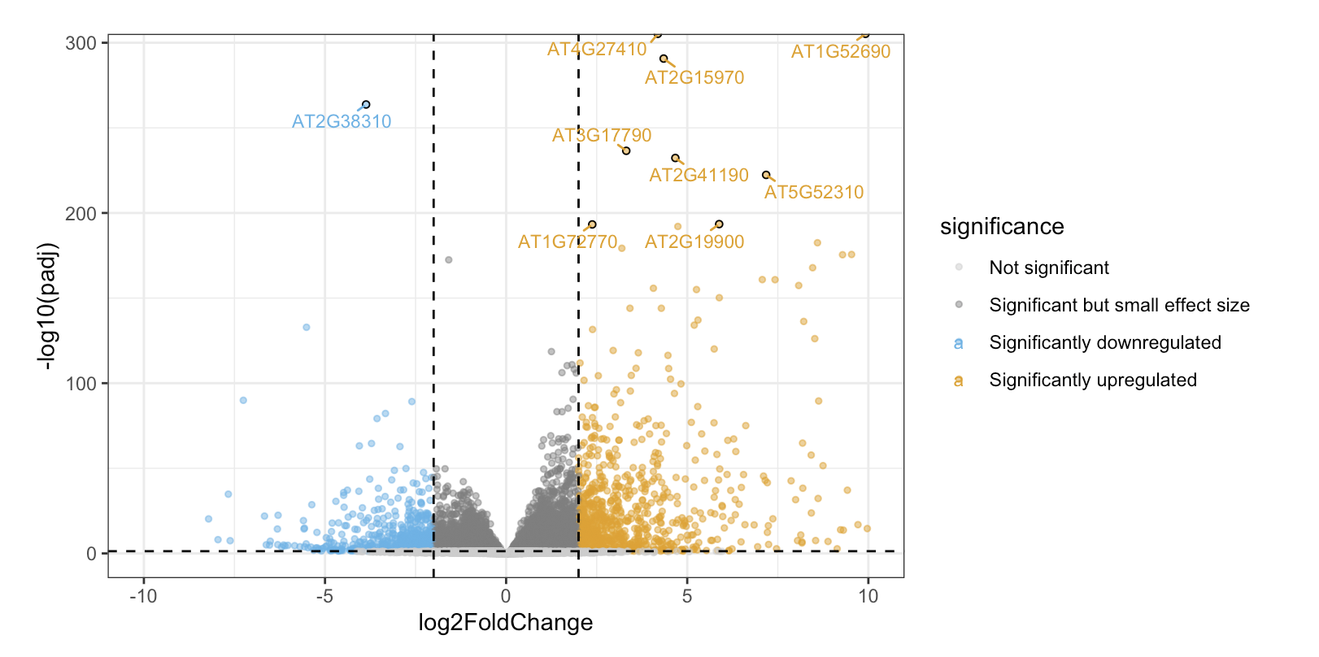
Between two conditions, we can visualize all differentially expressed genes in a volcano plot

Slide 37
Then, the biology starts
Are there surprisingly many genes with a particular function among the upregulated genes?
Do differentially expressed genes share regulatory elements in their promoter?
Is my favorite gene of interest differentially expressed?

Slide 38
Summary
RNA-seq captures a snapshot of which mRNAs are expressed under different conditions
A computational pipeline of QC, trimming, mapping, and counting is necessary to turn reads into a count table
The count table needs to be normalized first
Differential gene expression analysis reveals gene lists that are differentially expressed in certain condition
Follow-up analysis is required to give insights into a biological phenomenom

Slide 39
Now what?
We will practice all the steps we just discussed in tutorials (today and next week Monday)
Then you will the R part of the analysis with a new dataset for the upcoming assignment (next week Tuesday)

Slide 40

BKO questionaire: I need your feedback ☺

