Slide 1
TEXT SUMMARIZER

Slide 2
Project Supervisor
Jayana Kaneriya
Lecturer
Department of CE
LDRP-ITR
Team Members
Krupa Patel(1721BECE30094)
Mansi Patel(1721BECE30097)
Misha Patel(1721BECE30104)
Simran Patel(1721BECE30110)

Slide 3
Introduction....
Reducing a text with a computer program in order to create a summary that retains the most important points of the original text
Types of summarization
1) Extractive summaries
2) Abstractive summaries

Slide 4
Extractive Summaries
Extractive summaries are created by reusing portions (words,sentences etc.) of the input text document.
The system extraxcts text from the entire collection, without modifying the text document
Most of the summarization research today is on extractive summarization.

Slide 5
Abstractive summaries
Requires deep understanding and reasoning over the text.
It provides own summary over input text without using same word or sentence in the input text.
Determines the actual and short meaning of each element, such as words, sentences and paragraphs

Slide 6
Natural Language Toolkit
Leading platform for building python programs to work with human language data.
Field of ML and linguistics processing.
Interactions between computers and human(natural) languages
It provides suite of text processing libraries of classification, tokenization, stemming, tagging, parsing and semantic reasoning.

Slide 7
NLTK libraries...
Stopwords
BeautifulSoup4
Wordtokenizer

Slide 8
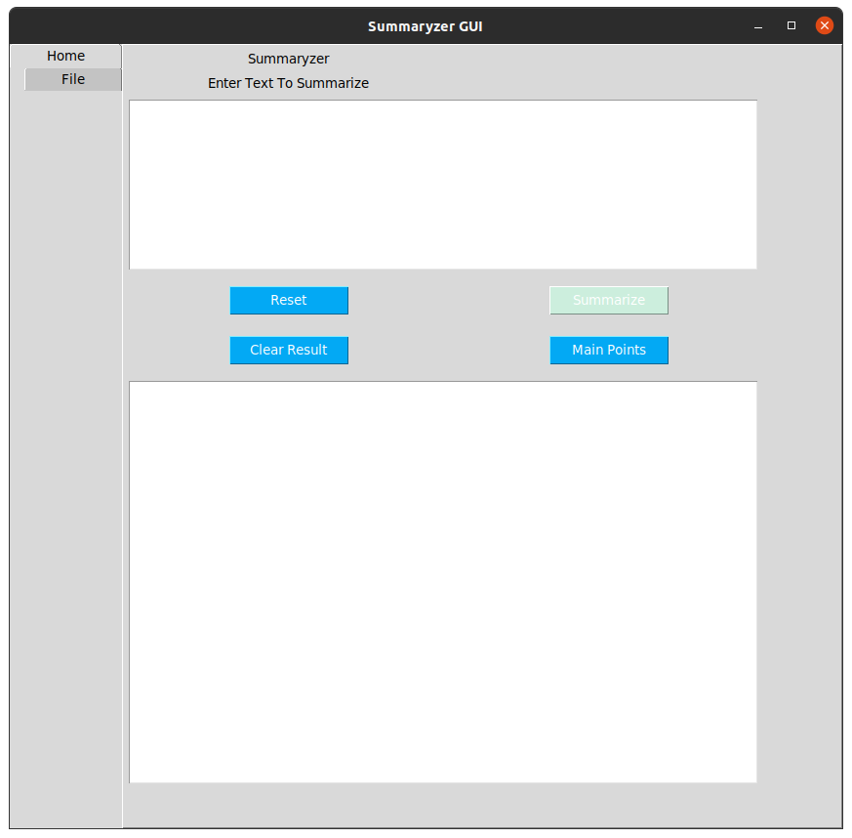

Slide 9
Conclusion
Automatic text summarization has been shown to be useful for NLP tasks such as question answering or text classification and other related fields of computer science such as information retrieval. And the access time for information searching will be improved.

Slide 10
Future work...
In future, we will try to summries text using some other libraries like gensim, spacy etc.
And we will try to compare the output of that summaried text.

