Slide 1
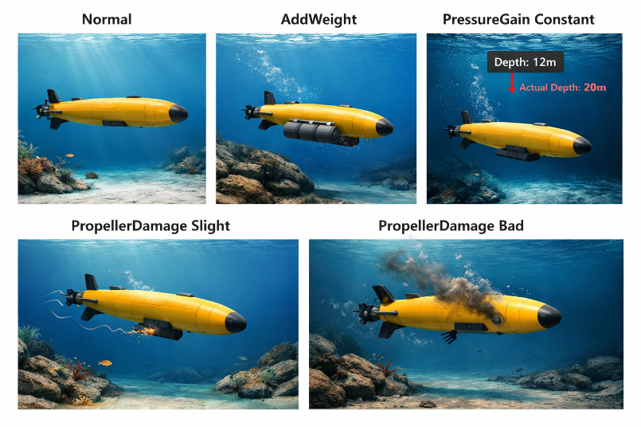
AUV Fault Diagnosis Dataset
Temporal Windowing (Preprocessing)
Feature Normalization
CSV Loader & Signal Parser
Read CSV rows as time-ordered samples
Extract only the 16 signal columns
Discard timestamp if present
Fixed-Length Window Generator
Channel-wise Normalization
Raw .csv file
X∈R^T×16
Wi​∈R^L×16
W~∈RL×16
W~∈RL×16
W~∈RL×16
Global Pooling
Discrete Fourier Transform
(per channel)
Conv1D
For each channel:
(i)Mean
(ii) Variance
(iii)Kurtosis
Bias addition
Explainable AI
Magnitude spectrum
Predicted class
𝑦^
Statistical Behavior Expert (SBE)
Frequency Domain Expert (FDE)
Temporal Dynamics Expert (TED)
Feature projection
(dense or conv)
Nonlinear activation
Concatenation
Temporal pooling
Feature Mapping
FEMNet
Zt​∈Rd
Zf​∈Rd
Zs​∈Rd
Ethical AI
Class probabilities
p(c∣Z)
Feature Alignment Layer
Channel alignment
Projection layer
Fused feature vector Z
Attention-weighted feature fusion
Z=αt​Zt​+αf​Zf​+αs​Zs​
Expert weights
(αt,αf,αs)
Expert Fusion Module
Edge & Real-Time Constraints
Fault Classification Head
Fully Connected
Softmax
p(c∣Z)
,c∈{1,…,5}
Normal
AddWeight
PressureGain constant
PropellerDamage sligh
PropellerDamage bad

Slide 2
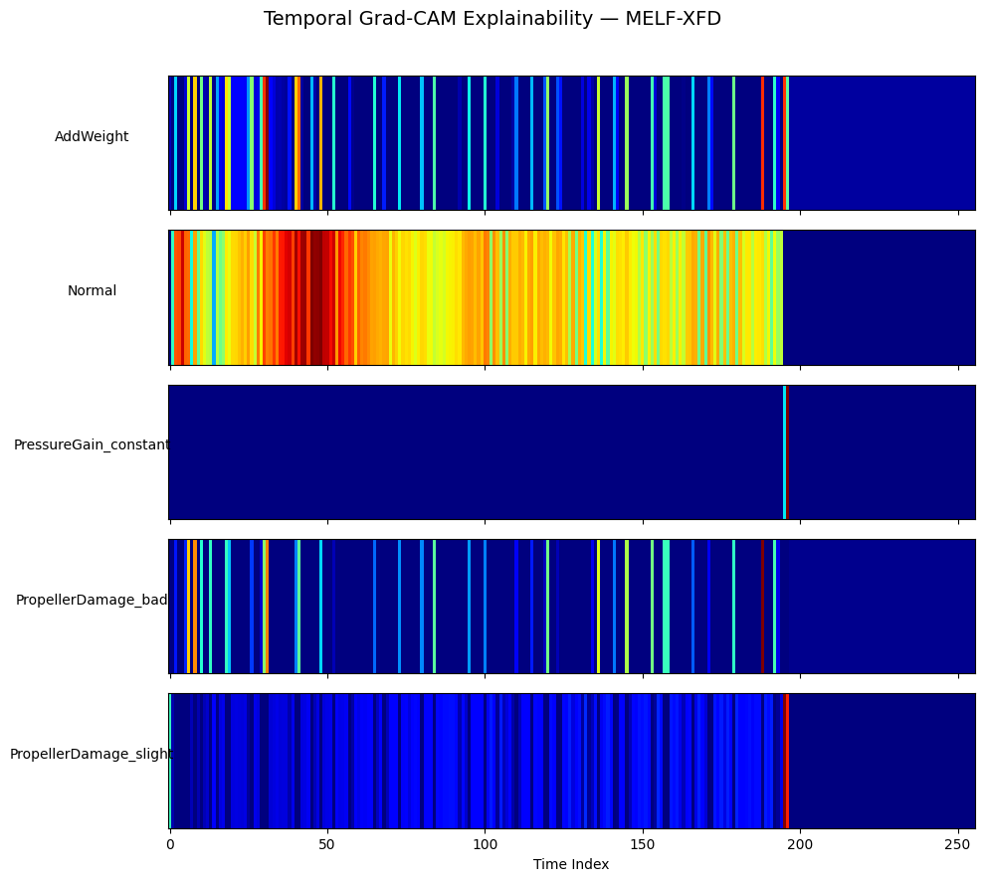
(i) Add weight
(ii) Normal
(ii) Propeller damage slight
(iv) Propeller damage bad
(v) Pressure gain constant

