Slide 1
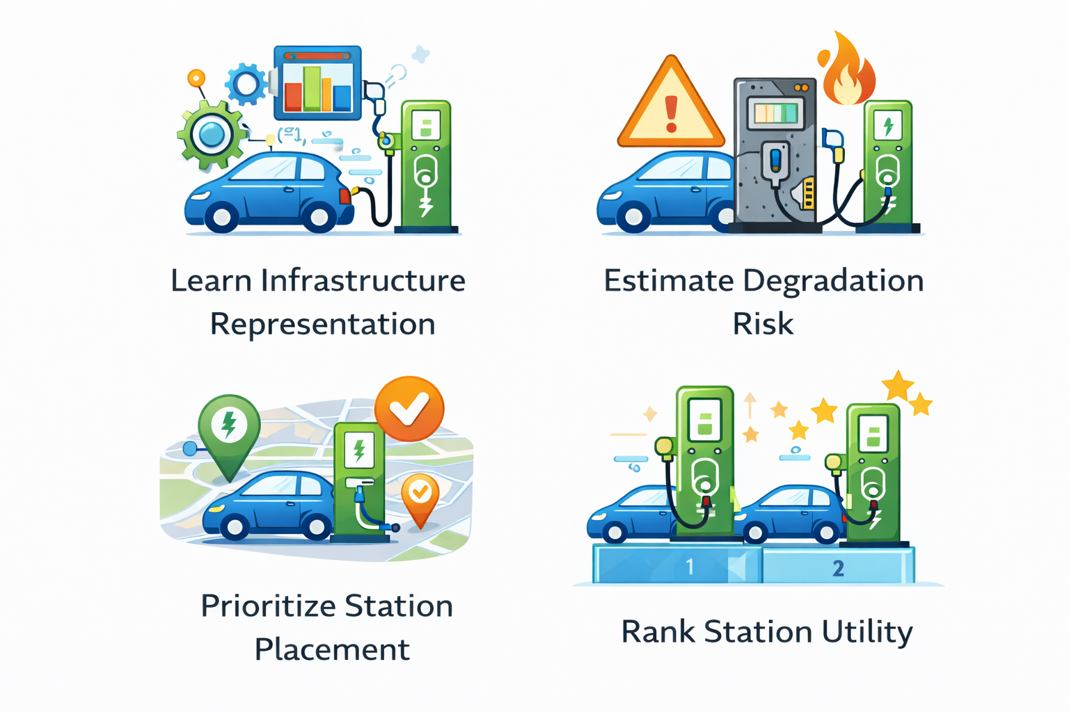
PRIME-EV: Probabilistic Representation–Integrated Modeling
(ii) PDDM — Probabilistic Degradation Dynamics Model
(iii) PPN — Placement Policy Network
(iv) RUN — Recommendation Utility Network
(i) LISE — Latent Infrastructure State Encoder
Input
For each charging station:
Age
Usage
Maintenance frequency
Cost
Capacity
Reviews
Distance
Encoded categorical attributes
Dense
z ∈ ℝ^{N×16}
X ∈ ℝ^{N×T×F}
Convolution
z ∈ ℝ^{N×16}
Dense
[ z , μ , distance , usage ]
Dense
[z, μ, cost, dist]
Linear
RELU
Convolution
Input
For each charging station:
Usage
Distance
Input
For each charging station:
Cost
Distance
exp (0.5 * Dense)
z ∈ ℝ^{N×16}
RELU
RELU
Attention
Dense
Dense
Linear
Softmax
μ ∈ ℝ^{N×1}
Mean degradation risk
Uncertainty
z ∈ ℝ^{N×16}
Placement priority score
Utility score
Latent infra-structure state vector
μ ∈ ℝ^{N×1}
σ ∈ ℝ^{N×1}
p ∈ ℝ^{N × 1}
(N × 1}
Concatenate
Concatenate
Concatenate

