Slide 1





























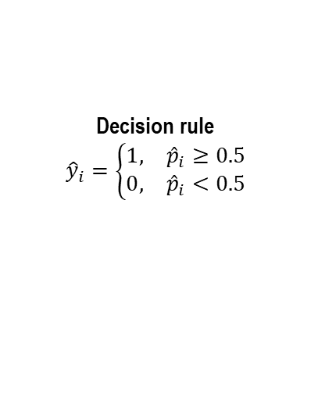

Module 1.
Module 2.
Module 3.
Cleaning, Encoding, And Normalization
Cleaning, Encoding, And Normalization
Train, Validation, And Test Partitioning
Operations
Operations
Operations
Input
Input
Input
Remove Duplicate
Sparse Timestamp
Derive Hour
Derive Day Of Week
Drop Timestamp
Label Encode Categorical Fields
Fill Missing Numeric Values With Median
Standardize All Features
Output
Inject five synthetic attack families:
DoS
Payload
Header
Flood
API Abuse
InsiderMimic
Output
$$X_{train}∈ℝ^{N_{train}×18}$$
$$X_{val}∈ℝ^{N_{val}×18}$$
$$X_{test}∈ℝ^{N_{te}×18}$$
Output
Xraw∈RN×17
Normal-only matrix:
$${\tilde{X}}_{normal}∈ℝ^{N_{0}×18}$$
Balanced supervised dataset:
$$X∈ℝ^{N×18}$$
Normalized feature matrix:
$$\tilde{X}∈ℝ^{N×18}$$
Balanced supervised dataset:
$$X∈ℝ^{N×18}, y∈{\left\{0 , 1\right\}}^{N}$$
$$X_{train}∈ℝ^{302328×18}$$
$$X_{val}∈ℝ^{53353×18}$$
$$X_{test}∈ℝ^{88921×18}$$
Module 4.
Module 5.
Module 6.
Hypergraph Contextual Augmentation
Risk-Adaptive Encoder (RAE)
Attention-based Risk Weighting (ARW)
Output
Operations
Hypergraph-augmented vector:
$$x_{i}^{hg}=\left[{\tilde{x}}_{i}∥h_{i}\right]∈ℝ^{27}$$
because:
$$d^{′}=18+9=27$$
Operations
Operations
Input
Context keys used
Compute group statistics for:
src_ip
path
method
For each key, add:
group mean
group standard deviation
group max
So, each key contributes 3 features, and 3 keys contribute:
$$3×3=9$$
Input
Input
Output
Attention tensors
Attention logits:
$$a_{i}^{\left(1\right)}∈ℝ^{64}$$
Risk weights:
$$a_{i}∈ℝ^{64}$$
Refined representation:
$$r_{i}=e_{i}⊙a_{i}∈ℝ^{64}$$
Output
Each request sample:
$${\tilde{x}}_{i}∈ℝ^{18}$$
$$x_{i}^{hg}∈ℝ^{27}$$
$$Dense(256, ELU)$$
$$BatchNorm$$
$$Dropout(0.2)$$
$$e_{i}∈ℝ^{64}$$
$$e_{i}∈ℝ^{64}$$
$$r_{i}∈ℝ^{64}$$
$$Dense(128, ELU)$$
$$BatchNorm$$
$$Dropout(0.2)$$
Batch shapes
$$X_{train}^{hg}∈ℝ^{302328×27}$$
$$X_{val}^{hg}∈ℝ^{53353×27}$$
$$X_{test}^{hg}∈ℝ^{88921×27}$$
$$Dense(64, ELU)$$
$$BatchNorm$$
$$Dropout(0.2)$$
R27→R256→R128→R64
It is a hypergraph-inspired contextual statistics augmentation layer.
This block learns compressed nonlinear request representations before weighting and latent sampling.
It reweights the 64 encoder channels.
Module 7.
Module 8.
Supervised Variational Latent Layer
Classification Head
Operations
Operations
Input
Input
$$Dense(64, ELU)$$
$$Dense(64, ELU)$$
Output
$$Dense(64, ELU)$$
$$Dropout(0.2)$$
$$Dense(1, sigmoid)$$
Output
Attention-refined representation:
$$r_{i}∈ℝ^{64}$$
Xraw∈RN×17
Latent vector:
$$z_{i}∈ℝ^{32}$$
Normal
$$Dense(32, ELU)$$
$$Dense(32, ELU)$$
Exact tensor flow
$$ℝ^{32}→ℝ^{64}→ℝ^{1}$$
$$μ_{i}∈ℝ^{32}$$
$$\log{σ_{i}^{2}}∈ℝ^{32}$$
Output
Attack probability:
$${\hat{p}}_{i}∈ℝ^{1}$$
or scalar form:
$${\hat{p}}_{i}=P\left(y_{i}=1∣x_{i}\right)$$
Decision rule
$${\hat{y}}_{i}=\left\{\begin{matrix}1, & {\hat{p}}_{i}≥0.5 \\ 0, & {\hat{p}}_{i}<0.5\end{matrix}\right.$$
Attack
Exact tensor flow
$$ℝ^{64}→ℝ^{32} \left(μ\right)$$
$$ℝ^{64}→ℝ^{32} \left(\log{σ^{2}}\right)$$
$$\left(ℝ^{32} , ℝ^{32}\right)→ℝ^{32}$$

