Slide 1




Data Augmentation
Acoustic Time Series Signal Acquisition Device
Normal (Silence) - NS
Gaussian noise
Music - M
Time stretching
Validation of Recorded Signals
Pitch shifting
Tilawat-e-QuranPak -TQ
Frequency & time masking
QSMAT ATS Encoder
Calmness Analysis Model - CAM
QSMAT ATS Encoder
Class Mapping
M -0
NS-1
TQ- 2
Feature Extraction
Input: [batch size, 25]
LSTM (Bidirectional)
[batch size, 256] (LSTM output)
Fully Connected Layer 1
Fully Connected Layer 2
Mel spectrogram
Spectrogram
MelScale
Audio to db
Conv2d
BatchNorm2d
ReLU
MaxPool2d
Sequential
Sequential
Sequential
Sequential
AdaptiveAvgPool2d
Linear
Fully Connected Layer 1
ReLU
Dropout
MFCC 0-12
Class Embeddings
ZCR + RMS
Wavelet coefficients 0-10
Calmness Evaluation using Pairwise T-tests
Compare all three distributions using ANOVA test
Pairwise comparisons using T tests
Calmest Class
Calculate mean of all 25 features

Slide 2
Data Augmentation
Acoustic Time Series Signal Acquisition Device
Normal (Silence) - NS
Gaussian noise
Music - M
Time stretching
Validation of Recorded Signals
Pitch shifting
Tilawat-e-QuranPak -TQ
Frequency & time masking
QSMAT ATS Encoder
Calmness Analysis Model - CAM
QSMAT ATS Encoder
Class Mapping
M -0
NS-1
TQ- 2
Feature Extraction
Input: [batch size, 25]
LSTM (Bidirectional)
[batch size, 256] (LSTM output)
Fully Connected Layer 1
Fully Connected Layer 2
Mel spectrogram
Spectrogram
MelScale
Audio to db
Conv2d
BatchNorm2d
ReLU
MaxPool2d
Sequential
Sequential
Sequential
Sequential
AdaptiveAvgPool2d
Linear
Fully Connected Layer 1
ReLU
Dropout
MFCC 0-12
Class Embeddings
ZCR + RMS
Wavelet coefficients 0-10
Calmness Evaluation using Pairwise T-tests
Compare all three distributions using ANOVA test
Pairwise comparisons using T tests
Calmest Class
Calculate mean of all 25 features

Slide 3

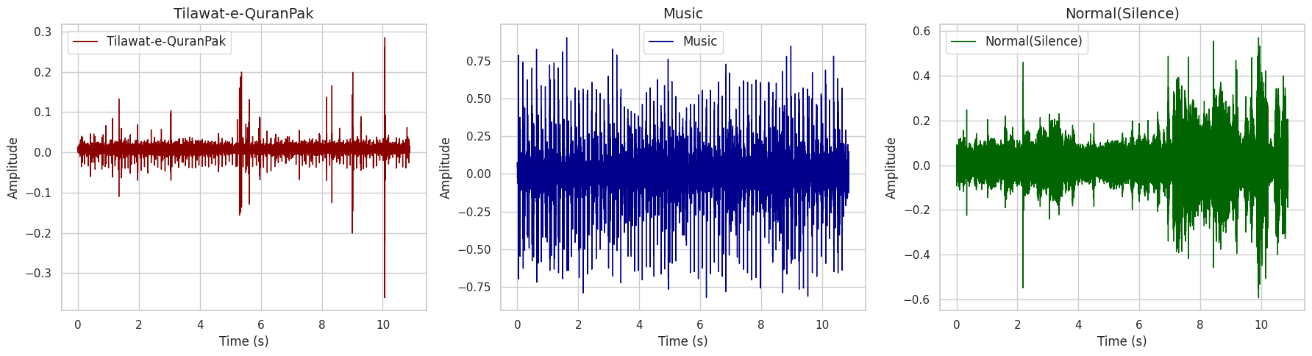
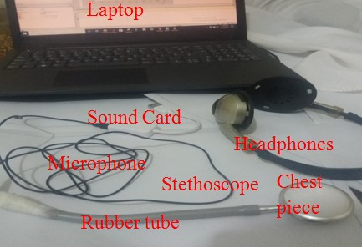
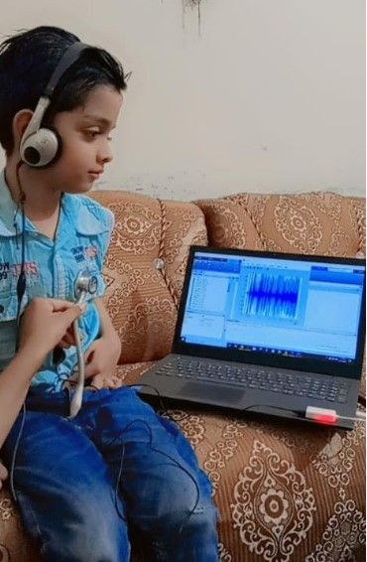
Spiritual Meditation
Normal (Silence) - NS
Music - M
Audio Stimuli
Data Acquisition System
(a) Data Acquisition System
(b) Subject during Data Acquisition

Slide 4
Data Augmentation
Feature Extraction
Spiritual Meditation
Normal (Silence) - NS
Gaussian noise
Music - M
Time stretching
Class Encoding [0, 1, 2]
CAM Classifier (Fig. 6a)
SMSAT ATS Encoder (Fig. 5a)
Wavelet coefficients 0-10
MFCC 0-12
Pitch shifting
ZCR + RMS
Validation of Recorded Signals
Frequency & time masking

Slide 5
Acoustic Time Series Signal Acquisition Device
Normal (Silence) - NS
Music - M
Tilawat-e-QuranPak -TQ

