Slide 1



TF-Net: Deep Learning Empowered Tiny Feature Network for Night-time UAV Detection
Department of Electrical and Computer Engineering, COMSATS University Islamabad, Wah Campus

Slide 2
Authors:
Zhaohui Yang
Maham Misbah
MS Scholar
Department of Electrical and Computer Engineering, COMSATS University Islamabad, Wah Campus
Assistant Professor
College of Information Science and Electronic Engineering, Zhejiang University,
Hangzhou 310027, China
Misha Urooj Khan
Zeeshan Kaleem
Research Assistant
Department of Electrical and Computer Engineering, COMSATS University Islamabad, Wah Campus
Assistant Professor
Department of Electrical and Computer Engineering, COMSATS University Islamabad, Wah Campus

Slide 3
Motivation and Introduction
Literature Review
Proposed TF-Net
Dataset and Implementation
Results and Discussion
References
Conclusion
1
2
Table of Content
3
4
5
6
7

Slide 4
Motivation and Introduction

Slide 5
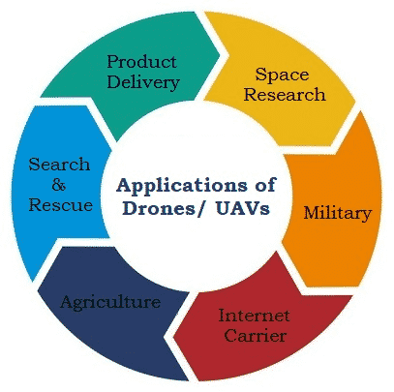
UAV Use Cases and Potential Risks
Technological advancements have normalized the usage of unmanned aerial vehicles (UAVs) in every sector, spanning from military to commercial
However, they also pose serious security concerns due to their enhanced functionalities and easy access to private and highly secured areas.
Several instances related to UAVs have raised security concerns, leading to UAV detection research studies.
Real-time drone identification is urgently needed to shield high-security places from the risk of drone intrusion.

Slide 6
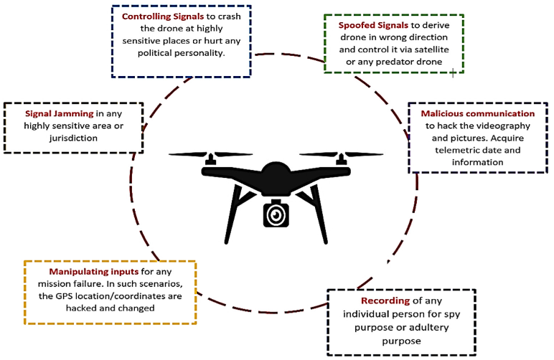
UAV Detection Techniques
Visual based UAV detection techniques offer a reliable solution compared to acoustic and radar-based techniques.
However, Visual techniques perform poorly at night, in complex backgrounds, and in adverse weather conditions.
Therefore, a robust night vision-based drone detection system is required to efficiently tackle this problem.

Slide 7
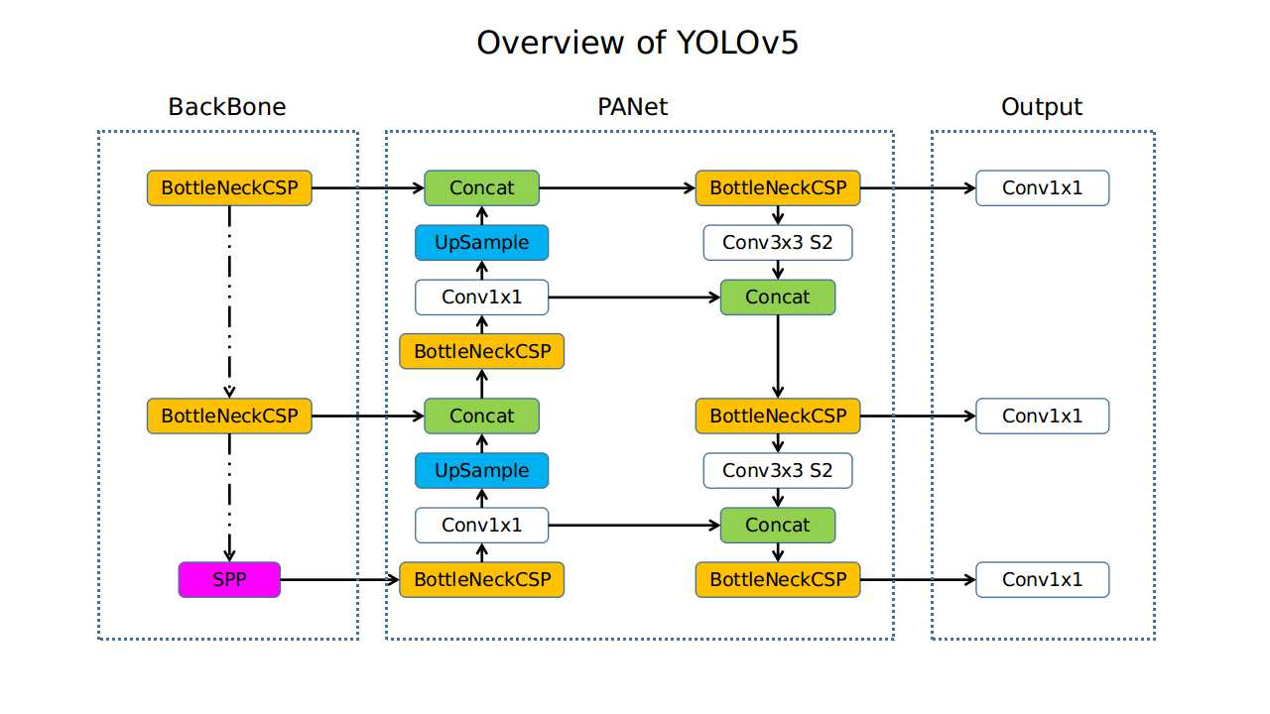
Frameworks for Object Detection
Currently, convolutional neural networks (CNNs) are the most effective models for detecting objects.
AlexNet
CNN
R-CNN
Fast R-CNN
YOLO

Slide 8
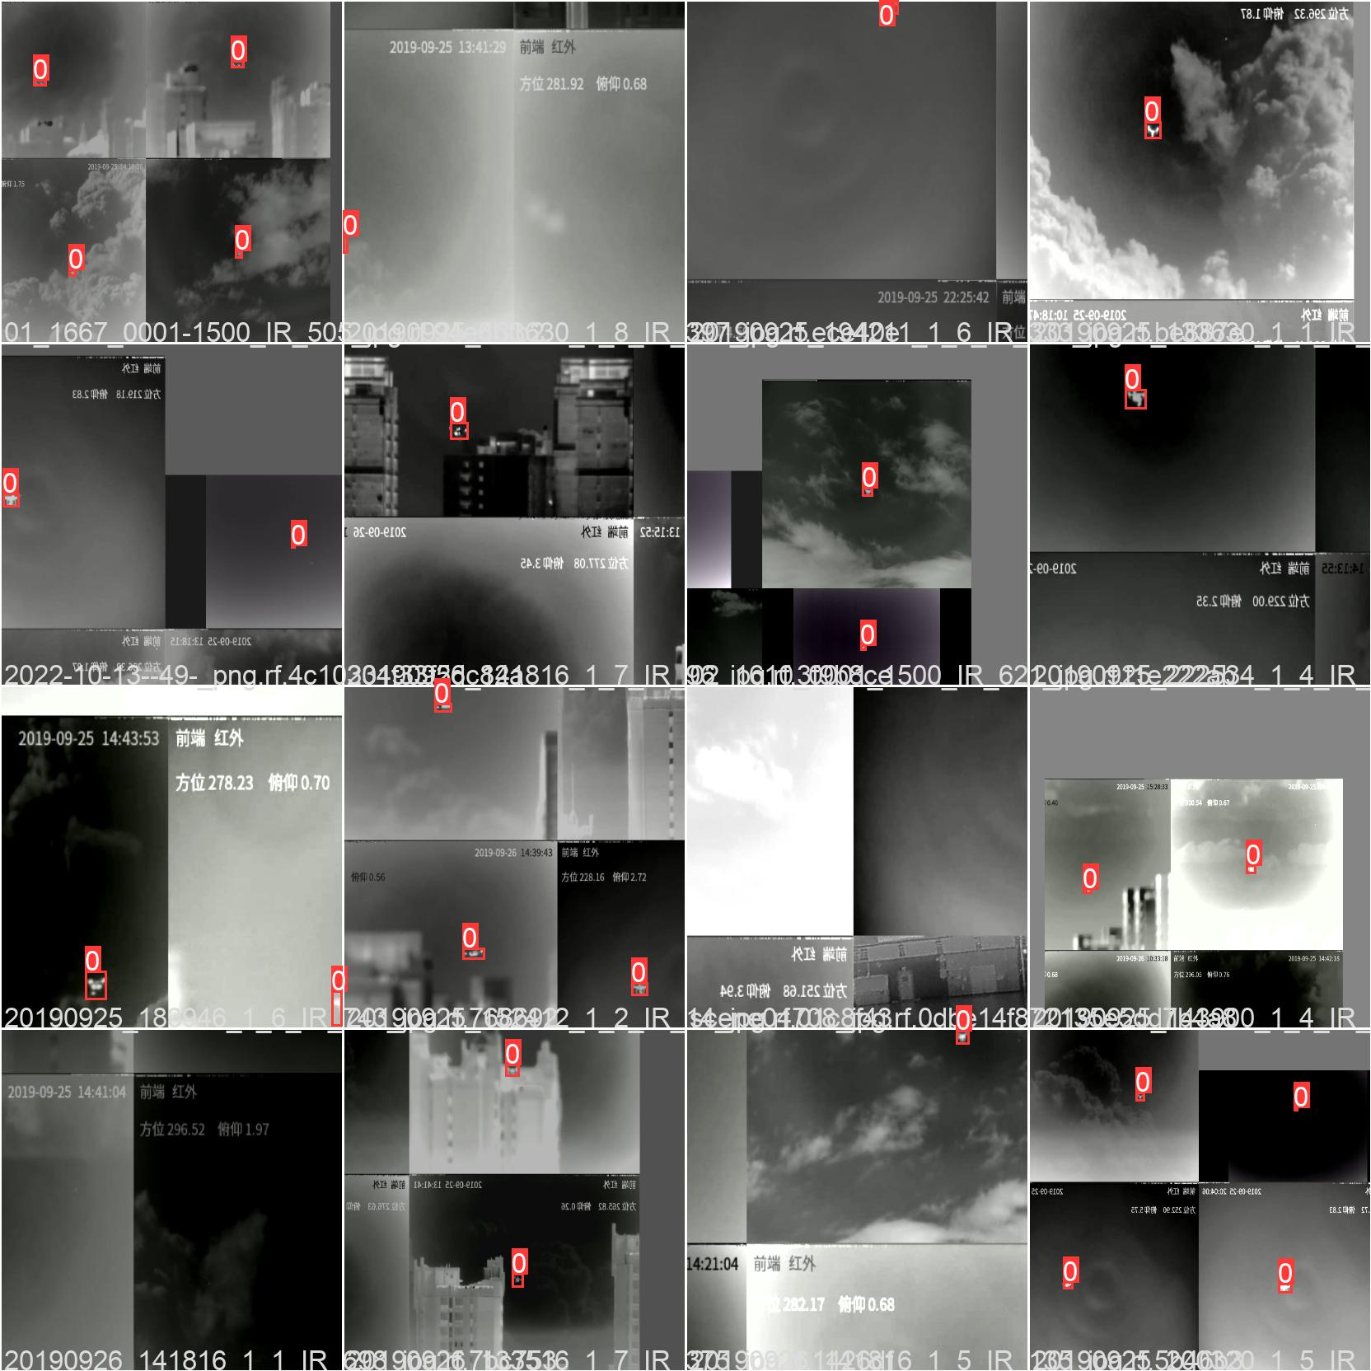
IR Images Based Drone Detection
The use of infrared cameras for nighttime monitoring has become quite common due to the use of night vision technology in surveillance and protection. Therefore we considered IR based drone detection technique.
Detection methods considering IR images is hindered by the scarcity of large data sets and the expensive cost of an IR camera.

Slide 9
Proposed Framework
A dataset consisted of IR based UAV images with multiple complex environmental background and weather conditions.
Fair comparison by training all considered models with same dataset and model parameters.
We proposed TF-Net, an improved version of YOLOv5s by introducing kernel based modifications in the neck and backbone.
To efficiently detect UAV during night time, we employ UAV detection based on IR images

Slide 10
Literature Review

Slide 11
Conventional
Modified YOLOv5
CNN, support vector machine (SVM), and kNearest neighbor (KNN)
drone-bird dataset
93% accuracy [1]
Multirotor drone detection
Modified YOLOv5s (backbone replaced with Efficientlite)
Dataset of 1,259 multirotor drone images
92.32% precision [3]
Thermal or IR
object recognition and classification at the sea’s surface using thermal pictures
92.5% accuracy [5]
Fine-tuned YOLOv5
Improved YOLOv4
Small drone detection
Improved YOLOv4s (Reduced convolutional channels)
Dataset of 10,000 drone images
90.5% mAP [2]
Fine-tuned YOLOv5
publicly accessible dataset of 1359 drone images.
Data Augmentation
95.2% accuracy [4]

Slide 12
Proposed TinyFeatureNet (TF-Net)

Slide 13
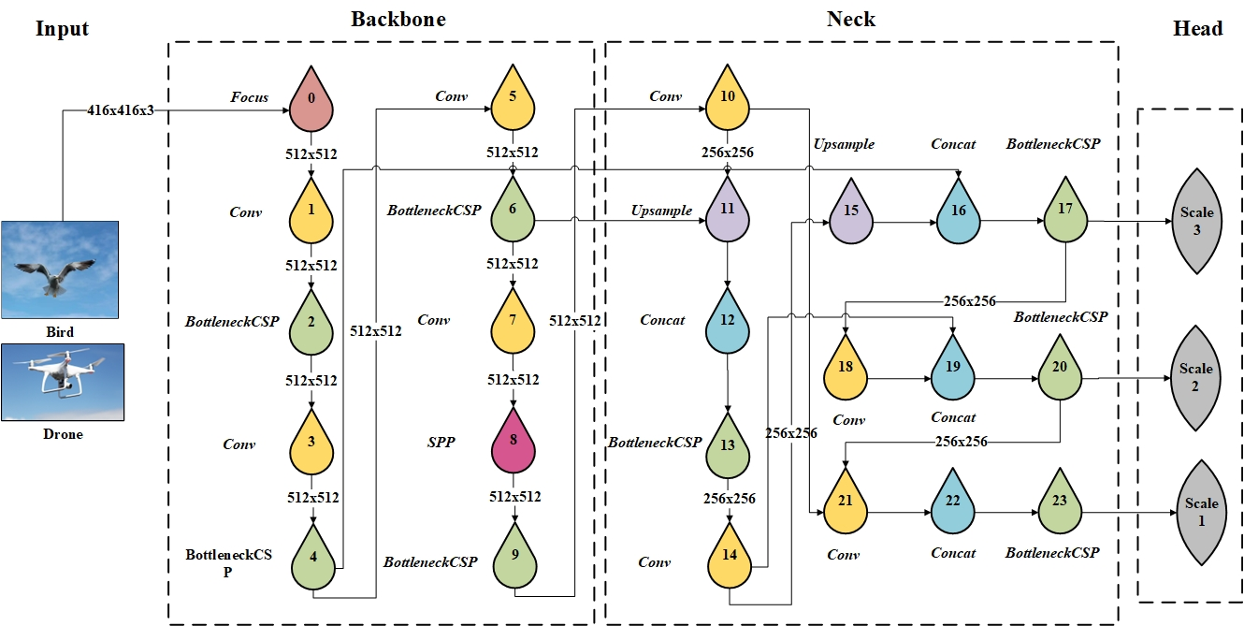
TF-Net Architecture
Kernel based modifications in Neck and Backbone
Input Block: MDA and AIF techniques
Backbone Block: CSP and SPP
Neck Block: Feature Pyramid Network (FPN)
Anchor boxes: 8 ×8 (P3), 16 × 16 (P4) and 32 × 32 (P5)

Slide 14
Dataset and Implementation

Slide 15
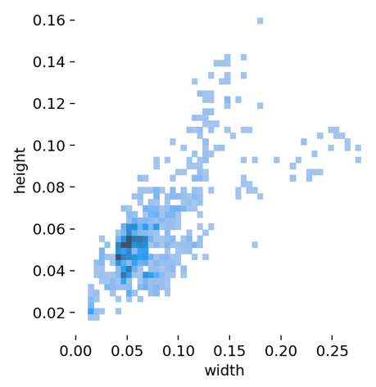
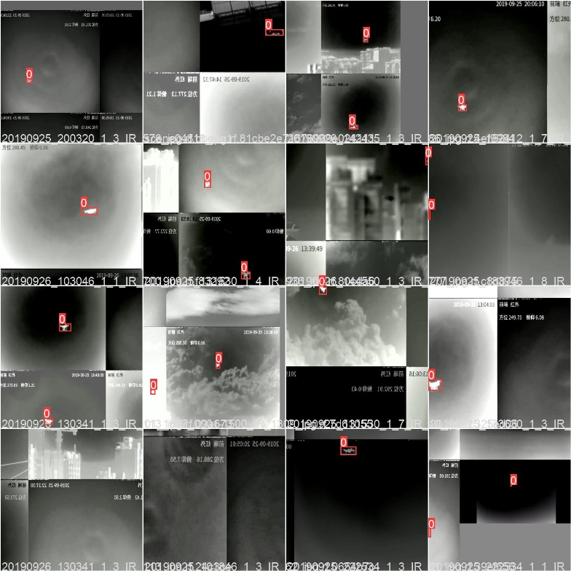
Dataset and Model Configuration
More than 3000 images of UAVs flying at night in various backgrounds.
train-test ratio of 8:2 with 3100 training and 791 test images.
Multi-size UAVs target
Preprocessing: resizing images to fixed dimension size of 416×416 scaling and contrast enhancement before training.
Dataset Distribution
Ground Truth Images

Slide 16
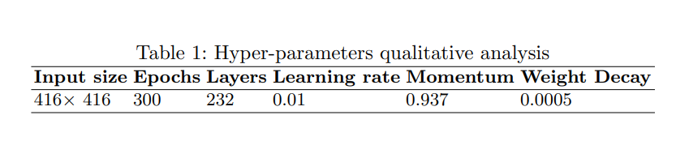
Hyper parameter Configuration
All models are trained on Google Colab with a K80 GPU and 12GB RAM
During training, the objectness loss decreased from 0.019 to 0.014 and the box loss decreased from 0.09 to 0.04.
The precision, recall, mAp, and IoU over 100 plus epochs showed an increasing trend,

Slide 17
Results and Discussion

Slide 18
Performance Metrics
Model Depth
We assessed the performance of the proposed TF-Net and YOLOv5 (s,ml and n) by calculating true positive (TP), true negative (TN), false positive (FP), and false negative (FN), precision (P), recall (R), mean accuracy precision (mAp), and intersection over union (IoU).
YOLOv5l has a depth multiple (DM) of 1.0 and a width multiple (WM) of 1.0. (Deepest model)
YOLOv5m shows 0.67 DM and 0.75 WM,
YOLOv5s and TF-Net has 0.33 DM with a WM of 0.50.
YOLOv5n has 0.33 DM with a WM of 0.25. (Lightest model)
YOLOv5s and TF-Net shows better performance compared to YOLOv5l and n.

Slide 19
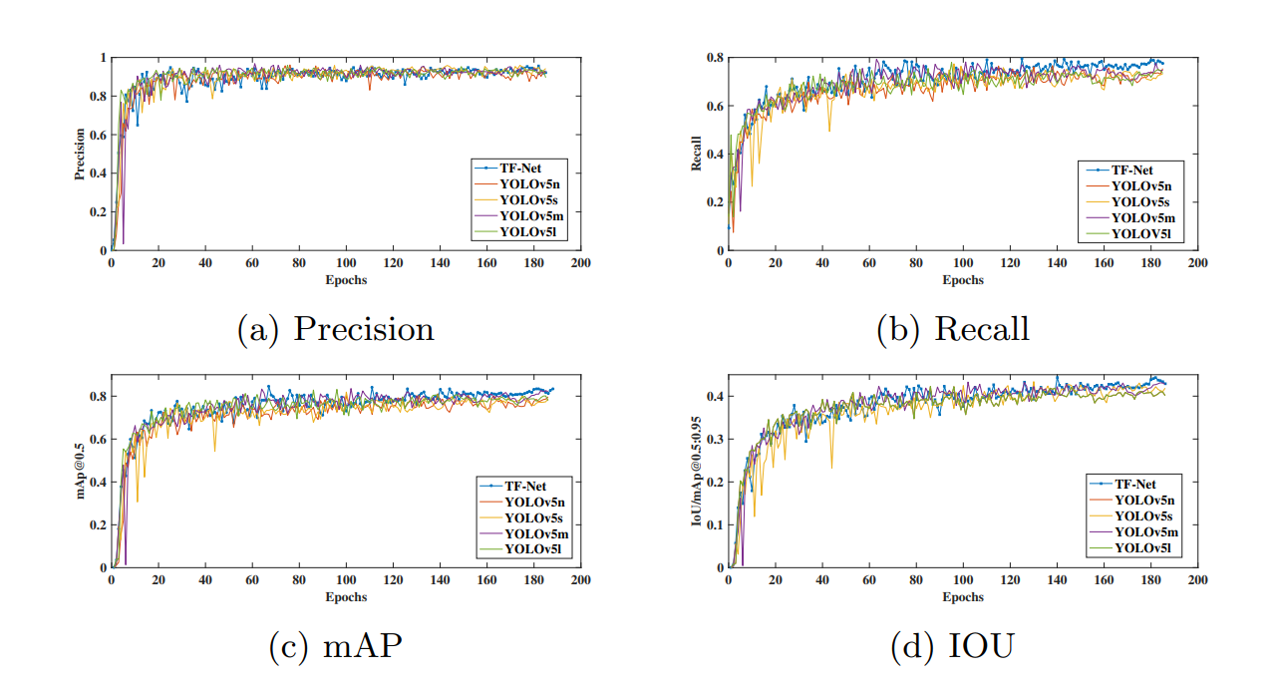
Graphical representation of merged dataset

Slide 20
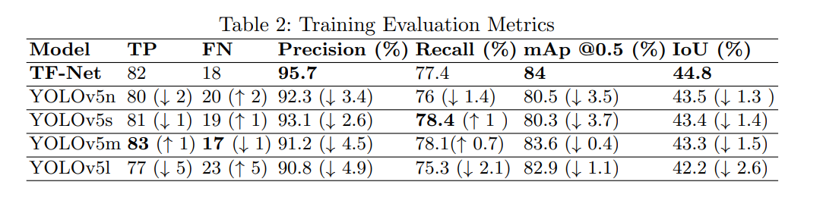
The proposed TF-Net outperforms all the YOLOv5 models (s,m,l,n) in terms of precision, mAp@0.5, and IoU.
TF-Net shows higher sensitivity for detecting multi-size objects compared to the rest of the standard YOLOv5 models during night time.

Slide 21
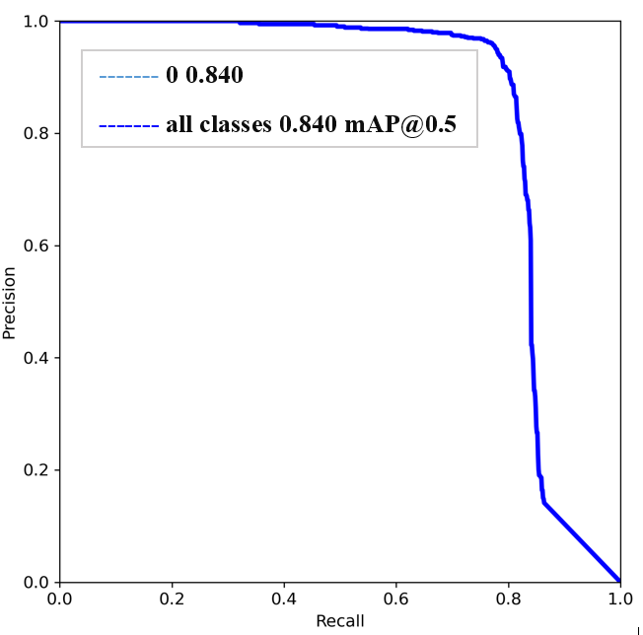
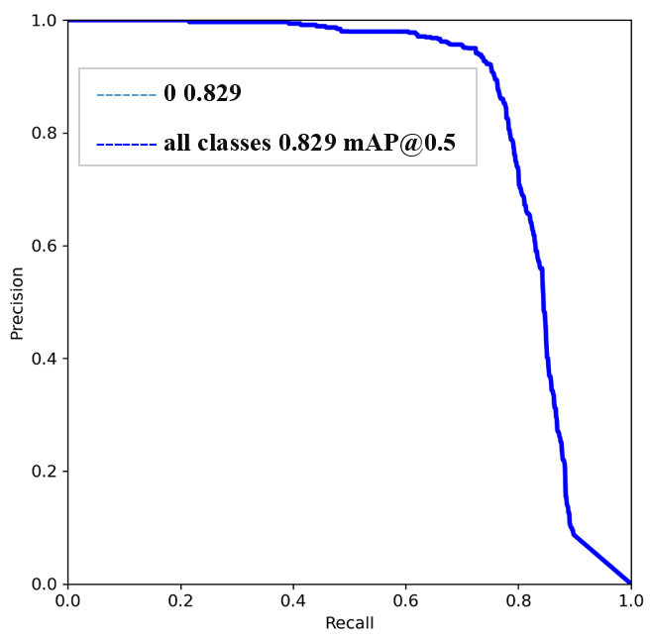
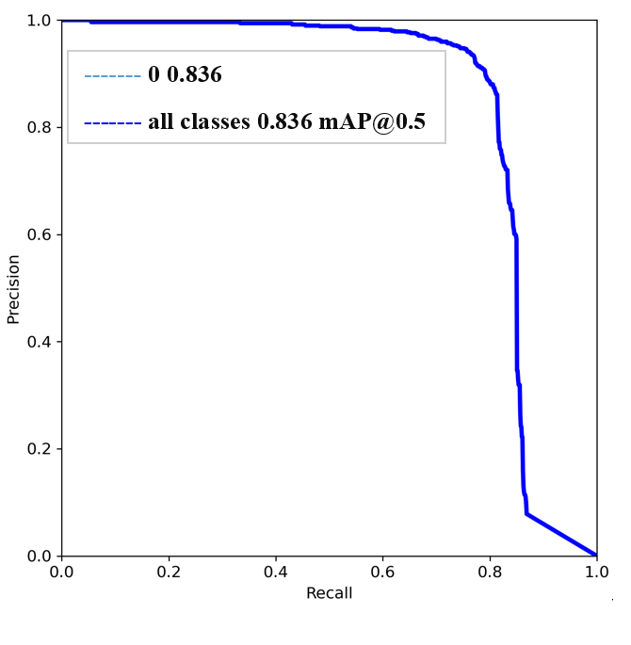
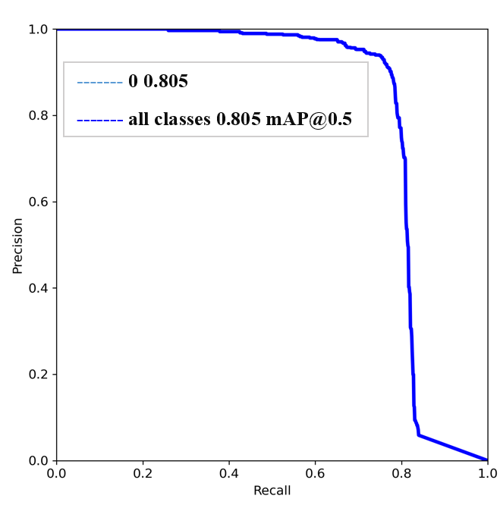
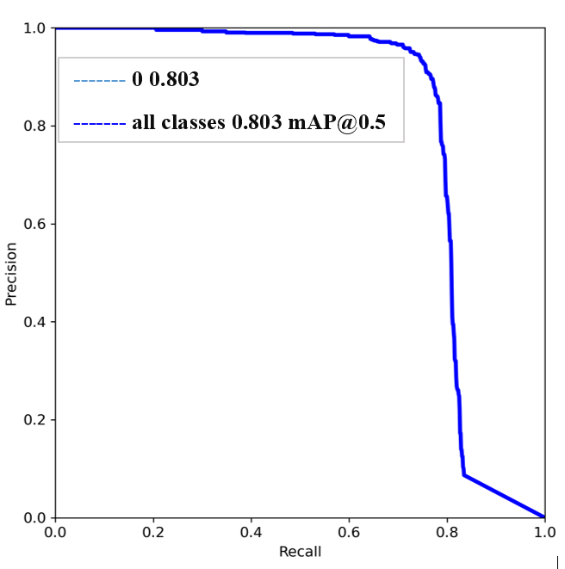
Precision-Recall Curve
TF-Net
YOLOv5s
YOLOv5m
YOLOv5n
YOLOv5l

Slide 22
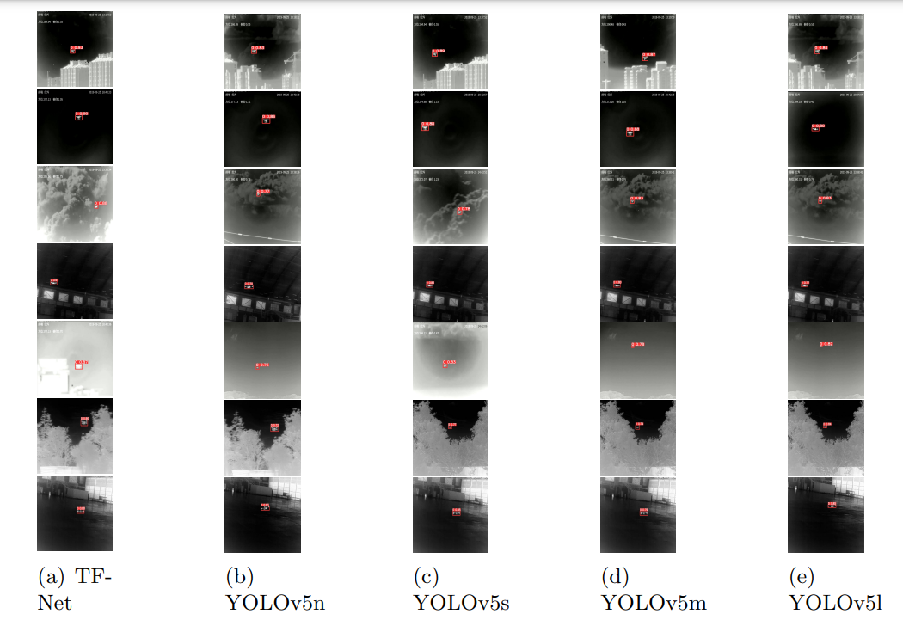
Model Performance under Varying Environmental Backgrounds and Conditions
Night time UAV Detection with complex backgrounds
(Top to bottom) like urban, clear sky, dense cloudy conditions, indoor settings, foggy weather, shrub and low altitude.

Slide 23

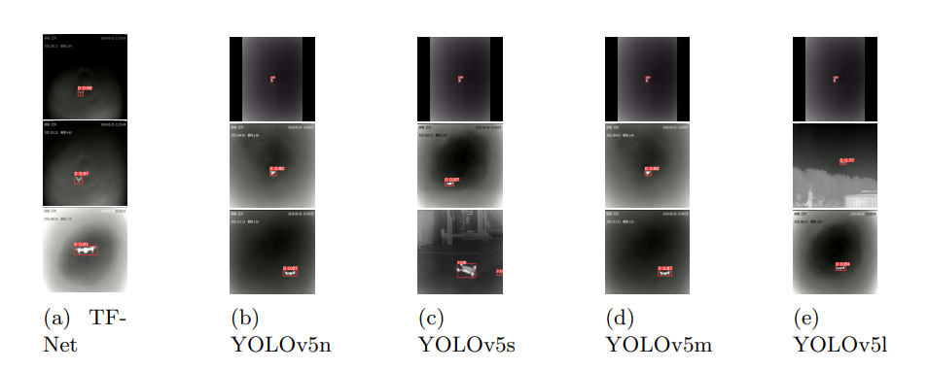
Model Performance for Multi-size Target
The modified kernel size enables the proposed TF-Net network to perform well on multi-size images.
Detection results of Multi-size IR UAV targets (Top to bottom) small, medium and large.

Slide 24
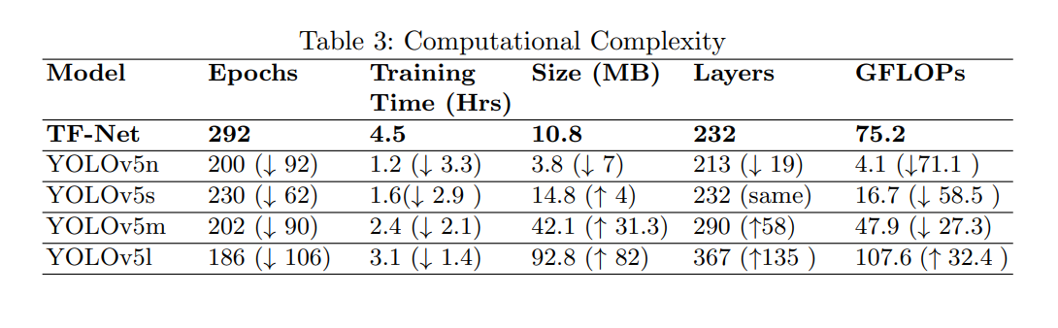
Models Computational Complexity
TF-Net has the most comparable computational complexity with good GFLOPs performance (75.2), low trained model size (10.8MB) plus layers (232) and high precision (95.7%).

Slide 25
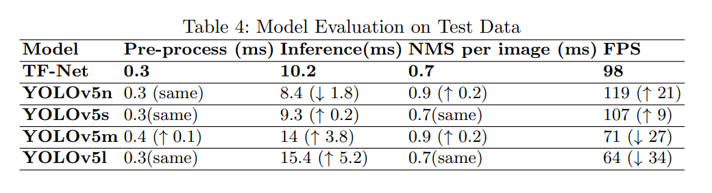
Models Inference time and Speed
TFNet achieved 0.7 ms NMS per image with 98 FPS trained on Tesla T4 GPU. This shows the effectiveness of TF-Net model in real time scenarios for fast UAV detection

Slide 26
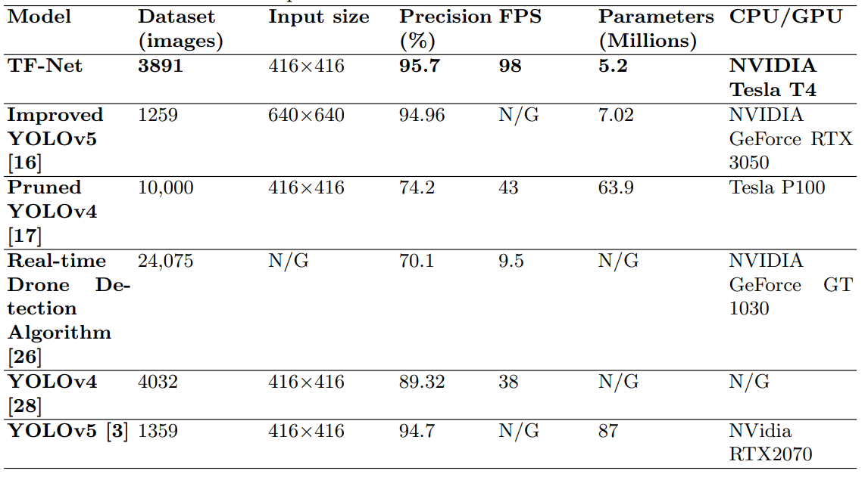
Comparison with the State-of-the-Art
[3]
[2]
[6]
[7]
[4]

Slide 27
Conclusion

Slide 28
Concluding Remarks
An improved version of the YOLOv5s based object detection model TF-Net to improve UAV detection in adverse weather conditions at night.
Input image were adaptively enhanced to obtain better detection performance.
Kernel-based feature-map extraction was used along with the best suited hyper-parameters to extract weather specific target information for the TF-Net detector.
The proposed TF-Net model performed well in terms of precision, model size, mAp@0.5, IoU and GFLOPs compared to the baseline YOLOv5 models. The TF-Net achieved 4.5% higher precision, compared to the baseline YOLOv5 model.

Slide 29
References

Slide 30
References
1. Mahdavi, F., Rajabi, R.: Drone detection using convolutional neural networks. 2020 6th Iranian Conference on Signal Processing and Intelligent Systems (ICSPIS) (2020). https://doi.org/10.1109/icspis51611.2020.9349620
2. Liu, H., Fan, K., Ouyang, Q., Li, N.: Real-time small drones detection based on pruned YOLOv4. Sensors 21(10), 3374 (2021). https://doi.org/10.3390/s21103374
3. Liu, B., Luo, H.: An improved YOLOV5 for multi-rotor UAV detection. Electronics 11(15), 2330 (2022). https://doi.org/10.3390/electronics11152330
4. Al-Qubaydhi, N., Alenezi, A., Alanazi, T., Senyor, A., Alanezi, N., Alotaibi, B., Alotaibi, M., Razaque, A., Abdelhamid, A.A., Alotaibi, A., et al.: Detection of unauthorized unmanned aerial vehicles using YOLOv5 and transfer learning. Electronics 11(17), 2669 (2022). https://doi.org/10.3390/electronics11172669
5. Rodin, C.D., de Lima, L.N., de Alcantara Andrade, F.A., Haddad, D.B., Johansen, T.A., Storvold, R.: Object classification in thermal images using convolutional neural networks for search and rescue missions with unmanned aerial systems. 2018 International Joint Conference on Neural Networks (IJCNN) (2018). https://doi.org/10.1109/ijcnn.2018.8489465
6. Seidaliyeva, U., Akhmetov, D., Ilipbayeva, L., Matson, E.T.: Real-time and accurate drone detection in a video with a static background. Sensors 20(14), 3856 (2020). https://doi.org/10.3390/s20143856
7. Shi, Q., Li, J.: Objects detection of UAV for Anti-UAV based on YOLOv4. 2020 IEEE 2nd International Conference on Civil Aviation Safety and Information Technology (ICCASIT (2020). https://doi.org/10.1109/iccasit50869.2020.9368788

Slide 31
Thank You!

