Slide 1


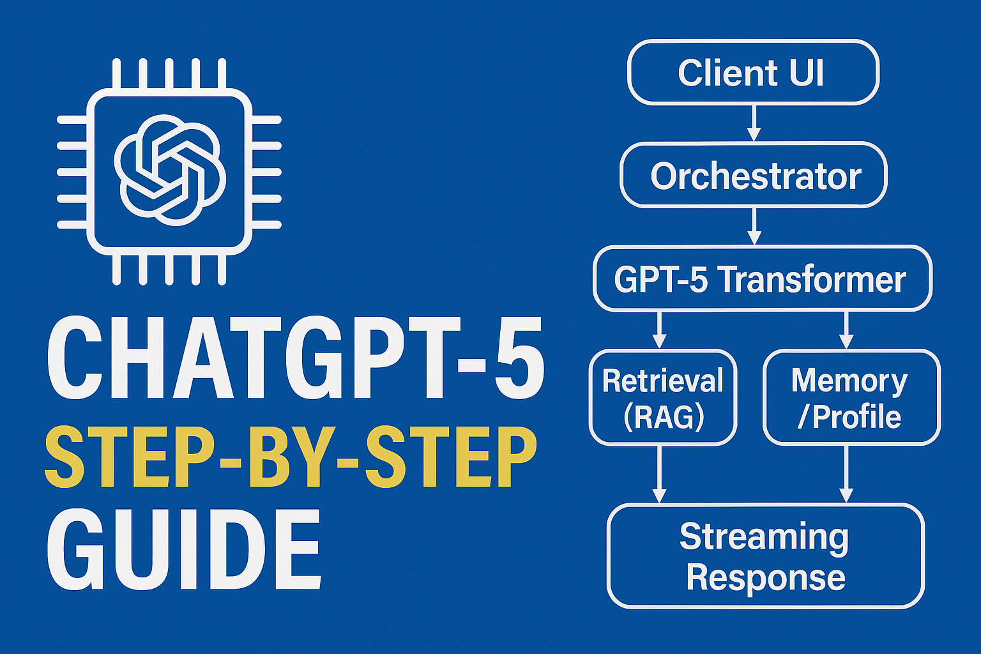
chatgpt5 architecture

Slide 2
ChatGPT-5: System Overview
User
Client UI
Orchestrator (Routing + Context Builder)
Safety Layer
Tools & APIs
GPT-5 Transformer (Multimodal, Function-Calling)
Retrieval (RAG)
Memory / Profile
Streaming Response

Slide 3
Inputs → Normalization → Tokens
Text
Image
Audio
Encoders (tokenizer / vision / speech)
Context Packer (window mgmt, truncation, compression)
Safety Prefilter (PII, policy screens)
Tokens/Embeddings → Model

Slide 4
Retrieval-Augmented Generation
Query Understanding
Vector DB / Search
Retriever
Relevance Scoring + De-dup + Grounding
Prompt Builder (system + tools + snippets)
Model Input Context

Slide 5
Prompt/Context Builder (system + tools + snippets)
System
Tools
Snippets
Final Context

Slide 6
Transformer Core (Conceptual)
Stack of N Blocks
Multi-Head Attention + MLP + Residual/Norm
Multi-Head Attention + MLP + Residual/Norm
Multi-Head Attention + MLP + Residual/Norm
KV Cache
Speculative Decoding
Logits → Tokens (Streaming)

Slide 7
Tool Use & Function Calling
Planner (decide tools / steps)
Tool Call #1
Tool Call #2
Result Parser + Re-plan
Grounded Answer Draft
Safety Check → Stream

Slide 8
Memory & Personalization
Session State (ephemeral)
Memory Read
Profile / Preferences
Gating & Privacy Controls
Write-Back (if allowed)
Personalized Output

Slide 9
Safety & Policy Enforcement
Prefilter (inputs)
Policy Classifiers (safety, content, PII)
Mitigations (refuse, redact, route)
Output Filter + Watermarking/Logging
Human Feedback Loops

Slide 10
Training (Illustrative)
Pretraining Data
Base Model
Supervised Fine-Tuning (SFT)
RLHF / DPO (preference learning)
Evals & Red-Team Gates
Deployable Checkpoint

Slide 11
Inference & Scaling
Request Router
Batching
KV Cache
Speculative / Assisted Decoding
Sharding
Autoscaling
Streaming to Client

Slide 12
Streaming Response
Model Output (Logits)
Token Selection
Streaming Engine
chooses most probable next word/token
User Screen
Interrupt / Stop Button
(words appear)
(optional mid-stream control)
Interactive UX
- Faster perception of speed
- Feels conversational
- Allows follow-up during generation
- Enables mid-stream tool usage

Slide 13
Quality & Feedback Loop
Telemetry & Metrics
Analysis
AB Tests
Offline Retraining / Policy Updates
New Release
User Impact

Slide 14
THANK YOU!

