Slide 1
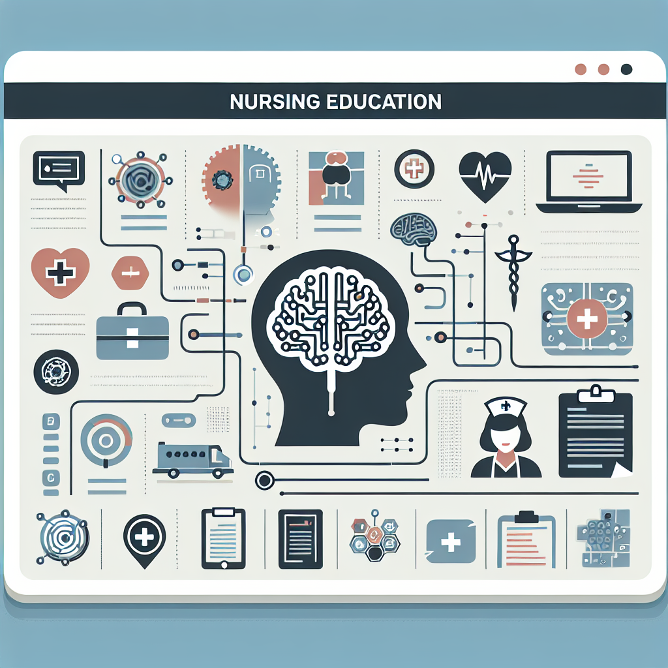
LUSAKA OPEN BUSINESS COLLEGE
Classroom Lesson Plan
Lesson Plan: Intelligence in Psychology
Nursing | Intelligence
NAME OF STUDENT
__
INTAKE
__
STUDENT NUMBER
__
SIZE OF CLASS
__
COURSE NAME
Psychology in Nursing
TIME
__
PROGRAMME
Diploma
DURATION
__
NAME OF TOPIC
Intelligence - Types of Intelligence...
METHOD OF TEACHING
__
DATE
__
MEDIA OF TEACHING
__
VENUE
__
NAME OF SUPERVISOR
__
AI-generated educational illustration

Slide 2

Introduction and General Objective
Curriculum-grounded orientation
INTRODUCTION
This lesson introduces intelligence as a core psychological construct in nursing education and links theory to clinical communication, assessment, and decision-making.
GENERAL OBJECTIVE
By the end of this lesson, learners should explain intelligence concepts and apply them to teaching, patient interaction, and reflective clinical practice.
AI-generated educational illustration

Slide 3
Specific Objectives
Expected learner performance outcomes
Define intelligence using accepted psychological perspectives.
Differentiate major types and theories of intelligence.
Discuss factors that influence intelligence development.
Apply intelligence concepts to nursing education scenarios.
Academic Quality Checks
- Curriculum aligned
- Observable verbs
- Assessment linked
- Time appropriate

Slide 4
Lesson Presentation 1/3
10 minutes | Define intelligence and establish baseline understanding.
CONTENT
Teacher Activity
Definition of intelligence and role in learning. Definitions/Descriptions: Intelligence is the capacity to learn, reason, solve problems, and adapt behavior to new contexts in educational and clinical settings.
Facilitates introductory discussion, elicits prior knowledge, and clarifies core definitions.
Learner Activity
Share prior understanding, contribute examples, and record key definitions.
Resources and Evaluation
Resources: Whiteboard, marker, projected definition slide
Evaluation: Oral questioning and concept recall checks

Slide 5
Lesson Presentation 2/3
30 minutes | Explain theories, types, and measurement approaches.
CONTENT
Teacher Activity
Overview of psychometric and cognitive approaches; multiple-intelligences perspective; clinical relevance for teaching and communication. Definitions/Descriptions: Psychometric view emphasizes quantifiable reasoning performance, while broader models include linguistic, interpersonal, and practical adaptive abilities.
Presents structured content, compares models, and guides interpretation of examples.
Learner Activity
Take notes, compare theories, and ask clarification questions.
Resources and Evaluation
Resources: Charts, handouts, LCD. Handouts/slides, whiteboard, notebook
Evaluation: Think-pair-share and targeted Q&A. Formative checks through questioning and mini-task responses.

Slide 6
Lesson Presentation 3/3
20 minutes | Apply intelligence concepts to nursing practice examples.
CONTENT
Teacher Activity
Case-based application: adapting patient education to cognitive level, language needs, and social context. Definitions/Descriptions: Applied intelligence in nursing includes selecting communication strategies that match learner readiness and support safe understanding.
Moderates case discussion and provides corrective feedback.
Learner Activity
Analyze mini-cases and propose context-appropriate teaching actions.
Resources and Evaluation
Resources: Case sheets, notebook. Summary notes
Evaluation: Short written response and verbal feedback

Slide 7

Summary and Evaluation
Lesson closure and competency checks
SUMMARY
The session connected intelligence theories to practical nursing education decisions, emphasizing clarity, adaptation, and learner-centered communication.
EVALUATION QUESTIONS
What is intelligence in the context of nursing education?
Name two theories and one practical implication of each.
How would you adapt teaching for learners with different cognitive readiness?
AI-generated educational illustration

Slide 8
Assignment
Independent learner practice
Indicate whether the following statements are True (T) or False (F):
1) Prepare a one-page comparison of two intelligence theories used in education.
2) Design three patient-education statements adjusted for different learner levels.

Slide 9
References
Curriculum and source traceability
FINAL PSYCHOLOGY IN NURSING MODULE
NMCZ Diploma in Nursing Curriculum (2022)

